Slide 1








Sample Size calculations for estimation
Curs d'Estadística Bàsica per a la Recerca Biomèdica
UEB – VHIR
Santiago Pérez-Hoyos i Alex Sánchez-Pla
santi.perezhoyos@vhir.org
alex.sanchez@vhir.org

Slide 2
Preliminaries
Before discussing sample size calculations there are several things to keep in mind
Type of SS calculations depending on the study goal.
Preliminary concepts to be used
Standard error of an estimator
Confidence interval
Type I and type II errors.Power of a test

Slide 3
Standard error of the mean
A measure of how variable is the sample mean when computed in distinct samples.
Standard deviation of the distribution of sample means
Usually it is defined as population standard deviation divided by squared root of sample size
It is estimated substituting population by sample deviation

Slide 4
Standard error of a proportion
The standard error of a proportion is computed similarly to the SEM.
Instead of the standard deviation it uses the population proportion in the formula.
Because p is usual unknown it is subsituted by its estimator.
It is common to put q=1-p

Slide 5
Confidence interval
PRECISION
PARAMETER
POSSIBLE VALUES
Estimator
Lower Bound
Upper Bound
Values in which we are confident that real population parameter is inside
With a prefixed confidence level (Usually 95%)

Slide 6
Confidence interval for the mean
Goal: Estimate ureic nitrogen concentracion in serum (SUN) in rats that have been eating a certain diet.
A sample of size 10 has been taken.
Confidence interval is computed from the formula below.

Slide 7
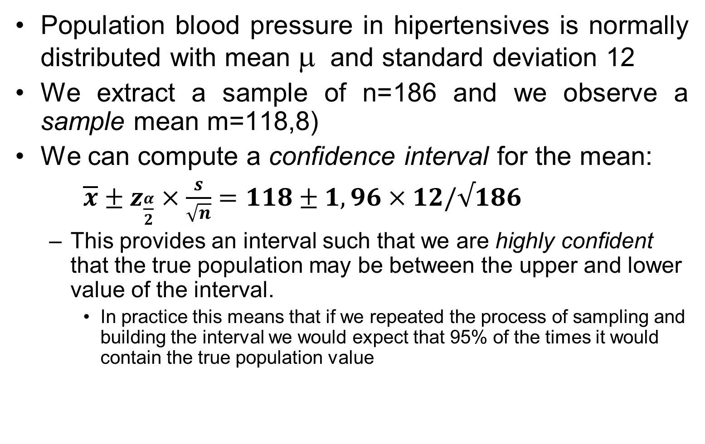
Confidence interval of Mean
Population blood pressure in hipertensives is normally distributed with mean μ and standard deviation 12
We extract a sample of n=186 and we observe a sample mean m=118,8)
We can compute a confidence interval for the mean:
$\overline{x}±z_{\frac{α}{2}}×\frac{s}{\sqrt{n}}=118±1,96×12/√186$
This provides an interval such that we are highly confident that the true population may be between the upper and lower value of the interval.
In practice this means that if we repeated the process of sampling and building the interval we would expect that 95% of the times it would contain the true population value

Slide 8
Exemple interval per una proporció
Problema
un laboratori de diagnòstic molecular realitza tests de detecció genètics de malalts amb patologia venosa hereditària (PVH).
d’una sèrie de 150 malalts 18 presenten en el seu perfil genètic l'al·lel AGx d’un un gen situat en el cromosoma 11.
amb una seguretat del 99%, quina estimació es pot donar del percentatge d’individus AGx dins de la població de malats PVH?
Solució
la freqüència relativa de la mostra és:
atès que es verifiquen les condicions per utilitzar la dist. asimptòtica
resulta finalment
amb un 99% de seguretat, la proporció està entre 0.052 i 0.188

Slide 9
Sample Size

Slide 10
Sample Size Calculation
Some questions must be answered before we can compute “sample size”
Precision (interval range) of estimations
Level of confidence of estimations
Sometimes (for proportions) it will help to have an idea of the value of the parameter we want to estimate

Slide 11
Sample Size Calculation
The question “what is the sample size” must be rephrased as:
What sample size is needed to estimate the mean, so that we have a high confidence (say 95%) that the estimation error will be less than a given threshold?

Slide 12
Sample SIZE for mean
If interval range is 10 ( precision =10/2=5), confidence levell is 95% and standard deviation is 20, sample size will be
n= 1.96² 20² / 5²= 62

Slide 13
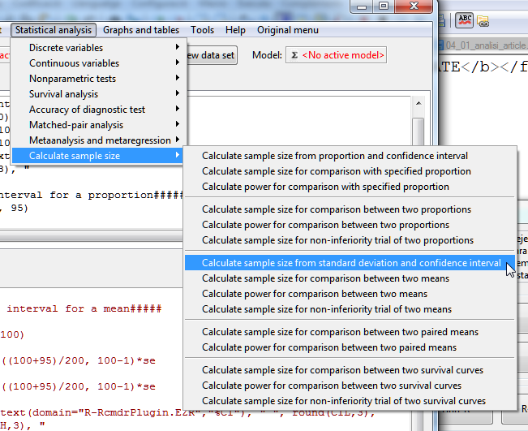

Slide 14
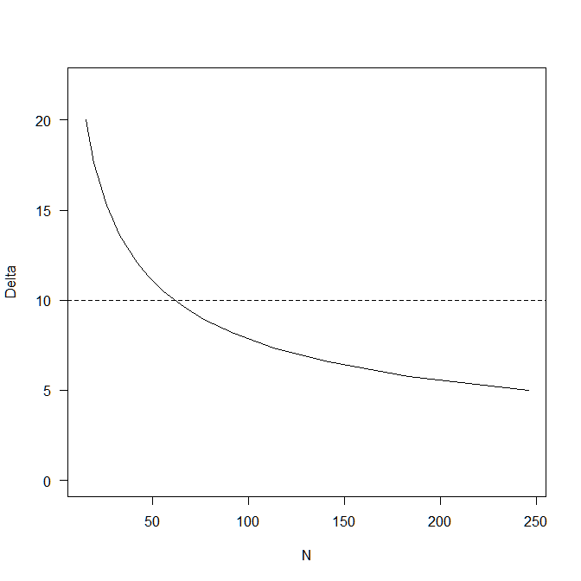
> SampleMeanCI(20, 10, 95)
Assumptions
Standard deviation 20
Confidence interval 10
Confidence level 0.95
Estimated
Required sample size 62

Slide 15
Sample size for proportion
Assume precision is 5% ( Interval = p±.05) and confidence level is 95%
If it is known that p is around 12.5%
n= 1.96² .125 (1-.125)/.05²= 168
If p is unknown maximum sample size will be if p=.50
n= 1.96² .5 (1-.5) /.05²= 384

Slide 16
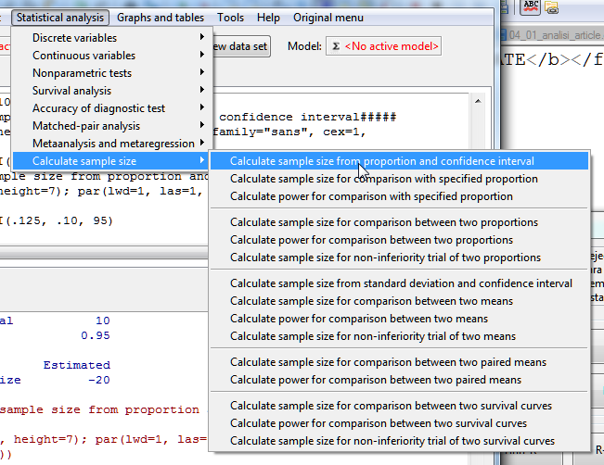
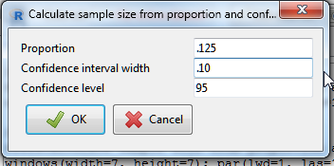
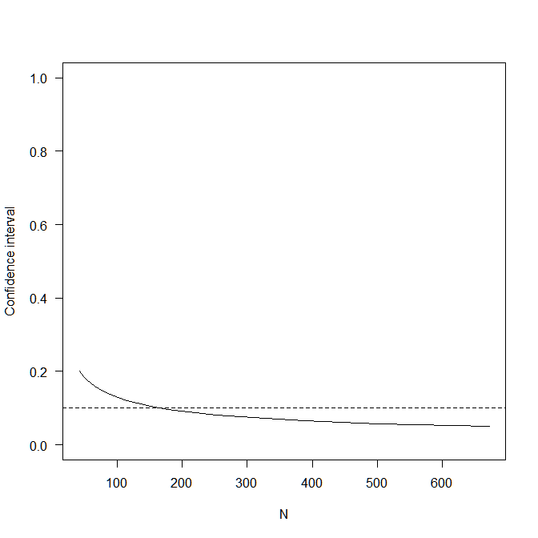
Assumptions
P 0.125
Confidence interval 0.1
Confidence level 0.95
Estimated
Required sample size 169

