Slide 1








Curs d'Estadística Bàsica per a la Recerca Biomèdica
UEB – VHIR
Santiago Pérez-Hoyos
santi.perezhoyos@vhir.org

Slide 2








































The objectives of statistical inference
Hypothesis
Population
Samples
(sampling techniques)
Conclusions based
on the observed data
(Statistical inference)
(Parameters estimation)
(Hypothesis testing)
Generalization to
the population

Slide 3
Statistical Inference Questions
Parameter estimation:
After assuming population data follow a certain probability distribution (normal. Binomial, Poisson, etc) which are the value of the parameters that better fit the sample data.
Hypothesis testing:
We have an assumption about the population data parameters
Population mean is equal to 10
The mean in population A is equal to the mean in population B
Hypothesis testing tries to verify if sample data are compatible with that hypothesis

Slide 4

Hypothesis testing: Making decisions about populations
Guess that average bone density in women is
70...
But... why not to check median,
mode or other estimators?

Slide 5
Case study problem I
Our guess:
The average ''bua'' value in our population is 70.
The ''bua'' mean value in menopausic and non-menopausic women is not the same
Exercise 1):
Explore osteoporosis data in order to get an idea about our first guess
Do de same for the second question
- What other things you can figure out about the bone density in our population?

Slide 6
Case study problem II
Cohort study with new lung cancer cases after 12 years of follow up (The NHANES Epidemiologic Follow-up Study. Am J Epidemiol 1997;146:231-243)
Total lung cancer rate =132/ 5034=2.6%
After this outcome can we say that fruit consumption is a protective factor for lung cancer?
How can I say this results is not caused by sampling or random?

Slide 7
We can stablish two basic hypothesis
Null Hypothesis (H₀)
Outcome is observed by chance.
No relationship among exposure and disease.
Alternative Hypothesis (H₁)
There is relationship among exposure and disease.

Slide 8
¿How to decide with hypothesis is more likely?
Calculate probability (p) to observe differences between both groups under the hypothesis of no differences
Lung cancer % is the same for both groups 2.6%
Groups must be different
Low
p
High
Groups can be equal

Slide 9
¿How to calculate this probability?
Depends on type of study.
Depends on type of variable.
Depends on the influence of other variables.
This probability is the error of assume that there is relation when there is NOT.
Statistical relations do not mean causal relations, moreover if are obtained in cross-sectional studies.

Slide 10
Hypothesis Testing
Test population hypothesis from samples
Stablish Null Hypothesis(H₀)
Stablish Alternative Hypothesis (H_{α})
Select statistical test to calculate probability under Null Hypothesis
Decide after comparing test value with a critical value or probability under null hypothesis.

Slide 11
Type of Hypothesis
Confirmation Hypothesis
Aim is to confirm hypothesis about parameters or distributions.
Goodness of fit test to verify hipothesis about the distribution of variable in population
Does arterial pression in the population follow a normal distribution?
Test to verify values about a parameter.
Is the average ''bua'' value in our population equal to 70?
Is the proportion of lung cancer cases equal to 2.6%?

Slide 12
Type of Hypothesis
Independence Hypothesis
Aim is to test hypothesis for relation of variables in a population or no differences of a variable in two or more populations
Is the average ''bua'' value the same in menopausic and in no menopausic population?
Is the proportion of lung cancer cases the same in people with high or low fruit consumption?
Is CD4 lymphocytes count related with CD8 count in HIV positive?
Pruebas de independencia

Slide 13
Type of Test
Parametric Test
It is assumed that the variable under study follow a particular distribution and values about parameters are tested
Distribution of proportion of lung cancer is binomial
H₀: p= 3%
BUA is the same in menopausic and non menopausic and variable is normal or symmetric
H₀: μ_{Menopausic}= μ_{Non} _{menopausic}
Distribution is binomial and proportion of lung cancer is the same in high and low fruit consummers
H₀: p_{High fruit}= p_{Low} _{fruit}

Slide 14
Type of Test
Non Parametric Test
No distribution is assumed and test are related to distribution not to values about parametersç
Distribution of bua follow a normal distribution
Bua is the same in menopausic and non menopausic and variable is normal or symmetric
H₀: distribution in Menopausic= Distribution in non menopausic
Lung cancer is not related to fruit consumption. They are independent.

Slide 15
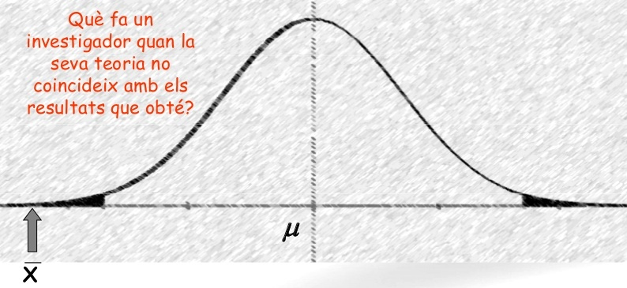
Example
Null hypothesis (H₀):
Alternative hypothesis (H_{α} =H_{a} =H₁): the opposite idea
Under the null hypothesis if all the samples of one size can be selected the sample distribition is as follows
H_{0:} The mean of BUA values is 70.0
H1: The mean of the bua values is not equal to 70.0 (Bilateral)
H1: The mean of the bua values is higher(lower) than 70.0 (Unilateral)
H₁ only accepted if clear evidence
that H₀ is not true
If observed mean = 18 H₀ is unlikely
= 70
= 18

Slide 16
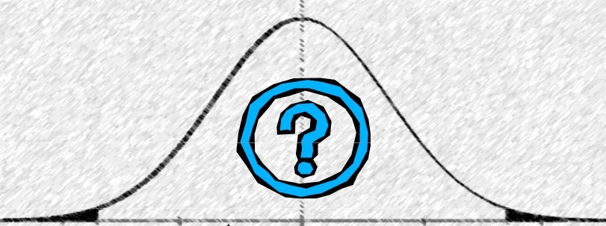
Accepting or rejecting the NULL
H₁ only accepted if clear evidence
that H₀ is not true
If observed mean = 18 H₀ is rejected
μ = 70
If observed mean = 58 H₀ can not be rejected
(it not means H₀
can be accepted!!)

Slide 17
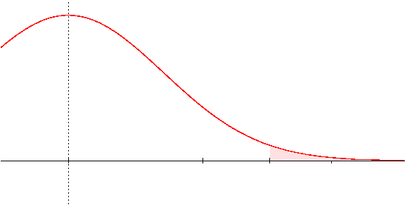
Critical Value
At which value of the sample mean does one change from non-rejecting to rejecting the null hypothesis?
A value is selected such that the probability that the sample mean exceeds it, if the null hypothesis is true, is “small”, (for example 5%).
This value is called “Critical Value” and
the probability is called “significance level (α)”
α
Critical value

Slide 18
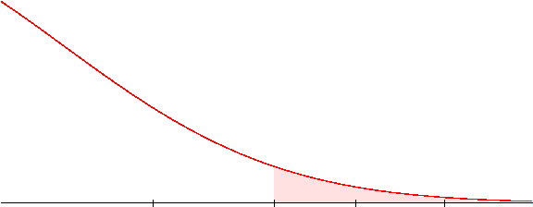
Example: Critical value and Sample mean
If σ =18, n =9 and α=0.05 the critical value will be 149,9
With a sample mean of 144 we will not reject H₀
With a sample mean of 155 we will t reject H₀
We cannot reject
H₀: μ=140
We reject
H₀: μ=140
α
H₀: μ=140
_{149.9}

Slide 19
P values: The alternative
We have based our decision about rejecting H₀ on comparing sample mean (i.e. 144) with the critical value (i.e. 149.9)
Instead we can compare the probability of observing at least that sample mean (p value) with the significance level (α) (which is the probability of observing at least the critical value),
The probabiliy is smaller than alfa if (and only if) the sample mean is bigger than the critical value.
In such situation we decide to reject H0
The probabiliy is bigger than alfa if (and only if) the sample mean is smaller than the critical value.
In such situation we cannot reject H0 so we accept it
Both criteria (critical value and p-value) are valid for testing hypotheses.

Slide 20
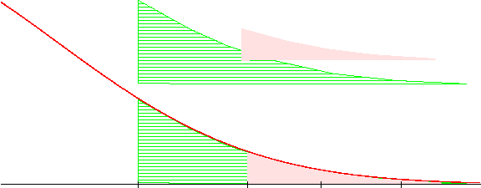
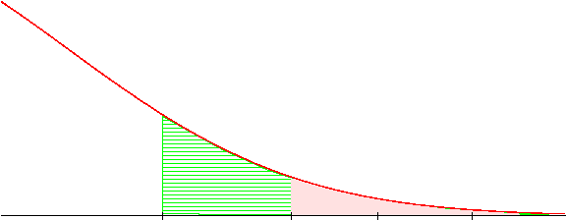
Example: P-value vs critical value
If σ =18, n =9 and the sample mean is 144 then
The probability that assuming that H0 is true, that is m=140, we can observe by chance a sample greater than 144 is: 0.328
pnorm(q=144, mean=140, sd=9, lower.tail=FALSE) [1] 0.3283606
P
α
H₀: μ=140
We cannot reject the null hypothesis
P=0.33
α= 0.05

Slide 21
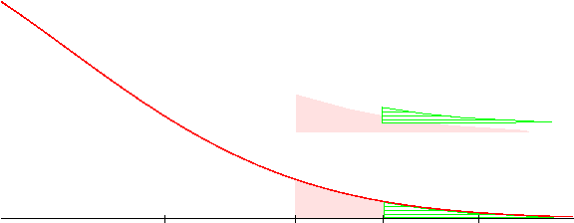
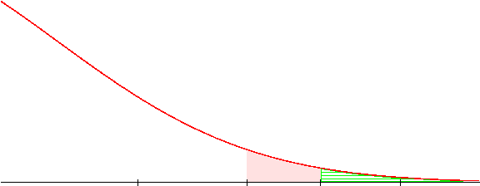
Example: P-value vs critical value
If σ =18, n =9 and the sample mean is 155 then
The probability that assuming that H₀ is true, that is μ=140, it can be obtained by chance a sample with a mean greater than 155 is: 0.0478
pnorm(q=55, mean=140, sd=9, lower.tail=FALSE) [1] 0.04779035
α
P
Reject H₀: μ=140
Accept H₁: μ>140
α
P
We usually say the test is statistically significant if p < α

Slide 22
Summary: α vs p
α and P are related but they are not the same …
About α
It is prefixed before experiment
Usually low ( 0.05)
Linked with critical value (“knowing one, the other is automatically known)
Unaffected by the sampling process.
About p
It is calculated after the experiment
Can take any values in (0,1)
After calculation one can know the achieved significance level.
Depends on the sampling process

Slide 23
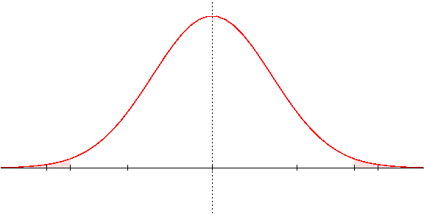
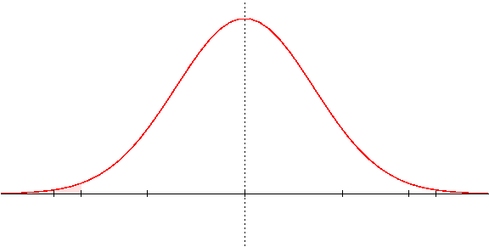
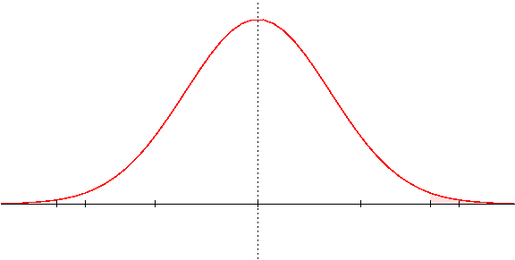
Unilateral vs Bilateral
Critical value depends on the type of alternative Hypothesis
Bilateral
H₁: m ≠
Unilateral
Unilateral
H₁: m <
H₁: m >

Slide 24
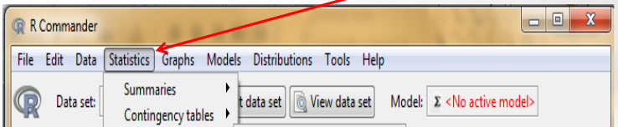
EExample: hypothesis testing with R-commander
Our assumptions:
The average ''bua'' value in our population is 70.
The ''bua'' mean value in menopausic and non-menopausic women is not the same.
Hint: look at this menu
Exercise 2):
- Test if the population mean bone density is 70.0 (Alternative “it is not 70”)
- Test if the population mean bone density is equal or not between groups
if we separate our observations by ''menop'' category

Slide 25
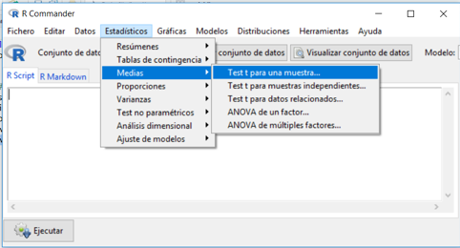
Exercise 2 – Solution (1)
# osteoAll is the dataset obtained reading osteoporosis.csv set.seed =123456 # change by your ID to obtain a distinct sample
index100<- sample( 1:nrow(osteoAll), 100)
osteo100 <- osteoAll[index100,]
with(osteo100, t.test (bua, mu=70, alternative="two.sided"))
t.test(bua, mu=70)
data: bua t = 1.8604, df = 99, p-value = 0.0658 alternative hypothesis: true mean is not equal to 70 95 percent confidence interval: 69.81491 75.74509 sample estimates: mean of x 72.78

Slide 26
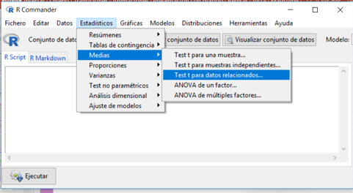
Exercise 2 – Solution (2)
# osteoAll is the dataset obtained reading osteoporosis.csv set.seed =123456 # change by your ID to obtain a distinct sample
index100<- sample( 1:nrow(osteoAll), 100)
osteo100 <- osteoAll[index100,]
with(osteo100, t.test (bua~menop, alternative="two.sided"))
Welch Two Sample t-test
data: bua by menop t = 1.797,
df = 90.184, p-value = 0.07568 alternative hypothesis: true difference in means is not equal to 0
95 percent confidence interval: -0.5399937 10.7761048
sample estimates: mean in group NO mean in group SI 76.05556 70.93750

Slide 27
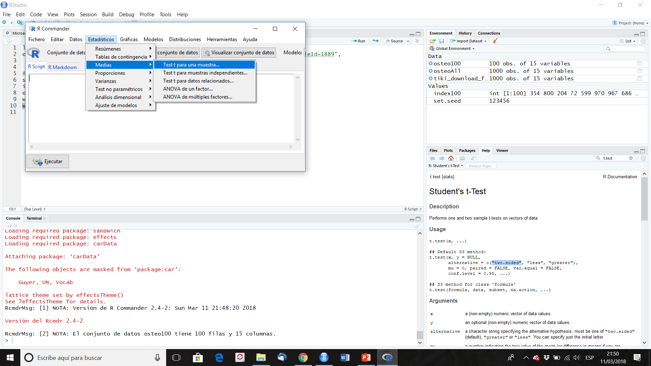

Slide 28


Slide 29
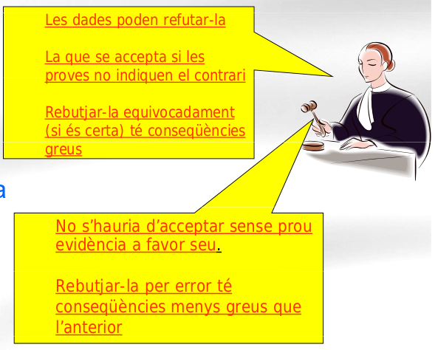
Errors and power (in hypothesis testing)
Data can lead to reject it
Accepted if data don't
show the contrary
Reject it by mistake (if it is true) has severe consequences
H₀
(innocent)
(not speculative)
Should not be accepted without enough evidence
Reject it erroneously has less dramatic consequences
H₁
(guilty)
(speculative)

Slide 30
Errors after Testing
 |  | True
 |  | Innocent | Guilty
veredict | Innocent | OK | Error
 | Guilty | Error | OK

Slide 31
Types of error
 | Null Hypothesis True | Null Hypothesis False
Test does not reject null hypothesis | ✓ | Type II Error β
Test rejects null hypothesis | Type I Error α | ✓ Power (1- β)

Slide 32
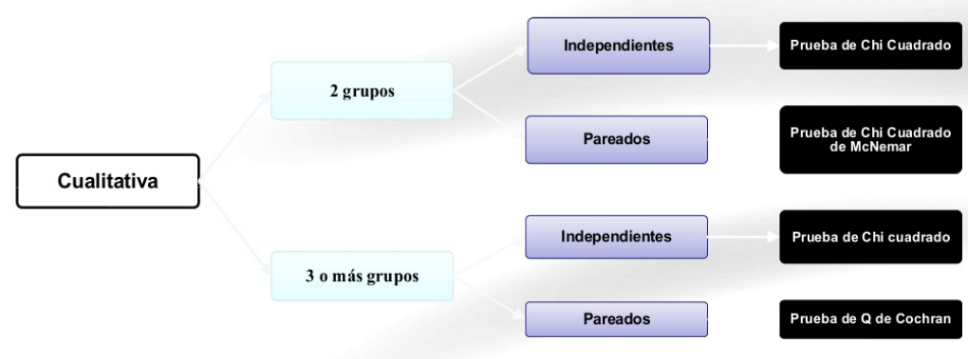
Test selection diagrams: Qualitative vars

Slide 33
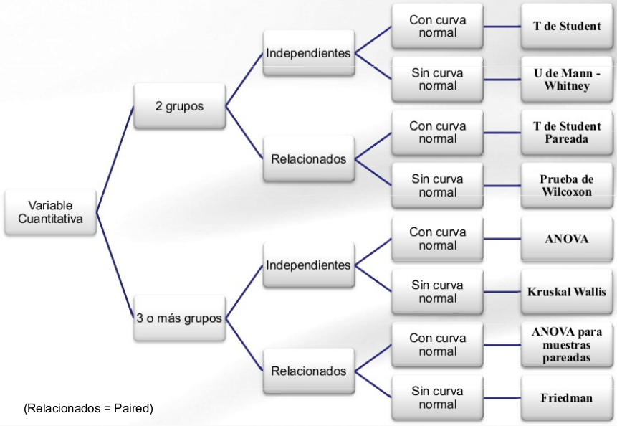
Test selection diagrams: Quantitative vars

Slide 34
Common misunderstandings about the p-value:
The p-value is not the probability that the null hypothesis is true, nor is it the probability that the alternative hypothesis is false (it is not connected to either of these). The p-value cannot be used to figure out the probability of a hypothesis being true.
The p-value is not the probability of falsely rejecting the null hypothesis.
The p-value is not the probability that replicating the experiment would yield the same conclusion.
The p-value does not indicate the size or importance of the observed effect. The two do vary together however: the larger the effect (effect size), the smaller sample size will be required to get a significant p-value.

Slide 35

To cross or not to cross?
Imagine you are an adventurer that has the option of to cross a bridge in order to escape from danger, find a treasure...
and that there is a post in front of the bridge stating: "This bridge has broken only one out of 100 times"

Slide 36
To cross or not to cross?
Imagine you are an adventurer that has the option of to cross a bridge in order to escape from danger, find a treasure...
and that there is a post in front of the bridge stating: "This bridge has broken only one out of 100 times"
So, the p-value of our metaphor is 0.01
You could accept that 1% is a risk small enough to pass the bridge and pursue your goal. OK.

Slide 37

To cross or not to cross?
Imagine you are an adventurer that has the option of to cross a bridge in order to escape from danger, find a treasure...
and that there is a post in front of the bridge stating: "This bridge has broken only one out of 100 times"
So, the p-value of our metaphor is 0.01
You could accept that 1% is a risk small enough to pass the bridge and pursue your goal. OK.
But... what do you decide if, in order to reach your goal, you have to cross hundreds of bridges of that kind?

Slide 38
To cross or not to cross? :Multiple comparison
Imagine you are an adventurer that has the option of to cross a bridge in order to escape from danger, find a treasure...
and that there is a post in front of the bridge stating: "This bridge has broken only one out of 100 times"
So, the p-value of our metaphor is 0.01
You could accept that 1% is a risk small enough to pass the bridge and pursue your goal. OK.
But... what do you decide if, in order to reach your goal, you have to cross hundreds of bridges of that kind?
In this case, the probability of falling while crossing one of the bridges is obviously too high ('cause we have just one life).
Therefore, in this case (multiple testing), the p-value by itself is not a good reference for accepting or not statistical significance. We must apply some type of correction to the p-values (allowing us to be safe in crossing all the bridges).

