Slide 1

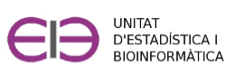
Practical exercises with R-commander
Curs d'Estadística Bàsica per a la Recerca Biomèdica
UEB – VHIR - GRBIO

Slide 2


Practice. Loading data sets
We have to load into Rcommander the dataset osteoporosis.csv
“.csv” -> “comma separated values” but could be separated with \tab, spaces, ; , ….
First of all “look” the file with a file viewer like “wordpad”, “bloc de notas”,…

Slide 3
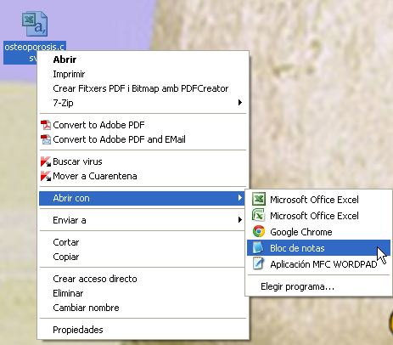
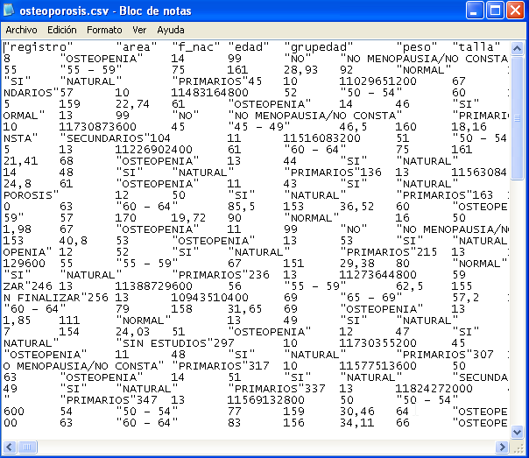
Practice. Loading data sets
We have to load into Rcommander the dataset osteoporosis.csv

Slide 4
Practice. Loading data sets
We have to load into Rcommander the dataset osteoporosis.csv
“.csv” -> “comma separated values” but could be separated with \tab, spaces, ; , ….
First of all “look” the file with a file viewer like “wordpad”, “bloc de notas”,…
Once we know how:
  the data is separated
  the decimals are separated
we can open with Rcmdr

Slide 5
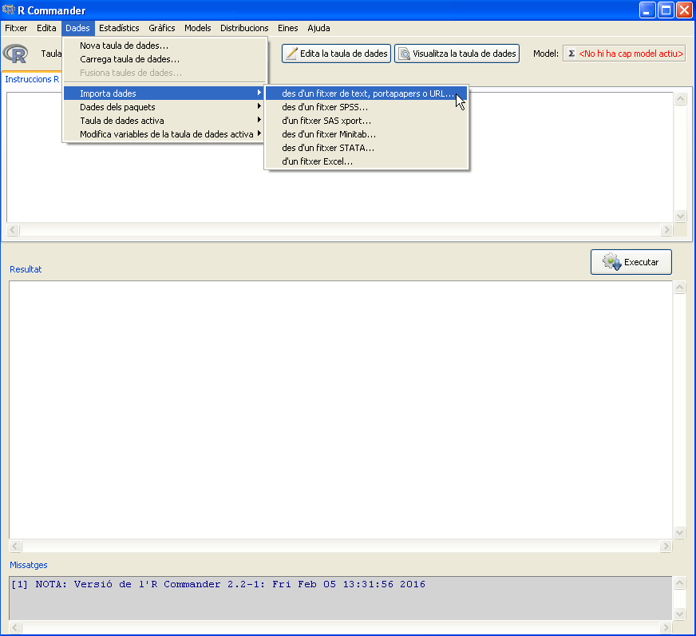
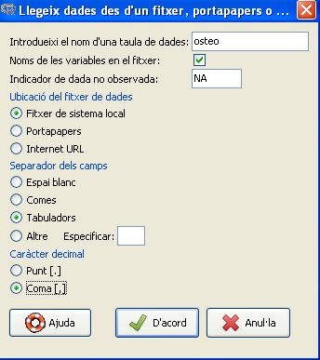
Practice. Loading data sets
We have to import into Rcommander the dataset osteoporosis.csv

Slide 6
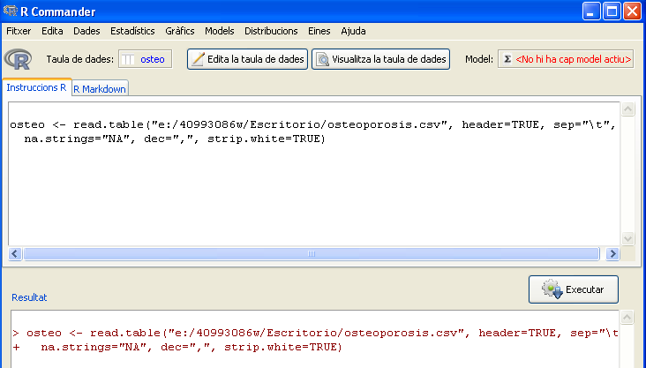
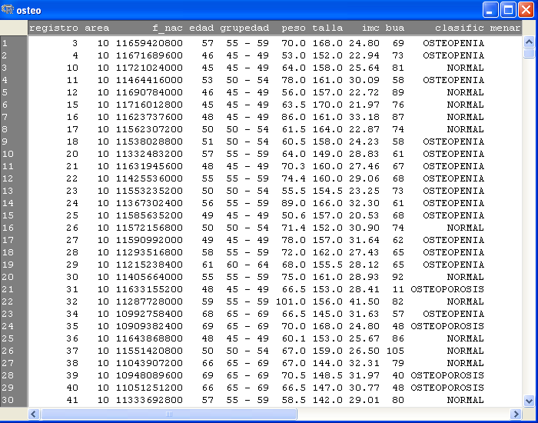
Practice. Loading data sets
We have to import into Rcommander the dataset osteoporosis.csv

Slide 7
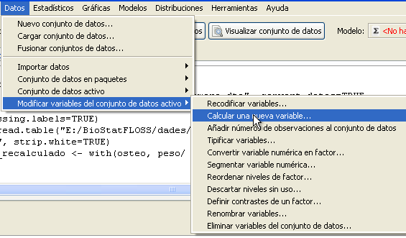
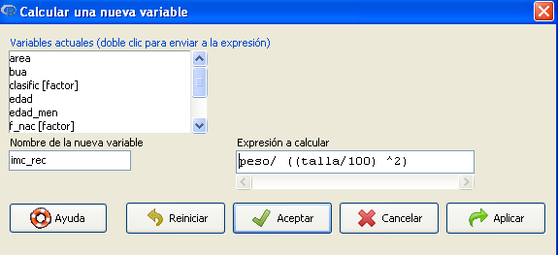
Practice. Adding variables to the data set
We have to add new variables to the dataset osteoporosis.csv

Slide 8
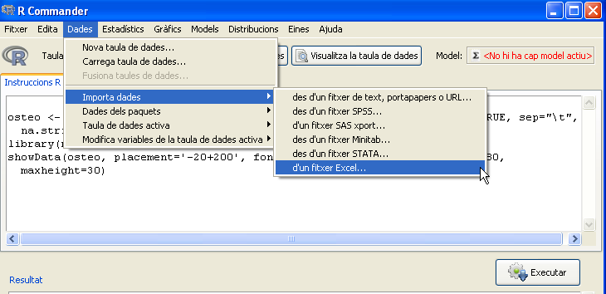
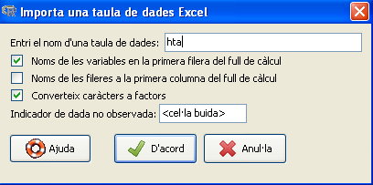
Practice. Loading data sets
We have to import into Rcommander the dataset hta.xls

Slide 9
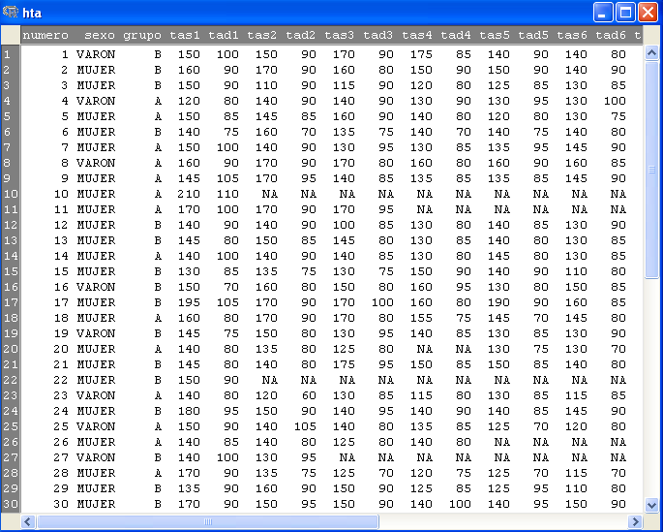
Practice. Loading data sets
We have to import into Rcommander the dataset hta.xls

Slide 10
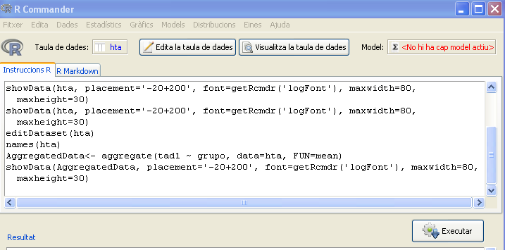
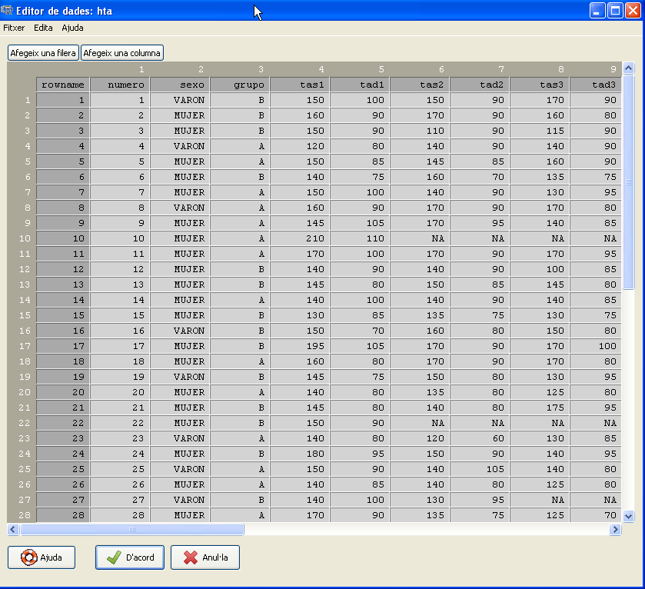
Practice. Adding variables to the data set
We have to add variables age and weight the dataset hta.xls

Slide 11
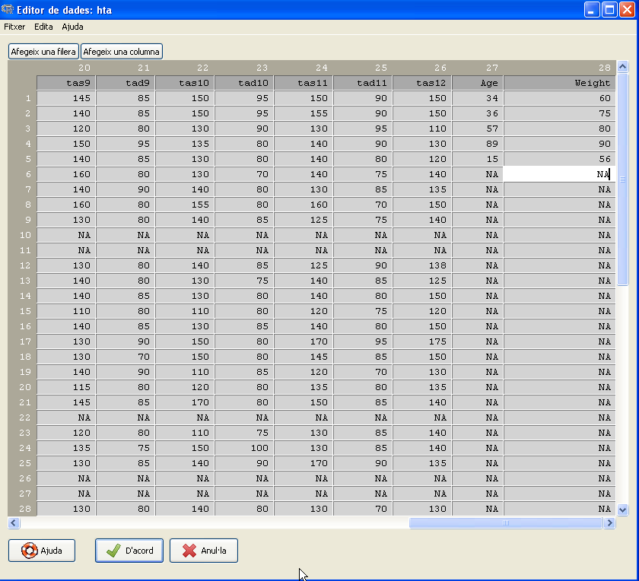
Practice. Adding variables to the data set
We have to add variables age and weight the dataset hta.xls

Slide 12
Exercise
Import into Rcmdr the dataset demora.dta (STATA file)
Convert numeric variable dolor to factor (rename levels accordingly, eg. 0=low, 1=medium, 2=high)
Remove cases with missing data (NA) in demora variable.
Recode variable edad in a new variable named rango_edad according to the following ranges:
            0:25=”young”
            25:50=”adult”
            51:75=”mid-old”
            76:100=”old”

Slide 13
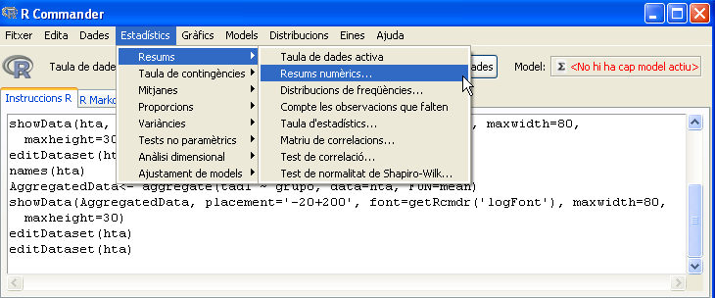
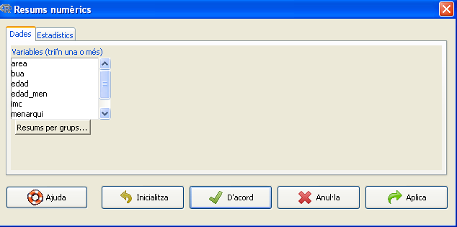
Practice. Statistics with Rcmdr
We have to calculate some descriptive statistics with the dataset osteo.

Slide 14
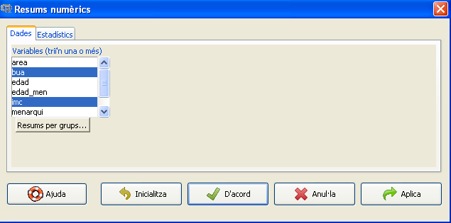
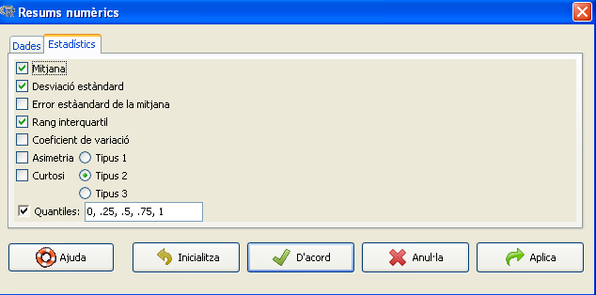
Practice. Statistics with Rcmdr
We have to calculate some descriptive statistics with the dataset osteo.

Slide 15
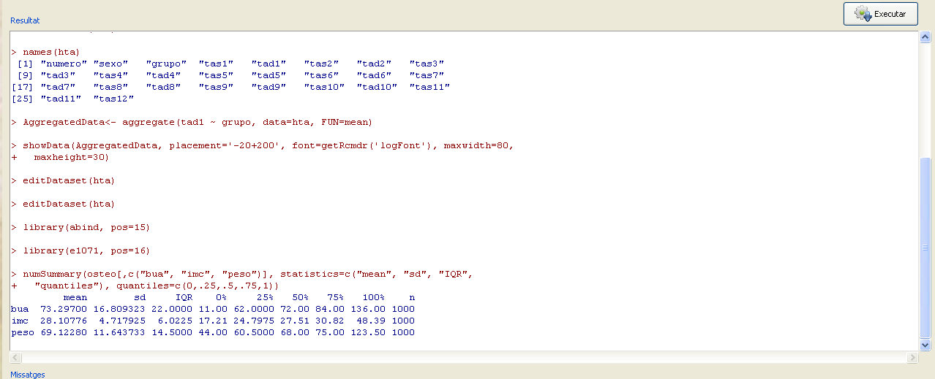
Practice. Statistics with Rcmdr
We have to calculate some descriptive statistics with the dataset osteo.

Slide 16
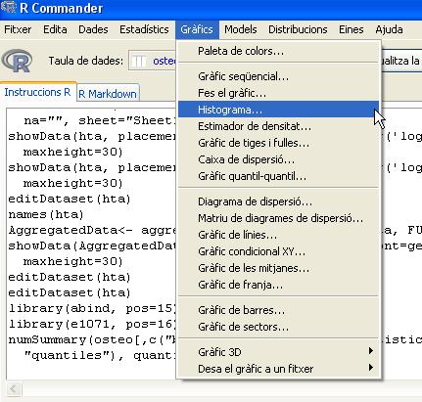
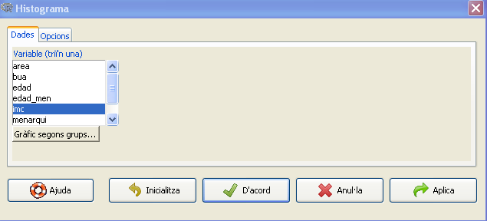
Practice. Graphics with Rcmdr
We want to see how the variable imc is distributed among the individuals

Slide 17
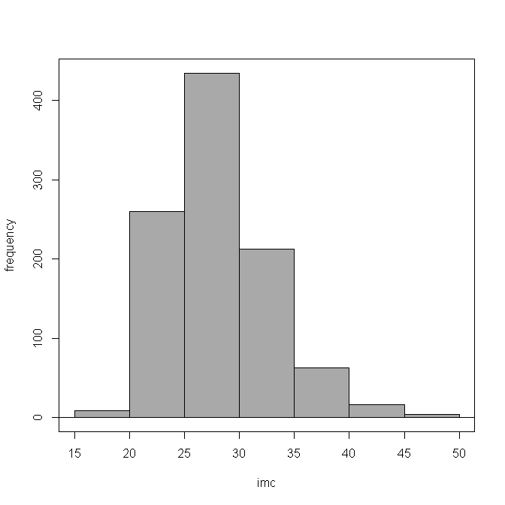
Practice. Graphics with Rcmdr
We want to see how the variable imc is distributed among the individuals

Slide 18
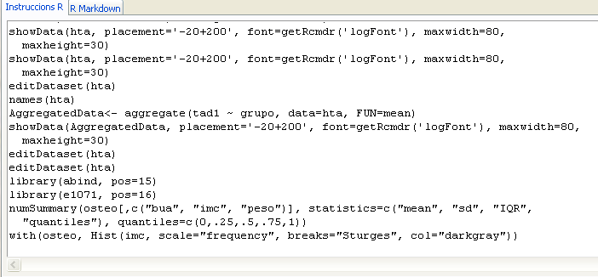
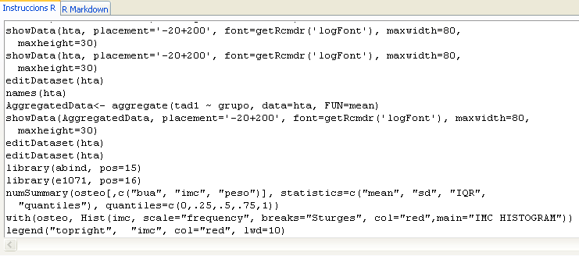
Practice. Running scripts with Rcmdr
We want to change the graphic colour, add a legend and a main title

Slide 19
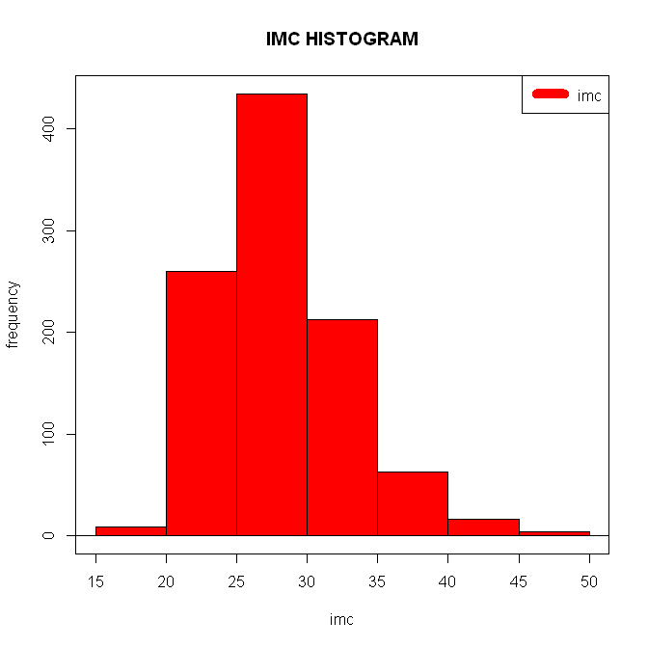
Practice. Running scripts with Rcmdr
We want to change the graphic colour, add a legend and a main title

Slide 20
Exporting results
Years ago, R-commander had the limitation that exporting data had to be
done through saving plots and copy-pasting code to external software.
Now, Rcmdr integrates Markdown/Knitr results writing system, that allows the
user to export all work (code, plots and results) to html pages in quick and
easy way.
https://github.com/adam-p/markdown-here/wiki/Markdown-Cheatsheet
http://www.rstudio.com/ide/docs/authoring/using_markdown
http://yihui.name/knitr/

Slide 21
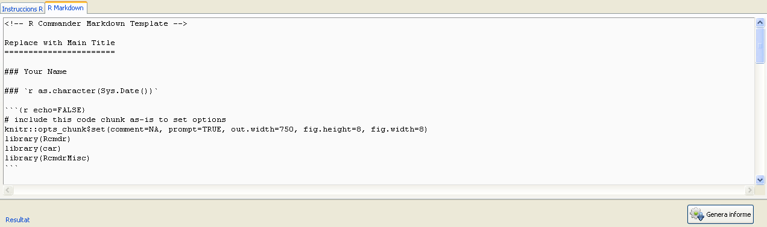
Practice. Export results as html
We want to export the results into an html report

Slide 22
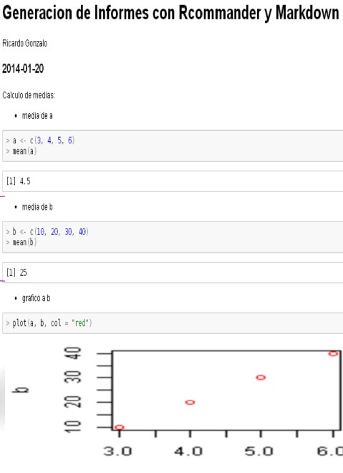
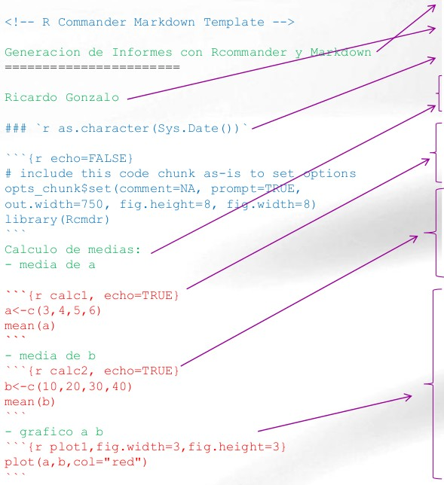
Practice. Export results as html

Slide 23
Exercise
Load into Rcmdr the dataset in prostate.csv
Calculate some descriptive statistics for some variables
Make a graphic from one or two variables
Generate the report with all the data

Slide 24
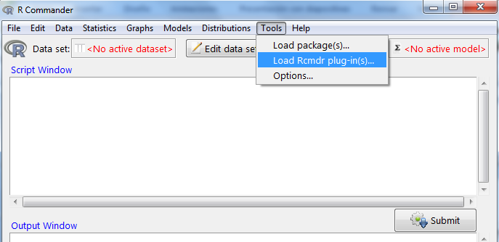

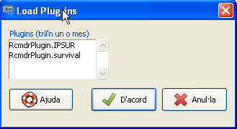
Rcommander’s plugins installation
Plug-ins are additional libraries that we may want
to have available in R-commander
To check if they are correctly installed…
You should find…

Slide 25
Additional souRces
R manuals
* Intro for beginners http://cran.r-project.org/doc/contrib/rdebuts_es.pdf
* SimpleR http://cran.r-project.org/doc/contrib/Verzani-SimpleR.pdf
* Quick-R http://www.statmethods.net/
* Basic statistics with R and R-commander http://knuth.uca.es/ebrcmdr/
* Statistical methods with R and R-commander
http://cran.r-project.org/doc/contrib/Saez-Castillo-RRCmdrv21.pdf
* Try R http://tryr.codeschool.com/levels/1/challenges/1
R books
* Introductory Statistics with R
* R for SPSS and SAS users

