Slide 1








DIAGNOSTICS TESTS. SENSITIVITY, SPECIFICITY AND ROC CURVES
Curs d'Estadística Bàsica per a la Recerca Biomèdica
UEB – VHIR
Santiago Pérez-Hoyos. Ricardo Gonzalo

Slide 2
OUTLINE
Diagnosis. Diagnostics tests
Sensitivity and specificity
Predictive values. Prevalence
Likelihood ratio
Receiver operator characteristic curves

Slide 3

Diagnostic
“If we did this 333 times, we’d be giving false hope to 332 people for approximately four hours and we’d save one life. Isn’t that worth it?”

Slide 4
Diagnostic Process
Likelihood ratio
Pretest probability
Diagnostic test
Posttest probability
Disease prevalence
Sensitivity, specificity
PPV, NPV

Slide 5


Diagnostic Measures
Disease
Prevalence
Healthy

Slide 6
Diagnostic Measures
Test +
Disease
Prevalence
Test +
Healthy

Slide 7
Diagnostic Measures
Test +
Sensitivity
Disease
Prevalence
Test +
% False Positive
Healthy

Slide 8
Diagnostic Measures
Disease
Test -
Prevalence
Healthy
Test -

Slide 9
Diagnostic Measures
Disease
Test -
% False negative
Prevalence
Healthy
Test -
Specificity

Slide 10
Diagnostic Measures
Test +
Sensitivity
Disease
Test -
% False negative
Prevalence
Test +
% False Positive
Healthy
Test -
Specificity

Slide 11
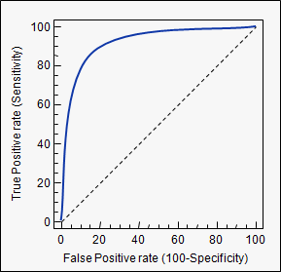
Relationship between the results of the test and the authentic diagnosis
In a diagnostic test with possible results:
Positive or Negative: Diagnostic table (contingency table)
Numerical values: ROC curve
 |  | Reference method
 |  | Sick | Healthy | TOTAL
Diagnostic | Positive | a | b | a+b
Test | Negative | c | d | c+d
 | TOTAL | a+c | b+d | a+b+c+d

Slide 12
Diagnosis. Diagnostics tests
 |  | Reference method
 |  | Sick | Healthy | TOTAL
Diagnostic | Positive | a | b | a+b
Test | Negative | c | d | c+d
 | TOTAL | a+c | b+d | a+b+c+d
a = True positives (TP)
b = False positives (FP)
c = False negative (FN)
d = True negative (TN)

Slide 13
Example
Sample: n= 2.641 patients with suspected prostate cancer
1st test: rectal examination
Reference method: prostate biopsy
 |  | Biopsy result
 |  | Disease | Healthy | TOTAL
Rectal | Disease | 634 | 269 | 903
examination | Healthy | 487 | 1251 | 1738
 | TOTAL | 1121 | 1520 | 2641
Sensitivity = 634 / (634+487) = 0.5656 = 56.6% 43.4% with cancer had a normal rectal examination
Specificity = 1251 / (269+1251) = 0.8230 = 82.3%
Other tests are needed to refine the diagnosis (Ex. PSA)
17.7% of the patients without disease were incorrectly diagnosed

Slide 14
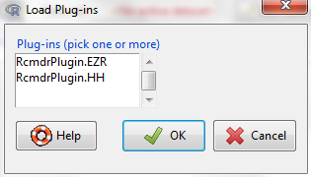
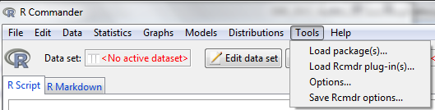
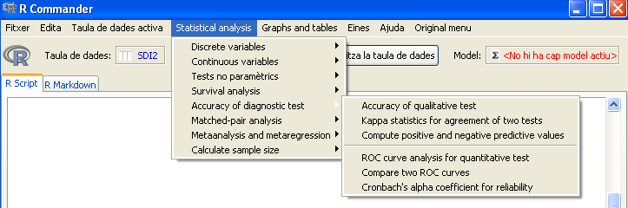
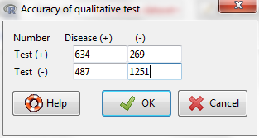
Example with R Commander. Plug-in “EZR”

Slide 15
Example with R Commander. Plug-in “EZR”
Disease positive Disease negative Total
Test positive 634 269 903
Test negative 487 1251 1738
Total 1121 1520 2641
Point estimates and 95 % CIs:
---------------------------------------------------------
Estimation Lower CI Upper CI
Apparent prevalence 0.342 0.324 0.360
True prevalence 0.424 0.406 0.444
Sensitivity 0.566 0.536 0.595
Specificity 0.823 0.803 0.842
Positive predictive value 0.702 0.671 0.732
Negative predictive value 0.720 0.698 0.741
Diagnostic accuracy 0.714 0.696 0.731
Likelihood ratio of a positive test 3.196 2.835 3.603
Likelihood ratio of a negative test 0.528 0.492 0.567
---------------------------------------------------------

Slide 16
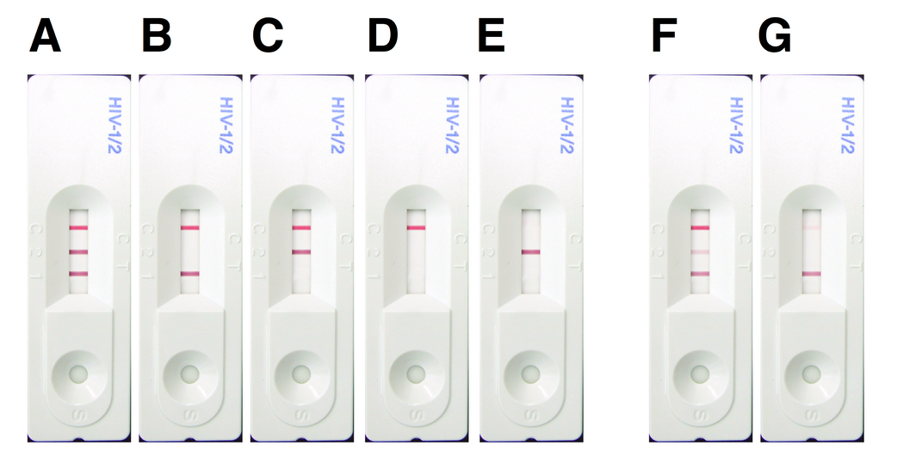
Positive/Negative predictive value
If the test is positive which is the probability the patient is really infected

Slide 17
Diagnostic Measures
Test +
+ Predictive Value
Sensitivity
Test +
Disease
Test -
% False negative
Prevalence
Test +
Test +
Test +
+
% False Positive
Healthy
Test -
Specificity

Slide 18
Diagnostic Measures
Test +
Sensitivity
Disease
Test -
- Predictive Value
% False negative
Prevalence
Test -
Test +
% False Positive
Healthy
Test -
Test -
+
Test -
Specificity

Slide 19
PPV, NPV Example with R Commander. Plug-in “EZR”
Disease positive Disease negative Total
Test positive 634 269 903
Test negative 487 1251 1738
Total 1121 1520 2641
Point estimates and 95 % CIs:
---------------------------------------------------------
Estimation Lower CI Upper CI
Apparent prevalence 0.342 0.324 0.360
True prevalence 0.424 0.406 0.444
Sensitivity 0.566 0.536 0.595
Specificity 0.823 0.803 0.842
Positive predictive value 0.702 0.671 0.732
Negative predictive value 0.720 0.698 0.741
Diagnostic accuracy 0.714 0.696 0.731
Likelihood ratio of a positive test 3.196 2.835 3.603
Likelihood ratio of a negative test 0.528 0.492 0.567
---------------------------------------------------------

Slide 20
PPV, NPV with more prevalence
Disease positive Disease negative Total
Test positive 6340 259 6599
Test negative 4870 1251 6121
Total 11210 1510 12720
Point estimates and 95 % CIs:
---------------------------------------------------------
Estimation Lower CI Upper CI
Apparent prevalence 0.519 0.510 0.528
True prevalence 0.881 0.876 0.887
Sensitivity 0.566 0.556 0.575
Specificity 0.828 0.808 0.847
Positive predictive value 0.961 0.956 0.965
Negative predictive value 0.204 0.194 0.215
Diagnostic accuracy 0.597 0.588 0.605
Likelihood ratio of a positive test 3.297 2.948 3.688
Likelihood ratio of a negative test 0.524 0.508 0.541
---------------------------------------------------------

Slide 21
PPV & NPV depend on prevalence
1
.8
.6
.4
.2
0
0
.2
.4
.6
.8
1
prev
Sen Spe
Sen Spe
ppv_99_99
npv_99_99
ppv_95_90
npv_95_90
ppv_95_50
npv_95_50
ppv_85_99
npv_85_99

Slide 22
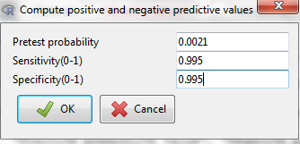

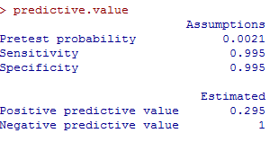
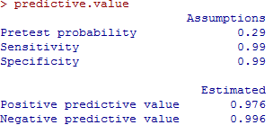
Dependence of PPV and NPV on disease prevalence
Example: VIH diagnosis of two populations with RCommander

Slide 23
Diagnostic Measures
Test +
Likelihood Ratio +
Sensitivity
Disease
Sensitivity
Test -
% False negative
Prevalence
Test +
% False Positive
% False Positive
Healthy
Test -
Specificity

Slide 24
Diagnostic Measures
Test +
Sensitivity
Disease
Test -
Likelihood Ratio -
% False negative
Prevalence
Test +
% False negative
% False Positive
Healthy
Test -
Specificity
Specificity

Slide 25
LR+,LR-Example with R Commander. Plug-in “EZR”
Disease positive Disease negative Total
Test positive 634 269 903
Test negative 487 1251 1738
Total 1121 1520 2641
Point estimates and 95 % CIs:
---------------------------------------------------------
Estimation Lower CI Upper CI
Apparent prevalence 0.342 0.324 0.360
True prevalence 0.424 0.406 0.444
Sensitivity 0.566 0.536 0.595
Specificity 0.823 0.803 0.842
Positive predictive value 0.702 0.671 0.732
Negative predictive value 0.720 0.698 0.741
Diagnostic accuracy 0.714 0.696 0.731
Likelihood ratio of a positive test 3.196 2.835 3.603
Likelihood ratio of a negative test 0.528 0.492 0.567
---------------------------------------------------------

Slide 26
LR+ & LR- do NOT depend on prevalence
100
.15
80
.1
60
40
.05
20
0
0
0
.2
.4
.6
.8
1
prev
Sen Spe
Sen Spe
lrp_99_99
lrp_95_90
lrp_95_50
lrp_85_99
lrn_99_99
lrn_95_90
lrn_95_50
lrn_85_99

Slide 27
Interpretation:
Positive Likelihood Ratio (LR+)
LR+ over 5 - 10: Significantly increases likelihood of the disease
LR+ between 0.2 to 5 (esp if close to 1): Does not modify the likelihood of the disease
LR+ below 0.1 - 0.2: Significantly decreases the likelihood of the disease

Slide 28
Diagnostic Measures
Test +
Sensitivity
Accuracy=% classified right
Disease
Test -
Test +
+
Test -
% False negative
Prevalence
Test +
% False Positive
Disease
+
Healthy
Healthy
Test -
Specificity

Slide 29
Diagnostic Measures
Test +
Sensitivity
Disease
Youden’s Index =
sensitivity + specificity -1
Test -
% False negative
Prevalence
+
-1
Test +
% False Positive
Healthy
Test -
Specifity

Slide 30
Accuracy depend on prevalence
Youden’s Index do NOT depend on prevalence
1
.8
.6
.4
0
.2
.4
.6
.8
1
prev
Sen Spe
Sen Spe
accuracy_99_99
youden_99_99
accuracy_95_90
youden_95_90
accuracy_95_50
youden_95_50
accuracy_85_99
youden_85_99

Slide 31
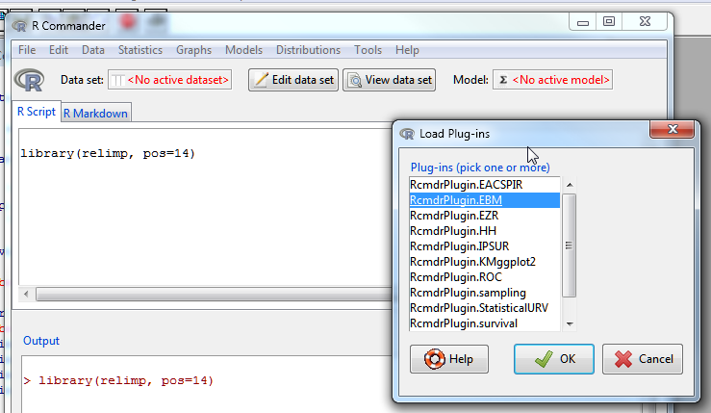
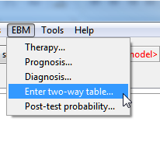
Diagnostic Measures in R Commander
Plugin EBM

Slide 32
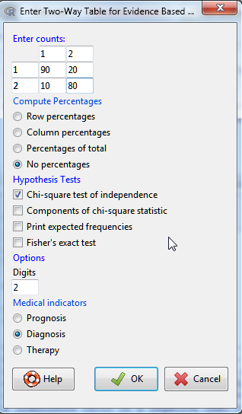
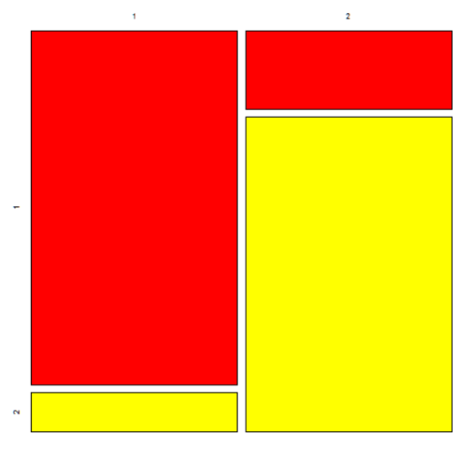
 | Disease | Non Disease | Total
Biomarker + | 90 | 20 | 110
Biomarker - | 10 | 80 | 90
Total | 100 | 100 | 200
# Sensitivity (Se) = 90 (95% CI 82.38 - 95.1) %
# Specificity (Sp) = 80 (95% CI 70.82 – 87.33)%
# Diagnostic acuracy (% of all correct results) = 85 (95% CI 79.28- 89.65) %.
# Youden's index = 0.7 (95% CI 0.53 - 0.82).
# Likelihood ratio of a positive test = 4.5 (95% CI 3.02 – 6.7).
# Likelihood ratio of a negative test = 0.12 (95% CI 0.07 - 0.23).
# Positive predictive value = 81.82 (95% CI 73.33 – 88.53) %.
# Negative predictive value = 88.89 (95% CI 80.51- 94.54) %.
# Number needed to diagnose = 1.43 (95% CI 1.21 – 1.88).

Slide 33
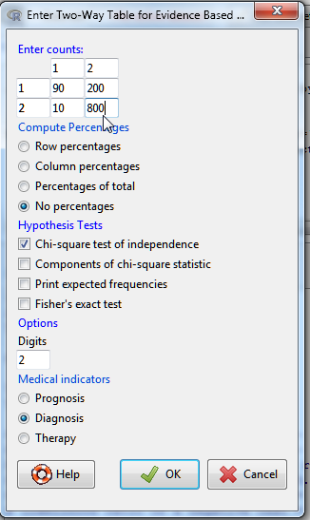
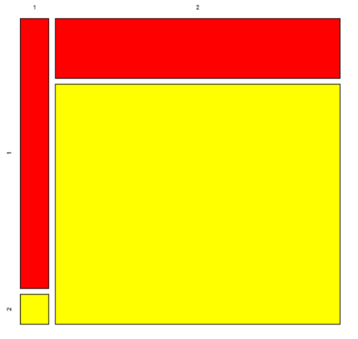
 | Disease | Non Disease | Total
Biomarker + | 90 | 200 | 290
Biomarker - | 10 | 800 | 910
Total | 100 | 1000 | 1100
# Sensitivity (Se) = 90 (95% CI 82.38 - 95.1) %
# Specificity (Sp) = 80 (95% CI 77.38 - 82.44)%
# Diagnostic acuracy (% of all correct results) = 80.91 (95% CI 78.46 - 83.19) %.
# Youden's index = 0.7 (95% CI 0.6 - 0.78).
# Likelihood ratio of a positive test = 4.5 (95% CI 3.91 - 5.18).
# Likelihood ratio of a negative test = 0.12 (95% CI 0.07 - 0.23).
# Positive predictive value = 31.03 (95% CI 25.76 - 36.71) %.
# Negative predictive value = 98.77 (95% CI 97.74 - 99.41) %.
# Number needed to diagnose = 1.43 (95% CI 1.29 - 1.67).

Slide 34
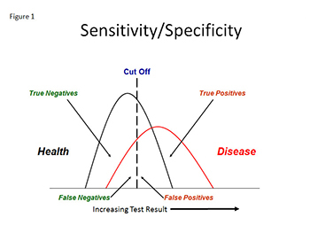
Discrimination for quantitative test o biomarker

Slide 35
If it is not a single biomarker or test you can build one by fitting a statistical model such as logistic regression
Select the best cutpoint to categorize biomarker or test in two groups (ROC Curve, Area Under Curve)
Proceed as before (Diagnostic Measures)

Slide 36
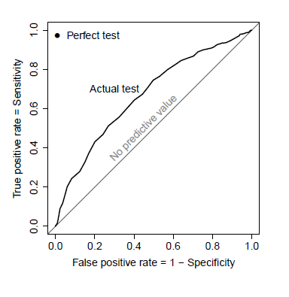
Receiver Operating Characteristic curves
Sensitivity vs false positive rate
Find best threshold for discrimination
Area Under Curve
(c-index) is the fraction of pairs (i,j) in which the predicted risk was
higher for the subject who had the event:
C<0.5 No classification
C>0.5 Successful classification
C =1 perfect classification

Slide 37
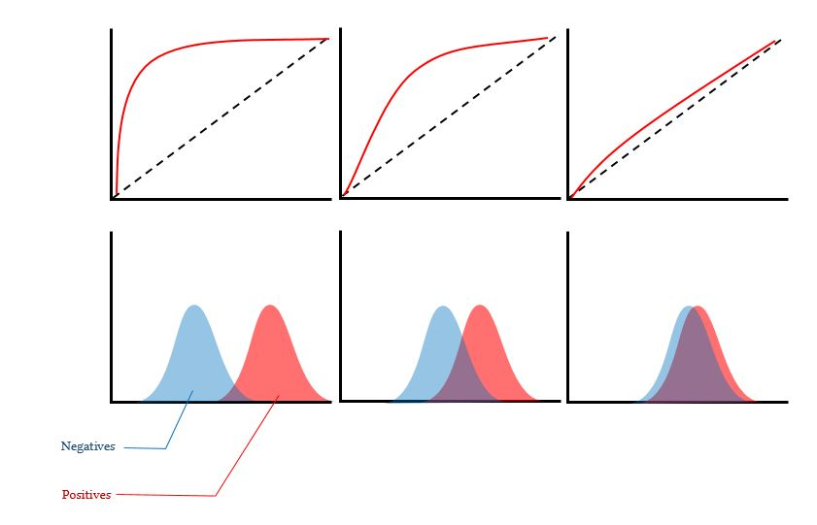
Building of ROC curves
http://www.derangedphysiology.com/main/cicm-primary-exam/required-reading/research-methods-and-statistics/Chapter%203.0.5/receiver-operating-characteristic-roc-curve

Slide 38
Example
Ultrasounds can be used to detect thinning of the uterus Wall (indicative of posible tumor). If the result is positive a biopsy is required
Cutoff for abnormal wall thickness | Sentivity (%) | Specificity (%) | 1-Specificity(%)
>4 mm | 99 | 50 | 50
>5 mm | 97 | 61 | 39
>10 mm | 83 | 80 | 20
>15 mm | 60 | 90 | 10
>20 mm | 40 | 95 | 5
>25 mm | 20 | 98 | 2
Objetive: To maximize the number of VP (correct diagnosis of cancer) with an aceptable number of FP (biopsies made when there was no cancer)

Slide 39
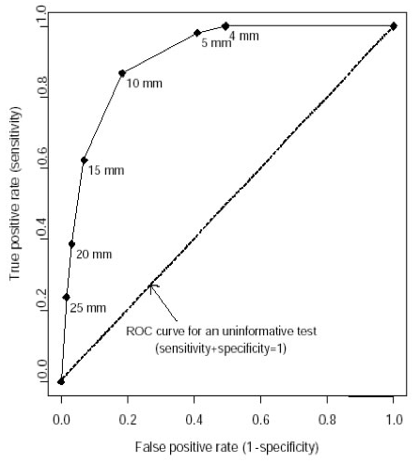
Receiver operator characteristic curves (ROC)
Example.

Slide 40
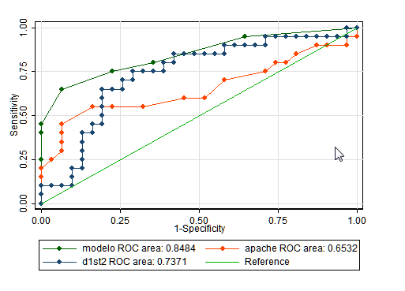
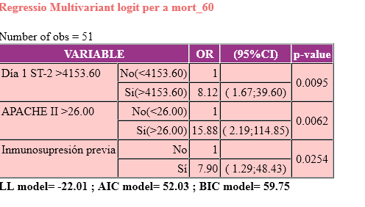
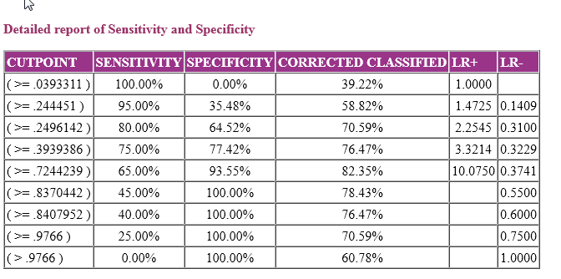

Slide 41
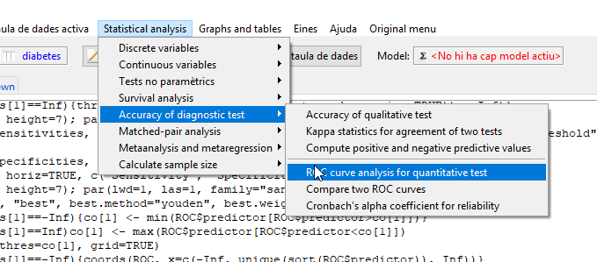
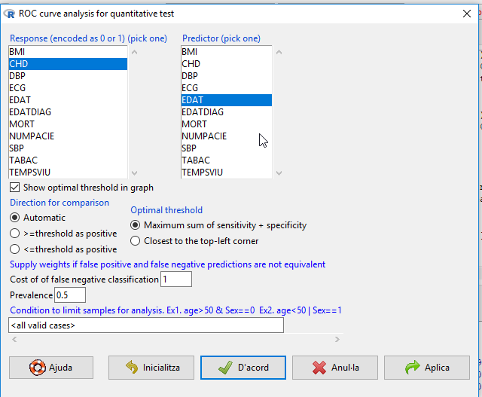
ROC curves in R Commander

Slide 42
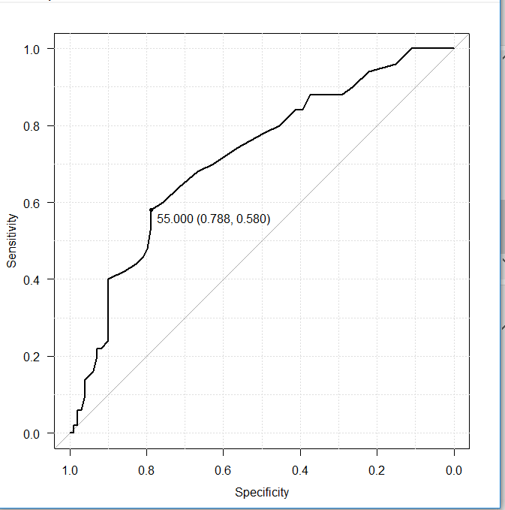
ROC curve for edat

Slide 43
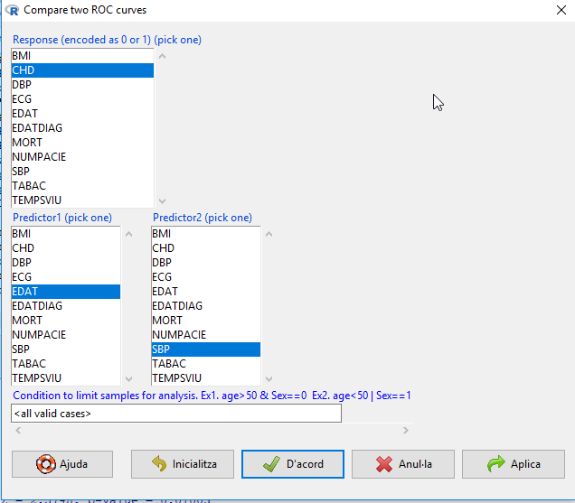
Compare ROC curve for edat and SBP

Slide 44
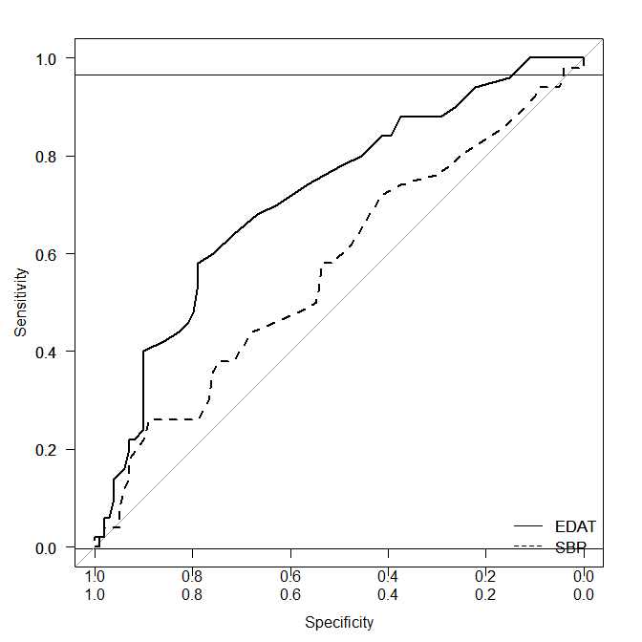
Compare ROC curve for edat and SBP

