Slide 1

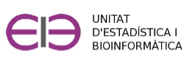
Introduction to R and R-commander
Curs d'Estadística Bàsica per a la Recerca Biomèdica
UEB – VHIR
21/01/2019

Slide 2

Table of contents
●
Introduction to R (and S)
●
Introduction to Rcmdr
●
The Rcmdr menus
●
Loading data sets
●
Working with data sets
●
Using R scripts
●
Exporting results
●
Additional sources
●
Practice

Slide 3


Introduction to R (and S)
R (and S) is a programming language and environment for data exploration and manipulation, statistical computing and high-quality graphics.
Currently, S and R are the two most widely used languages in statistical research.
S was originally developed at Bell Laboratories by John Chambers in 1976 and is a commercial language (S-Plus).
R ("GNU" S) was implemented in 1993 by Robert Gentleman and Ross Ihaka as a free alternative to S.
  It is currently developed and maintained by the R Development Core Team, a team of volunteer developers from across the globe including well-known statisticians (eg, J. Chambers, L. Terney, B. Ripley, D. Bates, etc.).
  It is available from the R-Project website:
        http://www.r-project.org/

Slide 4
Introduction to R
Advantages
It is free
Multi-platform (Linux, Mac, Windows)
Powerful in graphics generation
Powerful statistical tool (top statistical methods)
Is always growing in users and functionalities → Frequent updates
Flexible, open source programming language
Useful for repetitive tasks
Drawbacks
It is a programming language (though incorporates GUIs as Rcmdr, Rstudio)
Not so user friendly as desired
Supporting documentation is of variable quality
Frequent updates
Works better with internet connection

Slide 5
Introduction to R
How it works
R consists of a base system and additional packages that extend its functionalities.
Language based on objects and functions
PSA <-c(0.9, 7.8,6.9, 3.3, 10.1)
logPSA <- log(PSA)
resum <- summary(logPSA)
objects
functions
Different interfaces:
    R console
    RStudio: Simplifies the use of R through a window system that gives access to code, console, data, graphics or help in a powerful and intuitive way
    RCommander: allows the user to run basic functions using a menus interface. Offers a great way to begin familiarizing yourself with R and statistics within a GUI environment.

Slide 6
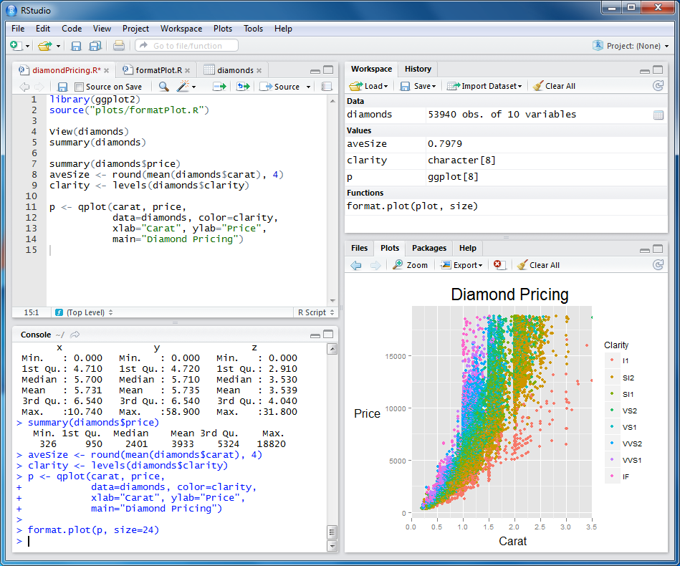
RStudio
Source
-scripts
-text edit
Environment & History
Files, plots, packages, help
Console
-commands
-output

Slide 7
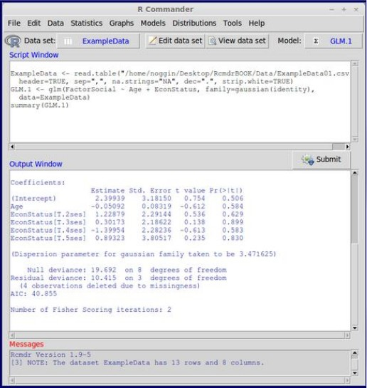
RCommander
●
Package to install after having R.
●
Developed by a statistician, John
Fox, to ease the use of R.
●
Inspired in SPSS software.
●
Menus accessible to use directly
the functions and avoid the
command line programming.
●
Graphics are generated in the R
interface.
●
There are plug-ins with specific
functionalities
Rcommander:
http://www.rcommander.com/

Slide 8
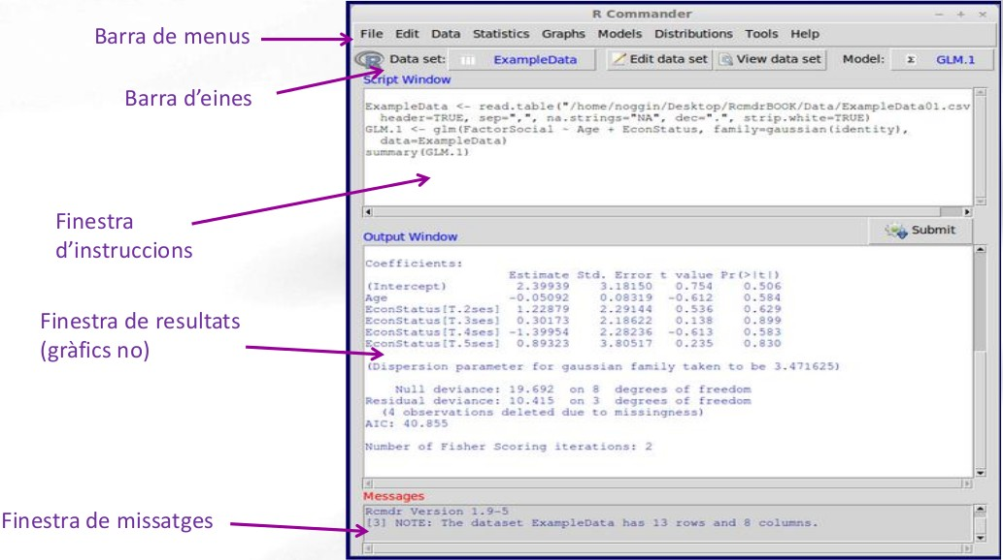
RCommander
●
Menu bar
Tool bar
Command
window
Text output
window
Messages window

Slide 9
RCommander
Menu bar
●
File: contains options to load and save files, define settings and exit.
●
Edit: options for editing output and log/script window contents.
●
Data: options to read and modify data.
●
Statistics: submenu containing options for basic statistical analysis
●
Graphs: contains options for creating simple statistical graphs
●
Models: options for obtaining numerical summaries, testing hypotheses
and regression models.
●
Distributions: options to calculate probabilities, obtain quantiles, and
get plots of already known statistical distributions.
●
Help: contains menus with info about how to work with R commander.

Slide 10
RCommander
Menu bar
Create / Load data
Editing and inspection of data files.
Data transformation / Creation of new variables.
Selection of subsets of data or subgroups of variables.
Conversion of numerical variables into factors.

Slide 11
RCommander
Menu bar
Summaries
Contingency tables
Mediums
Proportions
Variants
Non-parametric tests
Dimensional analysis (A. Multivariant)
Model adjustment (Regression)

Slide 12
RCommander
Tool bar
The program always works with a main set of data (active dataset).
With the active "dataset" we can:
- edit or visualize it
- Do analysis
- Build and use models
At any moment we can change the active dataset.

Slide 13
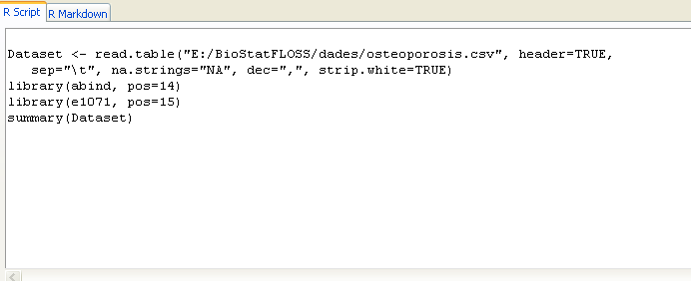
RCommander
Command window
The menu actions are converted into instructions in the Command window.

Slide 14
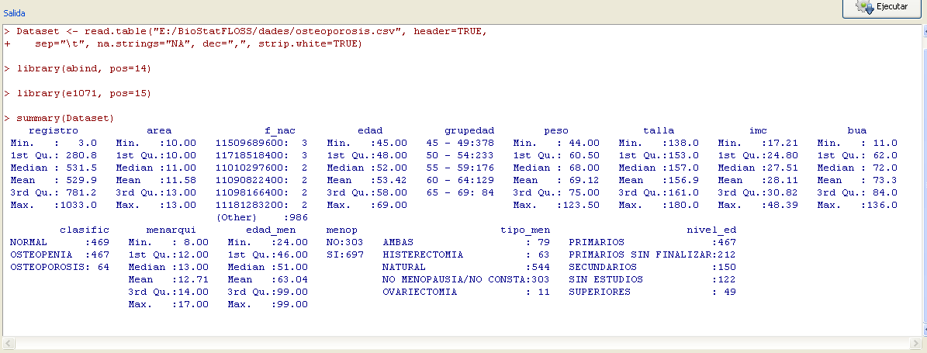

RCommander
Text output window
Message window

Slide 15

Practice. Loading data sets
We have to load into Rcommander the dataset osteoporosis.csv
“.csv” -> “comma separated values” but could be separated with \tab, spaces, ; , ….
First of all “look” the file with a file viewer like “wordpad”, “bloc de notas”,…

Slide 16
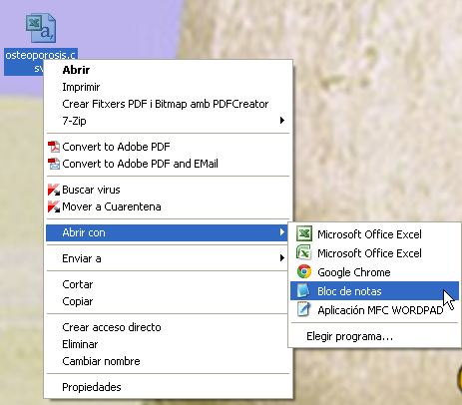
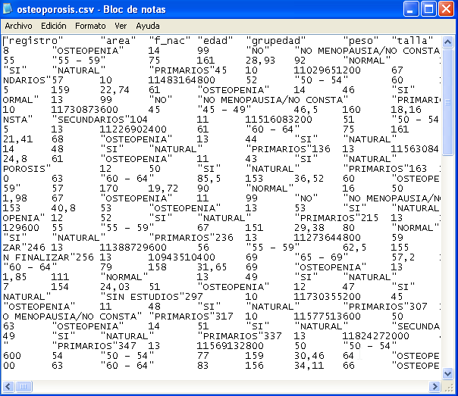
Practice. Loading data sets
We have to load into Rcommander the dataset osteoporosis.csv

Slide 17
Practice. Loading data sets
We have to load into Rcommander the dataset osteoporosis.csv
“.csv” -> “comma separated values” but could be separated with \tab, spaces, ; , ….
First of all “look” the file with a file viewer like “wordpad”, “bloc de notas”,…
Once we know how:
  the data is separated
  the decimals are separated
we can open with Rcmdr

Slide 18
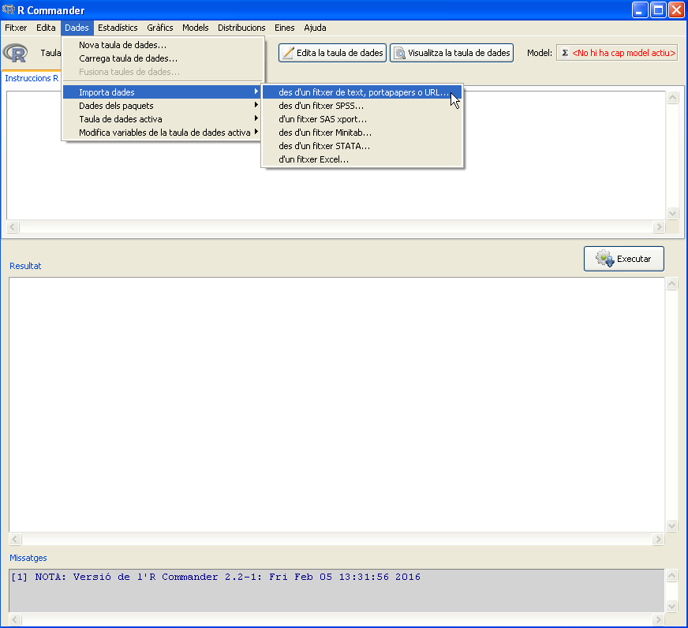
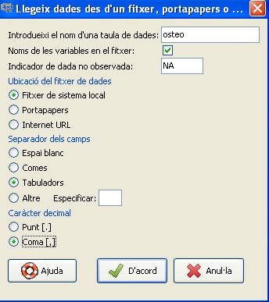
Practice. Loading data sets
We have to import into Rcommander the dataset osteoporosis.csv

Slide 19
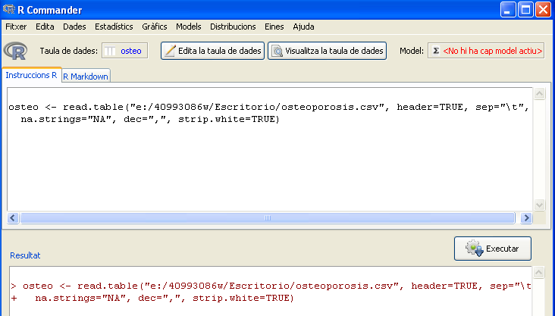
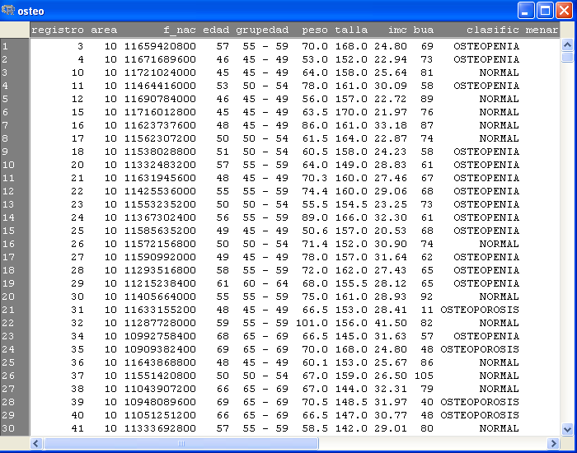
Practice. Loading data sets
We have to import into Rcommander the dataset osteoporosis.csv

Slide 20
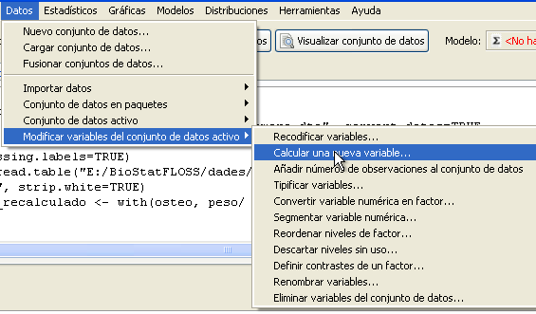
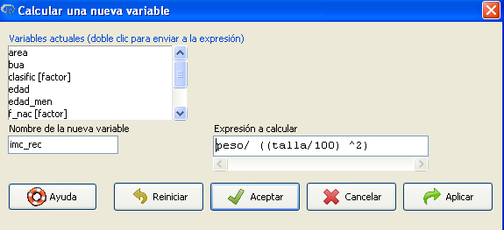
Practice. Adding variables to the data set
We have to add new variables to the dataset osteoporosis.csv

Slide 21
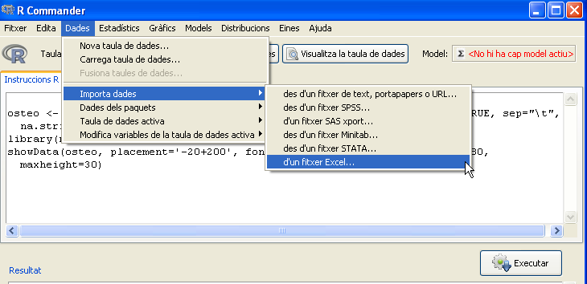
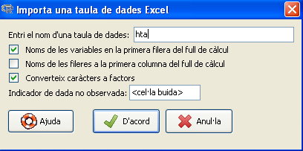
Practice. Loading data sets
We have to import into Rcommander the dataset hta.xls

Slide 22
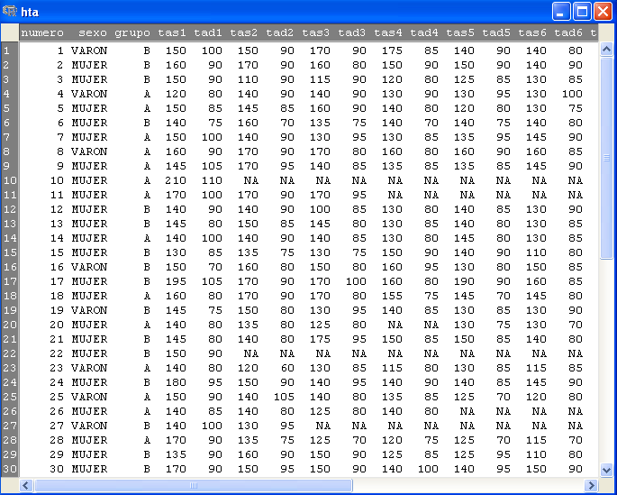
Practice. Loading data sets
We have to import into Rcommander the dataset hta.xls

Slide 23
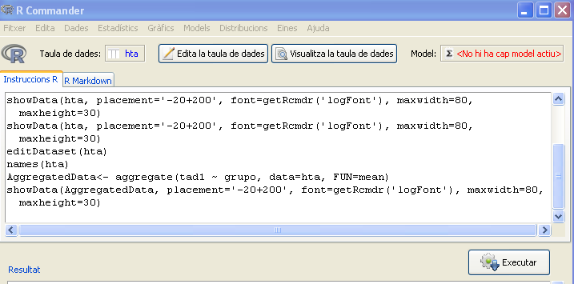
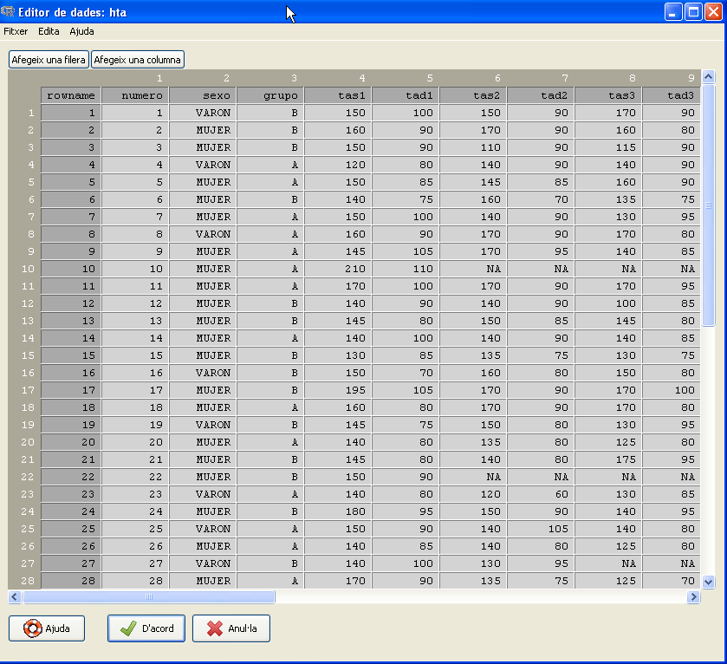
Practice. Adding variables to the data set
We have to add variables age and weight the dataset hta.xls

Slide 24
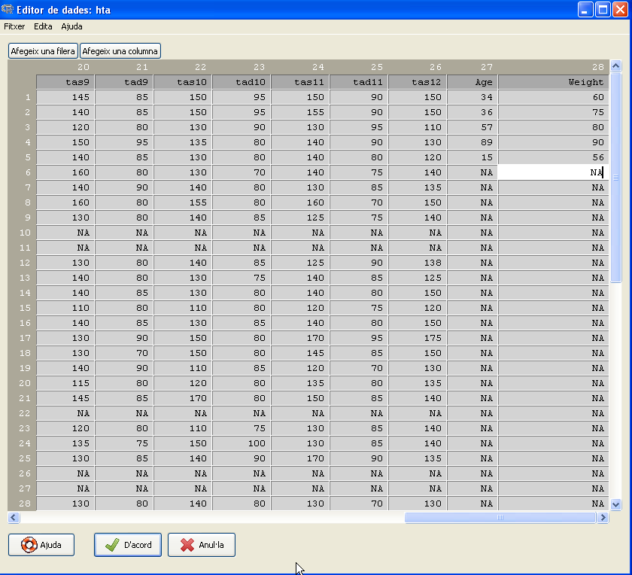
Practice. Adding variables to the data set
We have to add variables age and weight the dataset hta.xls

Slide 25
Exercise
Import into Rcmdr the dataset demora.dta (STATA file)
Convert numeric variable dolor to factor (rename levels accordingly, eg. 0=low, 1=medium, 2=high)
Remove cases with missing data (NA) in demora variable.
Recode variable edad in a new variable named rango_edad according to the following ranges:
            0:25=”young”
            25:50=”adult”
            51:75=”mid-old”
            76:100=”old”

Slide 26
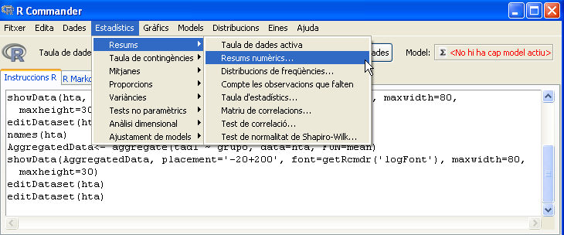
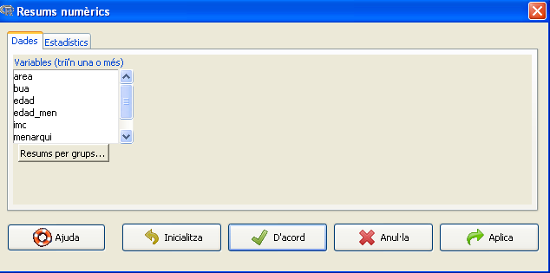
Practice. Statistics with Rcmdr
We have to calculate some descriptive statistics with the dataset osteo.

Slide 27
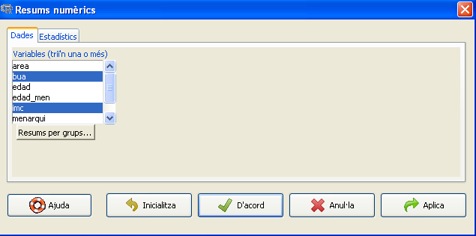
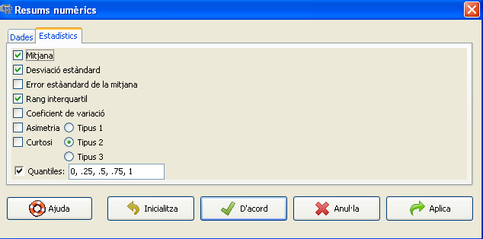
Practice. Statistics with Rcmdr
We have to calculate some descriptive statistics with the dataset osteo.

Slide 28
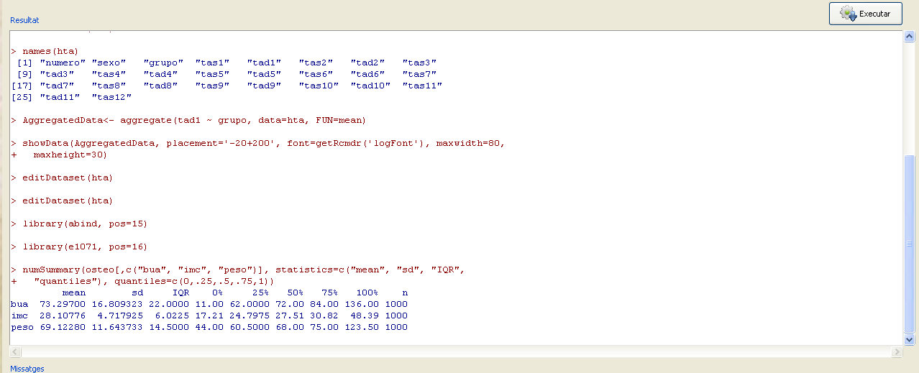
Practice. Statistics with Rcmdr
We have to calculate some descriptive statistics with the dataset osteo.

Slide 29
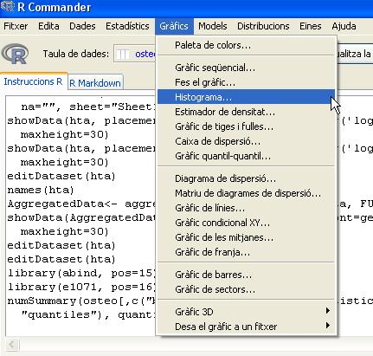
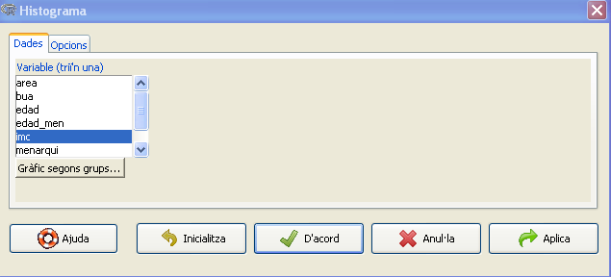
Practice. Graphics with Rcmdr
We want to see how the variable imc is distributed among the individuals

Slide 30
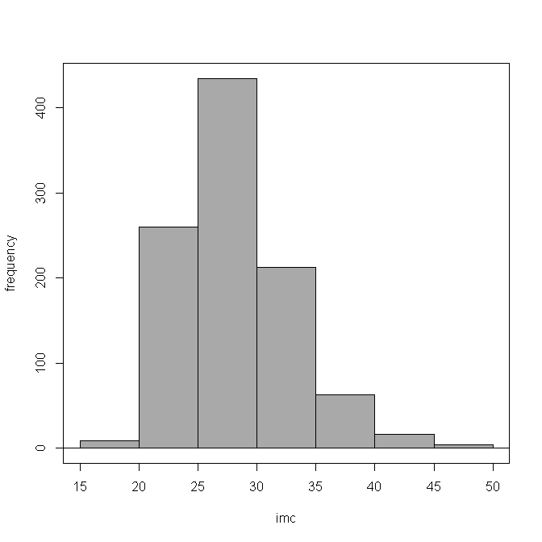
Practice. Graphics with Rcmdr
We want to see how the variable imc is distributed among the individuals

Slide 31
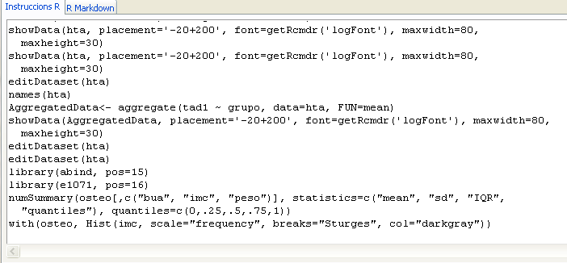
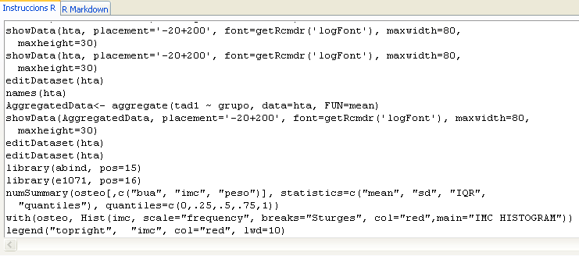
Practice. Running scripts with Rcmdr
We want to change the graphic colour, add a legend and a main title

Slide 32
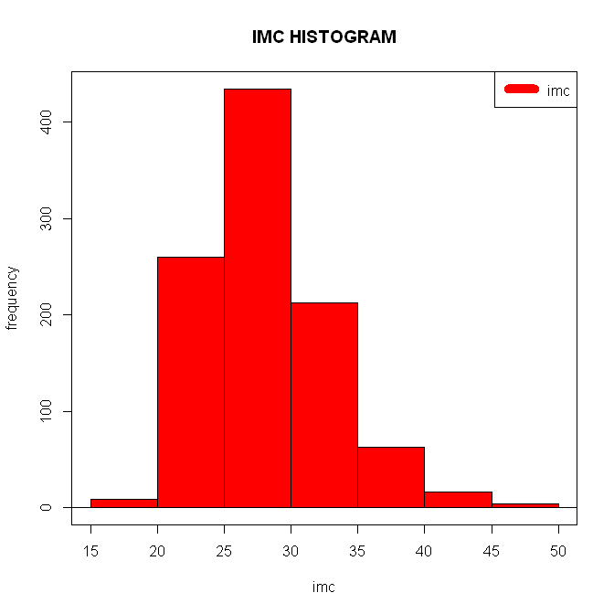
Practice. Running scripts with Rcmdr
We want to change the graphic colour, add a legend and a main title

Slide 33
Exporting results
Years ago, R-commander had the limitation that exporting data had to be
done through saving plots and copy-pasting code to external software.
Now, Rcmdr integrates Markdown/Knitr results writing system, that allows the
user to export all work (code, plots and results) to html pages in quick and
easy way.
https://github.com/adam-p/markdown-here/wiki/Markdown-Cheatsheet
http://www.rstudio.com/ide/docs/authoring/using_markdown
http://yihui.name/knitr/

Slide 34
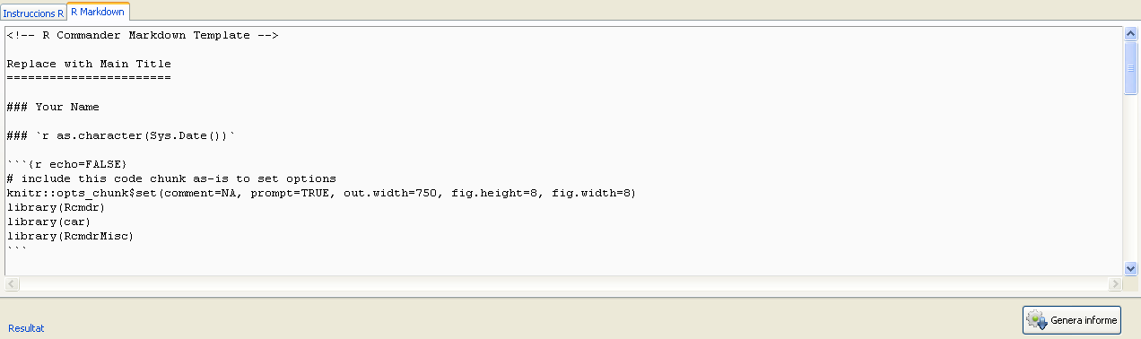
Practice. Export results as html
We want to export the results into an html report

Slide 35
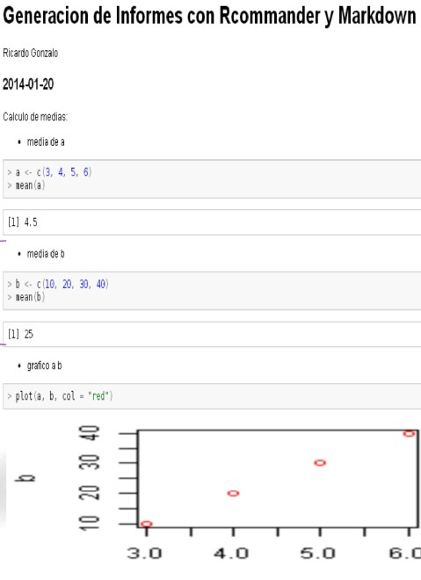
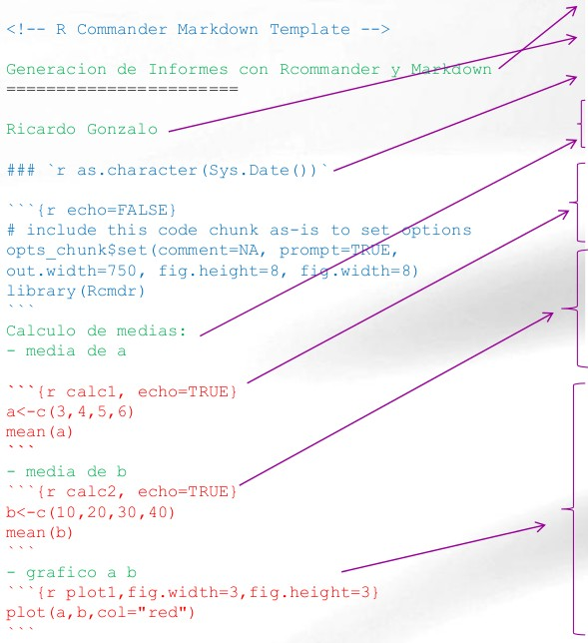
Practice. Export results as html

Slide 36
Exercise
Load into Rcmdr the dataset in prostate.csv
Calculate some descriptive statistics for some variables
Make a graphic from one or two variables
Generate the report with all the data

Slide 37
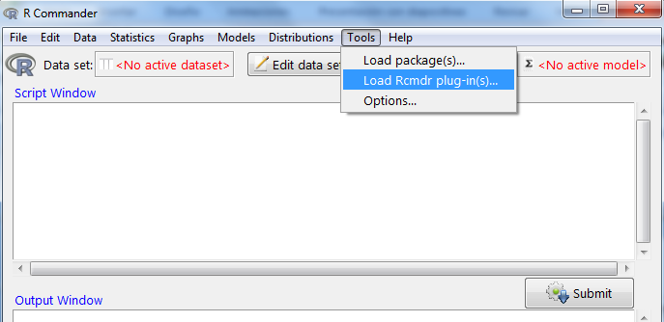

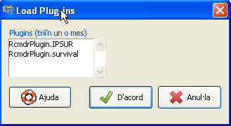
Rcommander’s plugins installation
Plug-ins are additional libraries that we may want
to have available in R-commander
To check if they are correctly installed…
You should find…

Slide 38
Additional souRces
R manuals
* Intro for beginners http://cran.r-project.org/doc/contrib/rdebuts_es.pdf
* SimpleR http://cran.r-project.org/doc/contrib/Verzani-SimpleR.pdf
* Quick-R http://www.statmethods.net/
* Basic statistics with R and R-commander http://knuth.uca.es/ebrcmdr/
* Statistical methods with R and R-commander
http://cran.r-project.org/doc/contrib/Saez-Castillo-RRCmdrv21.pdf
* Try R http://tryr.codeschool.com/levels/1/challenges/1
R books
* Introductory Statistics with R
* R for SPSS and SAS users

