Slide 1








1. Introduction to Bioinformatics
Ricardo Gonzalo¹ ,Mireia Ferrer ,Álex Sánchez^{1,2}
1 Unitat d’Estadística i Bioinformàtica (UEB) VHIR
2 Departament de Genètica Microbiologia i Estadística (UB)

Slide 2
We are drowning in information and starved for knowledge
John Naisbitt
Who on efficient work is bent,
Must choose the fittest instrument.
Goehthe (Fausto)

Slide 3
What is Bioinformatics?

Slide 4
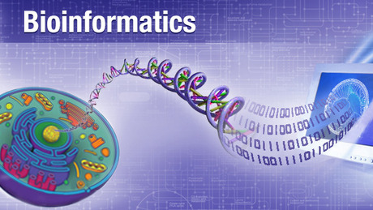
A (first) definition
Bioinformatics is the application of computer technology to the management of biological information.
Computers are used to gather, store, analyze and integrate biological information.
19/11/18

Slide 5
A historical approach
The term appeared in the 70’s
It became popular/important with the development of the human genome project
Bioinformatics is entering a big data era that will foster new possibilities.

Slide 6
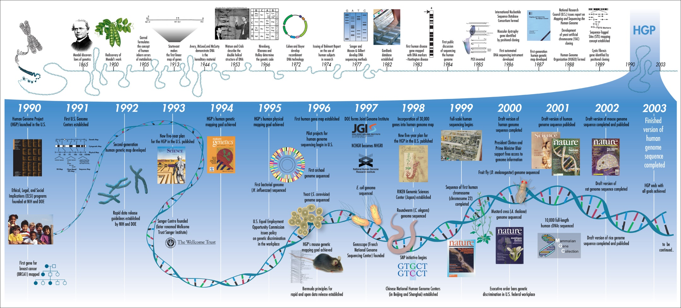
The Human Genome Project

Slide 7
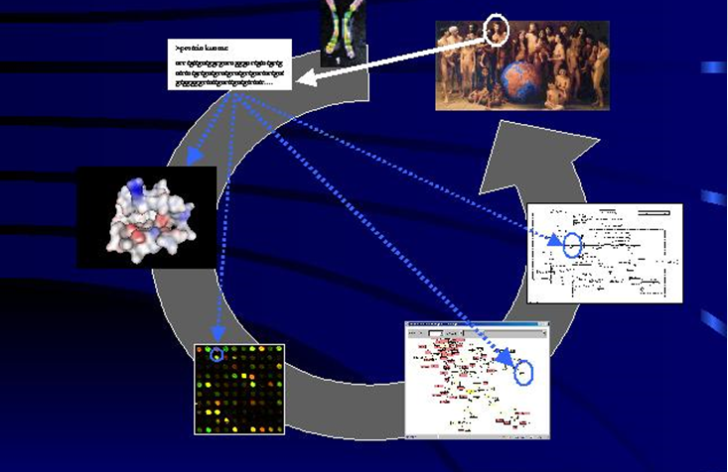
Pre genomics era vision in the lab
Adapted from a presentation by J. dopazo

Slide 8
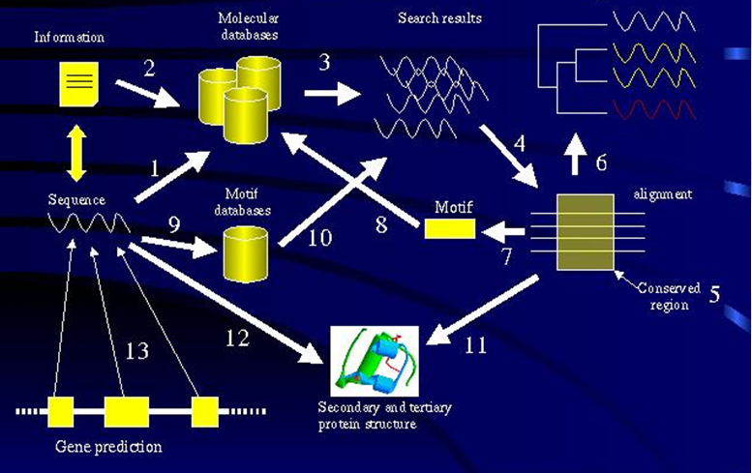
Bioinformatic analysis
Adapted from a presentation by J. dopazo

Slide 9
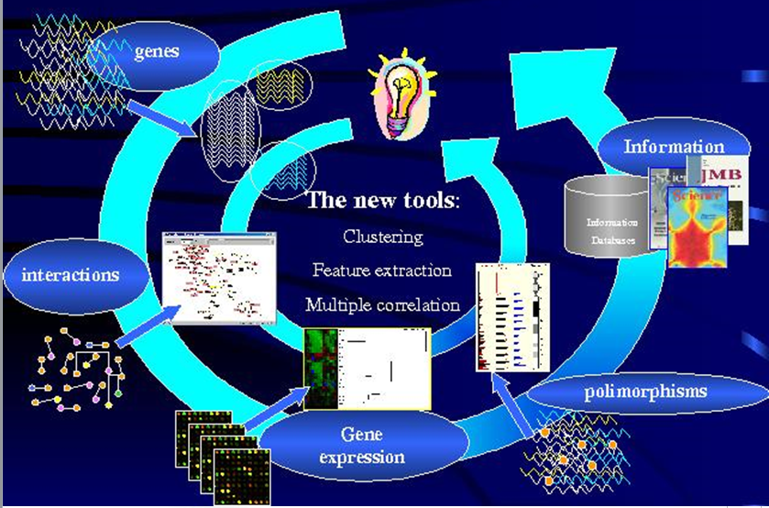
Post-genomic vision
Adapted from a presentation by J. dopazo

Slide 10
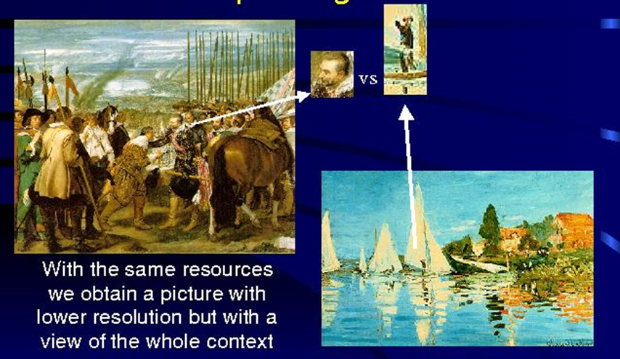
The (first) paradigm shift
Adapted from a presentation by J. dopazo

Slide 11
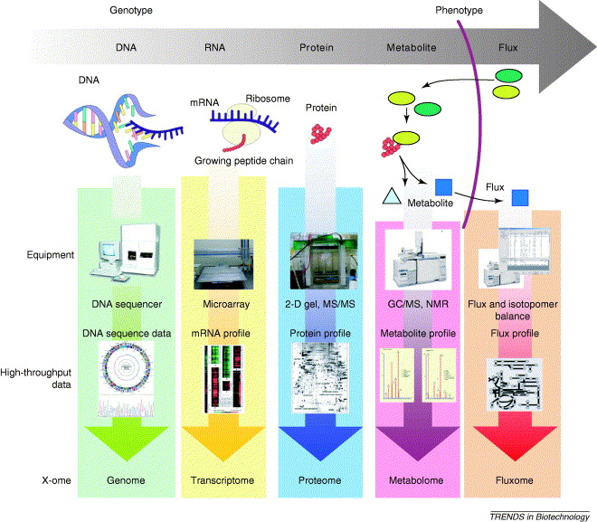
Omics technologies

Slide 12
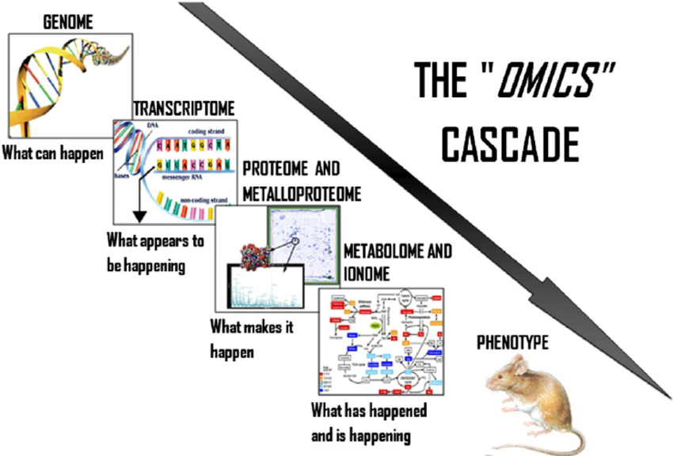
The “Omics cascade”

Slide 13
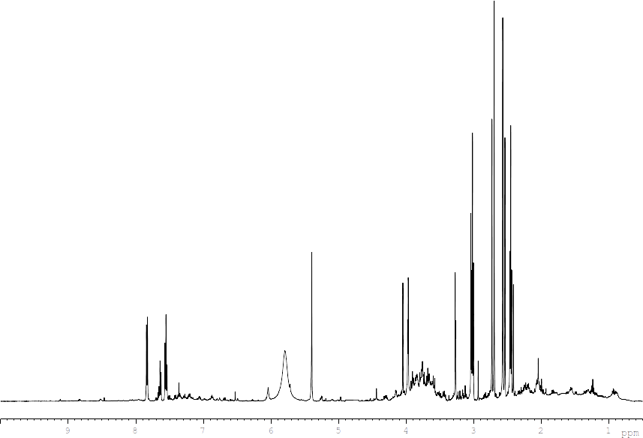

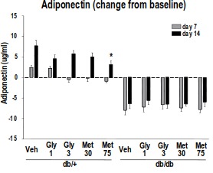

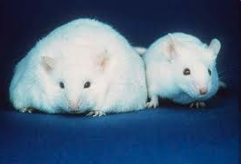
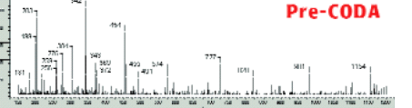
New paradigm shift: Integromics
“NGS-Sequences
H NMR metabolites
A
A
Veh A B C D Veh A B C D
Normal Disease
Affy Transcriptome
“Non-omic” markers
LC-MS proteomicss

Slide 14
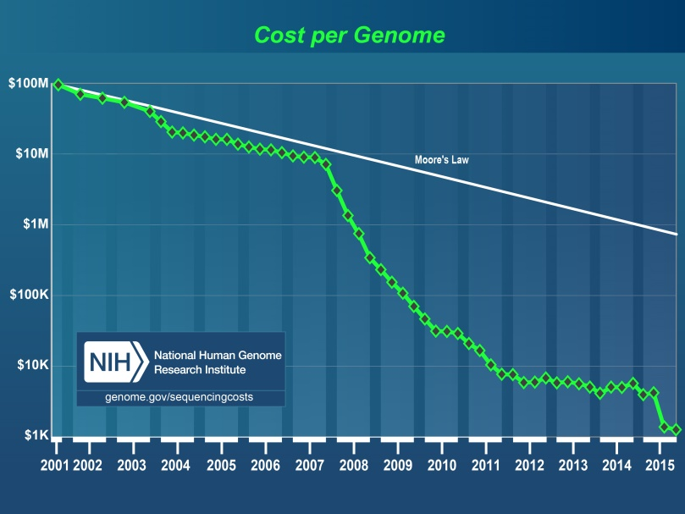
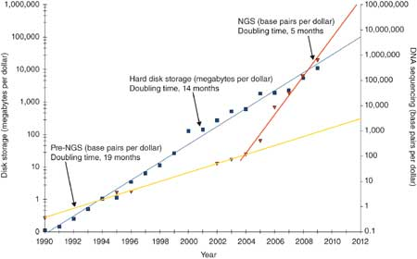
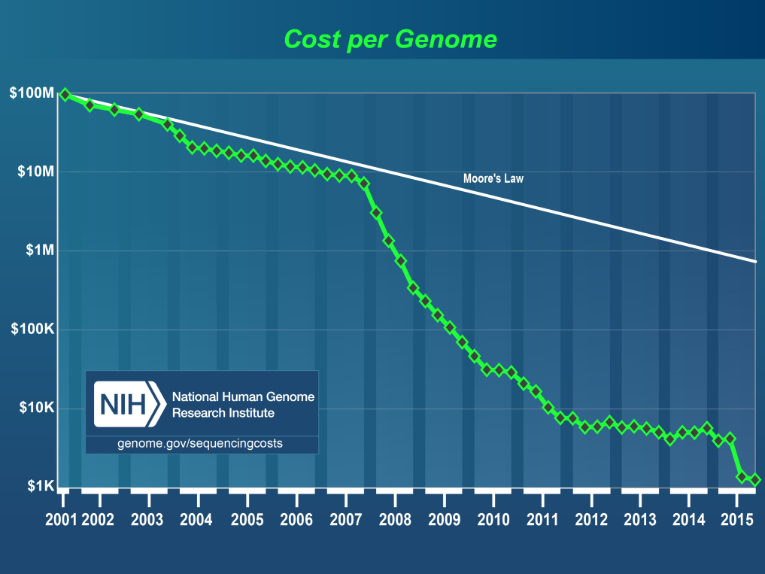
“Nextgen” sequencing revolution
19/11/18

Slide 15
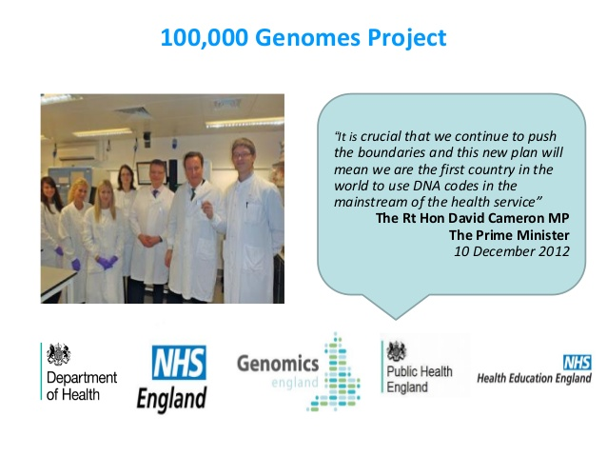
New paradigm shift: Precision Medicine
19/11/18

Slide 16
Bioinformatics domains
Information management
  Databases, databanks
  Algorithms and tools for database querying and searching
Information Modelling
  Protein structure characterization
Analysis & Interpretation of results
  Genome sequencing and analysis
  Comparative genomics
  Transcriptomics and gene expression
  Metagenomics
  Proteomics, metabolomics, …
Biological system modeling

Slide 17
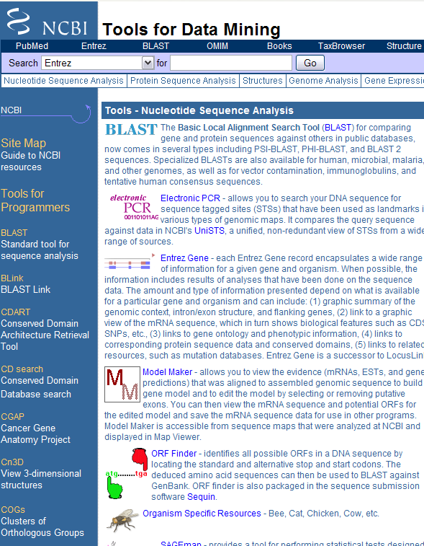
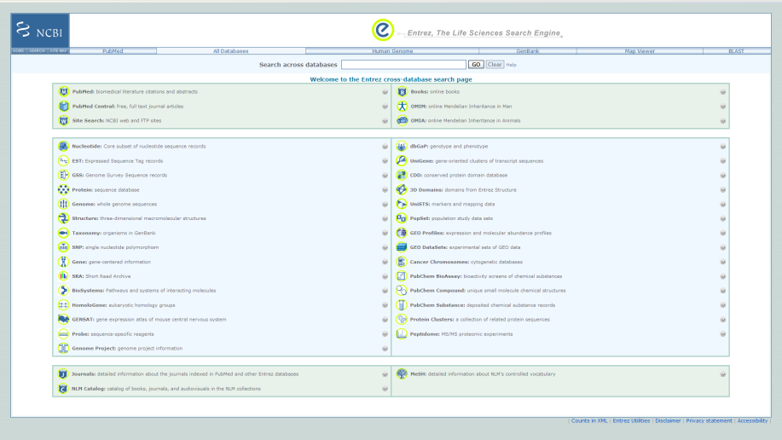
Information management

Slide 18
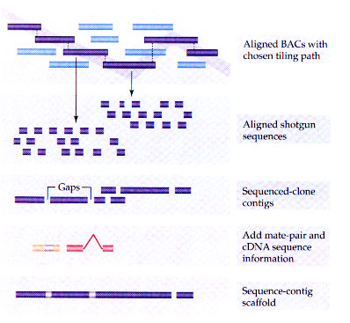
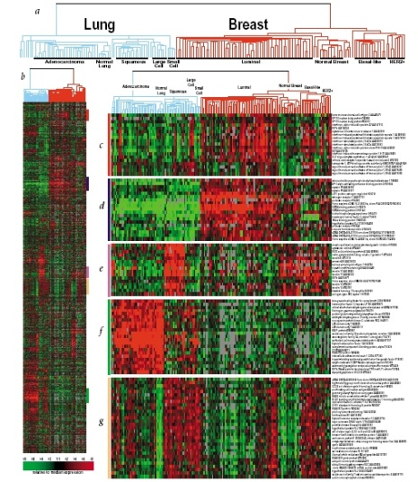
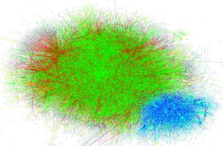
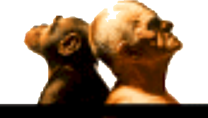
Analysis and interpretation
A G A G T T C T G C T C G
A G G G T T A T G C G C G

Slide 19

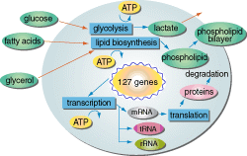
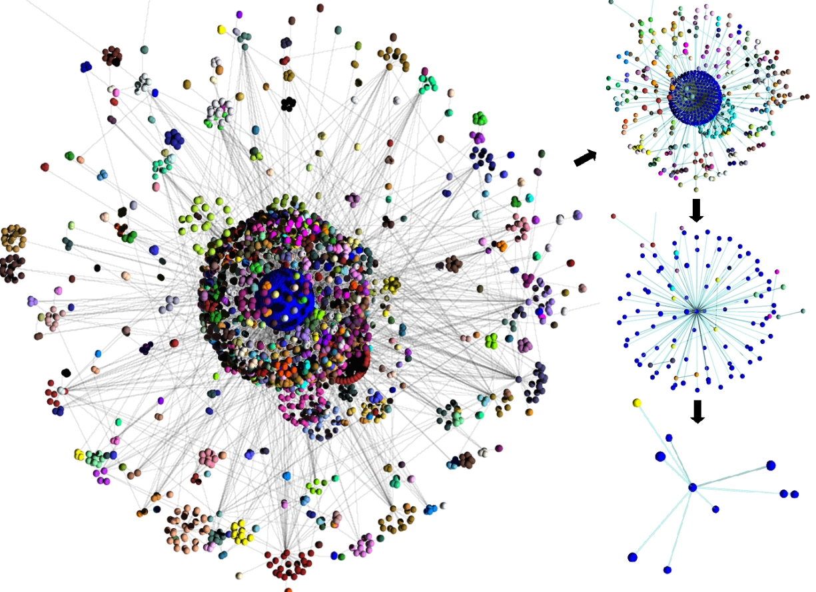
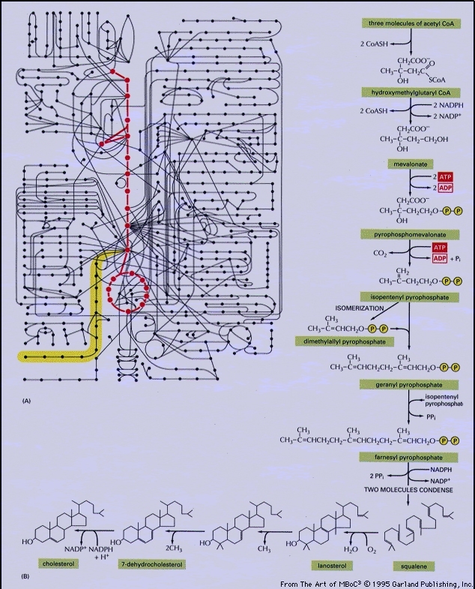
Biological system modeling

Slide 20
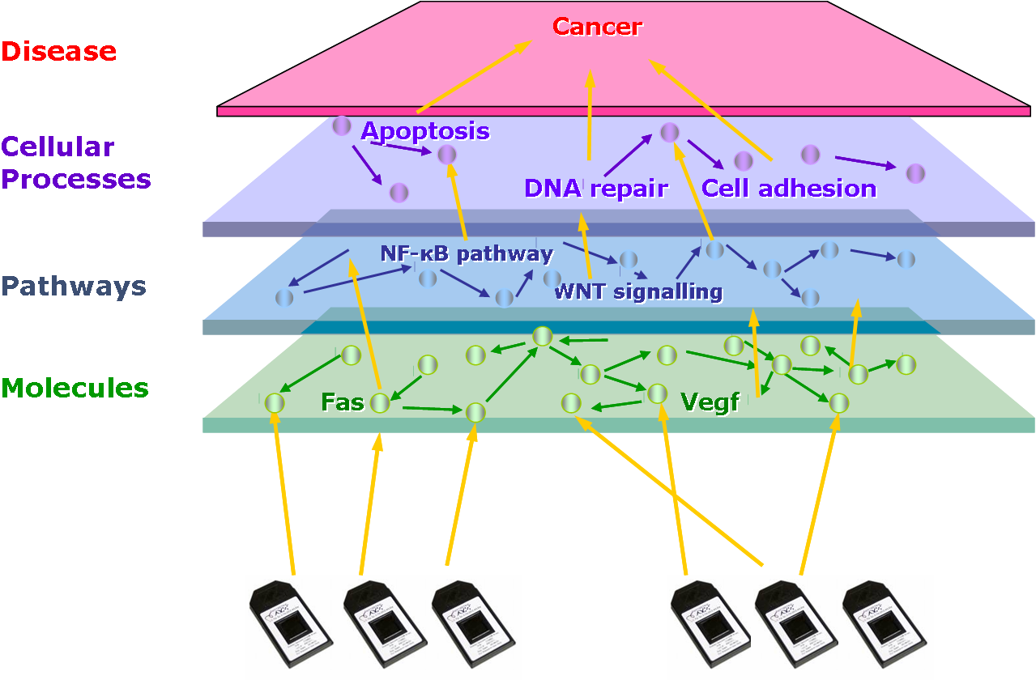
Integrative bioinformatics

Slide 21
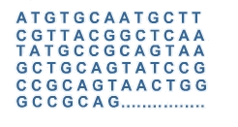
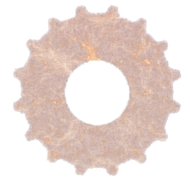
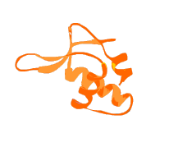

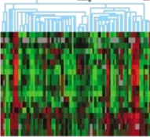
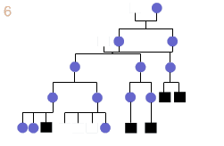
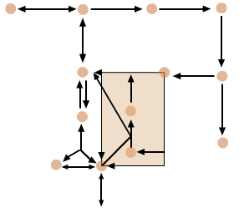
In summary…
Bioinformatics methods and resources
Data
Knowledge

Slide 22
How does one do bioinformatics?
http://biomedicalcomputationreview.org/content/landscape-bioinformatics-education

Slide 23
“Doing bioinformatics”
Bioinformatics analyses
  Database searching/querying
  Sequence analysis, Omics data analysis
  Systems biology
Can be done differently
  From console-based systems
    Using scripts (perl/python/R) for automating processes
    Doing data analysis with R
  Or working with graphical/web interfaces to do (almost) the same things
Each user has a different preferred approach

Slide 24
What does a bioinformatician know?
Must have “good background” in
Some biological discipline
  Molecular biology, biochemistry, evolution …
Computer science
  Operating systems: Linux
  Programming languages: Python, R, Perl
  Databases SQL
  Web development: HTML, PHP, …
Some “quantitative” science
  Mathematics, Physics, Statistics
Ideally 1, ½, ⅓ from the previous three!!

Slide 25
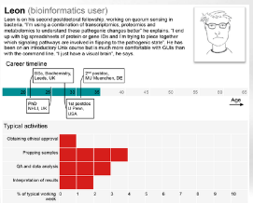
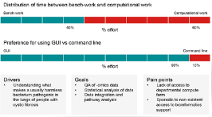

A typical “bioinformatics user”
Welch L, Lewitter F, Schwartz R, Brooksbank C, Radivojac P, et al. (2014) Bioinformatics Curriculum Guidelines: Toward a Definition of Core Competencies. PLoS Comput Biol 10(3): e1003496. doi:10.1371/journal.pcbi.1003496
http://journals.plos.org/ploscompbiol/article?id=info:doi/10.1371/journal.pcbi.1003496

Slide 26
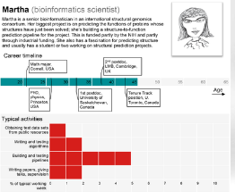
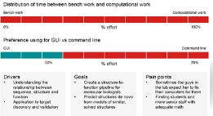
A typical “bioinformatics scientist”
Welch L, Lewitter F, Schwartz R, Brooksbank C, Radivojac P, et al. (2014) Bioinformatics Curriculum Guidelines: Toward a Definition of Core Competencies. PLoS Comput Biol 10(3): e1003496. doi:10.1371/journal.pcbi.1003496
http://journals.plos.org/ploscompbiol/article?id=info:doi/10.1371/journal.pcbi.1003496

Slide 27
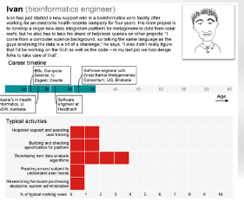
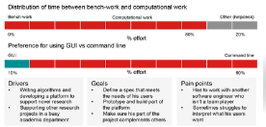
A typical “bioinformatics engineer”
Welch L, Lewitter F, Schwartz R, Brooksbank C, Radivojac P, et al. (2014) Bioinformatics Curriculum Guidelines: Toward a Definition of Core Competencies. PLoS Comput Biol 10(3): e1003496. doi:10.1371/journal.pcbi.1003496
http://journals.plos.org/ploscompbiol/article?id=info:doi/10.1371/journal.pcbi.1003496

Slide 28
In summary, bioinformatics ...
Was born with
  Development of new technologies
  Its application for generating –increasingly huge- of big masses of biological data.
Has become now an interdisciplinar science encompassing all aspects of the Acquisition, Processing, Distribution, Analysis, Integration and Interpretation of biological information.

