Slide 1








Course Presentation
Intrroduction to Bioinformatics for Biomedical Research
UEB – VHIR
Ricardo Gonzalo¹ ,Mireia Ferrer¹ ,Álex Sánchez^{1,2}
Berta Miró¹, Angel Blanco^{1,2}
1 Unitat d’Estadística i Bioinformàtica (UEB) VHIR
2 Departament de Genètica Microbiologia i Estadística, UB

Slide 2
Outline
Where are we?
What do we do?
Why this course
Goals
Methodology
Contents

Slide 3
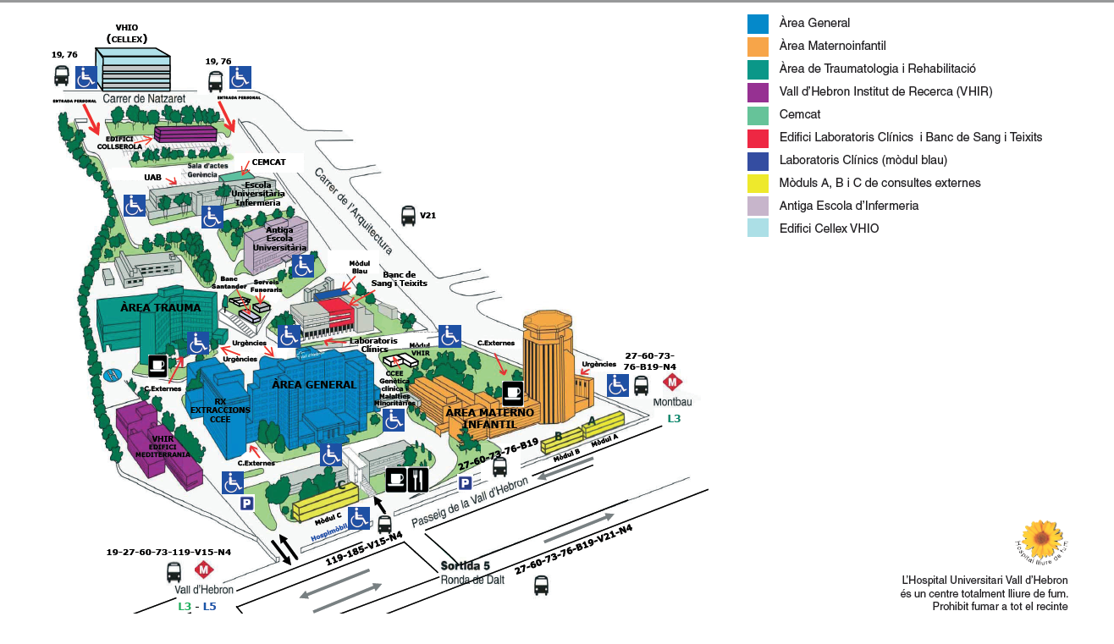
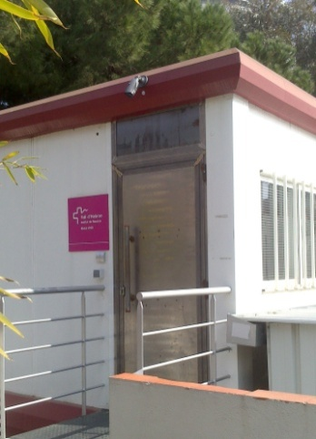
Where we are located
Where are we?

Slide 4
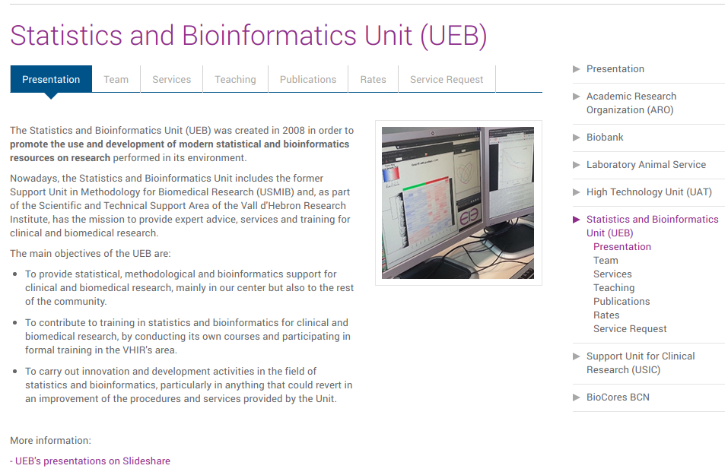
Our web at VHIR’s web site

Slide 5
What we do
We provide support in …
Clinical Data analysis
Omics Data Analysis
& Bioinformatics
Training
Consulting
Biostatistical Analysis
Clinical Trials
CRF development (Redcap)
Epidemiological studies
Data Management for Clinical Trials
Gene Expression Analysis
Methylation
Metagenomics
Exome sequencing
Integrative Omics
Database / applicationsn development
High performance Computing (HPC) services
Short Workshops
Courses
Official training (MSc)
Students in practice
Sample size
Experimental design
GRANT review
Statistical parts of papers
Short consultations (< 3hrs) are free
Other services budgeted according our rates:
http://ueb.vhir.org/Services

Slide 6
Why this course
Current biomedical research often has to do (either as “Input” or “output”) with massive quantities of biological information
Some of this requires sophisticated tools of methods
Other can be managed with basic knowledge of simple tools
Researchers and/or technicians must know
    How to deal with basic problems
    How to recognize complex situations
    How to communicate with specialists and understand their questions, proposals and work.
“Hiring a statistician bioinformatician after the data has been collected is like hiring a physician when a patient is in the morgue: She might be able to tell you what went wrong , but she is unlikely to be able to fix it”
R.A. Fisher

Slide 7
Objectives
Main objective is providing a (biased) overview of some of the most commonly used bioinformatics methods and tools in biomedical research.
At the end of the curse you should ...
  Have an overview of the main areas of bioinfomatics.
  Recognize some problems whose solution requires a bioinformatical approach.
  Identify the right methods to deal with these problems.
  Be familiar with some of the existing tools to solve these problems.
  Know when to ask for a bioinformatician’s help and understand the solution proposed.

Slide 8
Methodology
This is an applied bioinformatics course.
Most work based on examples & real data
Intended for non-programmers:
  Most tools presented will have a GUI
  We will do an introduction to R because doing Bioinformatics also means some scripting.
We have a program but there may be others: Ask questions and make suggestions to improve it or change it “on the fly”.

Slide 9
Methodology (II)
This is an on-line synchronic course
  We are not located on the same room
  But we work together at he same time.
We make our best to communicate fluidly, add examples and exercices to keep the class dynamic.
We ask you to avoid as much as possible to stay hidden below the screen
  Show yourselves, Participate, Ask questions and suggestions
It’s a new situation but communication need not be neither less nor worse, only different :-)

Slide 10
Contents
Session 1
  Course presentation. Introduction to Bioinformatics
  Introduction to R (I)
Session 2
  Introduction to R (II)
  Databases in Molecular Biology
Session 3
  Genomic browsers: Ensembl and USCS
  Omics data repositories: GTEx, GEO, TCGA, etc.
Session 4
  Introduction and applications of Next Generation Sequencing
  Managing NGS data with Galaxy.
Session 5
  Sequencing preprocessing and management
  Introduction to minor variant analysis

Slide 11
Contents (II)
Session 6
  Case study I: Minor variant analysis with Galaxy
Session 7
  Introduction to Omics Data Analysis
  Important ideas in RNA-seq data analysis.
Session 8
  Case Study II: RNA-seq data analysis
Session 9
  Methods and tools for Biological Significance Analysis.
Session 10
  Case Study III: Biological Significance Analysis.

Slide 12
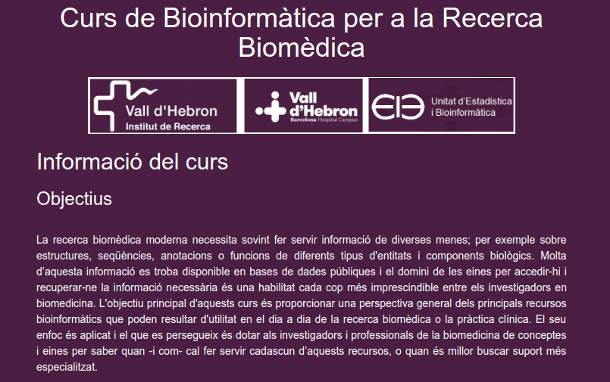
Course Web site
Materials
https://uebvhir.github.io/Course_Bioinformatics_2020.html

Slide 13
Materials
The course has no specific materials
  Slides in web site before session
  Software
    Online tools
    R & Bioconductor in class computers
  Links and resources from the web
    List of journals and books

Slide 14
Expected output
At the end of the course you should be able to
  Recognize a variety of bioinformatics problems
  Know how to solve some of them using online bioinformatic tools or adapting R scripts provided in the course (or found in the web).
  Recognize more complex situations and the resources (or people) needed to deal with them

