Slide 1
Course Presentation
Introduction to Bioinformatics for Biomedical Research
UEB – VHIR
Mireia Ferrer¹, Álex Sánchez^{1,2}, Esther Camacho¹, Angel Blanco^{1,2}, Berta Miró¹
¹ Unitat d’Estadística i Bioinformàtica (UEB) VHIR
² Departament de Genètica Microbiologia i Estadística, UB

Slide 2


OUTLINE
UEB Presentation
Who we are?
What do we do?
Course presentation
Why this course?
Main Goals
Methodology
Contents

Slide 3
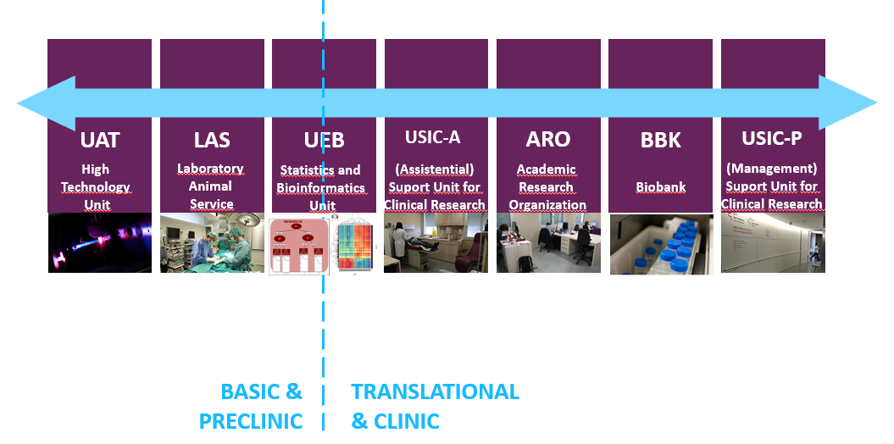
UEB Presentation
VHIR’s CoreFacilities
Statistical, methodological and bioinformatics support
Training
Innovation and development

Slide 4
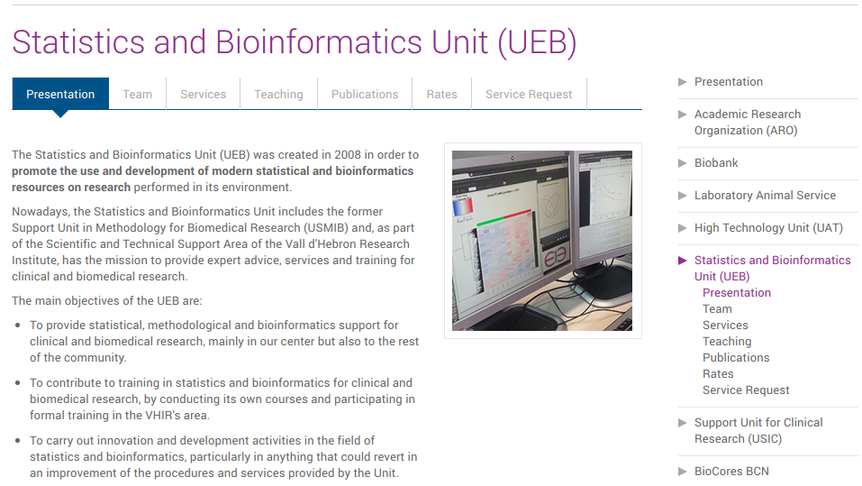
UEB Presentation
http://en.vhir.org/portal1/article_menu_serveis.asp?s=serveis&contenttypeid=43&contentid=1250&t=presentation

Slide 5
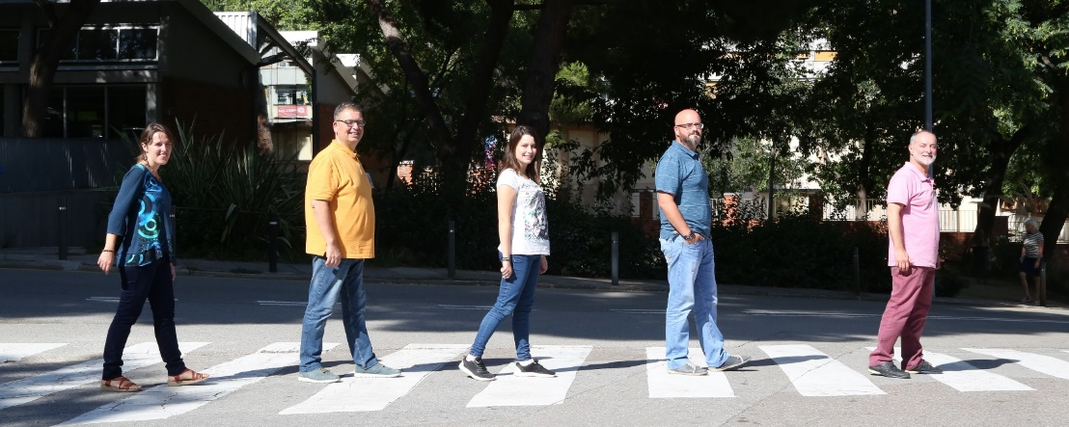
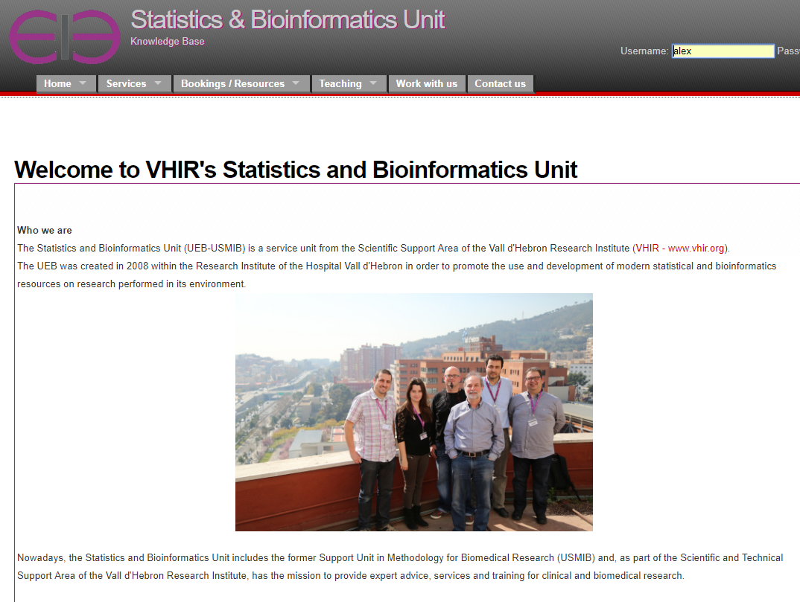
UEB Presentation
Incorporation of new methods & pipelines
Standarization of workflows and pipelines
Development of new tools
Adhesion to quality standards (ISO9001:2015)
2008
Former members:
Ricardo Gonzalo
Ferran Briansó
Xavier de Pedro
Israel Ortega
Josep Lluís Mosquera

Slide 6



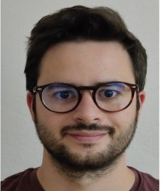
UEB Presentation
Bioinformatics Platform
Projects in Data Science
Esther Camacho
Bioinformatics Technician
Alex Sánchez
Responsible Projects
in Data Science
Mireia Ferrer
Responsible Bioinformatics
Angel Blanco
EOSC-LIFE Project Manager
Head of Unit
Santi Pérez-Hoyos
Statistics Platform
Guillem Fernández
Clinical data specialist
Berta Miró
VEIS Project Manager
Miriam Mota
Biostatistics Technician
Santi Pérez-Hoyos
Responsible Bioestatistics
Augusto Sao-Avilés
Biostatistics Technician
Anna Sanjuan
EU-Pearl Project Manager

Slide 7
UEB Presentation
We provide support in …
Clinical Data
Analysis
Bioinformatics
Analysis
Consulting and
Research Projects
Training
Biostatistical Analysis
Clinical Trials
CRF development (REDCap)
Epidemiological studies
Data Management for Clinical Research
Analysis of omics data (Microarrays, RNA-seq, proteomics and other NGS)
RTqPCR, HT-qPCR
Variant Analysis
Biological significance analyses (pathways, networks,…)
Integrative analyses and biomarker discovery
High performance computing, development of applications
Sample size
Experimental design
GRANT review
Statistical writing and response to reviewers
Support for research projects request
Courses
Short Workshops
Statistical Pills
Official training (MSc)
Students in practice
Short consultations (< 3hrs) are free
Other services budgeted according our rates: http://ueb.vhir.org/Services
Notes:
7

Slide 8


UEB Presentation
UEB teaching activities:
Annual scheduled courses:
Basic Statistics for biomedical research
Advanced Statistics for biomedical research
Bioinformatics for biomedical research
Participation in VHIR Annual Master (Translational Biomedical Research)
‘On demand’ Courses
Statistics Pills (back in January 2022!)

Slide 9

UEB Presentation
http://ueb.vhir.org/

Slide 10
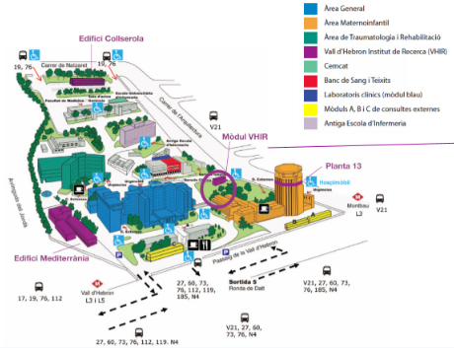
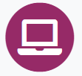
UEB Presentation
Where we are?

Slide 11
OUTLINE
UEB Presentation
Who we are?
What do we do?
Course presentation
Why this course?
Main Goals
Methodology
Contents

Slide 12
Course Presentation
Why this course?
Current biomedical research often has to do (either as “Input” or “output”) with massive quantities of biological information
Some of this requires sophisticated tools of methods
Other can be managed with basic knowledge of simple tools
Researchers and/or technicians must know
How to deal with basic problems
How to recognize complex situations
How to communicate with specialists and understand their questions, proposals and work.

Slide 13
Course Presentation
Goals and Expected Output
The main objective is to provide a (biased) overview of some of the most commonly used bioinformatics methods and tools in biomedical research.
At the end of the course you should ...
Have an overview of the main areas of bioinfomatics.
Recognize some problems whose solution requires a bioinformatics approach.
Recognize a variety of bioinformatics problems
Know how to solve some of them using online bioinformatics tools or adapting R scripts provided in the course (or found in the web).
Know when to ask for a bioinformatician’s help and understand the solution proposed.

Slide 14
Course Presentation
Methodology
This is an applied bioinformatics course.
Most work based on examples & real data
Intended for non-programmers:
Most tools presented will have a GUI
We will do an introduction to R because doing Bioinformatics also means some scripting.

Slide 15
Course Presentation
Practical infos
Classroom course: Aula d’Informàtica Pavelló Docent UAB Campus Vall d’Hebron – Mòdul Sud
Please keep your mask on!
5 Sessions from 9:30-13:50 h
2h (theoretical session) + 20min break + 2h (practical session)
In each session: Main professor + Support professor
Certificate of Assistance after the course
Sheet of signatures at the end of each class
Satisfaction Survey will be sent to you after the course
Any doubts/questions/comments: ueb@vhir.org

Slide 16
Course Presentation
Contents
Sessions: 2h + 2h (20 min break)
Session 1 – Wednesday 17th november
Introduction to Bioinformatics and Databases for Molecular Biology
Introduction to R/Rmarkdown and Bioconductor. Hands On
Session 2 – Monday 22nd november
Introduction and applications of Next Generation Sequencing
Managing NGS data with Galaxy. Hands On
Session 3 – Wednesday 24th november
Introduction to Variant Analysis
Running a variant analysis workflow on Galaxy. Hands On
Session 4 – Monday 29th november
Introduction to RNA-seq Analysis
Running a Differential Expression Analysis on R. Hands On
Session 5 – Wednesday 1st december
Introduction to Biological Significance Analyses (Pathway Analysis)
From Gene lists to Pathways. Hands On

Slide 17
Course Presentation
Course materials
Slides posted on UEB’s website before each session
Software
Online tools
Galaxy webserver
R & Bioconductor already installed in class computers
Links and resources from the web
List of journals and books

Slide 18

Course Presentation
Course materials
https://uebvhir.github.io/Course_Bioinformatics_2021.html

