Slide 1


BIOINFORMATICS COURSE
Databases in molecular biology
Bioinformatics Course UEB-VHIR
November 2021
Mireia Ferrer¹, Álex Sánchez^{1,2}, Esther Camacho¹, Angel Blanco^{1,2}, Berta Miró¹
¹ Unitat d’Estadística i Bioinformàtica (UEB) VHIR
² Departament de Genètica Microbiologia i Estadística, UB

Slide 2
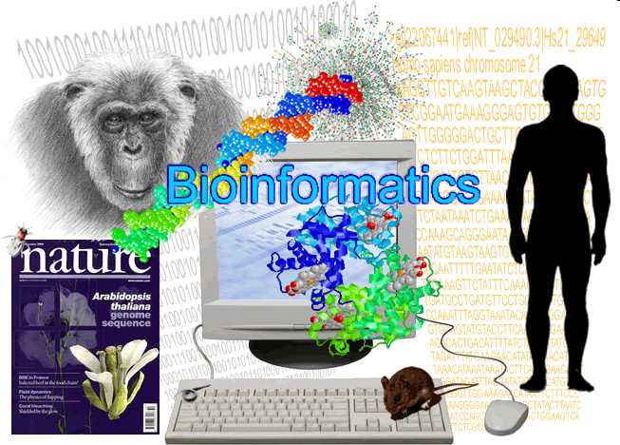
Information in the omics era
Massive quantities of information (not necessarily “big data”)
Open-access
For this information to be accessible it must be properly stored.
Access to information
  Must be fast
  Must be flexible
This has been made possible
  Creating databases
  Distributing them through the web
Notes:
<número>
Click to add Notes

Slide 3
Biological Databases
Definition: libraries of life sciences information, collected from scientific experiments, published literature, high-throughput experiment technology and computational analysis
What are they for?
  Storage of information
  Data organization
  Access information
  Knowledge discovery
There are many different general and specialized databases.
  Large list published yearly in NAR : 16371641 in 20201!
          https://www.oxfordjournals.org/nar/database/c/
          https://academic.oup.com/nar/article/49/D1/D1/6059975
Notes:
Obrir cataleg NAR I veure descripcio d’algunes bases de dades per categoria

Slide 4
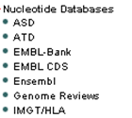
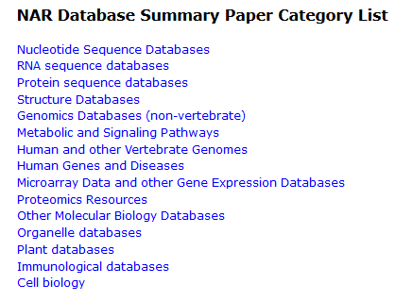
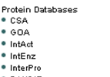
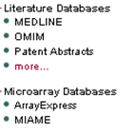
Biological Databases

Slide 5
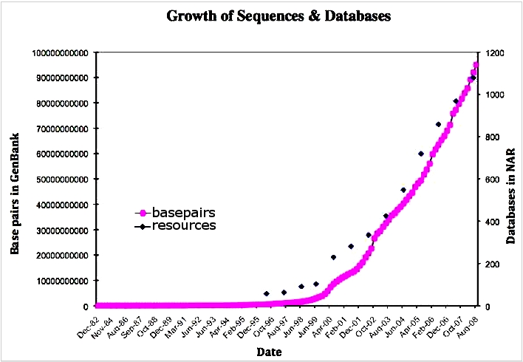

Challenges
This large number of databases, though extremely useful, can lead to its own issues of redundancy and lack of integration.
Lathe et al, Nature 2008
Structure/Integrate information
Annotation and Curation
Centralize data management
Notes:
<número>
-

Slide 6
I. Structuring and Integrating the information

Slide 7
Integrating the information
Primary databases:
  often hold only one type of specific data which is stored in their own archive.
  upload new data from experiments and update entries
Secondary databases:
  use other databases as their source of information.
  often already process or analyze the data to get new results.
Sources
Sources
Sources
Database
Database
Database
Secondary Database
Web Access
Different formats and models for structuring the data
Notes:
Normalment accedirem a la informació a través de bases de dades secundaries o portals web que presenten dades de varies bases de dades de manera integrada
Pero convé coneixer de quines fonts primaries es nodreix
Moltes d'aquestes bases secundaries a mes proporcionen diferentes eines per analitzar/visualitzar les dades

Slide 8
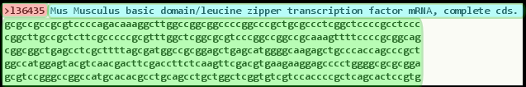
Integrating the information
The quality of the information in a database is closely related to its structure
This aspect is also crucial for its efficiency and accessibility.
There are many different types of file formats depending on the type of information they contain / source of data
Most are based on the flat-file format (text file)
FASTA format (sequences)
Identifier
Description
sequence

Slide 9
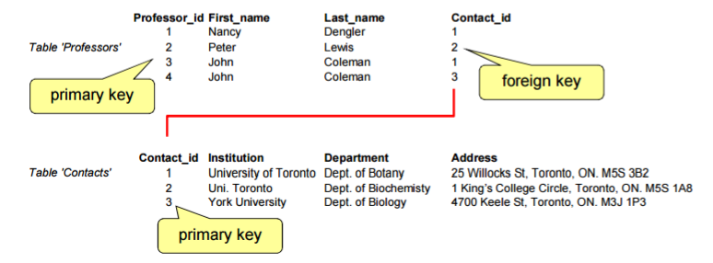
Integrating the information
Different models exist to relate/integrate the information (Relational, Hierarchical, Networks...).
Most common model: Relational databases
  flat-file format (text file)
  Many tables linked to each other: cross-referencing through a key (common) field (unique identifier)

Slide 10
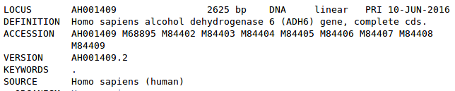
Integrating the information
In many databases an entry can be identified in 2 (ore more!) different ways:
  Identifier ("locus" in GenBank, "entry name" in UniProt): is a string of letters and digits. May change if the database curators decide that is no longer appropriate.
  Accession code (number): is a number (possibly with a few characters in front) that uniquely identifies an entry in its database. It is supposed to be stable.
  Versions and Gene Indices: The same accession number may be associated with a different GI if a newer or corrected sequence is submitted.
Example: human gene ADH6
GenBank
UniProt

Slide 11
II. Data Annotation and Curation

Slide 12
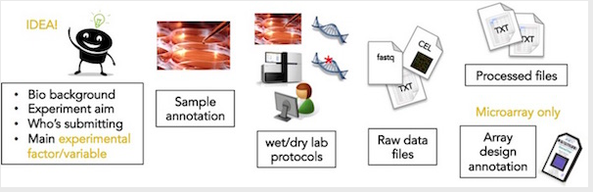
Data Annotation
Different levels of annotation
  Data: annotation of sequences/genomes (chromosome position, gene function, …)
  Metadata: information for an experiment, identification of samples, …
Collaborative efforts to provide as much information about the data
The Minimum Information Standard is a set of guidelines for reporting data
MIAME (Minimum Information About a Microarray Experiment)
Source: https://www.ebi.ac.uk/arrayexpress/submit/overview.html
Benefits:
  Ensures the verification, interpretation and reproducibility of data
  Facilitates the creation of structured databases and development of analysis

Slide 13
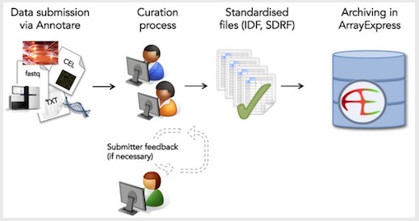
Data Curation
It involves annotation, publication and presentation of the data such that the value of the data is maintained over time, and the data remains available for reuse and preservation.
May be done by database experts or experts of the scientific community.
Source: https://www.ebi.ac.uk/arrayexpress/submit/overview.html

Slide 14
III. Centralizing data management

Slide 15
Centralizing data management
General
  Resource providers
Subject-specific
  Collaborative projects
  Multi-omics repositories
  Genomic Browsers
Integration
Tools
Curation

Slide 16



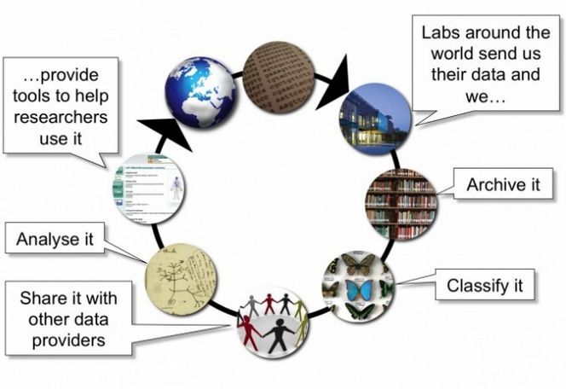
Resource providers
Big organizations that act as hubs that provide transparent access to data sources.
Integration
Tools
Curation
Source: https://www.ebi.ac.uk
Notes:
Obrir les 2 primeres I veure com s’estructuren (databases, tools)

Slide 17
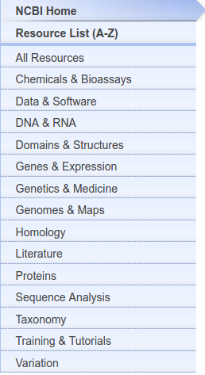
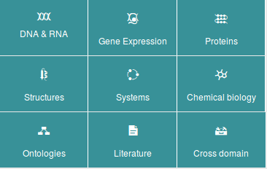
Resource providers
Provide integrated access to databases
Classification according to multiple criteria
Primary databases may be common or specific
Example: nucleotide DB are daily synchronized
NCBI
GenBank
International collaboration (INSDC)
EMBL-EBI
EMBL
NIG
DDBJ
Notes:
<número>

Slide 18
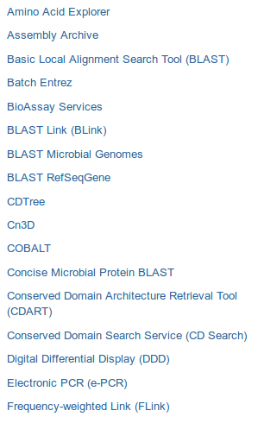
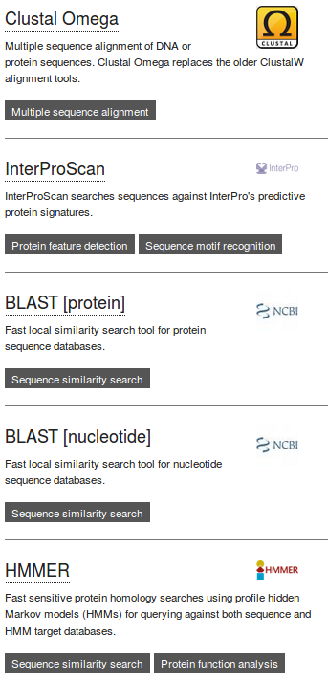
Resource providers
Provide a wide variety of data analysis tools that allow users to explore, manipulate, align, visualize and evaluate biological data.

Slide 19
Examples of Databases

Slide 20
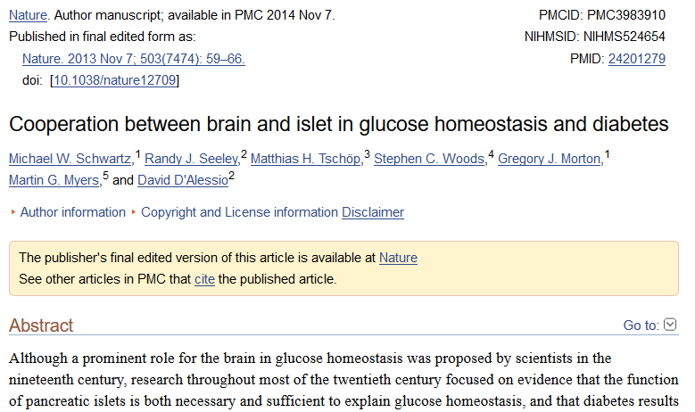
Examples of Databases
Literature DB
Contain different types of bibliographic information (articles, reviews, books, patents...). Not only peer-reviewed!
PubMed (NCBI): references and abstracts on life and biomedical sciences
Europe PMC (EBI-EMBL): a full-text literature database for life sciences
ArXiv: repository of electronic pre-prints after moderation
Patent databases (eg. EPO) can be accessed from EBI-search
Biocatalogue: provides a curated catalog of life-sciences web services

Slide 21
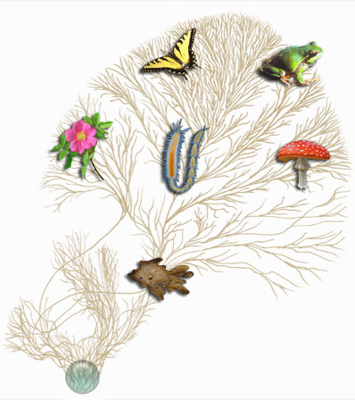
Examples of Databases
Taxonomic DB
Contain information about the classification of organisms, mainly from molecular data
Taxonomy DB: curated classification and nomenclature for all of the organisms in the public sequence databases.
This represents about 10% of described species

Slide 22
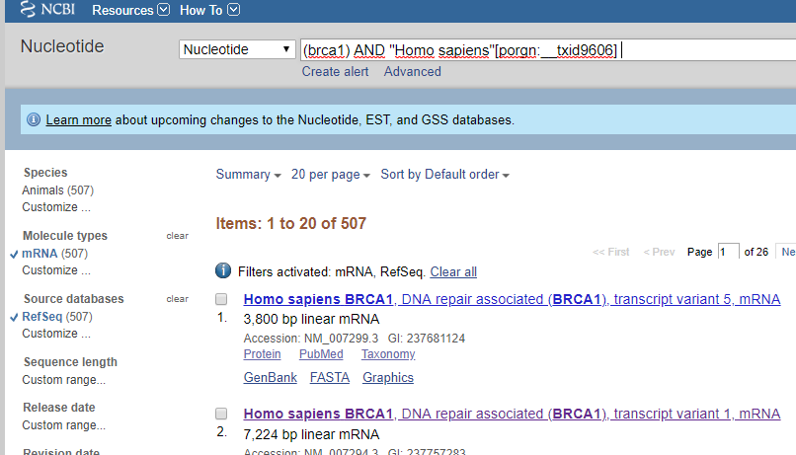
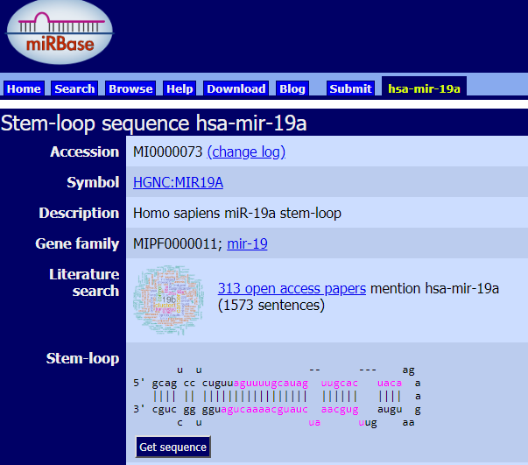
Examples of Databases
Nucleotide DB
Contain DNA / RNA (coding or non-coding) sequences from all organisms
Primary DB: GenBank (NCBI) / ENA (EMBL-EBI) / DDBJ (NIG)
RefSeq (NCBI) Project: maintains and curates a publicly available database of annotated genomic, transcript, and protein sequence records.
Nucleotide: collection from several DB (GenBank, RefSeq, TPA, PDB...)
miRBase: database of published miRNA sequences and annotation.

Slide 23
Examples of Databases
Protein DB
Contain data from protein sequences, structures. Predicted / experimental.
Protein (NCBI) / UniProtKB: collection of protein sequences from several sources:
  translations from annotated coding regions (GenBank, RefSeq.../TrEMBL)
  Records from SwissProt, PIR, PRF, and PDB.
InterPro: integrates information from protein family and domain DB like Pfam, PROSITE, CDD, ...
PDB: contains 3D structural data of large biological molecules (proteins, nucleic acids). Typically obtained by X-ray crystallography, NMR spectroscopy or cryo-electron microscopy.
IntAct: a curated DB of molecular interactions

Slide 24
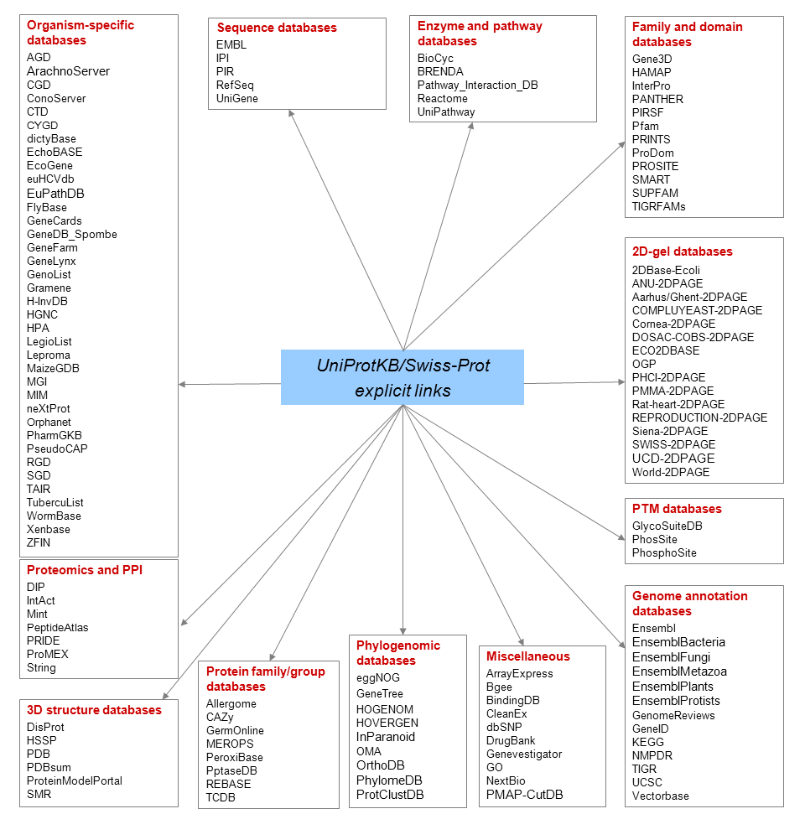
Examples of Databases
https://web.expasy.org/docs/userman.html

Slide 25
Practicum
To warm up...
Querying databases to answer biological questions
1- Using PubMed Advanced Search, look for a review paper published in Nature on colorectal cancer and authored by David SS
2- In the abstract, the authors mention a gene associated to the disease.
Find a well annotated mRNA sequence for this gene using the Nucleotide DB
3- Look for MUTYH human protein in UniProtKB
      Identify protein sequence, motifs and 3D structure
      With which proteins interacts according to IntAct DB?

Slide 26
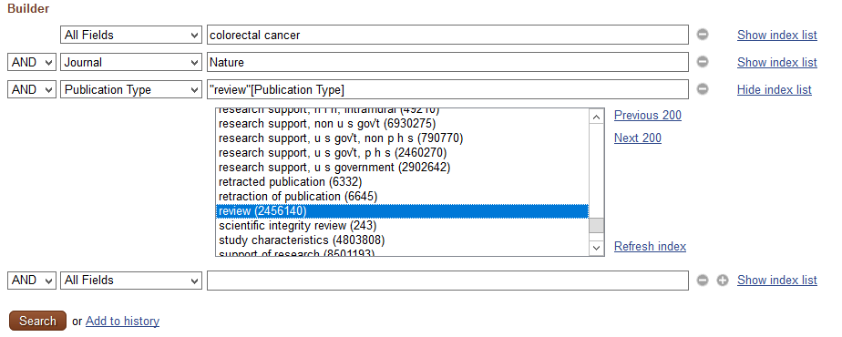
Practicum
1- Using PubMed Advanced Search, look for a review paper published in Nature on colorectal cancer and authored by David SS

Slide 27
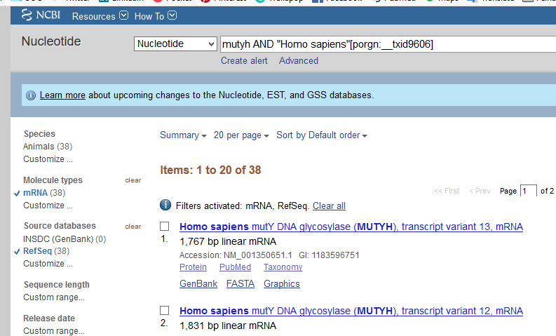
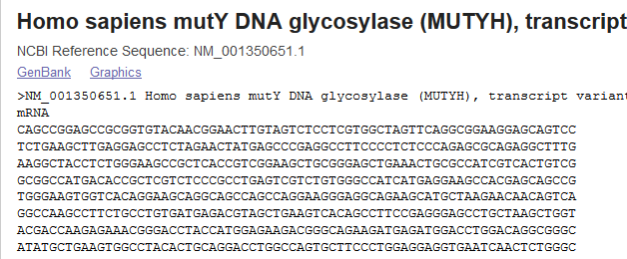
Practicum
2- In the abstract, the authors mention a gene associated to the disease.
Find a well annotated mRNA sequence for this gene using the Nucleotide DB
Using filters

Slide 28
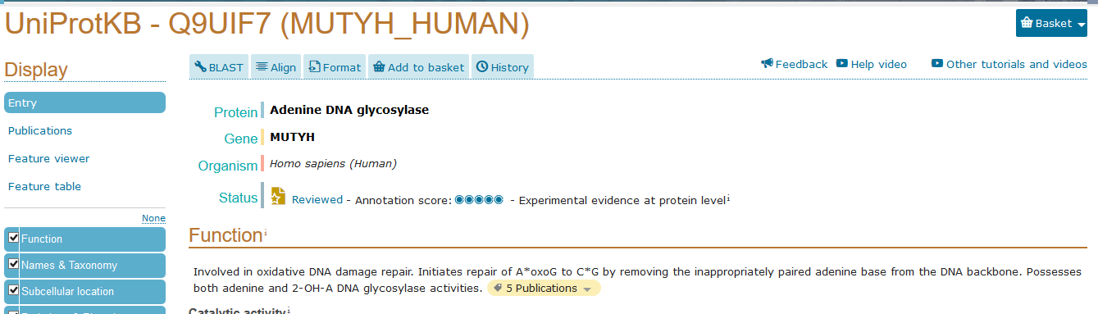
Practicum
3- Look for MUTYH human protein in UniProtKB
      Identify protein sequence, motifs and 3D structure
      With which proteins interacts according to IntAct DB?

Slide 29
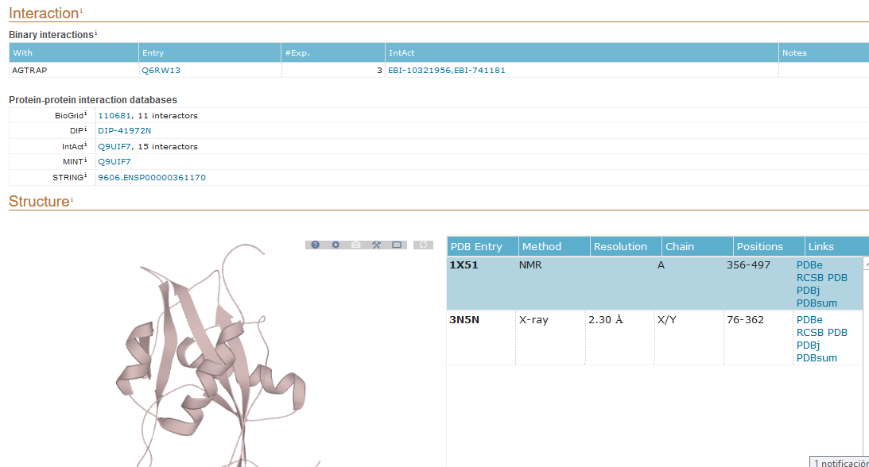
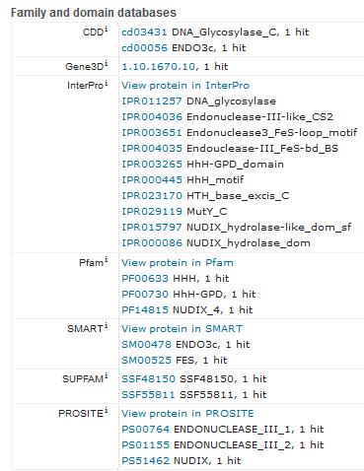
Practicum

Slide 30
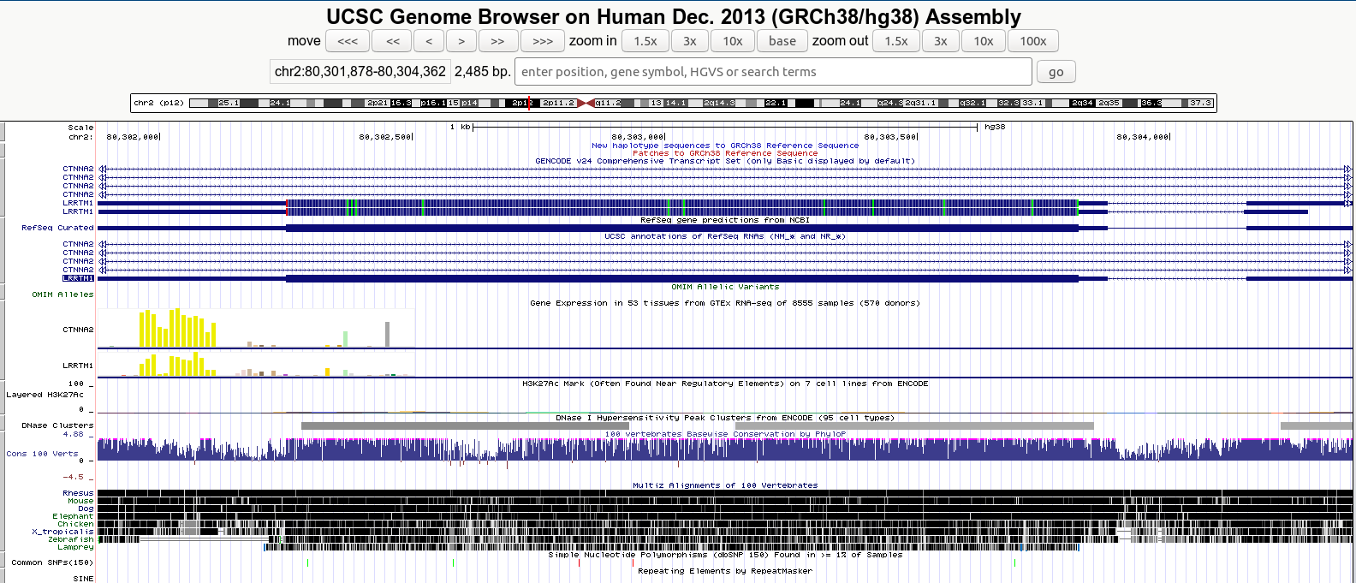
Examples of Databases
Genomic databases
Organize information on genomes including sequences, maps, chromosomes, assemblies, and annotations
Species-specific genome databases (eg. Mouse Genome Informatics)
Genome Browsers: provide tools for visualization and integrative genomic analysis
  NCBI Genome Data Viewer
  UCSC Genome Browser
  EBI's Ensembl

Slide 31
Examples of Databases
Gene Expression Databases
Contain gene expression data derived from microarray, next-generation sequencing, and other forms of high-throughput functional genomics data submitted by the research community
Gene Expression Omnibus (GEO) / ArrayExpress (EBI)
Sequence Read Archive (SRA): stores raw sequencing data and alignment information from high-throughput sequencing platforms
GTEx
Expression Atlas: provides gene expression results for different organisms, including metazoans and plants. Expression profiles of tissues from Human Protein Atlas, GTEx and FANTOM5, and of cancer cell lines from ENCODE, CCLE and Genentech projects can be explored.
Notes:
<número>

Slide 32
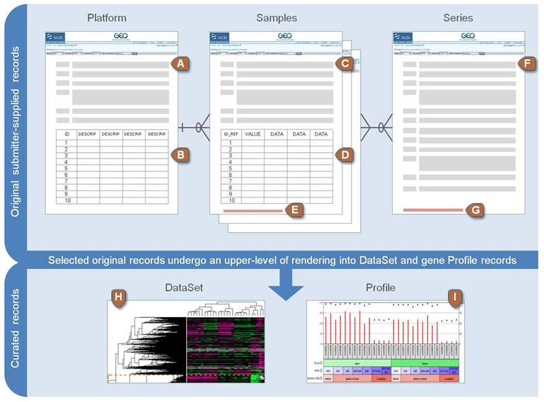




Practicum
Retrieving data from GEO
The Gene Expression Omnibus (GEO) is an international public repository that archives and freely distributes microarray, next-generation sequencing, and other forms of high-throughput functional genomics data submitted by the research community.
Data organization:
  Platform (GPLxxx)
  Samples (GSMxxx)
  Series (GSExxx)
  Datasets (curated) (GSDxxx)
  Profiles (curated)
See some examples

Slide 33
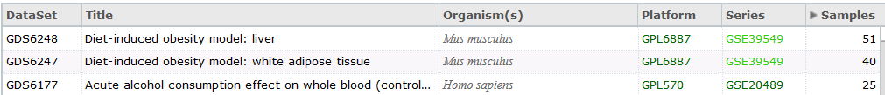
Practicum
Gene Expression Omnibus (GEO)
Queries can be performed for datasets or gene expression profiles
  GEO Datasets: stores original submitter-supplied study descriptions as well as curated gene expression DataSets.
      GEO Series (GSEXXX): original submitter-supplied record that summarizes a study
      GEO Datasets (GDSXXX): represents a collection of biologically- and statistically-comparable samples processed using the same platform.
  Example with GDS browser:

Slide 34
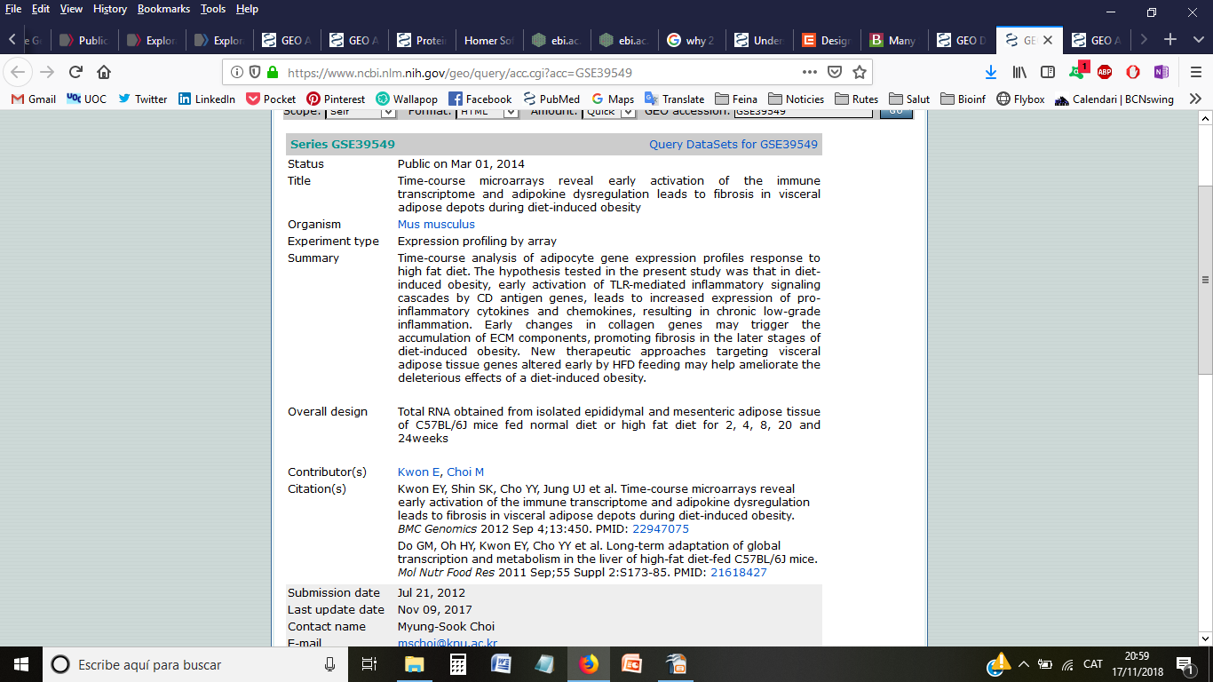
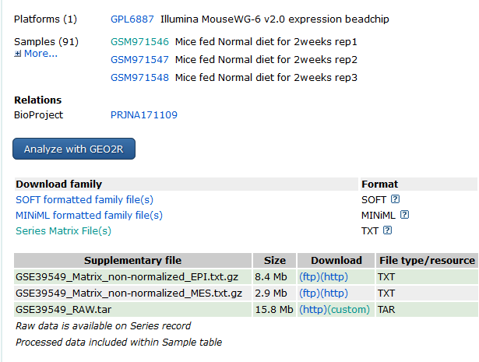
Practicum
Retrieving data from GEO
Study information
Platform used (data table with annotation of probes)
Samples
SOFT file can hold both data tables and descriptive information for multiple Platforms, Samples, and/or Series.
Series matrix with info for all samples and raw/processed data
Info on data files

Slide 35
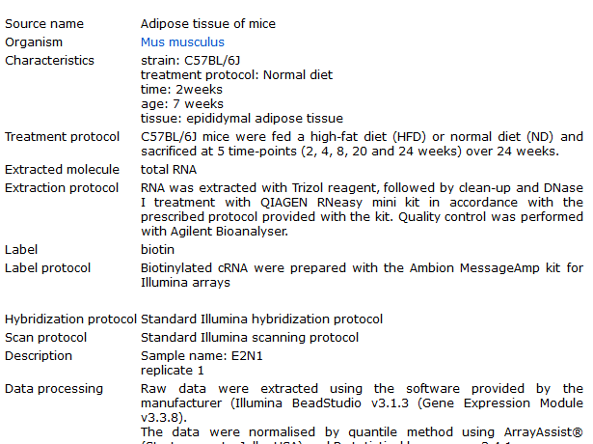
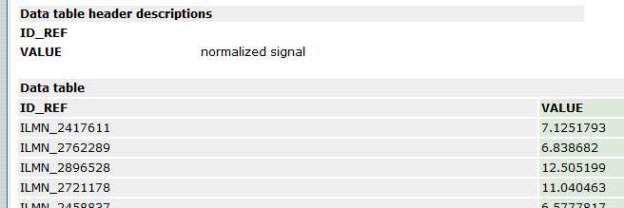
Practicum
Retrieving data from GEO
Sample specifications (identification, protocol, source...)
Data table with normalized expression values

Slide 36
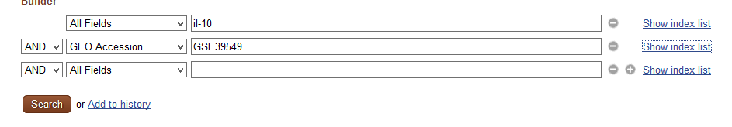
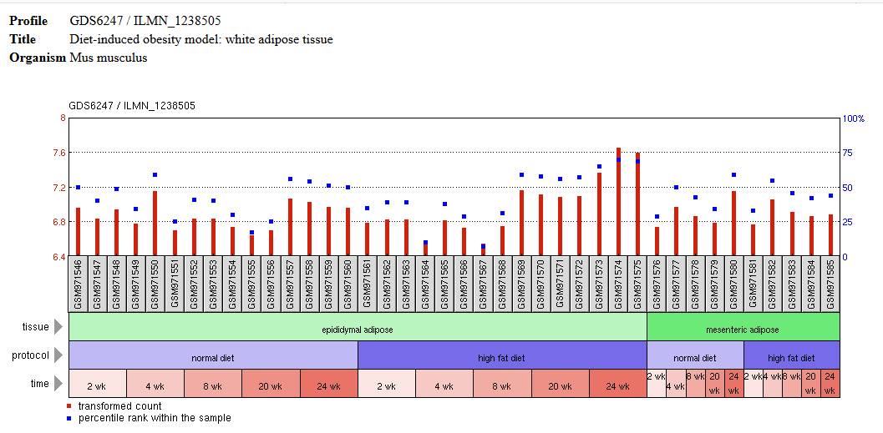
Practicum
Retrieving data from GEO
GEO Profiles: stores individual gene expression profiles from curated DataSets.
Example: search for expression profile of IL-10

Slide 37
Examples of Databases
Functional annotations
  Gene Ontology (GO): unify the representation of gene and gene product attributes across all species
  KEGG / Reactome: integrates genomic, chemical and systemic functional information
  Gene Cards
Terapeuthic targets
  Therapeutic targets database
  PharmGKB : pharmacogenomics (impact of genetics on drug response)
Disease-related
  DisGeNet: genes and variants associated to human diseases
  TCGA, COSMIC (Cancer)
Notes:
<número>

Slide 38
Examples of databases
And many more that can be found in / accessed from:
  Large list published yearly in NAR
  Journal-recommended repositories for publication (Nature)
  Resource providers portals (NCBI / EBI-EMBL)
  Integrative projects (disease-specific / organism-specific)
  Genome Browsers (genome-oriented)

Slide 39
Subject-specific repositories and collaborative projects

Slide 40
Subject-specific repositories
Collective initiatives: summing efforts from different researchers from different sites of the world.
Integrate different types of data (clinical, multi-omics,...) related to a specific subject (or sub-subject)
  A disease
  An organism
  A biological question, tissue, …
Provide curated, standardized, high-quality datasets for public research
  Raw and/or Processed data
Provide specialized visualization and analysis tools through their web sites

Slide 41
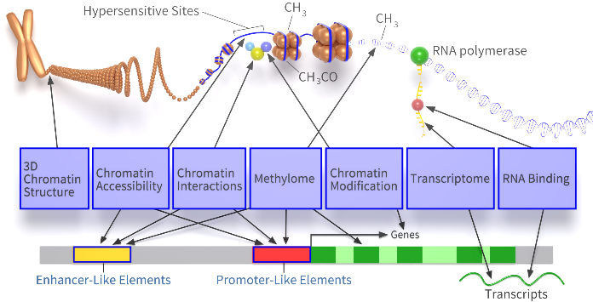
Subject-specific repositories
ENCODE
https://www.encodeproject.org/
The Encyclopedia of DNA Elements (ENCODE) Consortium is an ongoing international collaboration of research groups funded by the NHGRI.
Intended as a follow-up to the Human Genome Project, it aims to identify all functional elements in the human genome (genes, transcripts, miRNA, regulatory elements, etc) employing a variety of assays and methods.

Slide 42
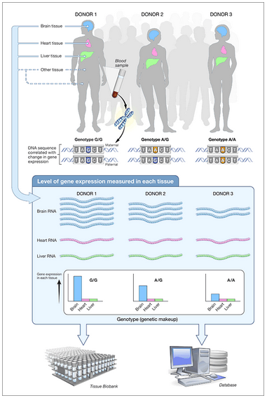
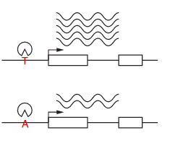
Subject-specific repositories
Genotype-Tissue Expression (GTEx) Project
https://gtexportal.org/home/
Aims to provide the scientific community with a public resource to study tissue-specific gene expression and regulation and its relationship to genetic variation across individuals.
On-going project
Samples from 53 non-diseased tissues across nearly 1000 individuals who were also densely genotyped.
Variations in gene expression that are highly correlated with genetic variation can be identified as expression quantitative trait loci, or eQTLs.

Slide 43
Subject-specific repositories
Genotype-Tissue Expression (GTEx) Project
https://gtexportal.org/home/
Types of data provided:
  Gene/transcript expression in tissues
  variants associated to gene expression (eQTLs and sQTLs)
  histology images
  Patient/sample metadata
Available datasets: https://www.gtexportal.org/home/datasets
Summary statistics: https://gtexportal.org/home/tissueSummaryPage

Slide 44
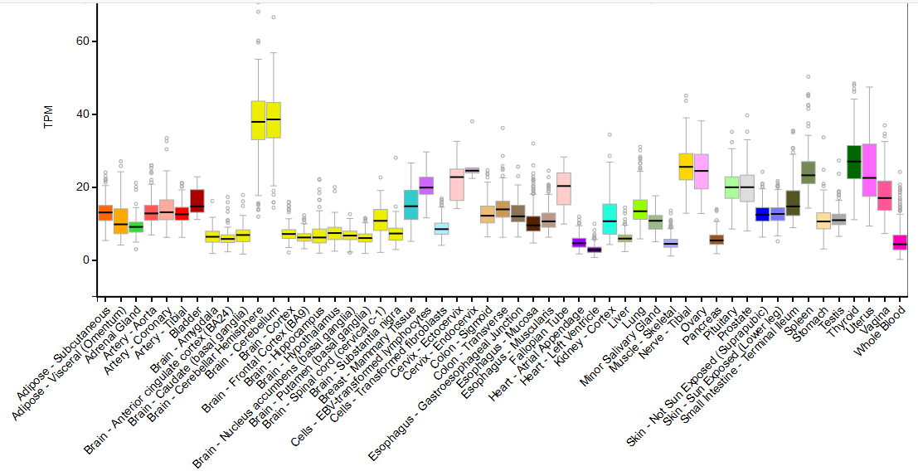
Subject-specific repositories
Genotype-Tissue Expression (GTEx) Project
Example: Normal tissue expression profile of mutyh gene

Slide 45
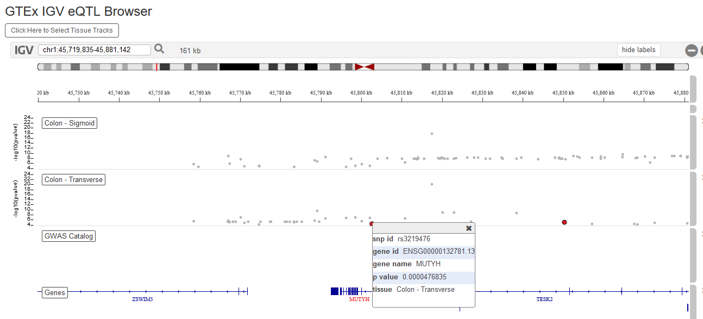
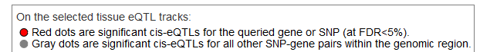
Subject-specific repositories
Genotype-Tissue Expression (GTEx) Project
Example: Looking for SNPs associated to changes in mutyh expression

Slide 46
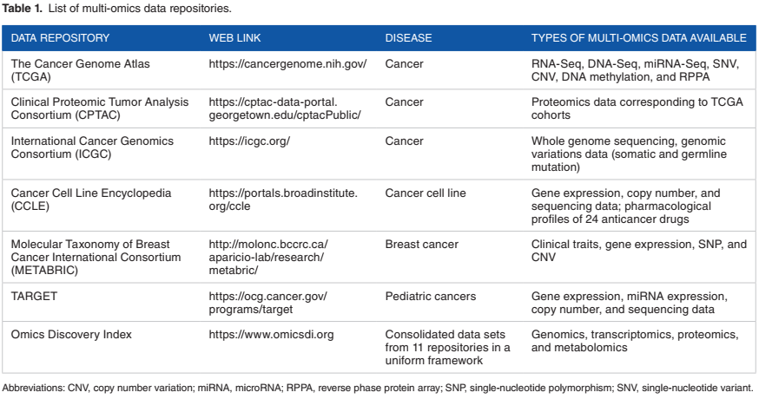
Subject-specific repositories
Examples
Disease-related multi-omics repositories (eg. cancer)
Source: Subramanian et al 2020, Bioinformatics and Biology Insights

Slide 47
Subject-specific repositories
The Cancer Genome Atlas (TCGA)
https://cancergenome.nih.gov/
Collaboration between the National Cancer Institute (NCI) and the National Human Genome Research Institute (NHGRI) that has generated comprehensive, multi-dimensional maps of the key genomic changes in 33 types of cancer.
High-quality tumor and matched normal samples from over 11,000 patients collected over 12 years (ended in 2015). The data collected includes:
  Clinical information about participants
  Metadata about the samples
  Histopathology slide images from sample portions
  Molecular information derived from the samples (e.g. mRNA/miRNA expression, protein expression, copy number, etc.)

Slide 48
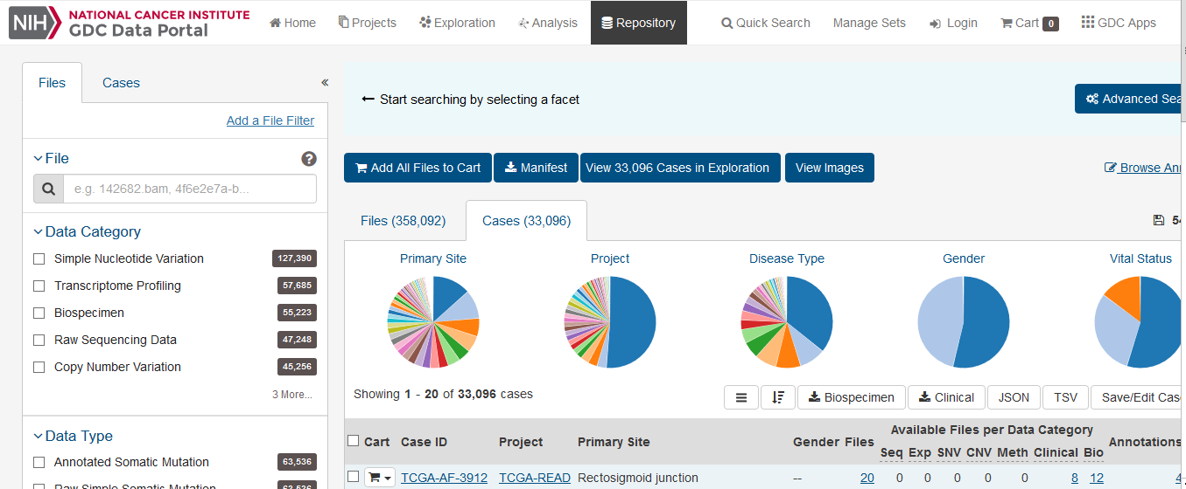
Subject-specific repositories
The Cancer Genome Atlas (TCGA)
https://cancergenome.nih.gov/
Data is available through the Genomic Data Commons (GDC) portal,
  receives, processes, and distributes genomic, clinical, and biospecimen data from cancer research programs
  Provides web-based analysis and visualization tools

Slide 49
Subject-specific repositories
The Cancer Genome Atlas (TCGA)
https://cancergenome.nih.gov/
Data in https://portal.gdc.cancer.gov/
To take into account when downloading data from the GDC/TCGA:
  Different procedures to process the data (workflows)
For documentation on procedures: https://docs.gdc.cancer.gov/
  Two available sources to download GDC data:
        GDC Legacy Archive: provides access to an unmodified copy of data that was previously stored in CGHub and in the TCGA Data Portal hosted by the TCGA Data Coordinating Center (DCC), in which uses as references GRCh37 (hg19) and GRCh36 (hg18).
        GDC harmonized database: data available was harmonized against GRCh38 (hg38) using GDC Bioinformatics Pipelines which provides methods to the standardization of biospecimen and clinical data.

Slide 50
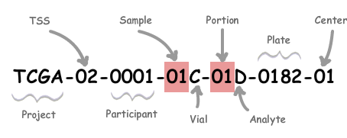
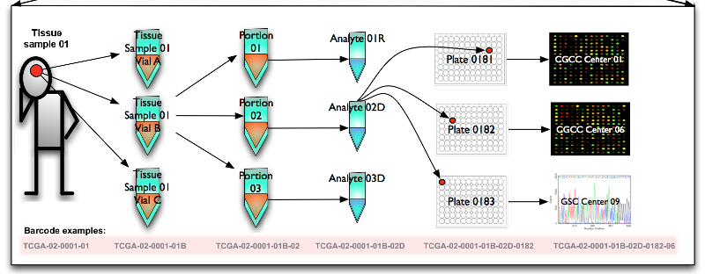
Subject-specific repositories
The Cancer Genome Atlas (TCGA)
https://cancergenome.nih.gov/
Data in https://portal.gdc.cancer.gov/
To take into account when downloading data from the GDC/TCGA:
  TCGA sample identification (barcode)

Slide 51
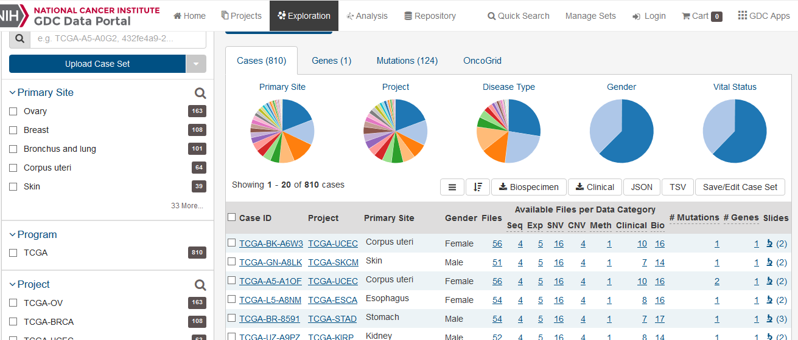
Subject-specific repositories
The Cancer Genome Atlas (TCGA)
Example: Retrieving known mutations in mutyh gene associated to colon cancer

Slide 52
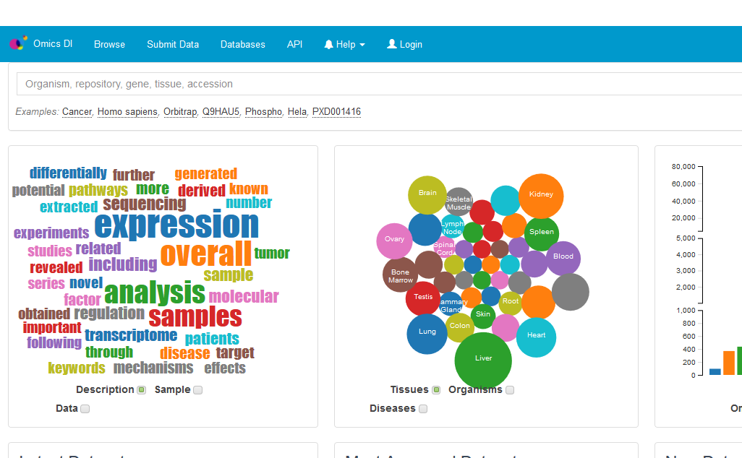
Subject-specific repositories
https://www.omicsdi.org/

Slide 53
Subject-specific repositories
Examples
Many other projects including
  1000 Genomes Project: the largest public catalogue of human variation and genotype data.
  Human Cell Atlas: aims to create comprehensive reference maps of all human cells
  NIH Roadmap Epigenomics Mapping Consortium: public resource of human epigenomic data

Slide 54
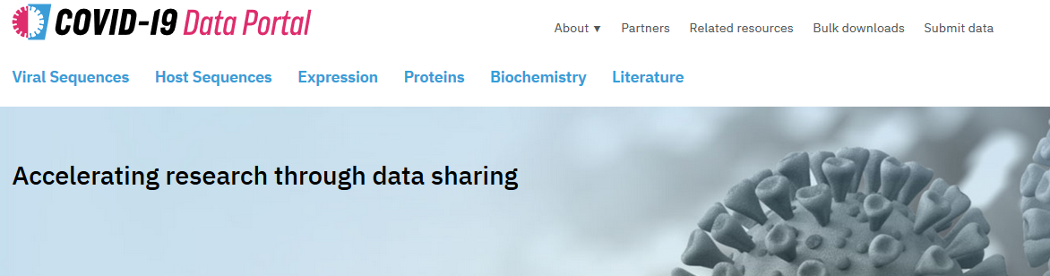
Subject-specific repositories
Examples
  COVID-19 has put a spotlight on open science and open repositories to improve the discovery and access to research outputs.
  Many repositories initiatives arised to act as central hub for data management
  Challenges related to:
      copyright, embargoes and licenses attached to resources
      metadata and data curation
      Infrastructure and connectivity

Slide 55
Subject-specific repositories
Not all is human! Model organisms-based resources:
Organism | Scientific name | Database (link)
Baker's yeast | Saccharomyces cerevisiae | Saccharomyces Genome Database
Fission yeast | Schizosaccharomyces pombe | PomBase
Clawed frog | Xenopus | Xenbase
Fruitfly | Drosophila melanogaster | FlyBase
Mouse | Mus musculus | Mouse Genome Informatics
Nematode | Caenorhabditis elegans | WormBase
Rat | Rattus norvegicus | Rat Genome Database
Social amoeba | Dictyostelium discoideum | DictyBase
Thale cress | Arabidopsis thaliana | The Arabidopsis Information Resource
Maize | Zea mays ssp. mays | MaizeGDB
Zebrafish | Danio rerio | Zebrafish Information Network
Yeast | Candida albicans | CGD
Bacteria | Escherichia coli | EcoCyc
Source: Wikipedia

Slide 56
Tools for exploiting database information

Slide 57
Tools
What are they for?
  Search of information (eg. Entrez)
  Finding/comparing sequences (eg. BLAST)
  Data exploration and visualization (eg. Genome Browsers)
  Manipulating and analyzing data
  Make predictions
  Knowledge discovery (data mining)
  Downloading/Exporting data
Can be accessed through
  Web interface from resource providers, databases, projects or subject-specific repositories
  Software (eg. R, Cytoscape)
  Platforms (eg. Galaxy)

Slide 58
Tools

Slide 59
Tools
The Entrez Search and Retrieval System
Text-based search and retrieval system used at NCBI for all of its major databases
All databases indexed by Entrez can be searched via a single query string. This returns a unified results page, that shows the number of hits for the search in each of the databases, which are also links to actual search results for that particular database.
Supports boolean operators (AND, OR, NOT, “”, *)
Use tags to limit parts of the search statement to particular fields.
Start with a general query and refine it progressively using Filters/Limits
For individual databases, the Advanced Search and Limits pages assist greatly in the construction of complex queries.

Slide 60
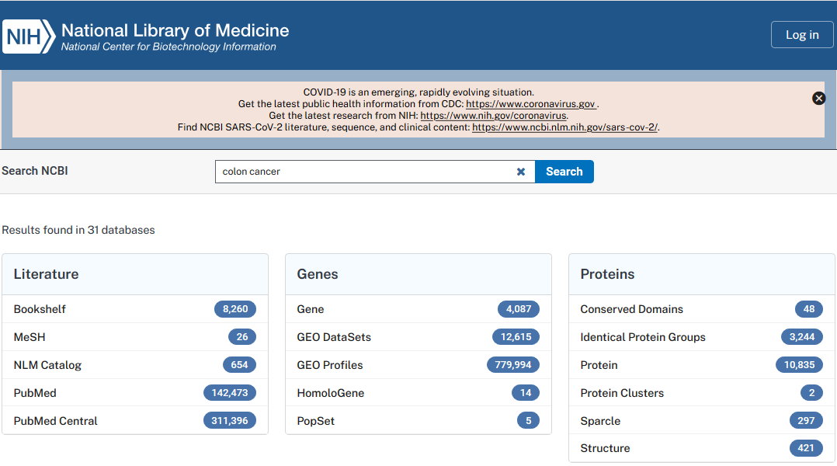
Practicum
Example of database cross-search with Entrez

Slide 61

Tools
https://www.ensembl.org/info/docs/tools/index.html

Slide 62

Tools
https://bioconductor.org/packages/3.12/BiocViews.html#___FunctionalGenomics

Slide 63

Tools
https://usegalaxy.eu/

Slide 64

Tools
https://apps.cytoscape.org/apps/

Slide 65
Genome Browsers

Slide 66


Genome Browsers
The advent of the Human Genome Project and subsequent projects to sequence genomes of other species and multiple individuals has driven the need for tools that can visualize vast amounts of genomics data.
Genome Browsers bring together information from multiple resources, using the genome as a base for this annotation.
Provide a graphic interface for visualization and integrative genomics analyses.

Slide 67
Genome Browsers
A wealth of biological data can be viewed, downloaded and compared:
  Genes
    Genomic location
    Gene model structures: exons, introns, UTRs
    Transcripts: mRNA, splice variants, pseudogenes, non-coding RNA,...
    Protein(s)
    Links to other sources of information
  Cytogenetic bands
  Polymorphic markers
  Genetic variation: SNPs, deletions/insertions, short tandem repeats,...
  Repetitive sequences
  Expressed Sequence Tags (ESTs)
  cDNAs or mRNAs from related species
  Regions of sequence homology

Slide 68
Genome Browsers
Popular Genome Browsers:
    NCBI Genome Data Viewer
    EBI's Ensembl
    UCSC Genome Browser

Slide 69
Genome Browsers
Important concepts to be aware of:
  Genome of reference
        A reference genome (also known as a reference assembly) is a digital nucleic acid sequence database, assembled by scientists as a representative example of the set of genes in one idealized individual organism of a species.
        Reference genomes are typically used as a guide on which new genomes are built, enabling them to be assembled much more quickly and cheaply than the initial Human Genome Project.
        The reference provides a good approximation of the DNA of any single individual. But in regions with high allelic diversity the reference genome may differ significantly from other individuals
            sets of alternate loci are assembled alongside the reference locus
        There are reference genomes for multiple species of viruses, bacteria, fungus, plants, and animals.

Slide 70
Genome Browsers
Important concepts to be aware of:
  Genome of reference
        The Genome Reference Consortium (GRC) is a collaborative effort between different institutes charged to maintain and improve reference genomes for human and some model organisms (mouse, zebrafish and chicken)
        New assemblies are released every X years integrating improvements in sequence
              closing gaps
              fixing misrepresentations in the sequence
              correcting sequences
        The coordinates of your favorite gene in one assembly may not be the same as those in the next release of the assembly!
              Always be aware of which version you are using
              NCBI provides a Genome Remapping Service

Slide 71


Genome Browsers
Important concepts to be aware of:
  Genome of reference
        To date, the major assembly releases for human, mouse, zebrafish, and chicken are GRCh38, GRCm38, GRCz11, and GRCg6a, respectively.
        There are "minor" assembly updates in the form of genome patches which either correct errors in the assembly or add additional alternate loci without changing chromosome coordinates. (e.g. GRCh37.p1).
        The assembly accession.version is an unambiguous identifier for the assembly and should always be included in publications.
For human:
For mouse:

Slide 72

Genome Browsers
Important concepts to be aware of:
  Genome of reference (assembly version)
  Genomic coordinate systems:
      base coordinate system: the first nucleotide counts as position 1
      interbase coordinate system: the first nucleotide counts as position 0
            allows to represent features that occur between nucleotides (like a splice site)
            simpler arithmetic for computing the length of features (length=end-start)
            more rational conversion of coordinates from the + to the - strand
→ TCGA is 2-5 (both start and end included)
→ TCGA is 1-5 (start included, end excluded)

Slide 73

Genome Browsers

Slide 74

Genome Browsers
Important concepts to be aware of:
  Genome of reference (assembly version)
  Genomic coordinate systems:
        Most genome annotation portals (e.g. NCBI or Ensembl), bioinformatics software (e.g. BLAST) and annotation file formats (e.g. GFF, BED) use the base coordinate system
        The UCSC genome browser uses both systems:
            the base coordinate system (1-based, fully-closed) is used in the UCSC genome browser display
            the interbase coordinate (0-based, half-open) is used in their tools and file formats

Slide 75
Genome Browsers
Popular Genome Browsers:
  NCBI Genome Data Viewer
  EBI's Ensembl
  UCSC Genome Browser
Similar though may differ in:
  Presentation
  Species represented
  Source of annotations / links to other resources
  Tools

Slide 76
Genome Browsers
Ensembl
https://www.ensembl.org/index.html
The project began in 1999, with the completion of the HGP, as a joint project between the EMBL-EBI and the Sanger Centre (now all moved to the EMBL-EBI).
As of Ensembl release 100 (April 2020), over 250 species are supported (mainly vertebrate species)
Sister project: EnsemblGenomes for non-chordates
  Since its establishment in 2009, the resource has grown rapidly and now contains over 1,400 eukaryotic and 44,000 prokaryotic genomes.
Genome assemblies are retrieved from other institutes/consortia (eg. NCBI for human, mouse genomes)

Slide 77
Genome Browsers
Ensembl
https://www.ensembl.org/index.html
There are a number of ways to access Ensembl data:
  From the website
  Using BioMart tool to quickly obtain tables of gene information
  Programmatically

Slide 78

Genome Browsers
Ensembl
https://www.ensembl.org/index.html

Slide 79

Genome Browsers
Ensembl
https://www.ensembl.org/index.html
The navigation of the Ensembl website is organised into tabs, or main pages. The location, gene, transcript, variant and regulation tabs allow data browsing at that level.
The available annotations (tracks) to be displayed are configured through the 'Configure this page' button

Slide 80

Genome Browsers
Ensembl
https://www.ensembl.org/index.html
The location tab’s main display is the ‘region in detail’, which shows a region of the genome up to 1 Mb long in a highly customisable view

Slide 81


Genome Browsers
Ensembl
https://www.ensembl.org/index.html
BioMart tool allows to:
  Search and quickly generate tables of information.
  Export data in different formats (FASTA, html, csv, tsv, xls ...)
  ‘Translate’ one ID type into another (eg. an Ensembl gene ID to an NCBI RefSeqID)
  Also in R! (see biomaRt Bioconductor's package )

Slide 82

Genome Browsers
Ensembl
https://www.ensembl.org/index.html
Other tools:

Slide 83
Genome Browsers
Ensembl
https://www.ensembl.org/index.html
Resources for training:
  Free Online EMBL course on using Ensembl genome browser
  Free Online EMBL course on using EnsemblGenomes

Slide 84
Genome Browsers
UCSC Genome Browser
https://genome.ucsc.edu/
Developed and maintained by the Genome Bioinformatics Group, within the UCSC Genomics Institute.
It began as a resource for the distribution of the initial fruits of the Human Genome Project. Funded by the Howard Hughes Medical Institute and the NHGRI, the browser offered a graphical display of the first full-chromosome draft assembly of human genome sequence.
In the ensuing years, the website has grown to include a broad collection of vertebrate and model organism assemblies and annotations, along with a large suite of tools for viewing, analyzing and downloading data.

Slide 85

Genome Browsers
UCSC Genome Browser
https://genome.ucsc.edu/

Slide 86


Genome Browsers
UCSC Genome Browser
https://genome.ucsc.edu/
Different search options:
  By gene/transcript/protein name, symbol or ID: LRRTM1
  By Chromosome number or region: chr11:1038475-1075482
  By Keywords: kinase, receptor
  By sequence (BLAT tool)
  By track type (Track search)

Slide 87

Genome Browsers
UCSC Genome Browser
https://genome.ucsc.edu/
Multiple results depending on available annotations:
  UCSC Genes
  RefSeq Genes
  Non-human RefSeq Genes: orthologs of the gene in other species
  ENCODE Gencode
  Human mRNA: annotated
  transcripts of the gene

Slide 88
Genome Browsers
Visualizing results: Genome Viewer and Tracks settings
Genomic location is shown along with data annotations that link out to additional data and databases.
Tracks info and options

Slide 89

Genome Viewer
Tracks (data type)
Mapping and Sequencing Tracks
Phenotype and Disease Tracks
Genes and Gene Prediction Tracks
(including sno/miRNA data)
mRNA and EST Tracks
Expression (such as microarray)
Regulation (including TFBS)
Comparative Genomics
As a group
Individual species
Variation and Repeats
(including SNPs, copy number variation)

Slide 90



Genome Browsers
Change your view or location with controls at the top
Click on items to view details in new window or
right click items to get details
Change track display modes:
  - Tip: Hide all and then select specific tracks to visualize so you don't get lost
Source of information
Refresh!
Display modes:
Hide=don’t show
Dense=features collapsed into a single line
Squish, Pack, Full=features in different lines

Slide 91

Genome Browsers
Some visual clues:
exon
< < <
exon
<
exon
< < < <
ex
3' UTR
5' UTR
Intron and direction of transcription <<< or >>>
Sequence conservation
height of a blue bar is increased likelihood of conservation,
red indicates a likelihood of faster-evolving regions
Alignment indications (Conservation pairs: “chain” or “net” style)
  Alignments = boxes, Gaps = lines
Tick marks; a single location (STS, SNP)

Slide 92
Practicum
Retrieving information with the UCSC Genome Browser
https://genome.ucsc.edu/
1. What is the genomic localization of human lrrtm1 gene?
-chromosome:
-position:
-strand:
2. Which genes are in the neighbourhood of this gene?
3. How many exons has the gene?
4. How many different transcripts do we know of this genomic region?
5. Can you find SNPs in this gene?
6. In which tissue is this gene mainly expressed?
7. Does the protein encoded by this gene have a transmembrane domain?
8. Has this gene an ortholog in mouse?
9. Use the CDS of human lrrtm1 gene to localize this gene in mouse genome. (Use BLAT)

Slide 93

Practicum
1. What is the genomic localization of human lrrtm1 gene?
- Click on the gene to see the information
2. Which genes are in the neighborhood of this gene?
- Zoom out in genome viewer
3. How many exons has the gene? 2
- Place the mouse on the gene
- Or: click on RefSeq link to open in NCBI-GenBank
- Or: TableBrowser

Slide 94


Practicum
4. How many different transcripts do we know of this genomic region? 5
- Use Genome Viewer or Table Browser for more detailed information
5. Can you find SNPs in this gene? yes
- Set display mode of track “Variation” > “SNPs” to ON
6. In which tissue is this gene mainly expressed? brain
- Info in track “Expression” > “GTEx”

Slide 95


Practicum
7. Does the protein encoded by this gene have a transmembrane domain?
- Set display mode of track “Gene and Gene Predictions” > “UniProt” to “pack”
8. Has this gene an ortholog in mouse? yes
- Set display mode of track “Gene and Gene Predictions” > “Other RefSeq” to “pack”

Slide 96


Practicum
9. Use the CDS of human lrrtm1 gene to localize this gene in mouse genome. (Use BLAT)
- Get the CDS sequence of human gene:
- Use BLAT to align this sequence on Mouse genome:

Slide 97


Practicum
- Visualize entry with highest score

Slide 98

Genome Browsers
UCSC Genome Browser
https://genome.ucsc.edu/
Table Browser tool allows to:
    Search for genes and annotation
    Combine queries on multiple tables or tracks
    Display basic statistics over a dataset
    Output to results table in convenient format
    Retrieve sequences
    Export to external resources

Slide 99

Practicum
Retrieving information with the UCSC Genome Browser
https://genome.ucsc.edu/
10. Use the Table Browser to get the list of SNPs in your region

Slide 100
Summary
Databases
  data collections
  many types and diverse information
For information to be accessible / useful it must be
  Structured
  Annotated
Resource Providers
  centers or organizations specialized in storing and maintaining databases
  centralize data management

Slide 101
Summary
General
  Resource providers
Subject-specific
  Collaborative projects
  Multi-omics repositories
Bioinformatics tools for exploiting database information
  Queries and access to data
  Genomic Browsers
Integration
Tools
Curation

Slide 102

Final considerations
Keeping informed about what you are seeing ensures correct interpretation of results
  type of information (mRNA, gene, protein, SNP...)
  source of information (curated, experimental, predicted, annotation, database)
  specific tutorials: a good beginning
Don't get overwhelmed: make specific queries, filter output
When using data for drawing conclusions, appropriate controls may be used that make confidence of your search
  scores of confidence
  contrast information

