Slide 1








Introduction to Bioinformatics
Mireia Ferrer¹, Álex Sánchez^{1,2}, Esther Camacho¹, Angel Blanco^{1,2}, Berta Miró¹
¹ Unitat d’Estadística i Bioinformàtica (UEB) VHIR
² Departament de Genètica Microbiologia i Estadística, UB
Notes:
<número>

Slide 2
We are drowning in information and starved for knowledge
John Naisbitt
Who on efficient work is bent,
Must choose the fittest instrument.
Goehthe (Fausto)

Slide 3
What is Bioinformatics?

Slide 4
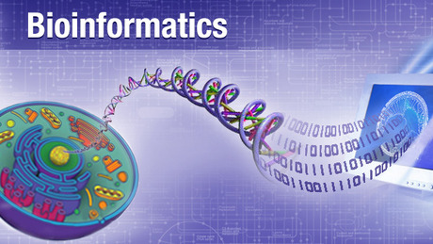
A (first) definition
Bioinformatics is the application of computer technology to the management of biological information.
Computers are used to gather, store, analyze and integrate biological information.
19/11/18

Slide 5
A historical approach
The term appeared in the 70’s
It became popular/important with the development of the human genome project
Bioinformatics is entering a big data era that will foster new possibilities.

Slide 6
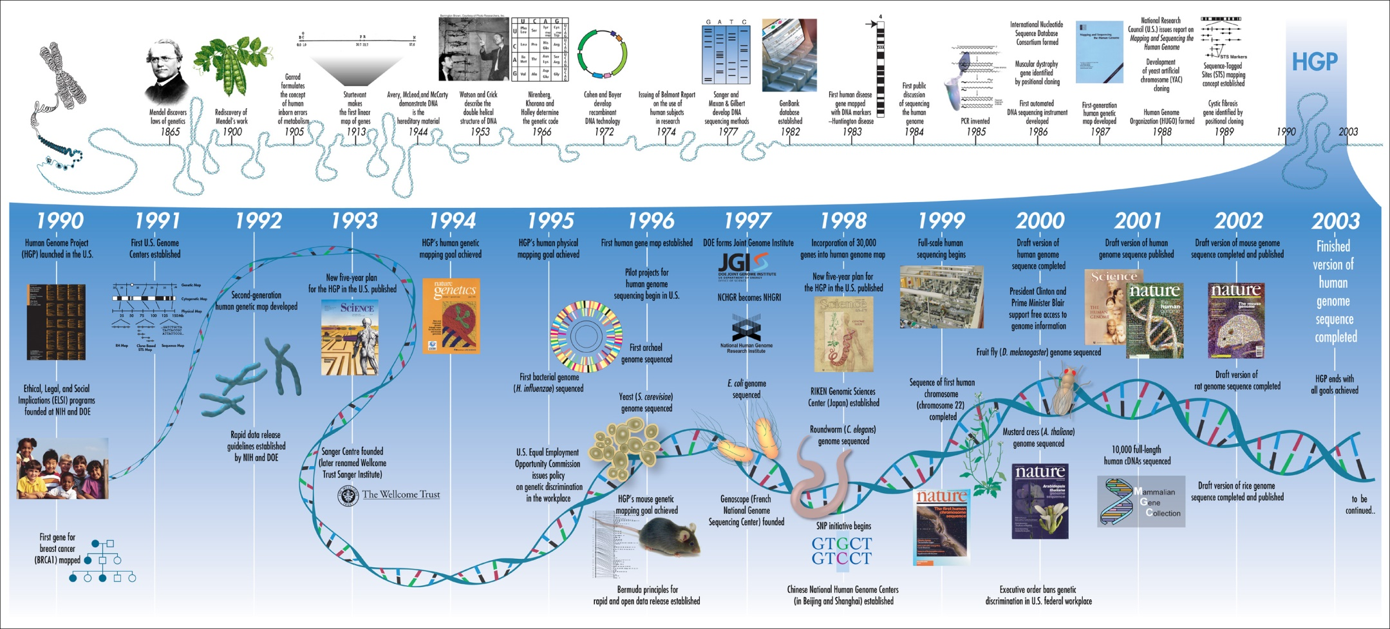
The Human Genome Project

Slide 7
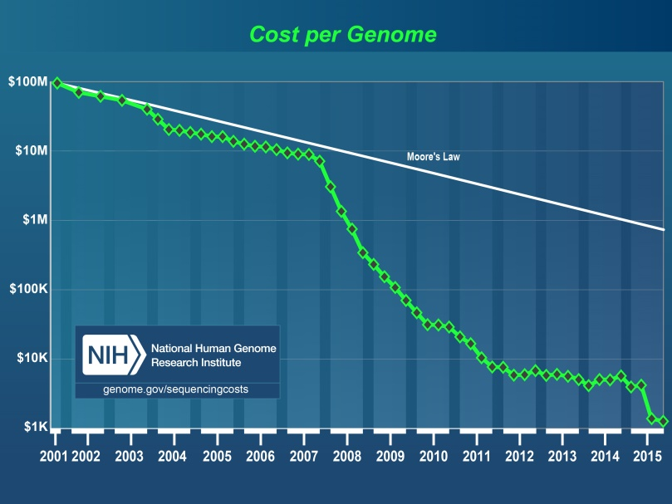
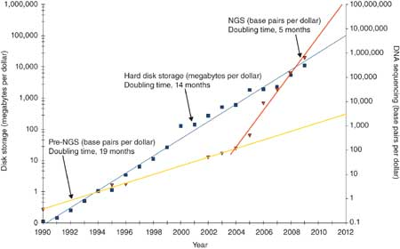
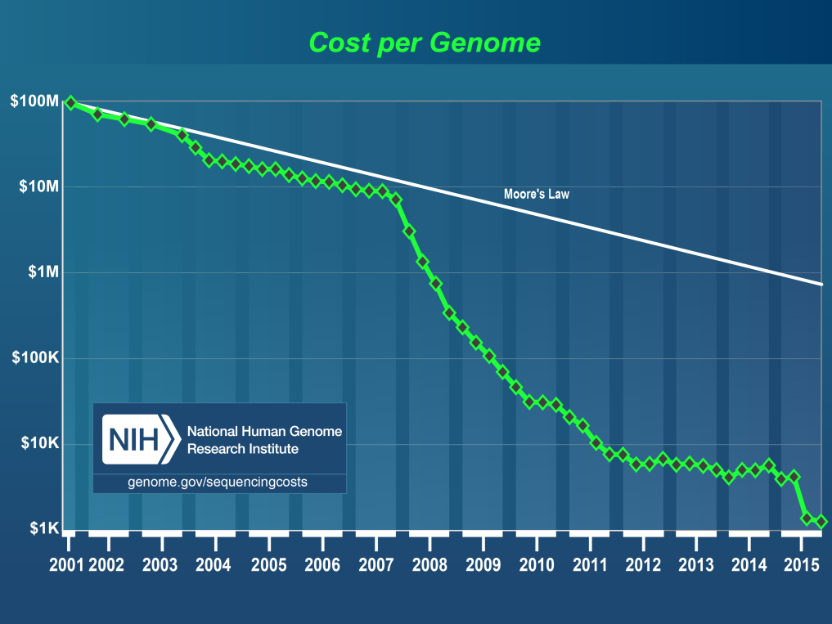
“Nextgen” sequencing revolution

Slide 8
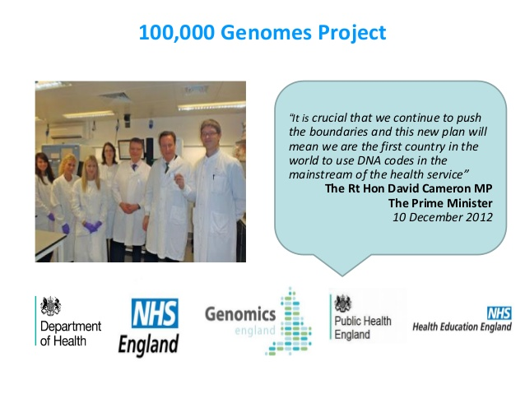
New paradigm shift: Precision Medicine
19/11/18

Slide 9
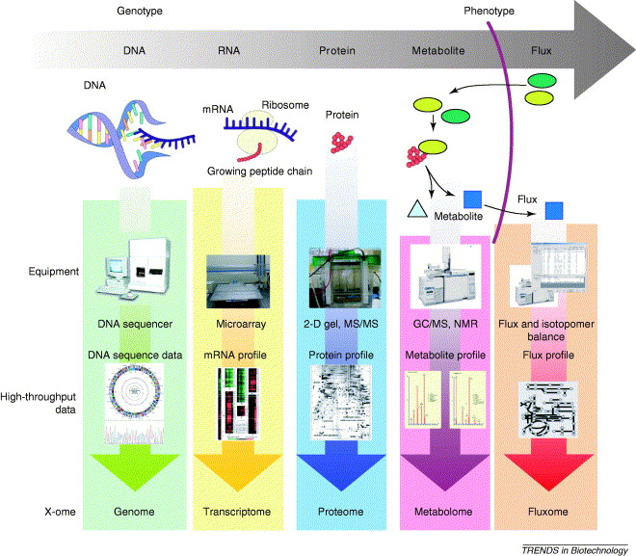
Omics technologies

Slide 10
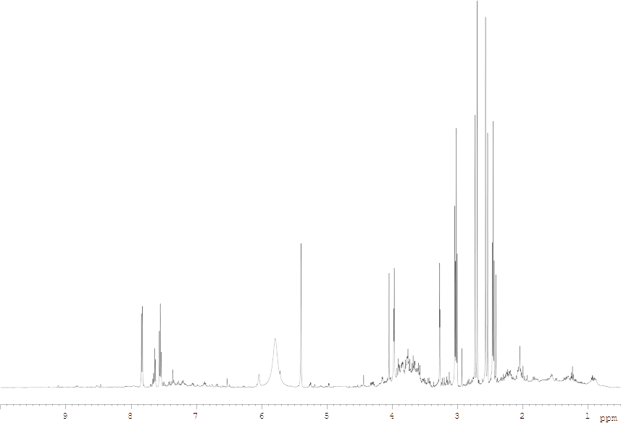

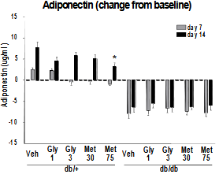

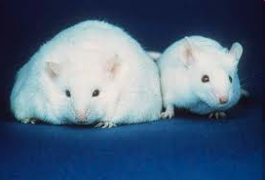
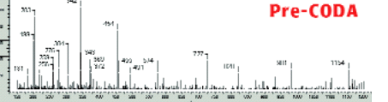
New paradigm shift: Integromics
“NGS-Sequences
H NMR metabolites
A
A
Veh A B C D Veh A B C D
Normal Disease
Affy Transcriptome
“Non-omic” markers
LC-MS proteomicss
<número>

Slide 11
Bioinformatics domains
Information management
  Databases, databanks
  Algorithms and tools for database querying and searching
Information Modelling
  Protein structure characterization
Analysis & Interpretation of results
  Genome sequencing and analysis
  Comparative genomics
  Transcriptomics and gene expression
  Metagenomics
  Proteomics, metabolomics, …
Biological system modeling

Slide 12
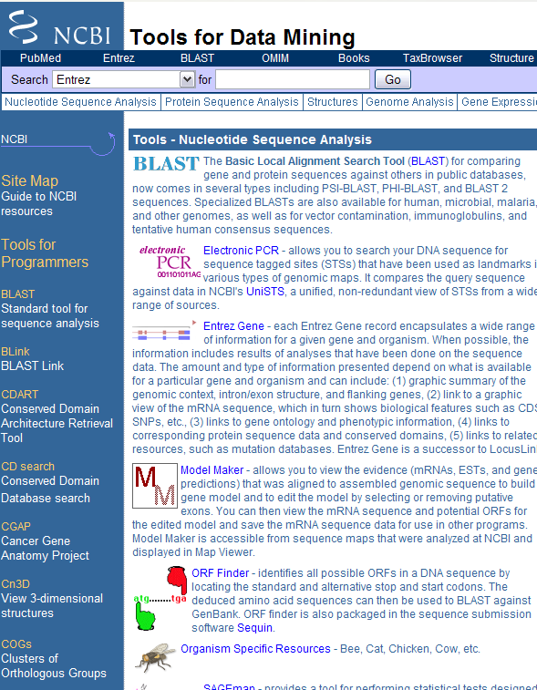
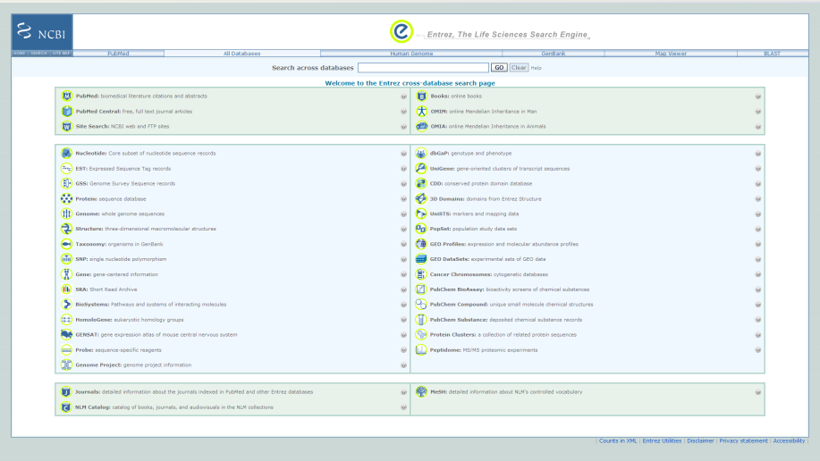
Information management

Slide 13
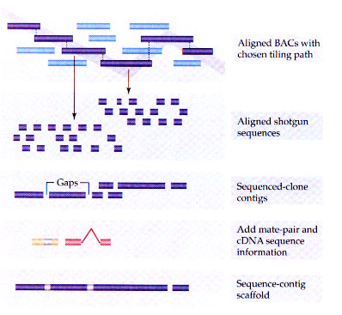
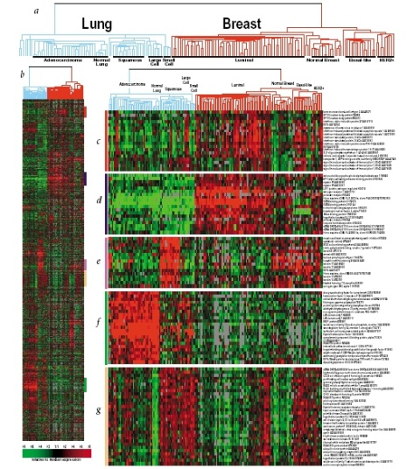
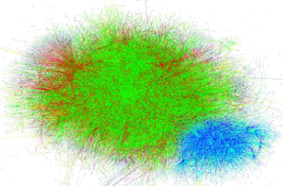
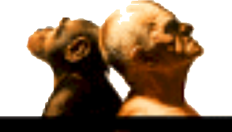
Analysis and interpretation
A G A G T T C T G C T C G
A G G G T T A T G C G C G

Slide 14

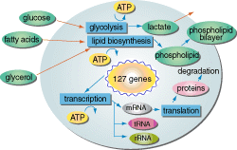
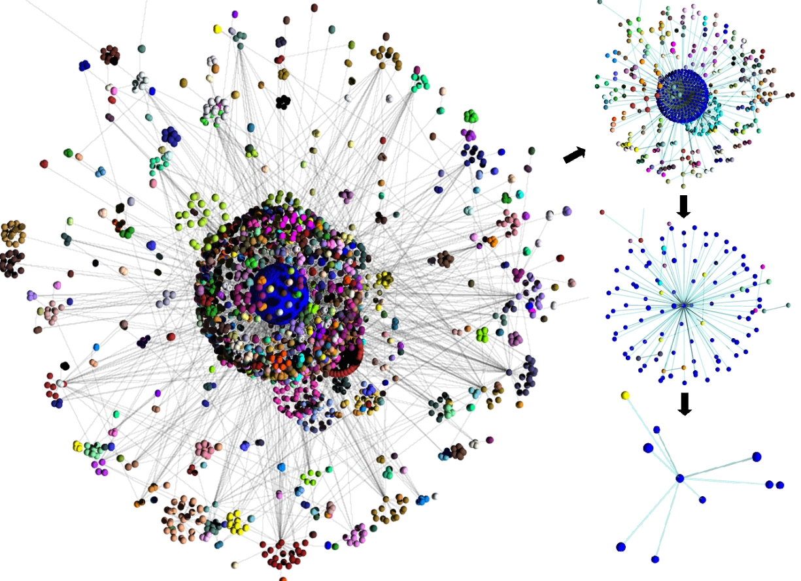
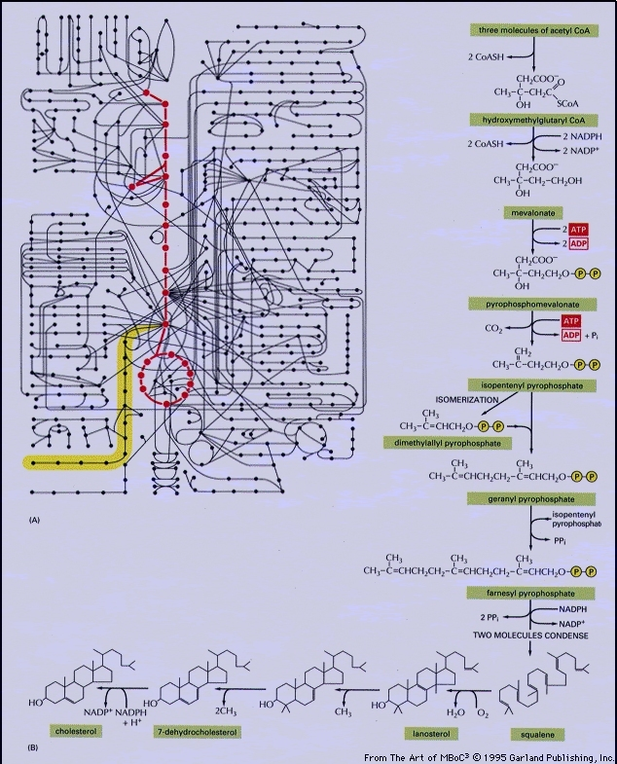
Biological system modeling

Slide 15
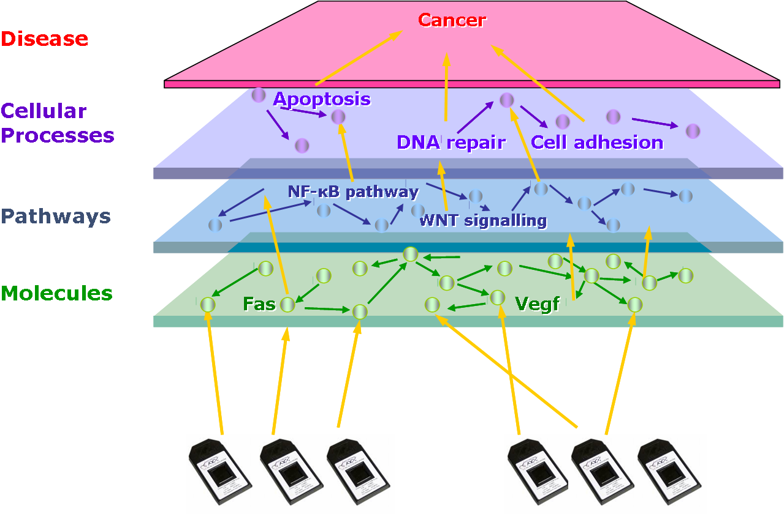
Integrative bioinformatics
<número>
Notes:
<número>

Slide 16
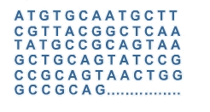
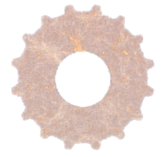
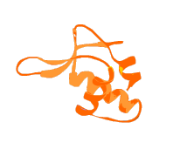
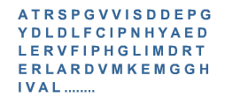
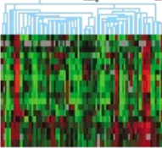
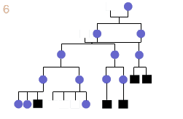
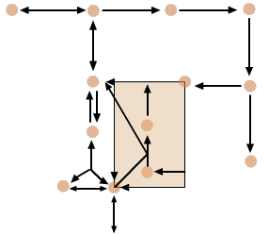
In summary…
Bioinformatics methods and resources
Data
Knowledge

Slide 17
In summary, bioinformatics ...
Was born with
  Development of new technologies
  Its application for generating –increasingly huge- of big masses of biological data.
Has become now an interdisciplinar science encompassing all aspects of the Acquisition, Processing, Distribution, Analysis, Integration and Interpretation of biological information.

Slide 18
“Doing bioinformatics”
Bioinformatics analyses
  Database searching/querying
  Sequence analysis, Omics data analysis
  Systems biology
Can be done differently
  From console-based systems
    Using scripts (perl/python/R) for automating processes
    Doing data analysis with R
  Or working with graphical/web interfaces to do (almost) the same things
Each user has a different preferred approach

