Slide 1
INTRODUCTION TO R
UEB – VHIR
Mireia Ferrer¹, Álex Sánchez^{1,2}, Esther Camacho¹, Angel Blanco^{1,2}, Berta Miró¹
¹ Unitat d’Estadística i Bioinformàtica (UEB) VHIR
² Departament de Genètica Microbiologia i Estadística, UB

Slide 2
Some data types in R
Getting data into R
Access to data
Plots with R
Install packages
Help!!

Slide 3
Some data types in R
Getting data into R
Access to data
Plots with R
Install packages
Help!!

Slide 4
Some data types in R
R store information in different types of objects.
The most common are:
Variables: A variable is a name for a value. We can create a new variable by assigning a value to it, using <-
width <- 5
width
## [1] 5

Slide 5
Some data types in R
Vectors: a collection of numbers or characters:
myvec <- c(10,20,30,40,50)
myvec
## [1] 10 20 30 40 50
myvec + 1
## [1] 11 21 31 41 51
myvec + myvec
## [1] 20 40 60 80 100
food <- c("eggs", "beans", "bacon", "sausage")

Slide 6
Some data types in R
Dataframe: is a table or a two-dimensional array-like structure in which each column contains values of one variable and each row contains one set of values from each column :
iris
Species Sepal.Length Sepal.Width Petal.Length Petal.Width
setosa 5.1 3.5 1.4 0.2
setosa 4.9 3.0 1.4 0.2
setosa 4.7 3.2 1.3 0.2
versicolor 7.0 3.2 4.7 1.4
versicolor 6.4 3.2 4.5 1.5
versicolor 6.9 3.1 4.9 1.5
versicolor 5.5 2.3 4.0 1.3
virginica 6.3 3.3 6.0 2.5
virginica 5.8 2.7 5.1 1.9
virginica 7.1 3.0 5.9 2.1
virginica 6.3 2.9 5.6 1.8
virginica 6.5 3.0 5.8 2.2

Slide 7
Some data types in R
List: is a generic vector containing other objects
n <- c(2, 3, 5)
s <- c("aa", "bb", "cc", "dd", "ee")
b <- c(TRUE, FALSE, TRUE, FALSE, FALSE)
x <- list(n, s, b, 3) # x contains copies of n, s, b
x[2]
[[1]]
[1] "aa" "bb" "cc" "dd" "ee"
Matrix: is a collection of data elements arranged in a two-dimensional rectangular layout:
A <- matrix(c(2, 4, 3, 1, 5, 7), nrow=2, ncol=3,byrow = TRUE)
A
[,1] [,2] [,3]
[1,] 2 4 3
[2,] 1 5 7

Slide 8
Some data types in R
Getting data into R
Access to data
Plots with R
Install packages
Help!!

Slide 9
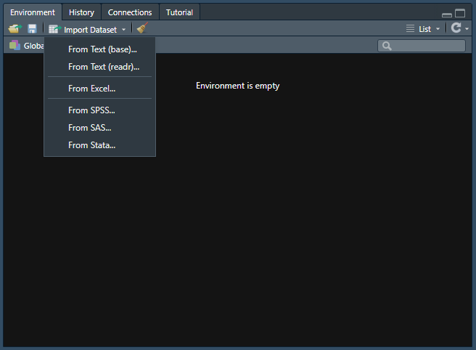
Getting data into R
The easiest way to get data into R is to click on the “Import Datasets” button.

Slide 10
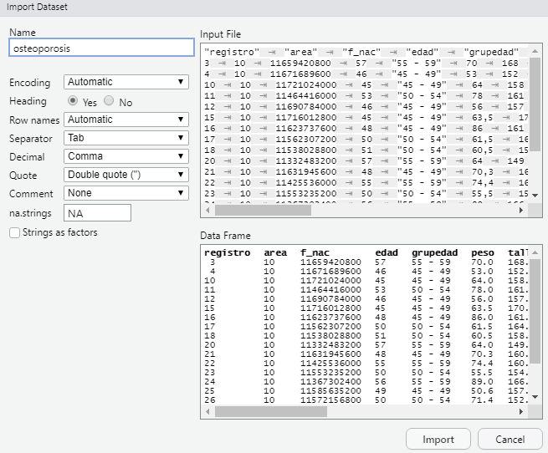
Getting data into R
The easiest way to get data into R is to click on the “Import Datasets” button.

Slide 11
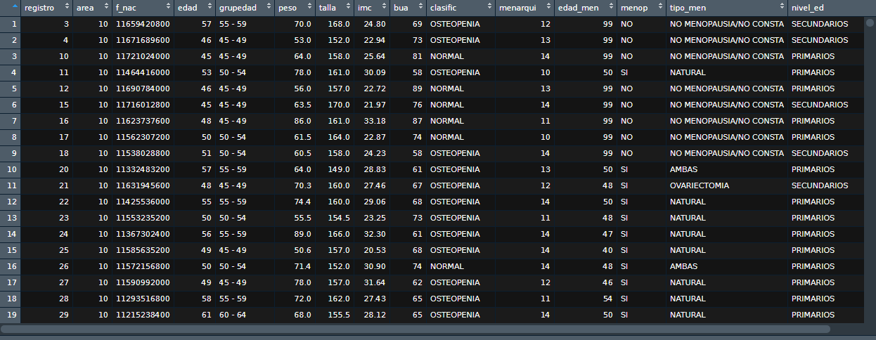
Getting data into R
What type of data is?

Slide 12
Getting data into R
With R instructions:
osteoporosis2 <- read.csv2("osteoporosis.csv", sep = "\t", dec = ",", header = TRUE)
check the folder you are working on!

Slide 13
Some data types in R
Getting data into R
Access to data
Plots with R
Install packages
Help!!

Slide 14
Access to data
Once you have loaded the data, it is necessary to check it
Different ways to do it
head(name of dataframe): to see the first rows of a dataframe
tail(name of dataframe): to see the last rows of a dataframe
str(name of dataframe): to check the structure of the dataframe and their variables
summary(name of dataframe): Little summary of the variables of the dataframe

Slide 15
Access to data
head(osteoporosis)
registro area f_nac edad grupedad peso talla imc bua clasific menarqui edad_men menop tipo_men nivel_ed
1 3 10 11659420800 57 55 - 59 70.0 168 24.80 69 OSTEOPENIA 12 99 NO NO MENOPAUSIA/NO CONSTA SECUNDARIOS
2 4 10 11671689600 46 45 - 49 53.0 152 22.94 73 OSTEOPENIA 13 99 NO NO MENOPAUSIA/NO CONSTA SECUNDARIOS
3 10 10 11721024000 45 45 - 49 64.0 158 25.64 81 NORMAL 14 99 NO NO MENOPAUSIA/NO CONSTA PRIMARIOS
4 11 10 11464416000 53 50 - 54 78.0 161 30.09 58 OSTEOPENIA 10 50 SI NATURAL PRIMARIOS
12 10 11690784000 46 45 - 49 56.0 157 22.72 89 NORMAL 13 99 NO NO MENOPAUSIA/NO CONSTA PRIMARIOS
15 10 11716012800 45 45 - 49 63.5 170 21.97 76 NORMAL 14 99 NO NO MENOPAUSIA/NO CONSTA SECUNDARIOS
tail(osteoporosis)
registro area f_nac edad grupedad peso talla imc bua clasific menarqui edad_men menop tipo_men nivel_ed
995 1028 11 11190182400 63 60 - 64 71 161 27.39 57 OSTEOPENIA 14 48 SI NATURAL PRIMARIOS
996 1029 11 11287036800 60 60 - 64 64 158 25.64 69 OSTEOPENIA 10 40 SI AMBAS SUPERIORES
997 1030 11 11066371200 67 65 - 69 68 157 27.59 75 NORMAL 11 55 SI NATURAL PRIMARIOS SIN FINALIZAR
998 1031 11 11289196800 59 55 - 59 72 153 30.76 67 OSTEOPENIA 12 56 SI NATURAL PRIMARIOS
999 1032 11 11137219200 64 60 - 64 80 152 34.63 55 OSTEOPENIA 14 50 SI NATURAL PRIMARIOS
1000 1033 11 11213164800 62 60 - 64 67 161 25.85 65 OSTEOPENIA 13 54 SI NATURAL SECUNDARIOS

Slide 16
Access to data
str(osteoporosis)
'data.frame': 1000 obs. of 15 variables:
$ registro: int 3 4 10 11 12 15 16 17 18 20 ...
$ area : int 10 10 10 10 10 10 10 10 10 10 ...
$ f_nac : chr "11659420800" "11671689600" "11721024000" "11464416000" ...
$ edad : int 57 46 45 53 46 45 48 50 51 57 ...
$ grupedad: chr "55 - 59" "45 - 49" "45 - 49" "50 - 54" ...
$ peso : num 70 53 64 78 56 63.5 86 61.5 60.5 64 ...
$ talla : num 168 152 158 161 157 170 161 164 158 149 ...
$ imc : num 24.8 22.9 25.6 30.1 22.7 ...
$ bua : int 69 73 81 58 89 76 87 74 58 61 ...
$ clasific: chr "OSTEOPENIA" "OSTEOPENIA" "NORMAL" "OSTEOPENIA" ...
$ menarqui: int 12 13 14 10 13 14 11 10 14 13 ...
$ edad_men: int 99 99 99 50 99 99 99 99 99 50 ...
$ menop : chr "NO" "NO" "NO" "SI" ...
$ tipo_men: chr "NO MENOPAUSIA/NO CONSTA" "NO MENOPAUSIA/NO CONSTA" "NO MENOPAUSIA/NO CONSTA" "NATURAL" ...
$ nivel_ed: chr "SECUNDARIOS" "SECUNDARIOS" "PRIMARIOS" "PRIMARIOS" ...

Slide 17
Access to data
summary(osteoporosis)
registro area f_nac edad grupedad peso talla imc
Min. : 3.0 Min. :10.00 Length:1000 Min. :45.00 Length:1000 Min. : 44.00 Min. :138.0 Min. :17.21
1st Qu.: 280.8 1st Qu.:10.00 Class :character 1st Qu.:48.00 Class :character 1st Qu.: 60.50 1st Qu.:153.0 1st Qu.:24.80
Median : 531.5 Median :11.00 Mode :character Median :52.00 Mode :character Median : 68.00 Median :157.0 Median :27.51
Mean : 529.9 Mean :11.58 Mean :53.42 Mean : 69.12 Mean :156.9 Mean :28.11
3rd Qu.: 781.2 3rd Qu.:13.00 3rd Qu.:58.00 3rd Qu.: 75.00 3rd Qu.:161.0 3rd Qu.:30.82
Max. :1033.0 Max. :13.00 Max. :69.00 Max. :123.50 Max. :180.0 Max. :48.39
bua clasific menarqui edad_men menop tipo_men nivel_ed
Min. : 11.0 Length:1000 Min. : 8.00 Min. :24.00 Length:1000 Length:1000 Length:1000
1st Qu.: 62.0 Class :character 1st Qu.:12.00 1st Qu.:46.00 Class :character Class :character Class :character
Median : 72.0 Mode :character Median :13.00 Median :51.00 Mode :character Mode :character Mode :character
Mean : 73.3 Mean :12.71 Mean :63.04
3rd Qu.: 84.0 3rd Qu.:14.00 3rd Qu.:99.00
Max. :136.0 Max. :17.00 Max. :99.00

Slide 18
Access to data
nrow(osteoporosis)
[1] 1000
ncol(osteoporosis)
[1] 15
colnames(osteoporosis)
[1] "registro" "area" "f_nac" "edad" "grupedad" "peso" "talla" "imc" "bua" "clasific" "menarqui" "edad_men" "menop"
[14] "tipo_men" "nivel_ed“

Slide 19
Access to data
Sometimes you are not interested in working with all the variables of cases of the dataset
There are different ways to select them:
#select the first 3 rows and columns
osteoporosis[1:3, 1:3]
registro area f_nac
1 3 10 11659420800
2 4 10 11671689600
3 10 10 11721024000

Slide 20
Access to data
#select the different rows and columns
osteoporosis[c(31:36, 115, 950), c(2, 4:6,13:15)]
area edad grupedad peso menop tipo_men nivel_ed
31 10 67 65 - 69 60.0 SI NATURAL PRIMARIOS
32 10 50 50 - 54 70.0 SI NATURAL PRIMARIOS
33 10 56 55 - 59 68.0 SI NATURAL PRIMARIOS
34 10 67 65 - 69 63.0 SI NATURAL PRIMARIOS
35 10 58 55 - 59 64.0 SI NATURAL PRIMARIOS
36 10 57 55 - 59 75.0 SI NATURAL SIN ESTUDIOS
115 10 45 45 - 49 57.0 NO NO MENOPAUSIA/NO CONSTA SECUNDARIOS
11 62 60 - 64 75.5 SI NATURAL PRIMARIOS
#select all the rows and by variable name and save the dataset with another name
osteoporosis2 <- osteoporosis[, c("edad", "grupedad", "tipo_men", "nivel_ed")]
head(osteoporosis2)
edad grupedad tipo_men nivel_ed
1 57 55 - 59 NO MENOPAUSIA/NO CONSTA SECUNDARIOS
2 46 45 - 49 NO MENOPAUSIA/NO CONSTA SECUNDARIOS
3 45 45 - 49 NO MENOPAUSIA/NO CONSTA PRIMARIOS
4 53 50 - 54 NATURAL PRIMARIOS
5 46 45 - 49 NO MENOPAUSIA/NO CONSTA PRIMARIOS
6 45 45 - 49 NO MENOPAUSIA/NO CONSTA SECUNDARIOS

Slide 21
Access to data
It is also possible to select some rows depending on logic expressions:
#select pacients older than 60 years
osteoporosis3 <- osteoporosis[which(osteoporosis$edad > 60), ]
head(osteoporosis3)
registro area f_nac edad grupedad peso talla imc bua clasific menarqui edad_men menop tipo_men nivel_ed
19 29 10 11215238400 61 60 - 64 68.0 155.5 28.12 65 OSTEOPENIA 14 50 SI NATURAL PRIMARIOS
23 34 10 10992758400 68 65 - 69 66.5 145.0 31.63 57 OSTEOPENIA 13 50 SI NATURAL PRIMARIOS SIN FINALIZAR
24 35 10 10909382400 69 65 - 69 70.0 168.0 24.80 48 OSTEOPOROSIS 13 45 SI NATURAL PRIMARIOS
27 38 10 11043907200 66 65 - 69 67.0 144.0 32.31 79 NORMAL 12 56 SI NATURAL PRIMARIOS
28 39 10 10948089600 69 65 - 69 70.5 148.5 31.97 40 OSTEOPOROSIS 11 43 SI NATURAL SIN ESTUDIOS
40 10 11051251200 66 65 - 69 66.5 147.0 30.77 48 OSTEOPOROSIS 13 40 SI NATURAL PRIMARIOS
osteoporosis4 <- subset(osteoporosis, edad > 60)
head(osteoporosis4)
registro area f_nac edad grupedad peso talla imc bua clasific menarqui edad_men menop tipo_men nivel_ed
19 29 10 11215238400 61 60 - 64 68.0 155.5 28.12 65 OSTEOPENIA 14 50 SI NATURAL PRIMARIOS
23 34 10 10992758400 68 65 - 69 66.5 145.0 31.63 57 OSTEOPENIA 13 50 SI NATURAL PRIMARIOS SIN FINALIZAR
24 35 10 10909382400 69 65 - 69 70.0 168.0 24.80 48 OSTEOPOROSIS 13 45 SI NATURAL PRIMARIOS
27 38 10 11043907200 66 65 - 69 67.0 144.0 32.31 79 NORMAL 12 56 SI NATURAL PRIMARIOS
28 39 10 10948089600 69 65 - 69 70.5 148.5 31.97 40 OSTEOPOROSIS 11 43 SI NATURAL SIN ESTUDIOS
29 40 10 11051251200 66 65 - 69 66.5 147.0 30.77 48 OSTEOPOROSIS 13 40 SI NATURAL PRIMARIOS

Slide 22
Access to data
We can combine different logic expressions
osteoporosis4 <- subset(osteoporosis, edad > 60 & nivel_ed == "PRIMARIOS")
head(osteoporosis4)
registro area f_nac edad grupedad peso talla imc bua clasific menarqui edad_men menop tipo_men nivel_ed
19 29 10 11215238400 61 60 - 64 68.0 155.5 28.12 65 OSTEOPENIA 14 50 SI NATURAL PRIMARIOS
24 35 10 10909382400 69 65 - 69 70.0 168.0 24.80 48 OSTEOPOROSIS 13 45 SI NATURAL PRIMARIOS
27 38 10 11043907200 66 65 - 69 67.0 144.0 32.31 79 NORMAL 12 56 SI NATURAL PRIMARIOS
29 40 10 11051251200 66 65 - 69 66.5 147.0 30.77 48 OSTEOPOROSIS 13 40 SI NATURAL PRIMARIOS
31 45 10 11029651200 67 65 - 69 60.0 147.0 27.77 49 OSTEOPENIA 13 53 SI NATURAL PRIMARIOS
34 48 10 11034489600 67 65 - 69 63.0 157.0 25.56 66 OSTEOPENIA 13 50 SI NATURAL PRIMARIOS

Slide 23
Some data types in R
Getting data into R
Access to data
Plots with R
Install packages
Help!!

Slide 24
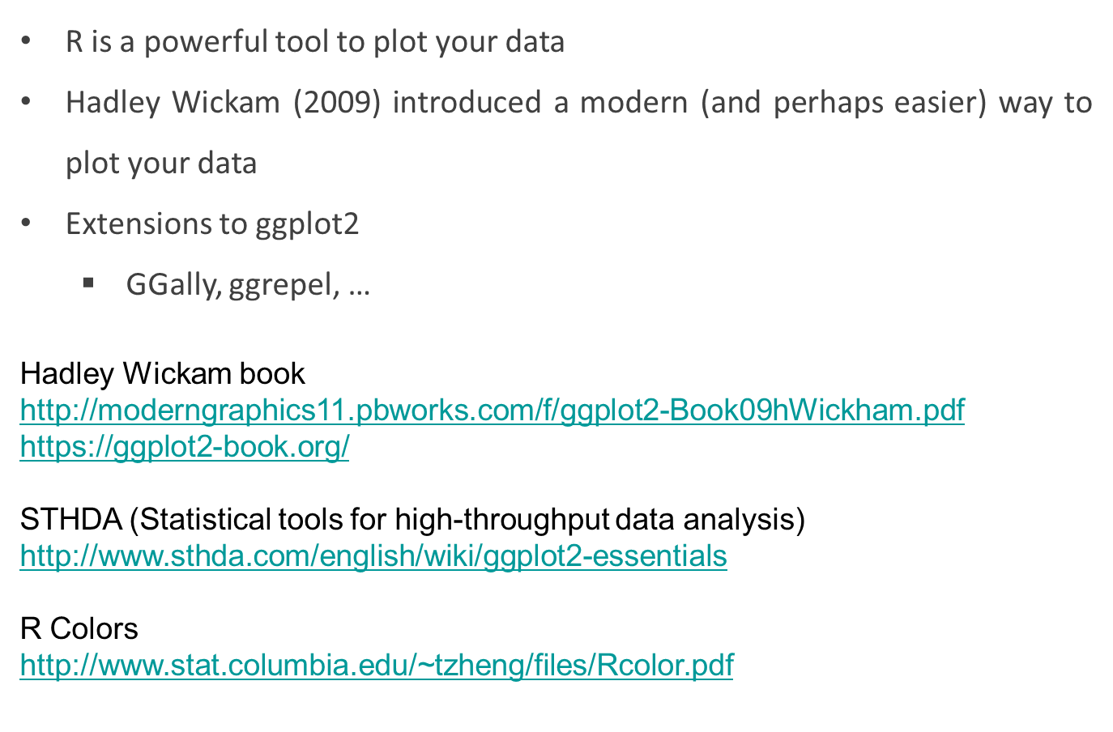
Plots with R

Slide 25
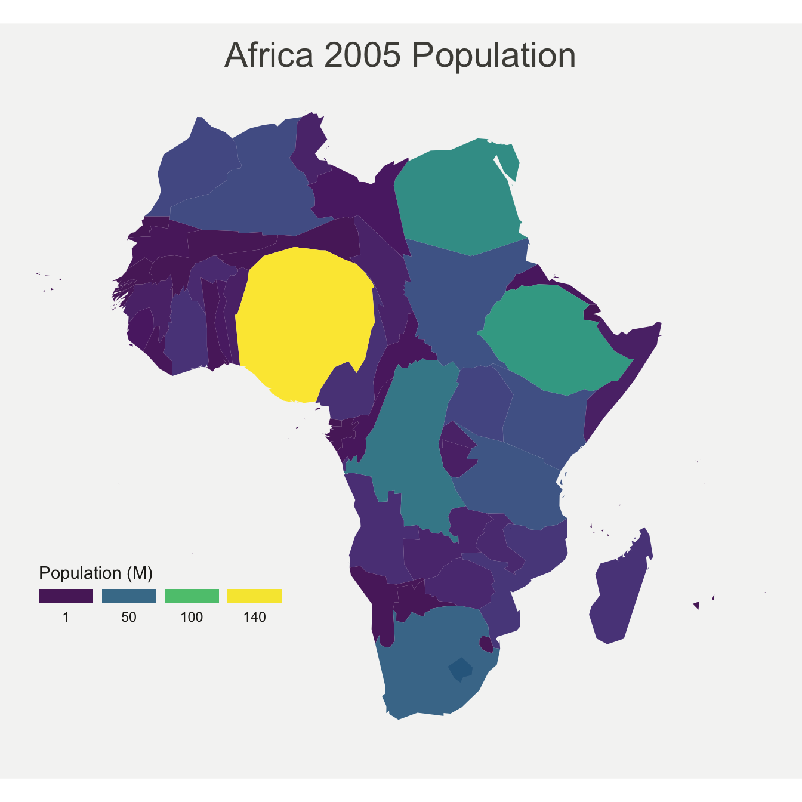
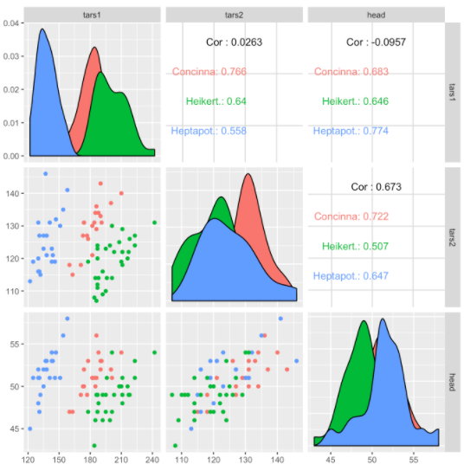
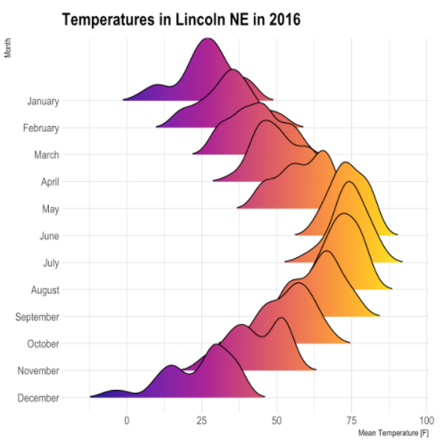
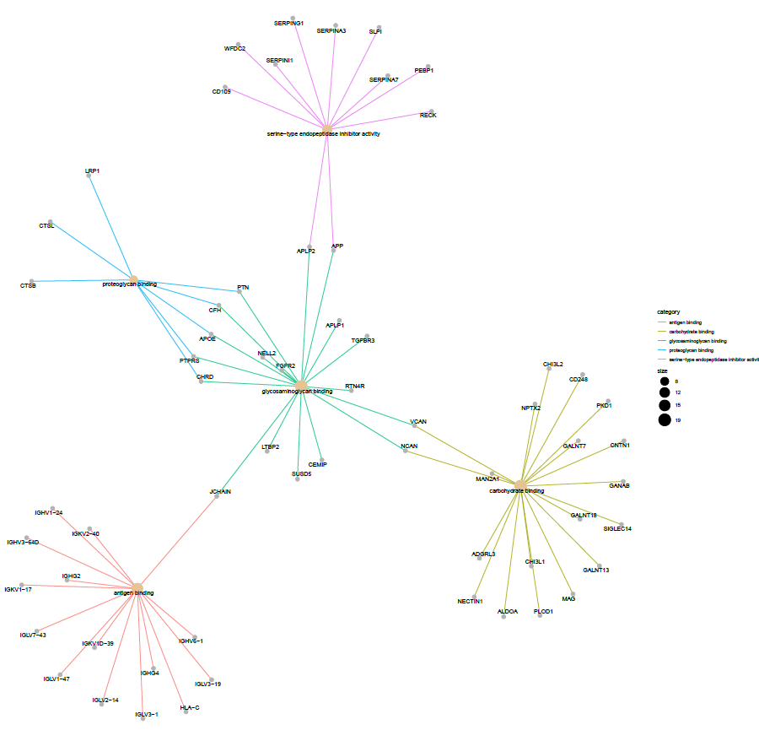
Plots with R
https://www.r-graph-gallery.com/

Slide 26
Plots with R
library(ggplot2) #Remember to install the packages before call it
ggplot(osteoporosis, aes(x = peso, y = imc)) +
geom_point()

Slide 27
Plots with R
library(ggplot2) #Remember to install the packages before call it
ggplot(osteoporosis, aes(x = peso, y = imc)) +
geom_point()

Slide 28
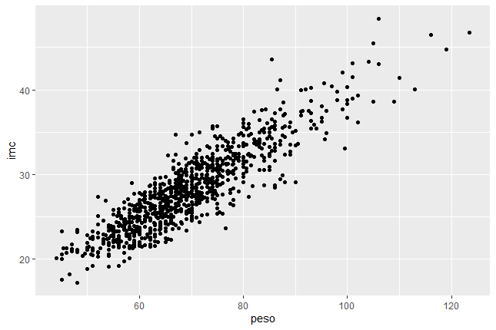
Plots with R
library(ggplot2) #Remember to install the packages before call it
ggplot(osteoporosis, aes(x = peso, y = imc)) +
geom_point()

Slide 29
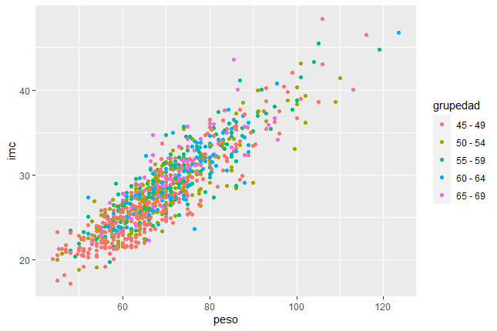
Plots with R
ggplot(osteoporosis, aes(x = peso, y = imc, color = grupedad)) +
geom_point()

Slide 30
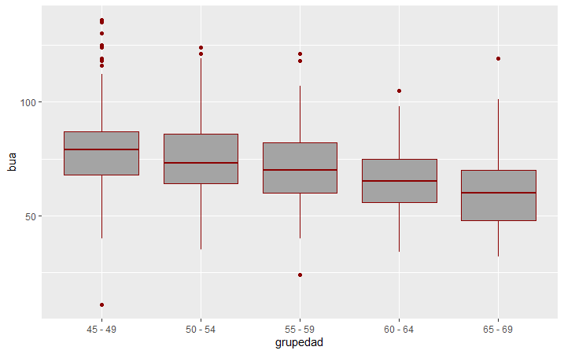
Plots with R
bp <- ggplot(osteoporosis, aes(x = grupedad, y = bua)) +
geom_boxplot(fill='#A4A4A4', color="darkred")

Slide 31
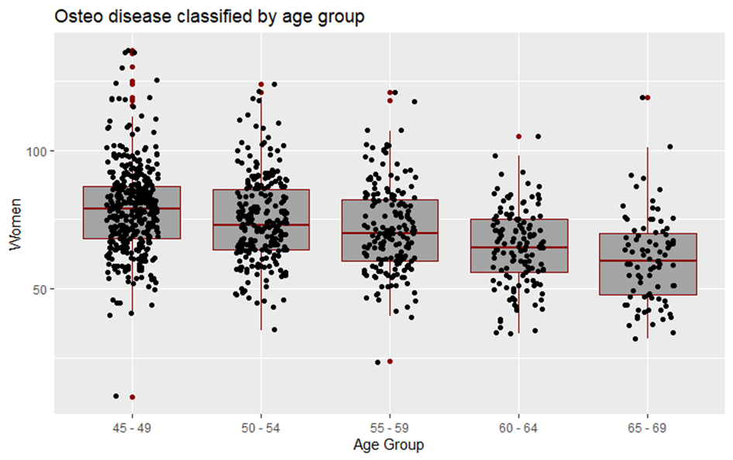
Plots with R
bp + geom_jitter(shape = 16, position = position_jitter(0.2)) +
labs(x = "Age Group", y = "Women", title = "Osteo disease classified by age group")

Slide 32
Some data types in R
Getting data into R
Access to data
Plots with R
Install packages
Help!!

Slide 33
Install packages
Packages are extensions of the basic R functions
It is necessary to install once in each computer when needed
Call it each time you want to use it
Two ways to install the packages:
install.packages(“name of the package”)

Slide 34
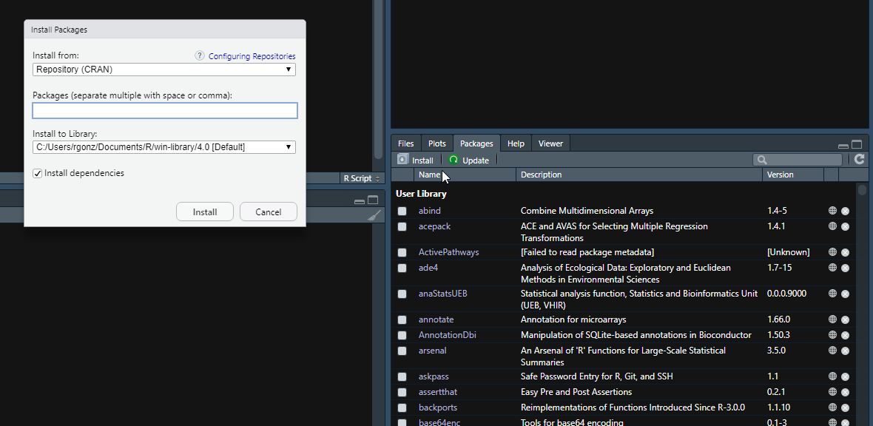
Install packages

Slide 35
Install packages
If package are hosted in Bioconductor repository:
if (!requireNamespace("BiocManager", quietly = TRUE))
install.packages("BiocManager")
BiocManager::install("airway")

Slide 36
Install packages
Bioconductor
airway
Rsamtools
GenomicFeatures
GenomicAlignments
BiocParallel
DESeq2
apeglm
genefilter
AnnotationDbi
org.Hs.eg.db
Gviz
ReportingTools
sva
RUVSeq
AnnotationHub
clusterProfiler
ReactomePA
topGO
GOstats
pasilla
IHW
Cran R
magrittr
dplyr
ggplot2
pheatmap
RColorBrewer
ggbeeswarm

Slide 37
Some data types in R
Getting data into R
Access to data
Plots with R
Install packages
Help!!

Slide 38
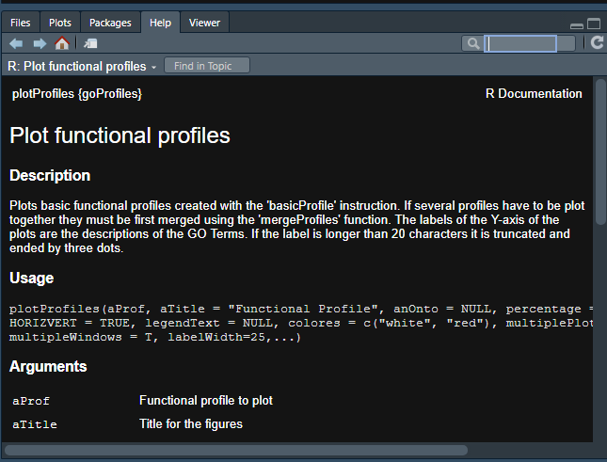
Help!!

