Slide 1




An Introduction to Biological Significance Analysis
Alex Sánchez
Statistics and Bioinformatics Unit
Vall d’Hebron Institut de Recerca
Statistics and Bioinformatics Research Group
Statistics department, Universitat de Barelona
Notes:
1

Slide 2
Outline
Introduction and Background
Gene lists, Identifiers and Pathway databases
What’s in the name of a gene
The Gene Ontology and other databases
Pathway Analysis: Methods and Tools
Overrepresentation analysis
GSEA: Gene Set Enrichment Analysis
Multiple Testing Adjustments
Notes:
2

Slide 3
Introduction & Background

Slide 4
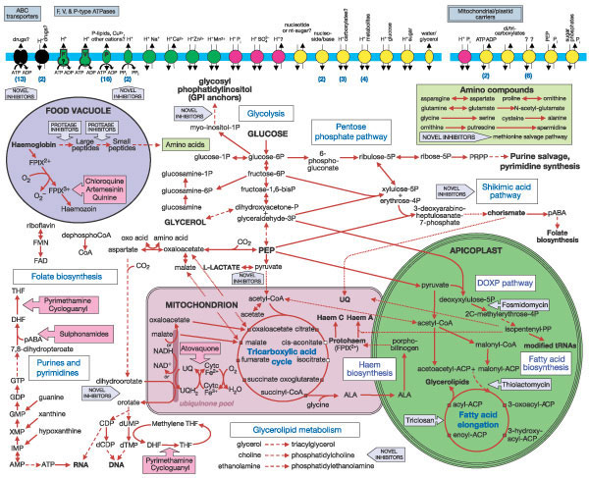
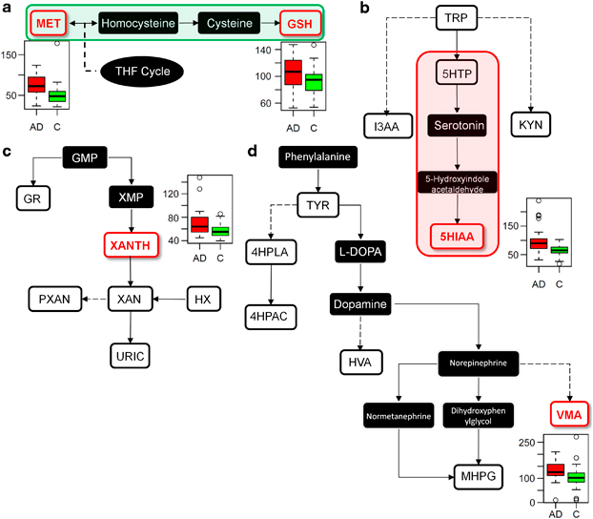
Health, disease and pathways
Metabolism is a complex network of chemical reactions within the confines of a cell that can be analyzed in self-contained parts called pathways
One can generally assume that “normal” metabolism is what happens in healthy state or, reciprocally, that disease can be associated with some type of alteration in metabolism.
Pathways altered in ALZHEIMER disease
Characterization of disease can be attempted by studying how this affects or disrupts pathways
That’s (more or less) what Pathway Analysis is about

Slide 5
Pathway Analysis
The term Pathway Analysis denotes any analytic technique that benefits from biological pathway or molecular network information to gain insight into a biological system. (Creixell et alt., Nature Methods 2015 (12 (7))
To be more specific, Pathway Analysis methods rely on high throughput information provided by omics technologies to:
Contextualize findings to help understand the mechanism of disease¹
Identify genes/proteins associated with the aetiology of a disease¹
Predict drug targets
Understand how to therapeutically intervene in disease¹
Conduct target literature searches
Integrate diverse biological information
¹In many cases “disease” can be substituted by “biological process”

Slide 6
The beginning: Gene Lists

Slide 7
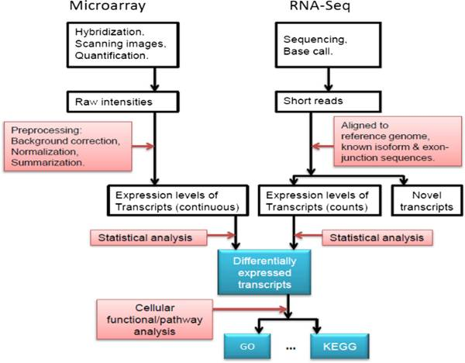
The life-cycle of an omics-based study
Fang et al. Cell Biosci. 2012; 2: 26.
Pathway Analysis !!!

Slide 8
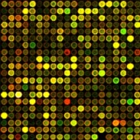
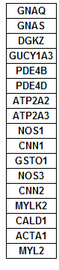
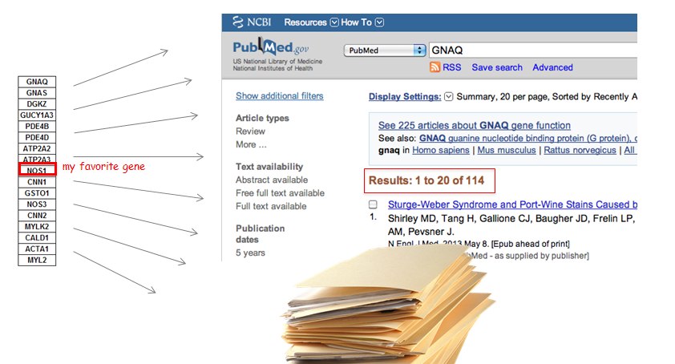
The (in)famous “where to now?” question
You obtained a list of features. What’s next?
Select some genes for validation?
Follow up experiments on some genes/proteins/…?
Publish a huge table with all results?
Try to learn about all features in the list?
?

Slide 9
From gene lists to Pathway Analysis
Gene lists are made of individual genes
Information about each gene can be extracted from databases.
Generically described as Gene Annotation
Besides, we may obtain information from the analysis of gene sets
Genes don’t act individually, rather in groups More realistic approach
There are less gene sets than individual genes Relatively simpler to manage.
Generically described as Pathway Analysis

Slide 10
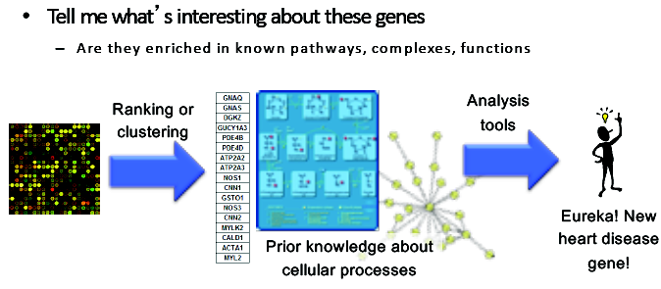
Pathway Analysis Wishlist

Slide 11
Example 1
Lists AvsB, AvsL and BvsL contain the IDs of genes selected by being differentially expressed between three types of breast cancer tumors.
Farmer P, Bonnefoi H, Becette V, Tubiana-Hulin M et al. Identification of molecular apocrine breast tumours by microarray analysis. Oncogene 2005 Jul 7;24(29):4660-71. PMID: 15897907
See the analysis that generates the list in:
https://github.com/alexsanchezpla/Ejemplo_de_MDA_con_Bioconductor

Slide 12
Example 2
Genes with frequent somatic SNVs identified in TCGA exome sequencing data of 3,200 tumors of 12 types
127 cancer driver genes displaying higher than expected mutation frequencies were detected using the MuSiC software.
Genes are ranked in decreasing order of significance and mutation frequency.
Follow this link to get the list
TP53
PIK3CA
PTEN
APC
VHL
KRAS
MLL3
MLL2
ARID1A
PBRM1
NAV3
EGFR
NF1
PIK3R1
CDKN2A
GATA3
RB1
NOTCH1
FBXW7
CTNNB1
DNMT3A
MAP3K1
FLT3
MALAT1
TSHZ3

Slide 13
Example 3
A ranked list of genes obtained from TCGA ovarian cancer dataset.
Two subgroups -immunoreactive and mesenchymal- were compared.
The list contains all genes, not only differentially expressed, ranked by the value of statistic.
rank | GeneName | test statistic
1 | IGDCC3 | 35.5553322839225
2 | ANTXR1 | 35.3770766531836
3 | AEBP1 | 33.0690543534961
4 | FBN1 | 32.1199562790897
5 | ANGPTL2 | 31.8605806216522
6 | COL16A1 | 31.7641267462069
7 | BGN | 31.533826423921
… | … | …
15201 | IRF1 | -14.7629673442493
15202 | CXCL10 | -14.982733665643
15203 | TAP2 | -15.1488606179238
15204 | UBE2L6 | -15.7162058907796
15205 | KIAA0319 | -15.7796986548781
15206 | PSMB8 | -15.7846188665582
15207 | PSME1 | -16.4510045533584
15208 | CSAG3 | -16.8014265945244
15209 | OVGP1 | -17.6903158148446
15210 | GBP4 | -17.9447602030134
15211 | TAP1 | -18.0549262210415
15212 | PSME2 | -18.3639448844986
15213 | PSMB9 | -18.6614452029879

Slide 14
Gene Lists and Annotations

Slide 15
Gene and Protein Identifiers
TP53
PIK3CA
PTEN
APC
VHL
KRAS
MLL3
MLL2
ARID1A
PBRM1
NAV3
EGFR
NF1
PIK3R1
CDKN2A
GATA3
RB1
NOTCH1
FBXW7
CTNNB1
DNMT3A
MAP3K1
FLT3
MALAT1
TSHZ3
When scientist study and characterize any biological feature, they assign it a name (E.g. “Insulin”).
As the number of features studied increase these names are stored in databases and assigned an identifier.
INSULIN is named “INS” in the NCBI database
Identifiers (IDs) are ideally unique, stable names or numbers that help track database records
E.g. Social Insurance Number, Entrez Gene ID 41232
But information on features may have been stored in distinct databases.
The same features may have multiple distinct IDs
What is worse they do not necessariliy map one-to-one
Notes:
15

Slide 16
Important to learn what is in each record type. E.g. Entrez Gene records don’t store sequence. They link to DNA regions, RNA transcripts and proteins e.g. in RefSeq, which stores sequence.
Gene
Ensembl ENSG00000139618
Entrez Gene 675
Unigene Hs.34012
RNA transcript
GenBank BC026160.1
RefSeq NM_000059
Ensembl ENST00000380152
Protein
Ensembl ENSP00000369497
RefSeq NP_000050.2
UniProt BRCA2_HUMAN or A1YBP1_HUMAN
IPI IPI00412408.1
EMBL AF309413
PDB 1MIU
Species-specific
HUGO HGNC BRCA2
MGI MGI:109337
RGD 2219
ZFIN ZDB-GENE-060510-3
FlyBase CG9097
WormBase WBGene00002299 or ZK1067.1
SGD S000002187 or YDL029W
Annotations
InterPro IPR015252
OMIM 600185
Pfam PF09104
Gene Ontology GO:0000724
SNPs rs28897757
Experimental Platform
Affymetrix 208368_3p_s_at
Agilent A_23_P99452
CodeLink GE60169
Illumina GI_4502450-S
Red = Recommended
Notes:
16

Slide 17
Identifier Mapping
There are many IDs!
Software tools recognize only a handful
May need to map from your gene list IDs to standard IDs
Four main uses
Searching for a favourite gene name
Link to related resources
Identifier translation
E.g. Proteins to genes, Affy ID to Entrez Gene
Merging data from different sources
Find equivalent records
Notes:
17

Slide 18
ID Challenges
Avoid errors: map IDs correctly
Beware of 1-to-many mappings
Gene name ambiguity – not a good ID
e.g. FLJ92943, LFS1, TRP53, p53
Better to use the standard gene symbol: TP53
Excel error-introduction
OCT4 is changed to October-4 (paste as text)
Problems reaching 100% coverage
E.g. due to version issues
Use multiple sources to increase coverage
Zeeberg BR et al. Mistaken identifiers: gene name errors can be introduced inadvertently when using Excel in bioinformatics BMC Bioinformatics. 2004 Jun 23;5:80
Notes:
18

Slide 19
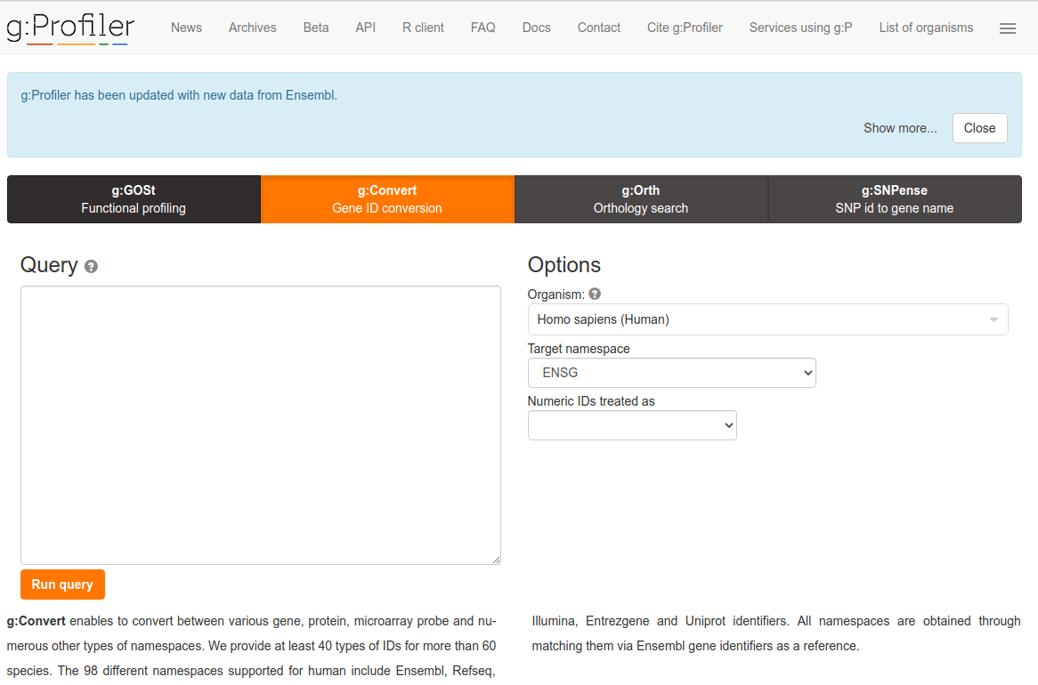
Use ID converters to prepare list

Slide 20
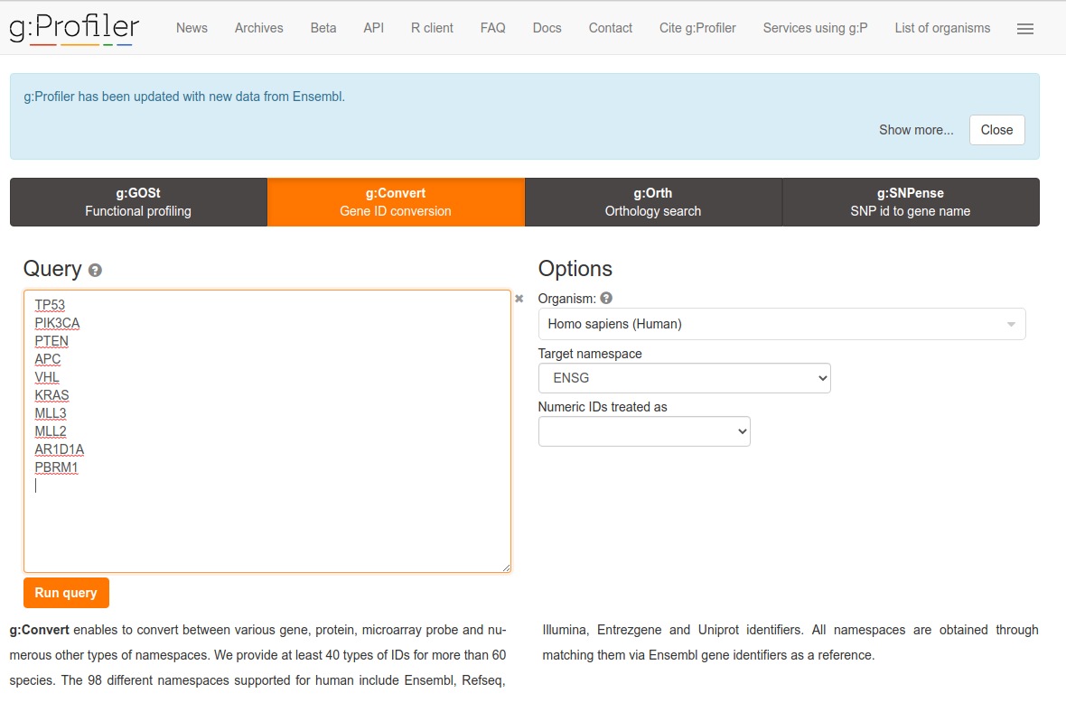
Example: Gene ID conversion with g:Convert
Input gene/protein/transcript IDs (mixed)
Type of output ID
Notes:
20

Slide 21
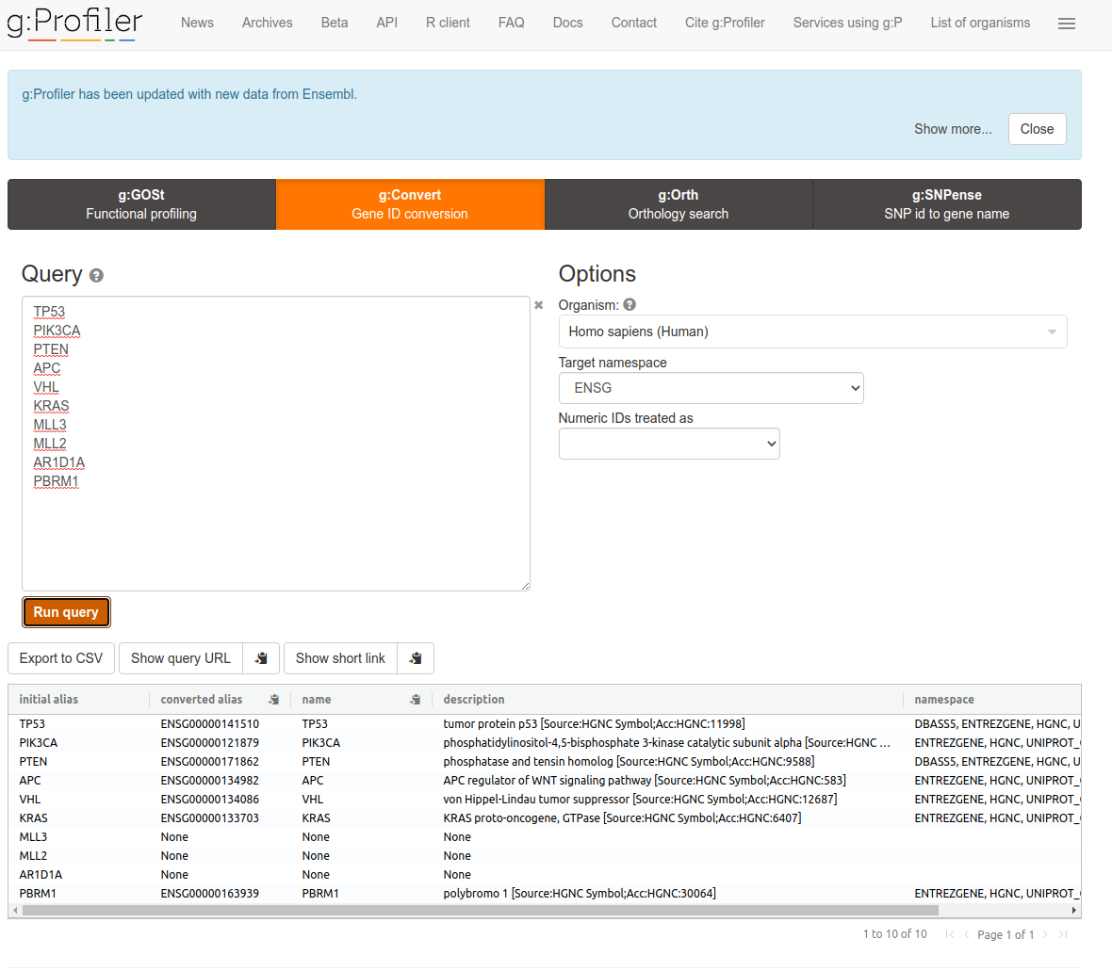
Example: Gene ID conversion with g:Convert
Notes:
21

Slide 22
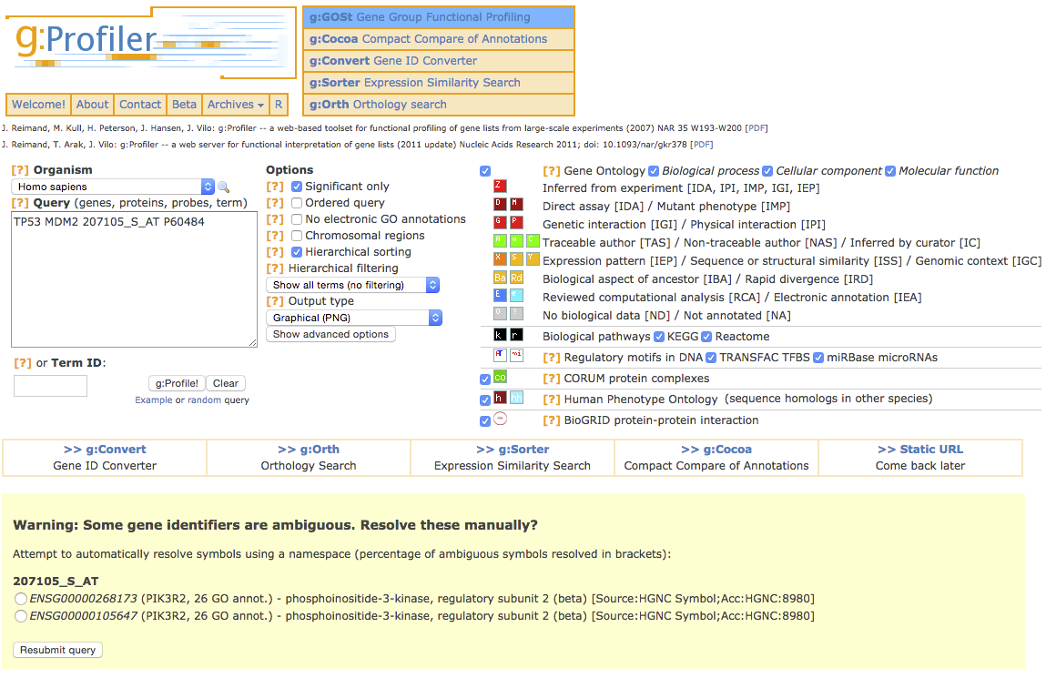
Beware of ambiguous ID mappings

Slide 23
Recommendations
For proteins and genes
(doesn’t consider splice forms)
Map everything to Entrez Gene IDs or Official Gene Symbols using an appropriate tool, such as gProfiler, DAVID or Biomart.
If 100% coverage desired, manually curate missing mappings using multiple resources
Be careful of Excel auto conversions – especially when pasting large gene lists!
Remember to format cells as ‘text’ before pasting
Notes:
23

Slide 24
Gene lists vs Features lists
Pathway Analysis has been developed starting from the results of transcriptomic experiments, mainly microarrays.
The analysis has traditionally been developed at gene level
Gene expression is measured at probe level or transcript level and then summarized at gene or transcript level
However, both the ideas and the methods can be extended directly or with minor changes to other omics such as genomics proteomics or metabolomics. This can be done
Either by mapping the features to their associated genes and doing the analysis at gene level, or
Relying on databases and ontologies that are specific for a given feature type (such as metabolomcis).
Altogether when considering pathway analysis it seems more appropriate to talk of feature lists than gene lists

Slide 25
Pathway and Gene Sets Databases

Slide 26
Where is pathway information? (1)
Most common sources*
Gene Ontology: Biological process,
Pathway databases:
Reactome : http://reactome.org
http://www.pathguide.org
MSigDB: http://www.broadinstitute.org/gsea/msigdb/
http://www.pathwaycommons.org/
*Comparison of human cell signaling pathway databases—evolution, drawbacks and challenges

Slide 27
Where is pathway information? (2)
Other annotations
Gene Ontology molecular function, cell location
Chromosome position
Disease association
DNA properties (TF binding sites, gene structure (intron/exon), SNPs, …)
Transcript properties (Splicing, 3’ UTR, microRNA binding sites, …)
Protein properties (Domains, 2ry and 3ry structure, PTM sites)
Interactions with other genes
*Comparison of human cell signaling pathway databases—evolution, drawbacks and challenges

Slide 28
What is the Gene Ontology (GO)?
Set of biological phrases (terms) which are applied to genes:
protein kinase, apoptosis, membrane
An ontology is not a dictionary
Dictionary: A collection of term definitions,
Alphabetic organization
Ontology: A formal system for describing knowledge
Hierarchical organization
http://geneontology.org/
Notes:
28

Slide 29
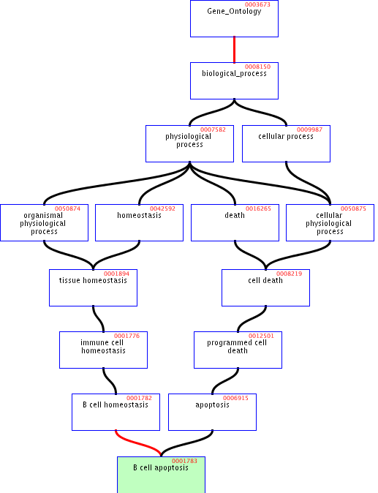
GO Structure
Terms are related within a hierarchy
is-a
part-of
Describes multiple levels of detail of gene function
Terms can have more than one parent or child
Notes:
29

Slide 30
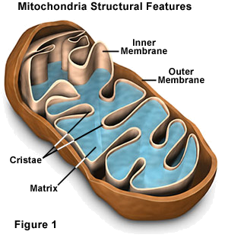
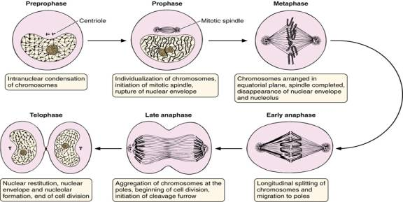
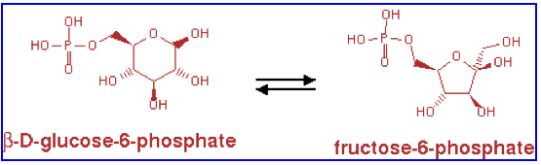
What is covered by the GO?
GO terms divided into three aspects:
cellular component
molecular function
biological process
glucose-6-phosphate isomerase activity
Cell division
Notes:
30

Slide 31
Part 1/2: Terms
Where do GO terms come from?
GO terms are added by editors at EBI and gene annotation database groups
Terms added by request
Experts help with major development
 | Jun 2012 | Apr 2015 | increase
Biological process | 23,074 | 28,158 | 22%
Molecular function | 9,392 | 10,835 | 15%
Cellular component | 2,994 | 3,903 | 30%
total | 37,104 | 42,896 | 16%
Notes:
31

Slide 32
Part 2/2: Annotations
Genes are linked, or associated, with GO terms by trained curators at genome databases
Known as ‘gene associations’ or GO annotations
Multiple annotations per gene
Some GO annotations created automatically (without human review)
Notes:
32

Slide 33
Annotation Sources
Manual annotation
Curated by scientists
High quality
Small number (time-consuming to create)
Reviewed computational analysis
Electronic annotation
Annotation derived without human validation
Computational predictions (accuracy varies)
Lower ‘quality’ than manual codes
Key point: be aware of annotation origin
Notes:
33

Slide 34


Evidence Types
Experimental Evidence Codes
EXP: Inferred from Experiment
IDA: Inferred from Direct Assay
IPI: Inferred from Physical Interaction
IMP: Inferred from Mutant Phenotype
IGI: Inferred from Genetic Interaction
IEP: Inferred from Expression Pattern
Author Statement Evidence Codes
TAS: Traceable Author Statement
NAS: Non-traceable Author Statement
Curator Statement Evidence Codes
IC: Inferred by Curator
ND: No biological Data available
Computational Analysis Evidence Codes
ISS: Inferred from Sequence or Structural Similarity
ISO: Inferred from Sequence Orthology
ISA: Inferred from Sequence Alignment
ISM: Inferred from Sequence Model
IGC: Inferred from Genomic Context
RCA: inferred from Reviewed Computational Analysis
IEA: Inferred from electronic annotation
http://www.geneontology.org/GO.evidence.shtml
Notes:
34

Slide 35
Contributing Databases
Berkeley Drosophila Genome Project (BDGP)
dictyBase (Dictyostelium discoideum)
FlyBase (Drosophila melanogaster)
GeneDB (Schizosaccharomyces pombe, Plasmodium falciparum, Leishmania major and Trypanosoma brucei)
UniProt Knowledgebase (Swiss-Prot/TrEMBL/PIR-PSD) and InterPro databases
Gramene (grains, including rice, Oryza)
Mouse Genome Database (MGD) and Gene Expression Database (GXD) (Mus musculus)
Rat Genome Database (RGD) (Rattus norvegicus)
Reactome
Saccharomyces Genome Database (SGD) (Saccharomyces cerevisiae)
The Arabidopsis Information Resource (TAIR) (Arabidopsis thaliana)
The Institute for Genomic Research (TIGR): databases on several bacterial species
WormBase (Caenorhabditis elegans)
Zebrafish Information Network (ZFIN): (Danio rerio)
Notes:
35

Slide 36
Pathway Analysis Methods
Overrepresentation Analysis
Gene Set Enrichment Analysis

Slide 37
Pathway Analysis
“Any type of analysis that involves pathway or information”
Most popular type is over-representation analysis, but many others exist.
Intended to gain insight into ‘omics’ data. E.g:
Identifying a master regulator gene,
Finding drug targets,
Characterizing pathways active in a sample.
Notes:
37

Slide 38
Benefits of Pathway Analysis
Relatively easy to interpret
Familiar concepts e.g. cell cycle
Identifies possible causal mechanisms
Predicts new roles for genes
Improves statistical power
Fewer tests, aggregates data from multiple genes into one pathway
More reproducible
E.g. gene expression signatures
Facilitates integration of multiple data types

Slide 39
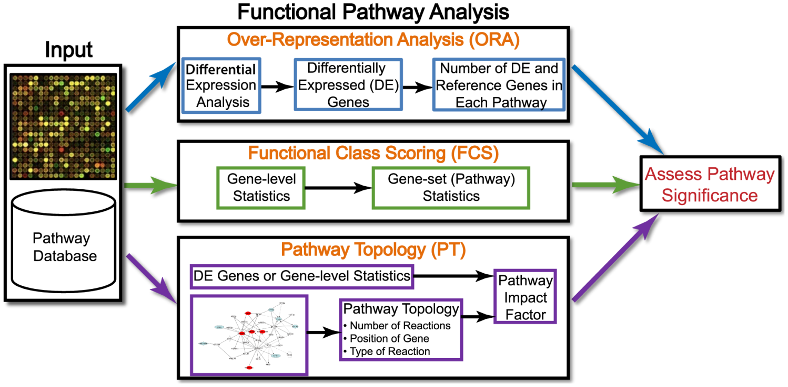
Types of Pathway Analysis
Khatri et alt. 10 years of Pathway Analysis

Slide 40
Analysis of thresholded lists with Enrichment Analysis (also called Overrepresentation A.)

Slide 41
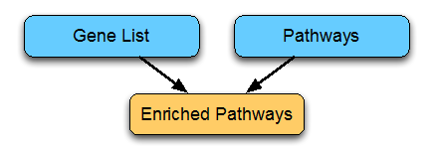
Over-representation analysis
Combines
Gene (feature) lists ← (Gen)omic experiment
Pathways and other gene annotations
Gene Ontology
Reactome
Pathway commons

Slide 42
Over-representation analysis
Given:
Gene list: e.g. RRP6, MRD1, RRP7, RRP43, RRP42 (yeast)
Gene sets or annotations: e.g. Gene ontology, transcription factor binding sites in promoter
Question: Are any of the gene annotations surprisingly enriched in the gene list?
Details:
Where do the gene lists come from?
How to assess “surprisingly” (statistics)
How to adjust for test multiplicity?
Notes:
42

Slide 43
Obtaining the gene lists
Genes Ranked by
Differential Statistic
Expression Matrix
Selection by Threshold
UP
UP
DOWN
DOWN
Class-1
Class-2
E.g.:
Fold change
Log (ratio)
t-test
Significance analysis of microarrays
Notes:
43

Slide 44
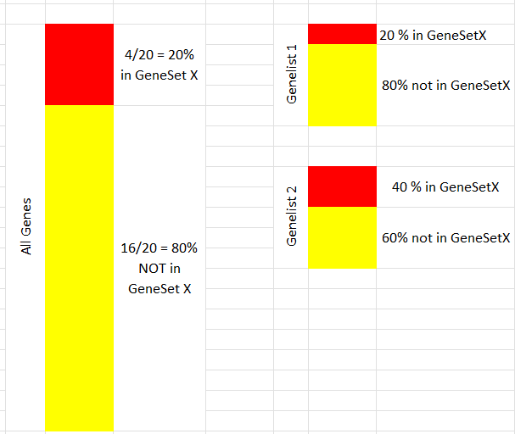
Assessing “surprisingly”
Given a gene list, “gl”, and a gene set, “GS”, check:
Is the % of genes in “gl” annotated in “GS” the same as the % of genes globally annotated in “GS”?
If both percentages are similar --> No Enrichment
If the % of genes annotated in “GS” is greater in “gl” than in the rest of genes --> “gl” is enriched in “GS”
60% not in GenSet X
Notes:
44

Slide 45
Examples
 | Differentially expressed (gl₁) | Not differentially expressed | TOTAL
In Gene Set (GS1) | 10 | 30 | 40
Not In Gene Set | 390 | 3570 | 3960
TOTAL | 400 | 3600 | 4000
% of gl1 in GS1 | 10/400=0.025 | 30/3600=0.00833
0.025 >> 0.00833 : “gl₁” is enriched in “GS₁”
 | Differentially expressed (gl₂) | Not differentially expressed | TOTAL
In Gene Set (GS2) | 10 | 30 | 40
Not In Gene Set | 390 | 1220 | 1610
TOTAL | 400 | 1500 | 1650
% of gl₂ in GS₂ | 10/400=0.025 | 30/1500=0.02
0.025 ≈ 0.02 : Can’t say that “gl₂” is enriched in “GS₂”

Slide 46
Assessing significance: Fisher test
The examples shows two cases
One where percentages are quite different
Another where percentages are similar
How can we set a threshold to decide that the difference is “big enough” to call it “Enriched”
Use Fisher Test or, equivalently,
a test to compare proportions or
a hypergeometric test.

Slide 47
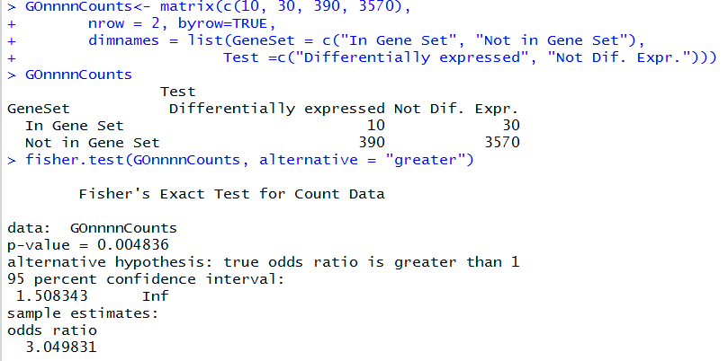
Assessing significance: Fisher test (1)
P-value small, odds-ratio high → List is surprisingly enriched in Gene Set

Slide 48
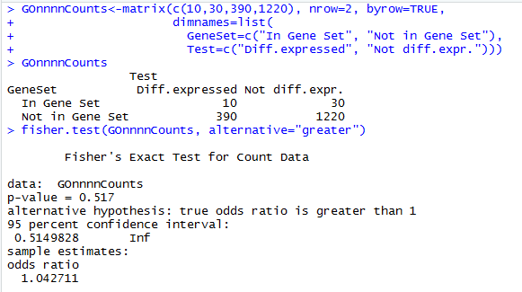
Assessing significance: Fisher test (2)
P-value not small, odds-ratio approx. 1 : List is not surprisingly enriched in Gene Set

Slide 49
Recipe for gene list enrichment test
Step 1: Define gene list (e.g. thresholding analyzed list ) and background list,
Step 2: Select gene sets to test for enrichment,
Step 3: Run enrichment tests and correct for multiple testing, if necessary,
Step 4: Interpret your enrichments
Step 5: Publish! ;)
Notes:
49
Consequtive basepairs

Slide 50
Possible problems with gene list tests
No “natural” value for the threshold
Possible loss of statistical power due to thresholding
No resolution between significant signals with different strengths
Weak signals neglected
Different results at different threshold settings
Based on the wrong assumption of independent gene (or gene group) sampling, which increases false positive predictions
Notes:
50

Slide 51
An example of ORA using Bioconductor (1)
# Get Genelist and expression marix
topTabAvsB <- read.table ("datasets/Top_AvsB.csv2", head=T, sep=";", dec=",", row.names=1)
expresAvsB <- read.table ("datasets/expres_AvsB.csv2", head=T, sep=";", dec=",", row.names=1)
# Define Gene list using arbitrary though reasonable cutoffs
probesUniverse <- rownames(topTabAvsB)
whichGenesInTop<- topTab["adj.P.Val"]<0.05 & topTab["logFC"] > 1
# Annotate Gene Universe and Gene list
entrezUniverse<- select(hgu133a.db, probesUniverse, "ENTREZID")
entrezUniverse <- entrezUniverse$ENTREZID
topGenes <- entrezUniverse[whichGenesInTop]
entrezUniverse <- entrezUniverse[!duplicated(entrezUniverse)]
topGenes <- topGenes[!duplicated(topGenes)]

Slide 52
An example of ORA using Bioconductor (2)
library(GOstats)
GOparams = new("GOHyperGParams",
geneIds=topGenes, universeGeneIds=entrezUniverse,
annotation="hgu133a.db", ontology="BP", pvalueCutoff=0.001)
GOhyper = hyperGTest(GOparams)
head(summary(GOhyper))
GOBPID Pvalue OddsRatio ExpCount Count Size Term
1 GO:0019370 0.0000917494 31.294444 0.2904762 4 7 leukotriene biosynthetic process
2 GO:0046395 0.0004796855 3.282433 4.4816327 13 108 carboxylic acid catabolic process
3 GO:0016054 0.0005736863 3.213594 4.5646259 13 110 organic acid catabolic process
4 GO:0072329 0.0007287196 4.193992 2.4897959 9 60 monocarboxylic acid catabolic process
5 GO:0006691 0.0007580159 13.402381 0.4564626 4 11 leukotriene metabolic process
6 GO:0045109 0.0008510094 8.401076 0.7884354 5 19 intermediate filament organization

Slide 53
Analysis of ranked gene lists with Gene Set Enrichment Analysis (also called Functional Class Scoring)

Slide 54
Gene Sets
A gene set
a group of genes with related functions.
sets of genes or pathways, for their association with a phenotype.
Examples: metabolic pathway, protein complex, or GO (gene ontology) category.
Identified from a prior biological knowledge.
May better reflect the true underlying biology.
May be more appropriate units for analysis.

Slide 55
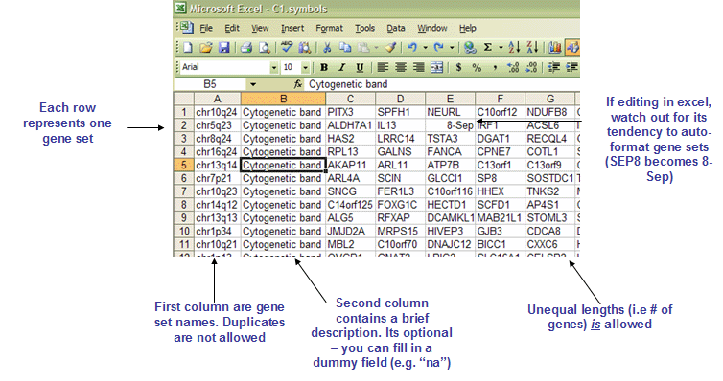
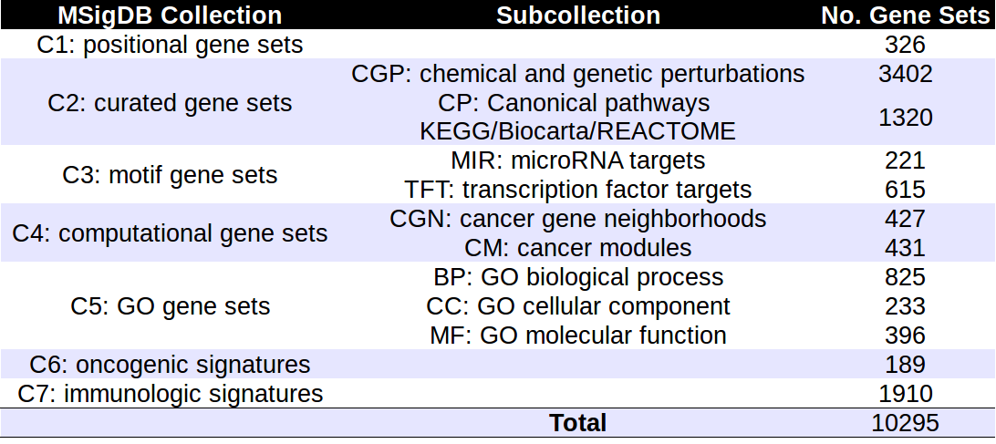
Gene Sets

Slide 56
Gene Set (Enrichment) Analysis
Mootha (2003) as an alternative to ORA.
It aims to identify gene sets with subtle but coordinated expression changes that cannot be detected by ORA methods.
Weak changes in individual genes gathered to large gene sets can show a significant pattern.
Results not affected by arbitrarily chosen cutoffs.
It does not provide information as detailed as ORA

Slide 57
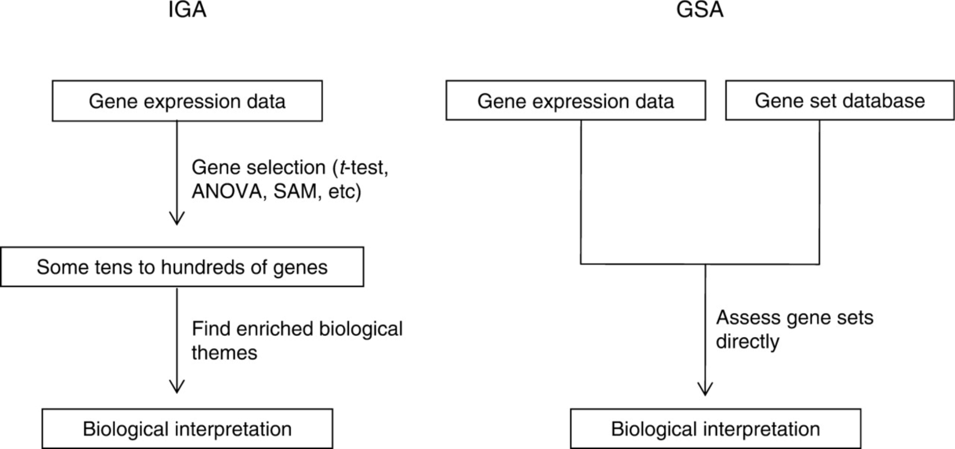
From: Gene-set approach for expression pattern analysis
Brief Bioinform. 2008;9(3):189-197. doi:10.1093/bib/bbn001
A schematic diagram comparing gene set analysis (GSA) with individual gene analysis (IGA). IGA is a two-step process which first selects some tens to hundreds of genes by an arbitrarily chosen cutoff and then, from the selected genes, infers the biological meaning of the gene expression data. In contrast, GSA is single-step process which in advance prepares gene sets from diverse sources as a testable hypothesis and then directly infers the biological meaning of gene expression data by applying either a sample or a gene randomization test.
Date of download: 4/19/2017
© The Author 2008. Published by Oxford University Press. For Permissions, please email: journals.permissions@oxfordjournals.org
Notes:
57

Slide 58
The GSEA method
Original GSEA method is based on comparing, for each gene group, the distribution of the test statistic within the group with the overall distribution of those statistics, i.e. the calculated for all genes.
To do this, test statistics are ranked (from biggest to smallest) and for each gene set a running sum is computed such that
If a gene is in the gene set add a certain quantity (moderate)
If a gene is not in the gene set, substract a (small) quantity
The distribution of the running sum is compared with that of the random walk using a Kolmogorov-Smirnov test (K-S test) statistic
P-values are computed based on a randomization.

Slide 59
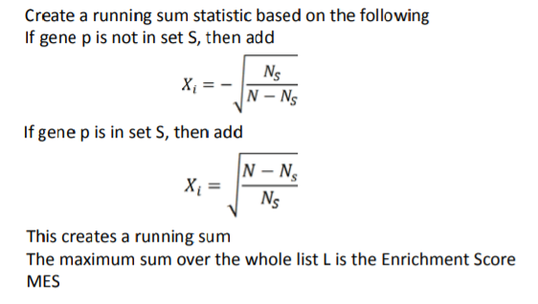
Calculating enrichment score (ES)
Notes:
Let N= #genes in the array, G= #genes in the gene set.
If a gene belongs to the gene set a quantity is added
If a gene does not belong to gene set a quantity is subtracted
If there is no concentration of genes belonging to the gene set (this appear at random) the random sum behaves as a random walk
If, instead, genes in the gene set tend to be more abundant in the top part of the list the running sum will tend to increase deviating from the random walk distribution.

Slide 60
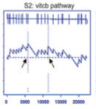
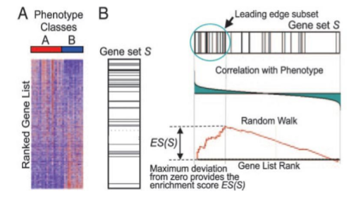
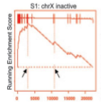
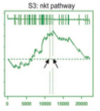
The GSEA method

Slide 61
Recipe for ranked list enrichment test
Step 1: Rank ALL your genes,
Step 2: Select gene sets to test for enrichment,
Step 3: Run enrichment tests and correct for multiple testing, if necessary,
Step 4: Interpret your enrichments
Step 5: Publish! ;)
Notes:
61
Consequtive basepairs

Slide 62
GSEA variants
GSEA is not free from criticisms
Use of KS test
Null hypothesis is not clear
Many alternative available
Efron’s GSA
Limma’s ROAST
Irizarry’s simple GSA based on Wilcoxon…

Slide 63
Multiple test adjustments
Notes:
63

Slide 64
Why we need to “adjust”
We use a statistical test to decide if a gene list is “surprisingly” enriched in a Gene Set.
We use “surprisingly” instead of “significantly”
Remember that when doing statistical tests one can be right or wrong differently.
Right
Rejecting the null hypothesis (H₀) when it is false
Not rejecting H₀ when it is true
Wrong
Rejecting the null hypothesis (H₀) when it is true
Not rejecting H₀ when it is false

Slide 65
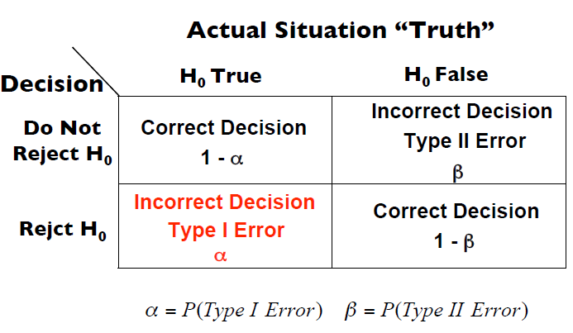
Errors and Successes in tests: Type I and type II errors

Slide 66
Testing repeatedly
Omics studies are “high throughput”
Selecting genes: One test per each gene
Finding enriched gene sets: One test per each gene set
Doing many tests means facing repeatedly the probability of making one false positive.
As the number of tests increases →
The chance of observing at least one false positive is going to increase too.

Slide 67
Why multiple testing matters
The probability of observing one false positive if testing once is:
P(Making a type I error) = α
P(not making a type I error) = 1- α
Now imagine we perform m tests independently
P(not making a type I error in m tests) = (1- α)^{m}
P(making at least a type I error in m tests) = 1-(1- α)^{m}
As m increases the probability of having at least one type error tends to increase

Slide 68
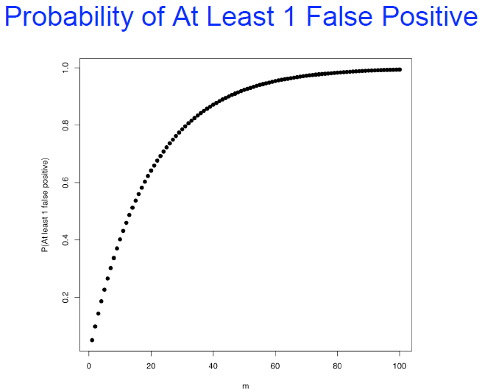
Type I error not useful in multiple testing
Number of tests: m | P(making at least a type I error) = 1-(1- a)^{m}
1 | 0.050000
2 | 0.097500
3 | 0.142625
4 | 0.185494
5 | 0.226219
6 | 0.264908
7 | 0.301663
8 | 0.336580

Slide 69
How can we deal with this issue?
Controlling for type I error is not feasible if many tests.
Idea: Modify α (or alternatively the p-value) so the error probability is controlled overall
This may mean different things:
The probability of at least one error in m tests is < α
The expected number of false positives is below a fixed threshold.
…

Slide 70
Controlling the FWER: Bonferroni
If M = # of annotations tested:
Adjusted P-value = M x original P-value
Adjusted P-value is greater than or equal to the probability that one or more of the observed enrichments are due to random draws.
The jargon for this correction is “controlling for the Family-Wise Error Rate (FWER)”
Notes:
70

Slide 71
Bonferroni correction caveats
Bonferroni correction is very stringent and can “wash away” real enrichments leading to false negatives,
Often one is willing to accept a less stringent condition, the “false discovery rate” (FDR), which leads to a gentler correction when there are real enrichments.
Notes:
71

Slide 72
False discovery rate (FDR)
FDR is the expected proportion of “False Positives” that is of the observed enrichments due to random chance.
Compare to Bonferroni correction which is a bound on the probability that any one of the observed enrichments could be due to random chance.
Typically, FDR adjustments are calculated using the Benjamini-Hochberg procedure.
FDR threshold is often called the “q-value”
Notes:
72

Slide 73
Benjamini-Hochberg example I
(Nominal)
P-value
Rank
Category
1
2
3
4
5
…
52
53
Transcriptional regulation
Transcription factor
Initiation of transcription
Nuclear localization
Chromatin modification
…
Cytoplasmic localization
Translation
0.001
0.002
0.003
0.0031
0.005
…
0.97
0.99
Sort P-values of all tests in decreasing order
Notes:
73

Slide 74
Benjamini-Hochberg example II
(Nominal)
P-value
Rank
Category
Adjusted P-value
1
2
3
4
5
…
52
53
Transcriptional regulation
Transcription factor
Initiation of transcription
Nuclear localization
Chromatin modification
…
Cytoplasmic localization
Translation
0.001
0.002
0.003
0.0031
0.005
…
0.97
0.99
0.001 x 53/1 = 0.053
0.002 x 53/2 = 0.053
0.003 x 53/3 = 0.053
0.0031 x 53/4 = 0.040
0.005 x 53/5 = 0.053
…
0.985 x 53/52 = 1.004
0.99 x 53/53 = 0.99
Adjusted P-value is “nominal” P-value times # of tests divided by the rank of the P-value in sorted list: AdjP-value = P-value X [# of tests] / Rank
Notes:
74

Slide 75
Benjamini-Hochberg example III
(Nominal)
P-value
FDR /
Q-value
Rank
Category
Adjusted P-value
1
2
3
4
5
…
52
53
Transcriptional regulation
Transcription factor
Initiation of transcription
Nuclear localization
Chromatin modification
…
Cytoplasmic localization
Translation
0.001
0.002
0.003
0.0031
0.005
…
0.97
0.99
0.001 x 53/1 = 0.053
0.002 x 53/2 = 0.053
0.003 x 53/3 = 0.053
0.0031 x 53/4 = 0.040
0.005 x 53/5 = 0.053
…
0.985 x 53/52 = 1.004
0.99 x 53/53 = 0.99
0.040
0.040
0.040
0.040
0.053
…
0.99
0.99
Adjusted P-value is “nominal” P-value times # of tests divided by the rank of the P-value in sorted list: AdjP-value = P-value X [# of tests] / Rank
Q-value (or FDR) corresponding to a nominal P-value is the smallest adjusted P-value assigned to P-values with the same or larger ranks.
Notes:
75

Slide 76
Benjamini-Hochberg example III
P-value threshold for FDR < 0.05
FDR /
Q-value
(Nominal)
P-value
Rank
Category
Adjusted P-value
1
2
3
4
5
…
52
53
Transcriptional regulation
Transcription factor
Initiation of transcription
Nuclear localization
Chromatin modification
…
Cytoplasmic localization
Translation
0.001
0.002
0.003
0.0031
0.005
…
0.97
0.99
0.001 x 53/1 = 0.053
0.002 x 53/2 = 0.053
0.003 x 53/3 = 0.053
0.0031 x 53/4 = 0.040
0.005 x 53/5 = 0.053
…
0.985 x 53/52 = 1.004
0.99 x 53/53 = 0.99
0.040
0.040
0.040
0.040
0.053
…
0.99
0.99
Red: non-significant
Green: significant at FDR < 0.05
Adjusted P-value is “nominal” P-value times # of tests divided by the rank of the P-value in sorted list: AdjP-value = P-value X [# of tests] / Rank
Q-value (or FDR) corresponding to a nominal P-value is the smallest adjusted P-value assigned to P-values with the same or larger ranks.
P-value threshold is highest ranking P-value for which corresponding Q-value is below desired significance threshold
Notes:
76

Slide 77
Reducing adjustment stringency
The adjustment to the P-value threshold depends on the # of tests that you do,
So, no matter what, the more tests you do, the more sensitive the test needs to be
Can control the stringency by reducing the number of tests:
Don’t use all collections of Gene Sets available
Restrict testing to the appropriate GO annotations;
Filter gene sets by size
Notes:
77

Slide 78
Summary
Pathway Analysis is a useful approach to help gain biological understanding from omics-based studies.
There are many ways, many methods, many tools
Choice of the method should be guided by
a combination of availability, ease of use and usefulness ,
Usually obtained from a good understanding of how it
Different methods may yield different results
Worth checking!
Notes:
78

Slide 79
References
Efron, Bradley, and Robert Tibshirani. 2007. “On Testing the Significance of Sets of Genes.” The Annals of Applied Statistics 1 (1): 107–29. doi:10.1214/07-AOAS101.
Irizarry, Rafael A., Chi Wang, Yun Zhou, and Terence P. Speed. 2009. “Gene Set Enrichment Analysis Made Simple.” Statistical Methods in Medical Research 18 (6): 565–75. doi:10.1177/0962280209351908.
Khatri, Purvesh, and Sorin Drăghici. 2005. “Ontological Analysis of Gene Expression Data: Current Tools, Limitations, and Open Problems.” Bioinformatics (Oxford, England) 21 (18): 3587–95. doi:10.1093/bioinformatics/bti565.
Khatri, Purvesh, Marina Sirota, and Atul J. Butte. 2012. “Ten Years of Pathway Analysis: Current Approaches and Outstanding Challenges.” PLOS Computational Biology 8 (2): e1002375. doi:10.1371/journal.pcbi.1002375.
Maciejewski, Henryk. 2014. “Gene Set Analysis Methods: Statistical Models and Methodological Differences.” Briefings in Bioinformatics 15 (4): 504–18. doi:10.1093/bib/bbt002.
Mootha, Vamsi K., Cecilia M. Lindgren, Karl-Fredrik Eriksson, Aravind Subramanian, Smita Sihag, Joseph Lehar, Pere Puigserver, et al. 2003. “PGC-1α-Responsive Genes Involved in Oxidative Phosphorylation Are Coordinately Downregulated in Human Diabetes.” Nature Genetics 34 (3): 267–73. doi:10.1038/ng1180.
Pan, Kuang-Hung, Chih-Jian Lih, and Stanley N. Cohen. 2005. “Effects of Threshold Choice on Biological Conclusions Reached during Analysis of Gene Expression by DNA Microarrays.” Proceedings of the National Academy of Sciences of the United States of America 102 (25): 8961–65. doi:10.1073/pnas.0502674102.
Subramanian, Aravind, Pablo Tamayo, Vamsi K. Mootha, Sayan Mukherjee, Benjamin L. Ebert, Michael A. Gillette, Amanda Paulovich, et al. 2005. “Gene Set Enrichment Analysis: A Knowledge-Based Approach for Interpreting Genome-Wide Expression Profiles.” Proceedings of the National Academy of Sciences of the United States of America 102 (43): 15545–50. doi:10.1073/pnas.0506580102.
the Mutation Consequences and Pathway Analysis working group of the International Cancer Genome Consortium. 2015. “Pathway and Network Analysis of Cancer Genomes.” Nature Methods 12 (7): 615–21. doi:10.1038/nmeth.3440.

