Slide 1
CLEAR CITY · COMMUNICATIONS DIRECTOR · FINAL PRESENTATION
Two Neighborhoods, Two Communications Strategies
A data-informed, equity-first approach for Clear City
CLARITY · EQUITY · ACCESS FOR EVERY RESIDENT
Notes:
Good [morning / afternoon]. I'm [your name], applying for Communications Director.
Two weeks ago I gave you a three-minute draft of this talk. You gave me thoughtful feedback. Today's seven-minute version is what I built from it — a fuller view of the data, a more concrete strategy, and a clearer plan for how I'd measure whether it's working.

Slide 2
THE BRIEF, IN ONE SLIDE
Two neighborhoods inside one city.
The Dunes
Palm Haven
• 1,200 residents —
• 800 residents —
• Working-class — younger, multilingual
• Mid-to-upper income — strong digital access
• Significant health needs — elevated BMI affects 59% of residents
• High civic engagement — engaged with city services
Same city. Same services on offer. Profoundly different starting points — and that means our communications cannot be one-size-fits-all.
Notes:
Two neighborhoods, both in Clear City. The Dunes — twelve hundred residents, working-class, younger, more multilingual, with serious health needs. Palm Haven — eight hundred residents, mid-to-upper income, digitally connected, civically engaged. Same city, same services on offer. The data tells me they need profoundly different communications. Let me show you why.

Slide 3
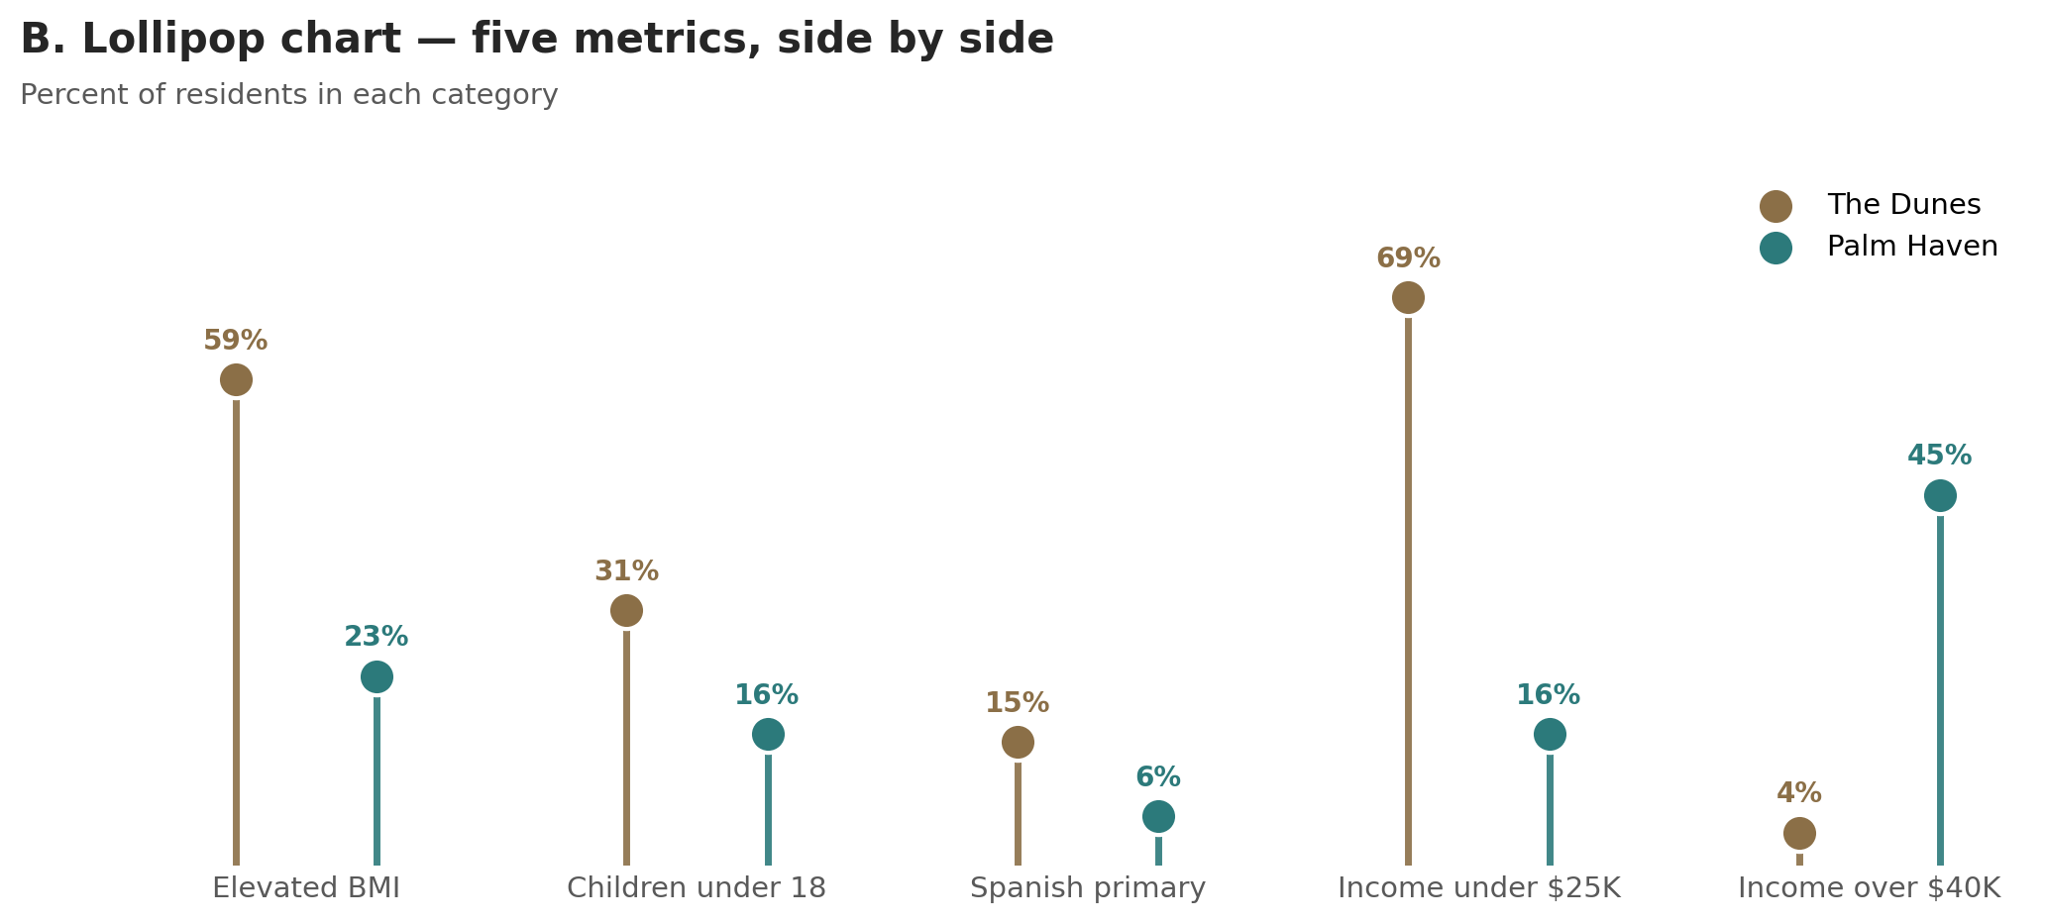
FIVE THINGS I LOOKED AT
The metrics that matter for outreach.
Notes:
Five things I looked at — health, age, language, and the two ends of the income spectrum. I picked these because each one changes how we should communicate. Health drives what we lead with. Age affects how we talk to families. Language affects whether we get through at all. And income shapes which channels reach people.

Slide 4
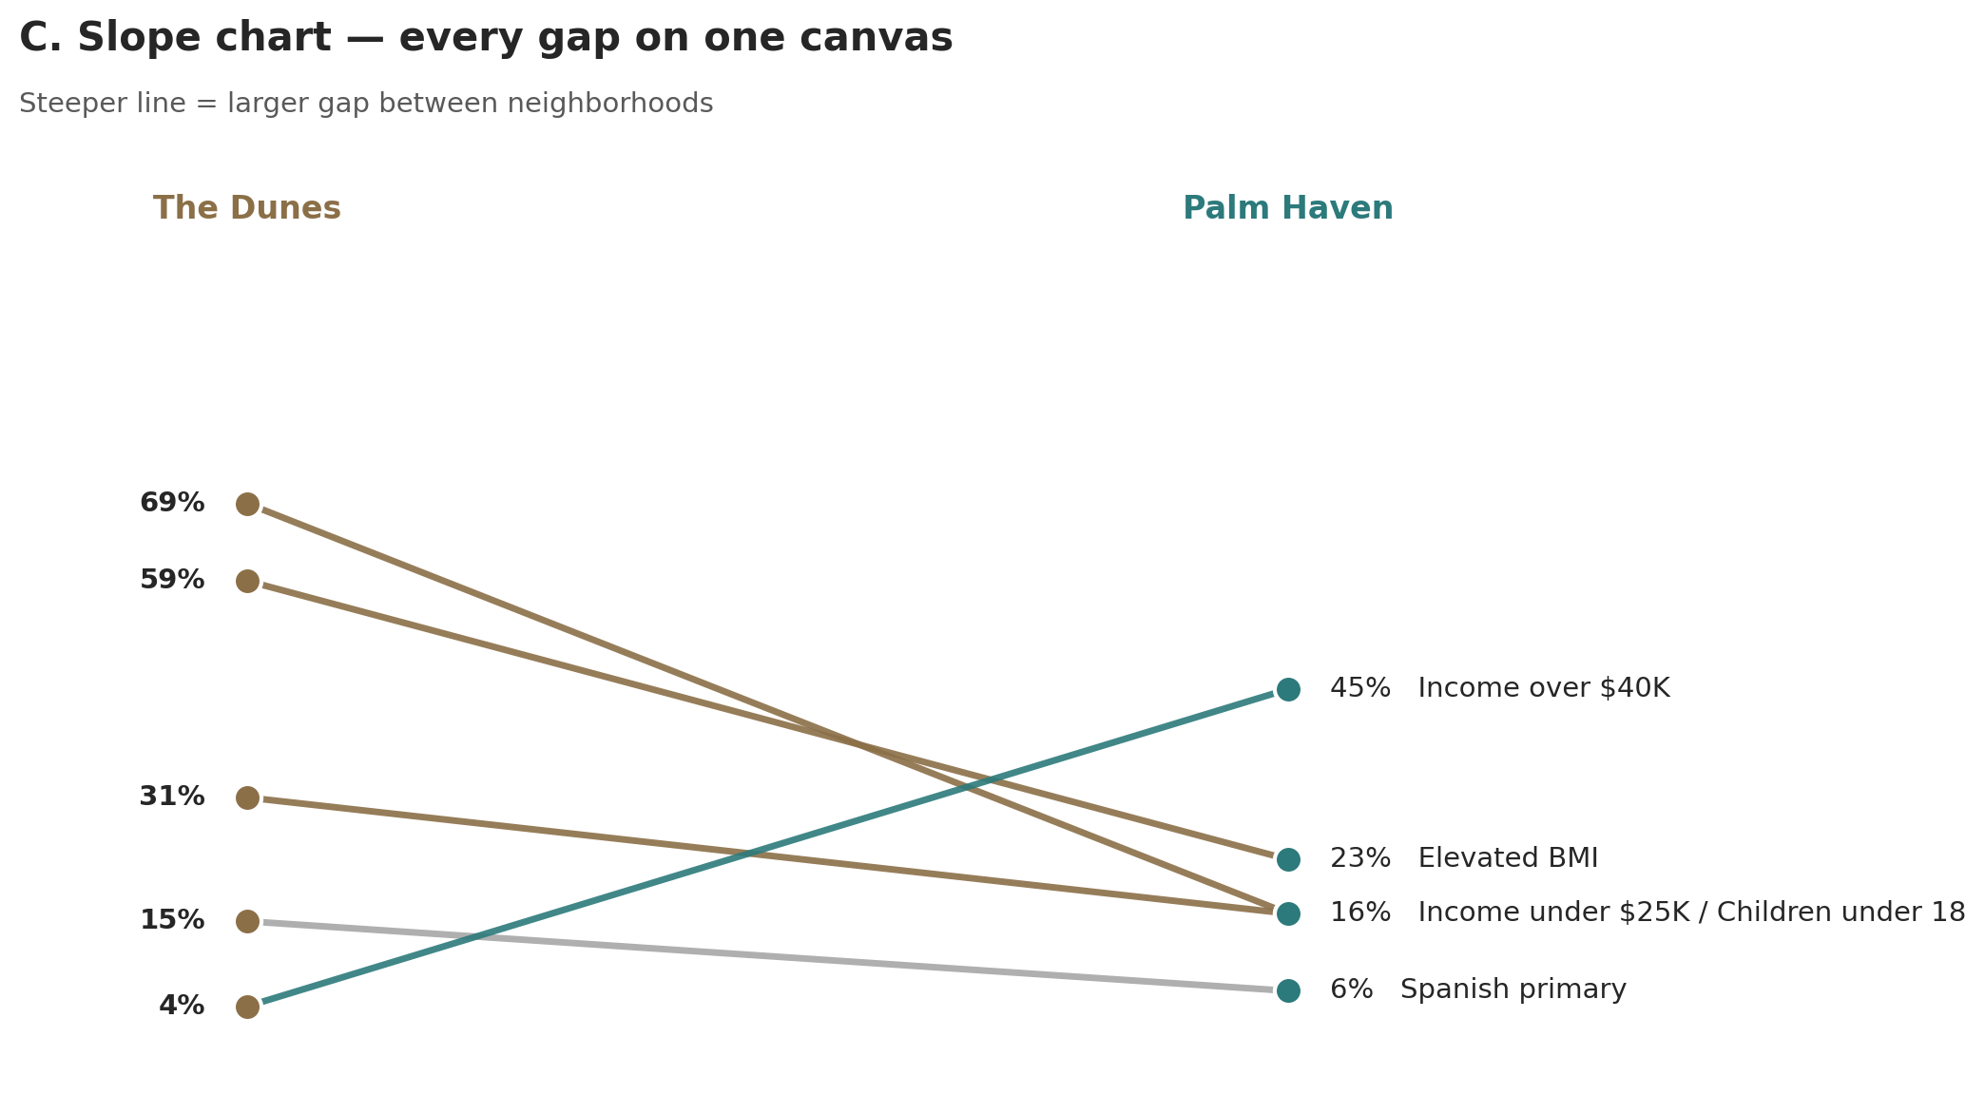
THE GAPS TELL A STORY
Same data. Tilted view. Different revelation.
Every metric diverges. The steepest line — the 36-point health gap — is the one I cannot ignore.
Notes:
Now look at the same data tilted ninety degrees. Each line connects the same metric across the two neighborhoods. The steeper the line, the bigger the gap. Four of the five lines slope downward — The Dunes higher than Palm Haven on health risk, children, Spanish at home, and lower income. One line goes the other way — higher income, where Palm Haven is far ahead. The steepest line — and the most consequential one — is the health gap.

Slide 5
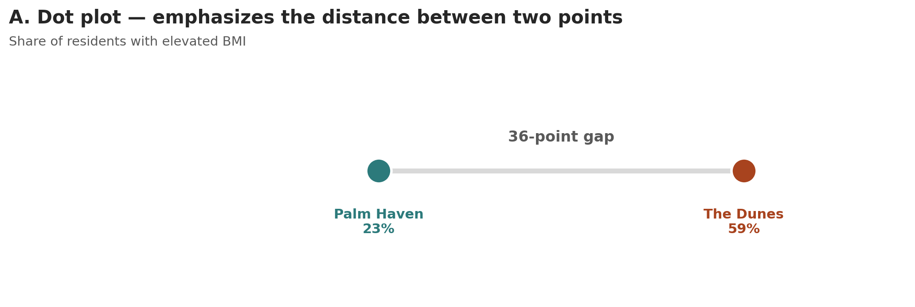
THE HEADLINE
A 36-point health gap.
In Palm Haven, this is one campaign a year. In The Dunes, it's the through-line of everything we publish.
Notes:
Fifty-nine percent of Dunes residents are at elevated weight risk. Twenty-three percent in Palm Haven. A thirty-six-point gap. For context: a thirty-six-point gap is the difference between a public-health emergency and a healthy community.
In Palm Haven, health is one campaign a year. In The Dunes, it's the through-line of everything we publish — every newsletter, every event, every billboard touches it somehow.

Slide 6
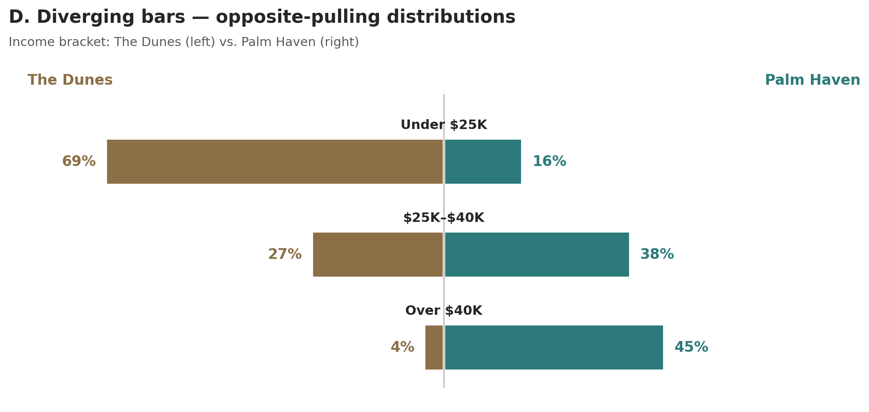
THE CHANNEL QUESTION
Why income demands different channels.
69% of Dunes households earn under $25K. 45% of Palm Haven earns over $40K. The right channel mix is different in each neighborhood.
Notes:
Income flips the script. Sixty-nine percent of Dunes households earn under twenty-five thousand a year. Forty-five percent of Palm Haven households earn over forty thousand. That gap matters because it shapes which channels actually reach people. Households in The Dunes are less likely to have unlimited data — so print, text, and in-person aren't fallbacks, they're the front door. Households in Palm Haven have all of those things. Email and self-serve portals aren't shortcuts — they're respectful of how this community wants to engage.

Slide 7
WHAT I'D DO ABOUT IT
Two neighborhoods. Two strategies.
The Dunes
Palm Haven
• Spanish first — written natively, plain language
• Digital-first — captioned video, screen-reader friendly
• Lead with health — clinics, food access, family programs
• Lead with civic engagement — volunteering, advocacy, town halls
• Trusted messengers — schools, faith leaders, community health workers
• Self-serve resources — clear portals, on-demand video
• Print, text, in-person — channels people actually use
• Monthly newsletter — opt-in, data-rich, transparent
• Multimodal — same message, three formats
• Two-way — comment forms, surveys, public meetings
Notes:
Two strategies, not one. The Dunes — Spanish first, written natively. Plain language. Health as the through-line. Trusted messengers — schools, faith leaders, community health workers — carry the message. Print, text, in-person. Same message, three formats.
Palm Haven — digital-first works. Captioned video, screen-reader friendly. Lead with civic engagement. Self-serve, transparent, data-rich. Two-way — comment forms, surveys, public meetings. They want to engage with us, not just receive us.

Slide 8
FIRST 90 DAYS & HOW I'LL MEASURE
Sequenced. Measurable. Honest.
First 90 days
How I'll know it's working
• Days 1–30 — Audit — inventory every channel; translate nothing yet
• Reach by neighborhood — never aggregate
• Days 31–60 — Build — Spanish-language editor; accessibility workflow
• Outcome metrics — clinic visits, town halls, enrollments
• Days 61–90 — Re-mix — SMS pilot, email cleanup, sunset what isn't working
• Accessibility scan — every published asset
• Trust surveys — before-and-after every event
Notes:
Sequenced. Measurable. Honest.
First thirty days — audit. I don't translate anything until I understand what's already in market. Next thirty — build. A Spanish-language editor. An accessibility checklist on every asset. Final thirty — re-mix. SMS for The Dunes. A clean email program for Palm Haven. Sunset what isn't working.
And here's how I'll know it's working — reach by neighborhood, never aggregate, because aggregate dashboards hide the gap. Outcome metrics tied to program goals. Accessibility scans. And short trust surveys, before and after every event.

Slide 9
THANK YOU
I'd be honored to do this work for Clear City.
Two neighborhoods. Two strategies. One goal — every resident reached.
Notes:
Thank you. I'd be honored to do this work for Clear City. I'm happy to take questions.

