Slide 1
CLEAR CITY · COMMUNICATIONS DIRECTOR · 3-MINUTE PITCH
Two Neighborhoods, Two Communications Strategies
The Dunes · 1,200 residents | Palm Haven · 800 residents
Same city. Same services. Profoundly different starting points.
CLARITY · EQUITY · ACCESS FOR EVERY RESIDENT
Notes:
Good [morning / afternoon]. I'm [your name], and I'm here to apply for Communications Director. In the next three minutes I'll do three things — show you a story I found in our city's data, tell you what I'd do about it, and let the work itself show you how I'd communicate for Clear City.

Slide 2
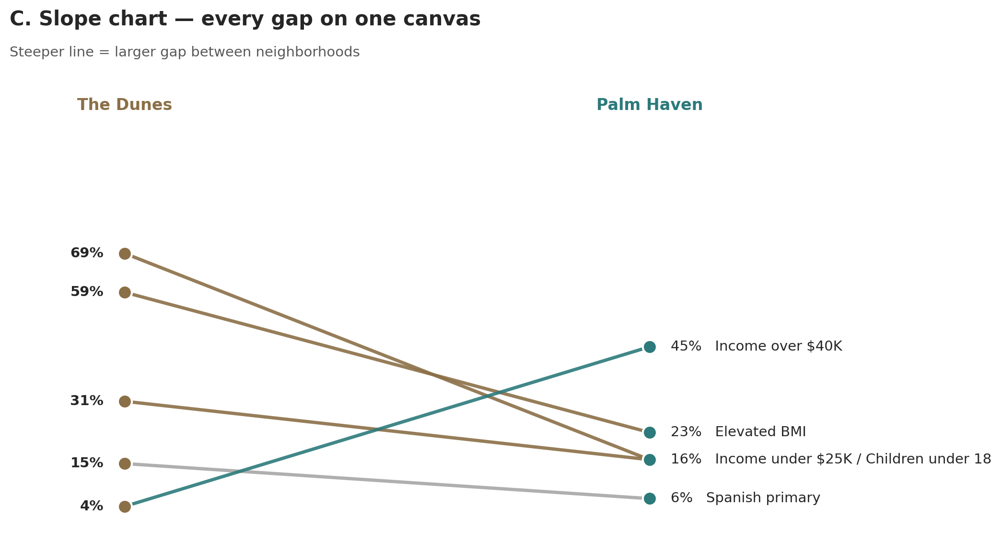
WHAT THE DATA SHOWS
Two neighborhoods. One picture.
On every measure that matters, these two neighborhoods are starting in different places. The widest gap — a 36-point difference in residents with elevated BMI — is the one we cannot ignore.
ONE CHART, FIVE FACTS · PLAIN NUMBERS · READABLE FOR EVERYONE
Notes:
One chart, two neighborhoods, five facts. The steeper the line, the bigger the gap.
The headline: fifty-nine percent of Dunes residents are at elevated weight risk — versus twenty-three percent in Palm Haven. A thirty-six-point gap.
Sixty-nine percent of Dunes households earn under twenty-five thousand a year. Forty-five percent of Palm Haven households earn over forty thousand. Incomes at opposite ends.
The Dunes also has more children — about one in three residents is under eighteen — and is two-and-a-half times more likely to use Spanish at home.
Same city. Same services on offer. Profoundly different starting points.

Slide 3
WHAT I'D DO ABOUT IT
Two neighborhoods. Two strategies.
The Dunes
Palm Haven
• Spanish first — written natively, plain language
• Digital-first — screen-reader friendly, captioned video
• Lead with health — clinics, food access, family programs
• Lead with civic engagement — volunteering, advocacy, town halls
• Trusted messengers — schools, faith leaders, community health workers
• Self-serve resources — clear portals, on-demand video
• Print, text, in-person — meet people on the channels they use
• Monthly newsletter — opt-in, data-rich, transparent
The goal — every Clear City resident reached on a channel they use, in a language they speak, at a reading level they understand.
Notes:
So what does this mean for Clear City? Two strategies, not one.
For The Dunes — Spanish first. Written in Spanish from day one, not translated at the end. Plain language — short sentences, everyday words. Health is the through-line. The schools, the faith communities, and community health workers carry the message. Print, text message, and in-person. Not email-first.
For Palm Haven — digital-first works. Captioned video, screen-reader friendly, keyboard-accessible. Lead with civic engagement. Self-serve, transparent, data-rich.
In my first ninety days I'd audit what we already publish, build the Spanish-language and accessibility workflow, and re-mix the channels.

Slide 4
THANK YOU
I'd be honored to do this work for Clear City.
Two neighborhoods. Two strategies. One goal — every resident reached.
Notes:
Thank you. I'd be honored to do this work for Clear City. I'm happy to take questions.

Slide 5
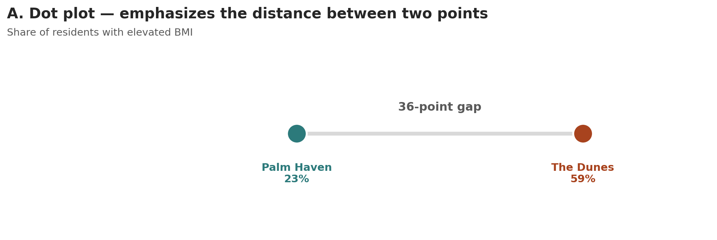
APPENDIX · ZOOMING IN ON THE HEADLINE
The 36-point gap, on its own.
Notes:
Use this slide if a panelist asks: 'Can you show just the BMI number on its own?' The dot plot is the simplest possible chart — two values, the distance between them.

Slide 6
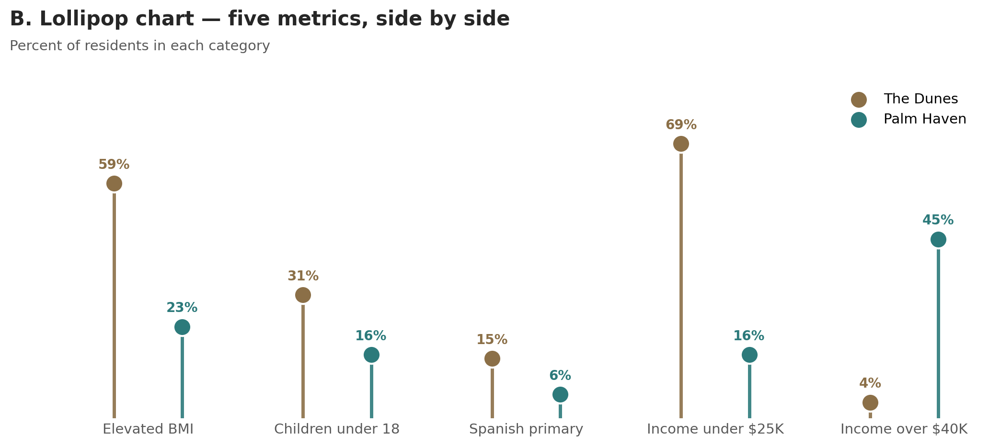
APPENDIX · ALL METRICS, SIDE BY SIDE
Every metric, paired and labeled.
Notes:
Use this slide if a panelist asks: 'Can you break out each metric separately?' Trades the slope chart's at-a-glance view for clearer per-metric reading.

Slide 7
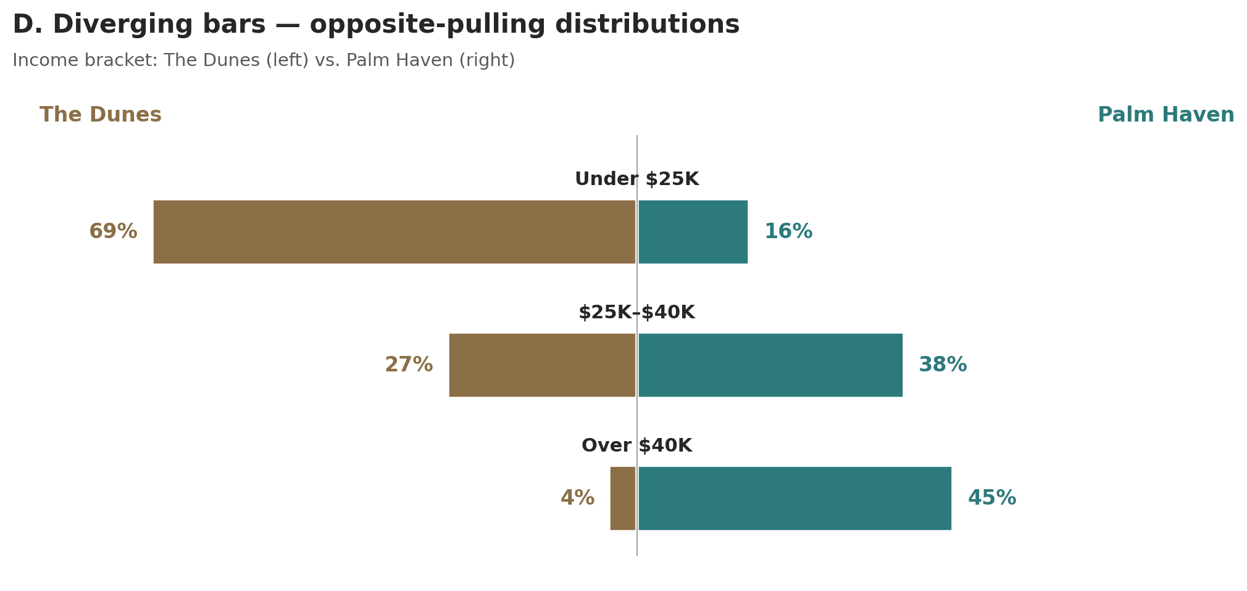
APPENDIX · INCOME, IN DETAIL
Incomes pulling in opposite directions.
Notes:
Use this slide if a panelist asks: 'Tell me more about the income story.' The asymmetry makes the case for different channels in each neighborhood.

