Slide 1
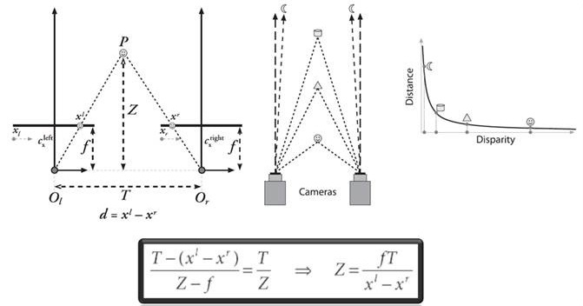
Overview of dual camera projection: (depth)

Slide 2
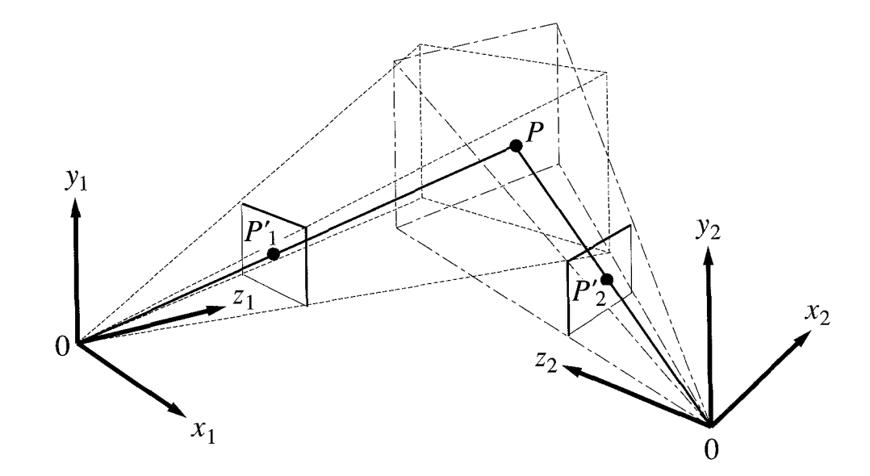
For single camera projection: (extrinsics: R+T)
cam coordinate system
World coordinate system (origin point is the end-effector)

Slide 3
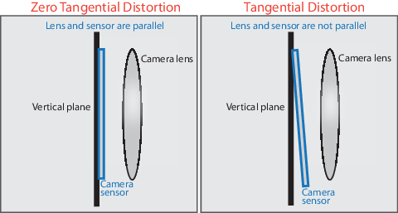
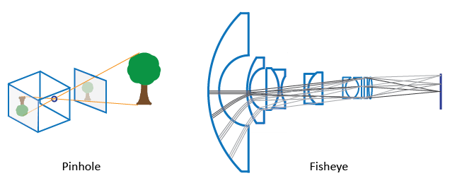
For single camera projection: (intrinsics)
camera calibration

Slide 4
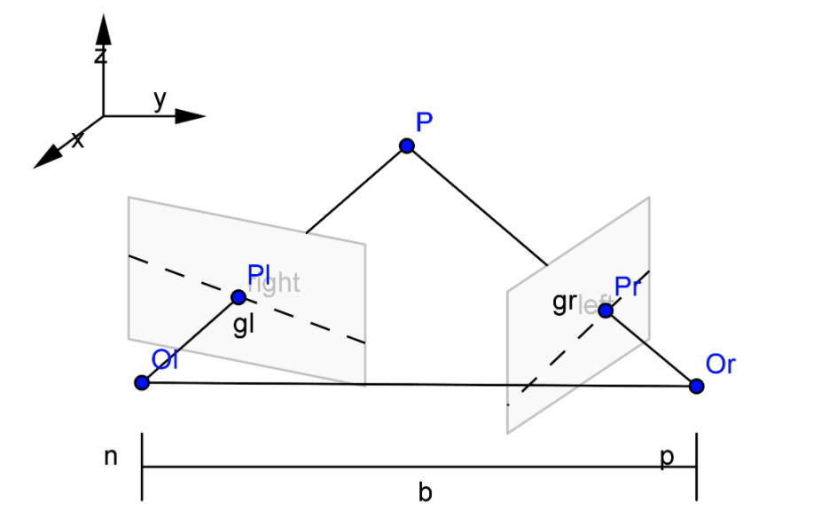
For dual camera projection: (biased)

Slide 5
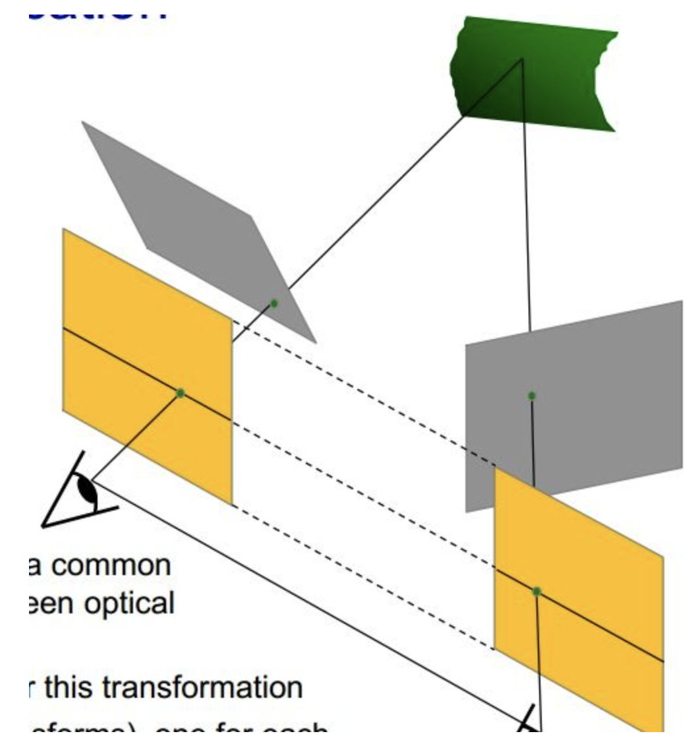
For dual camera projection: (calibration)

Slide 6
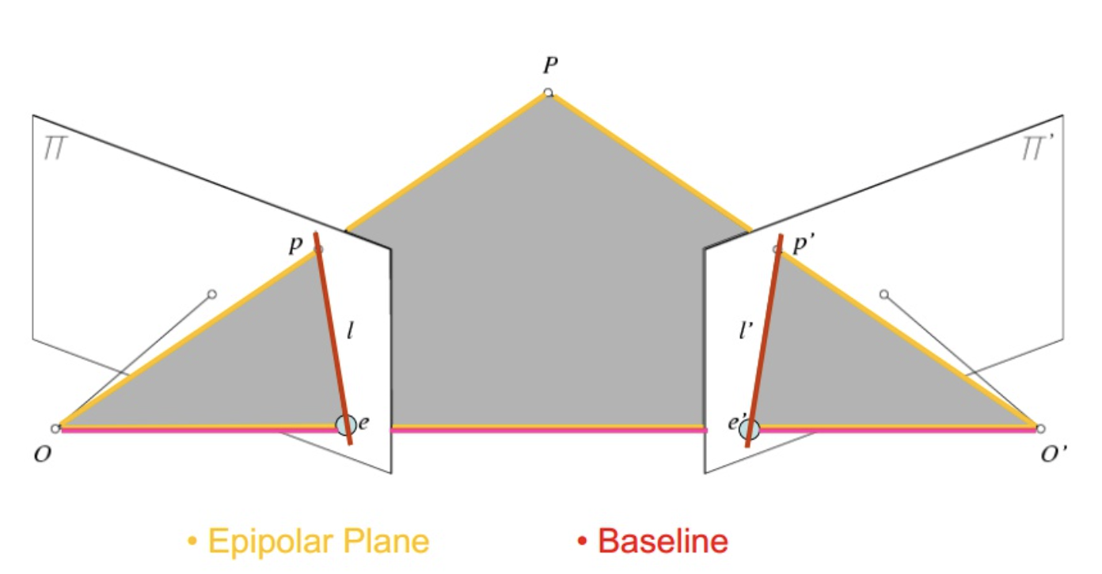
For dual camera projection: (calibration)

Slide 7
For dual camera projection: (depth)

Slide 8
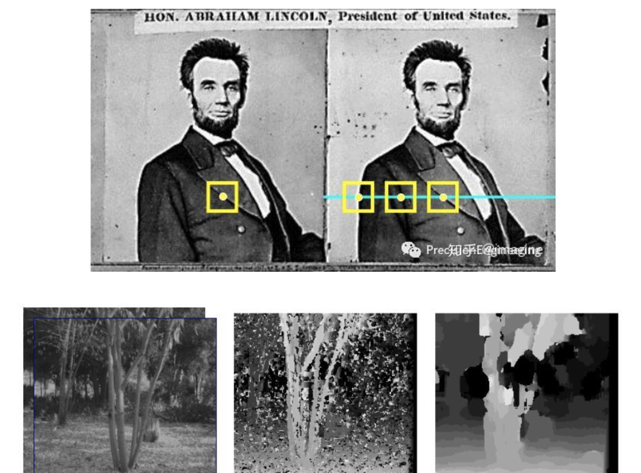
For dual camera projection: (feature matching)

