Slide 1
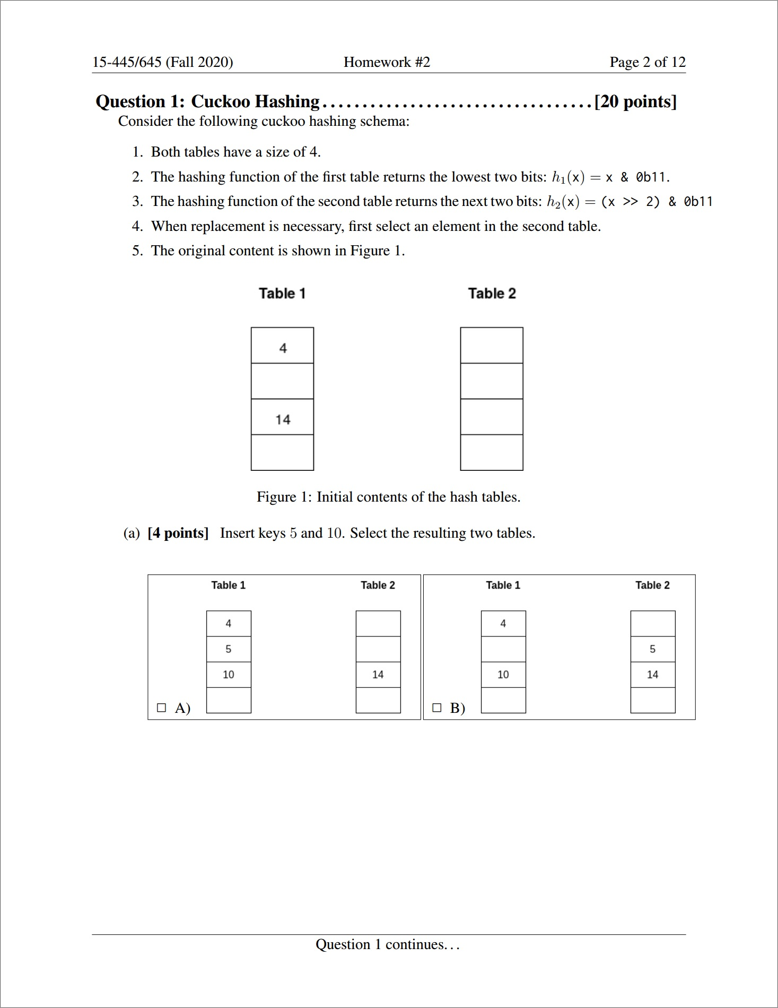
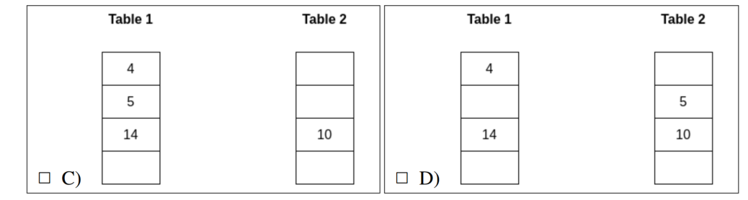

Slide 2
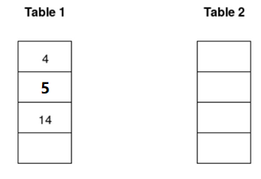
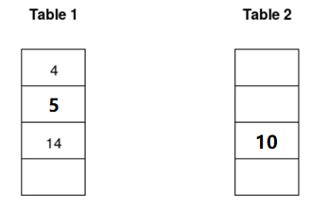
$$Insert 5:$$
$$h_{1}\left(5\right)=0b00101 \& 0b00011=0b00001=1$$
$$Insert 10:$$
$$h_{1}\left(10\right)=0b01010 \& 0b00011=0b00010=2 \left(conflict\right)$$
$$h_{2}\left(10\right)=0b00010 \& 0b00011=0b00010=2$$
$$Question1\left(a\right):C$$

Slide 3
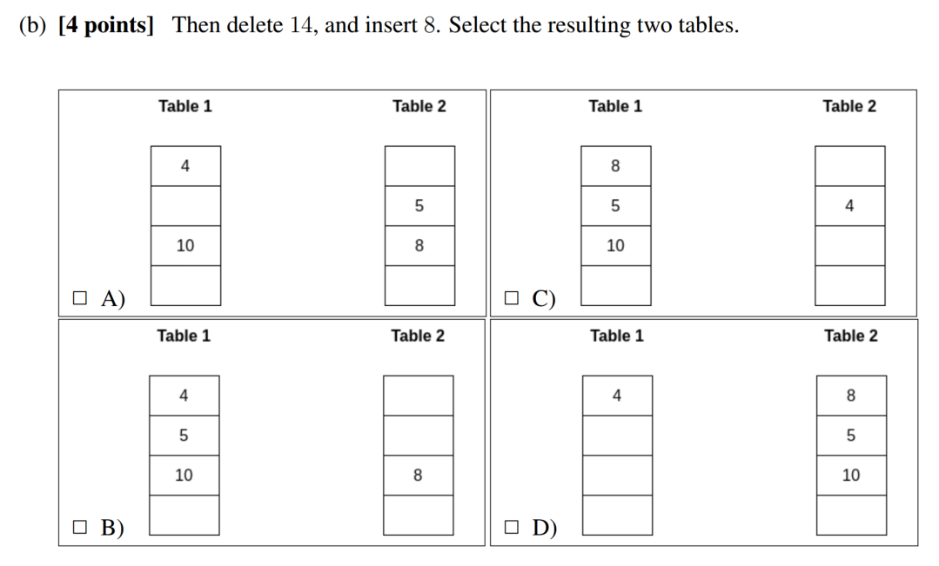

Slide 4
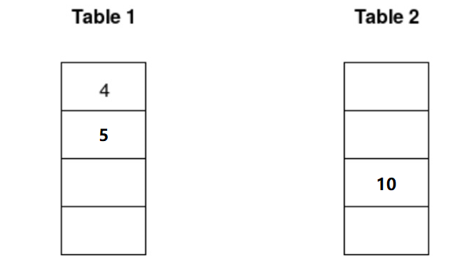
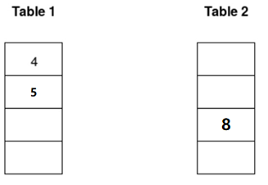
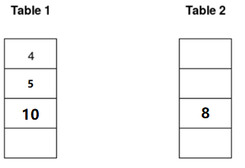
$$Delete 14:$$
$$Insert 8:$$
$$h_{1}\left(8\right)=0b01000 \& 0b00011=0b00000=0\left(conflict\right)$$
$$h_{2}\left(8\right)=0b00010 \& 0b00011=0b00010=2\left(conflict\right)$$
$$h_{1}\left(10\right)=0b01010 \& 0b00011=0b00010=2$$
$$Question1\left(b\right):B$$

Slide 5
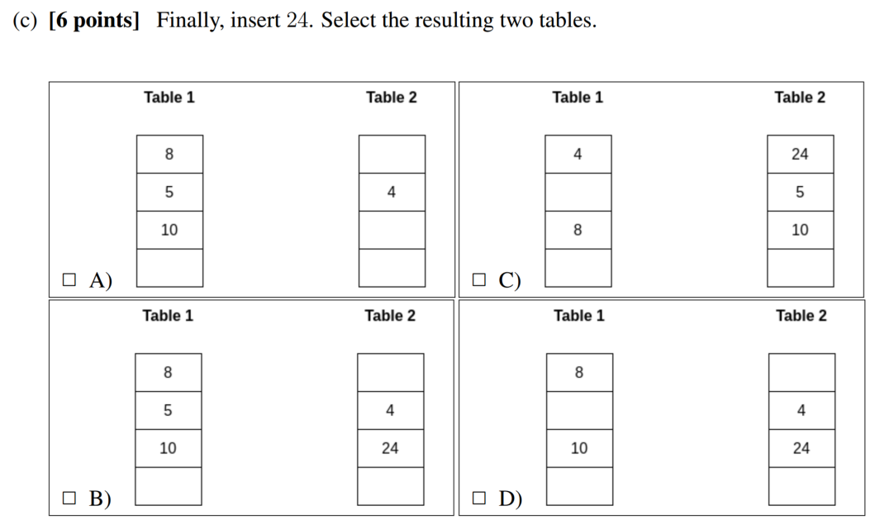

Slide 6
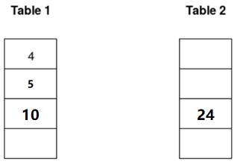
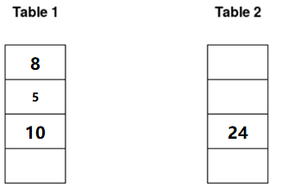
$$Insert 24:$$
$$h_{1}\left(24\right)=0b11000 \& 0b00011=0b00000=0\left(conflict\right)$$
$$h_{2}\left(24\right)=0b00110 \& 0b00011=0b00010=2\left(conflict\right)$$
$$h_{1}\left(8\right)=0b01000 \& 0b00011=0b00000=0\left(conflict\right)$$

Slide 7
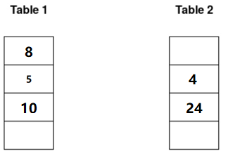
$$h_{2}\left(4\right)=0b00001 \& 0b00011=0b00001=1$$
$$Question1\left(c\right):B$$

Slide 8
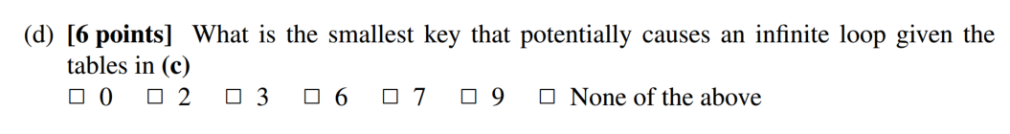

Slide 9
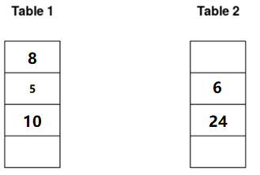
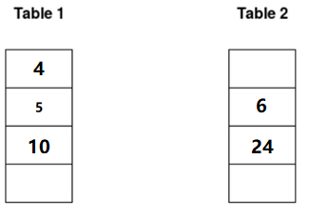
$$Insert 6:$$
$$h_{1}\left(6\right)=0b00110 \& 0b00011=0b00010=2\left(conflict\right)$$
$$h_{2}\left(6\right)=0b00001 \& 0b00011=0b00001=1\left(conflict\right)$$
$$h_{1}\left(4\right)=0b00100 \& 0b00011=0b00000=0\left(conflict\right)$$

Slide 10
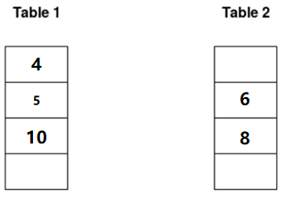
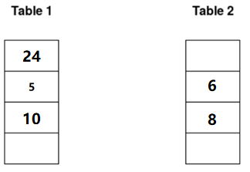
$$h_{2}\left(8\right)=0b00010 \& 0b00011=0b00010=2\left(conflict\right)$$
$$h_{1}\left(24\right)=0b11000 \& 0b00011=0b00000=0\left(conflict\right)$$
$$Now we are back to 4 again$$
$$Question1\left(d\right):6$$

