Slide 1
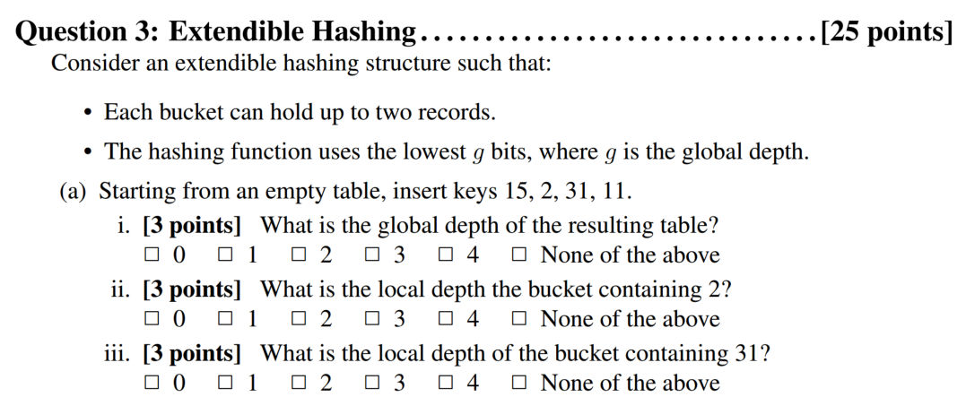

Slide 2



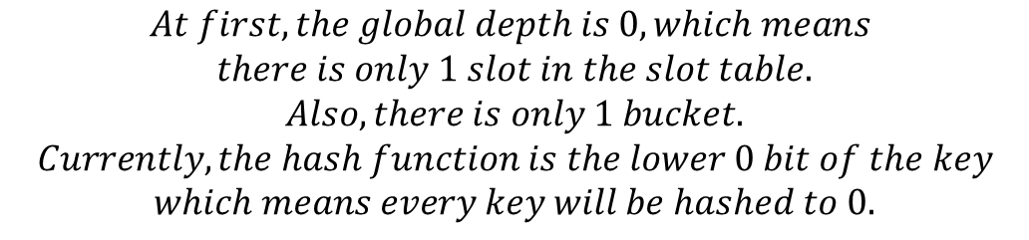





$$At first, the global depth is 0, which means$$
$$there is only 1 slot in the slot table.$$
$$Also, there is only 1 bucket.$$
$$Currently, the hash function is the lower 0 bit of the key$$
$$which means every key will be hashed to 0.$$
$$Insert 15:$$
$$15=0b01111$$
$Global Depth:$ 0
$Local Depth:$ 0
15
$$Insert 2:$$
$$2=0b00010$$
$Global Depth:$ 0
$Local Depth:$ 0
15
2

Slide 3




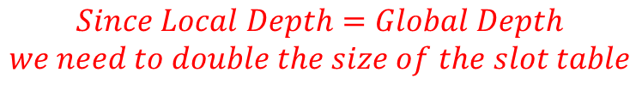



$$Insert 31:$$
$$31=0b11111$$
$Global Depth:$ 0
$Local Depth:$ 0
15
2
31
$$Since Local Depth=Global Depth$$
$$we need to double the size of the slot table$$
$Global Depth:$ 1
$Local Depth:$ 1
2
0
1
$Local Depth:$ 1
15
31

Slide 4



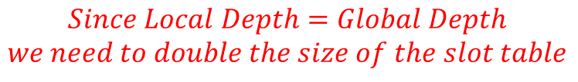




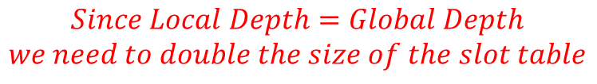


$$Insert 11:$$
$$11=0b01011$$
$Global Depth:$ 1
$Local Depth:$ 1
2
0
1
$Local Depth:$ 1
15
31
$$Since Local Depth=Global Depth$$
$$we need to double the size of the slot table$$
$Global Depth:$ 2
$Local Depth:$ 1
2
00
01
$Local Depth:$ 2
10
11
$Local Depth:$ 2
15
31
11
$$Since Local Depth=Global Depth$$
$$we need to double the size of the slot table$$

Slide 5





$Global Depth:$ 3
$Local Depth:$ 1
2
000
001
$Local Depth:$ 2
010
011
$Local Depth:$ 3
100
11
101
$Local Depth:$ 3
110
15
31
111
$$Question3\left(a\right)i:3$$
$$Question3\left(a\right)ii:1$$
$$Question3\left(a\right)iii:3$$

Slide 6







$$Insert 6:$$
$$6=0b00110$$
$Global Depth:$ 3
$Local Depth:$ 1
2
000
6
001
$Local Depth:$ 2
010
011
$Local Depth:$ 3
100
11
101
$Local Depth:$ 3
110
15
31
111

Slide 7


$$Insert 9:$$
$$9=0b01001$$
$Global Depth:$ 3
$Local Depth:$ 1
2
000
6
001
$Local Depth:$ 2
9
010
011
$Local Depth:$ 3
100
11
101
$Local Depth:$ 3
110
15
31
111

Slide 8


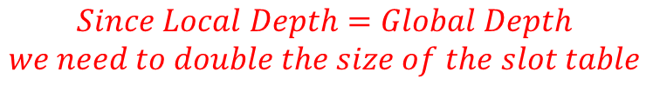
$$Insert 23:$$
$$23=0b10111$$
$Global Depth:$ 3
$Local Depth:$ 1
2
000
6
001
$Local Depth:$ 2
9
010
011
$Local Depth:$ 3
100
11
101
$Local Depth:$ 3
110
15
31
111
23
$$Since Local Depth=Global Depth$$
$$we need to double the size of the slot table$$

Slide 9






$Global Depth:$ 4
$Local Depth:$ 1
2
0000
6
0001
$Local Depth:$ 2
9
0010
0011
$Local Depth:$ 3
0100
11
0101
$Local Depth:$ 4
0110
23
0111
$Local Depth:$ 4
1000
15
1001
31
1010
1011
1100
1101
1110
1111

Slide 10







$$Insert 12:$$
$$12=0b01100$$
$Global Depth:$ 4
$Local Depth:$ 1
2
0000
6
0001
12
0010
0011
$Local Depth:$ 2
9
0100
0101
$Local Depth:$ 3
11
0110
0111
$Local Depth:$ 4
23
1000
1001
$Local Depth:$ 4
1010
15
31
1011
1100
1101
1110
1111

Slide 11






$Global Depth:$ 4
$Local Depth:$ 2
2
0000
6
0001
$Local Depth:$ 2
0010
12
0011
0100
$Local Depth:$ 2
0101
9
0110
0111
$Local Depth:$ 3
11
1000
1001
$Local Depth:$ 4
23
1010
1011
$Local Depth:$ 4
15
1100
31
1101
1110
1111

Slide 12

$$Insert 11:$$
$$Since 11 is already there, we do nothing.$$
$Global Depth:$ 4
$Local Depth:$ 2
2
0000
6
0001
$Local Depth:$ 2
0010
12
0011
0100
$Local Depth:$ 2
0101
9
0110
0111
$Local Depth:$ 3
11
1000
1001
$Local Depth:$ 4
23
1010
1011
$Local Depth:$ 4
15
1100
31
1101
1110
1111

Slide 13
$$Question3\left(b\right)i:12$$
$$Question3\left(b\right)ii:23$$

Slide 14




$Global Depth:$ 3
000
$Local Depth:$ 1
2
8
001
$Local Depth:$ 3
010
1
17
25
011
$Local Depth:$ 2
100
3
101
110
$Local Depth:$ 3
13
111

Slide 15

$$Delete 3:$$
$Global Depth:$ 3
000
$Local Depth:$ 1
2
8
001
$Local Depth:$ 3
010
1
17
25
011
$Local Depth:$ 2
100
101
110
$Local Depth:$ 3
13
111

Slide 16

$$Delete 8:$$
$Global Depth:$ 3
000
$Local Depth:$ 1
2
001
$Local Depth:$ 3
010
1
17
25
011
$Local Depth:$ 2
100
101
110
$Local Depth:$ 3
13
111

Slide 17




$$Delete 1:$$
$Global Depth:$ 3
000
$Local Depth:$ 1
2
001
$Local Depth:$ 3
010
17
25
011
$Local Depth:$ 2
100
101
110
$Local Depth:$ 3
13
111
$$A merge is possible$$

Slide 18



$Global Depth:$ 3
000
$Local Depth:$ 1
2
001
$Local Depth:$ 2
010
13
17
25
011
$Local Depth:$ 2
100
101
110
111
$$We can do furthur merge$$

Slide 19
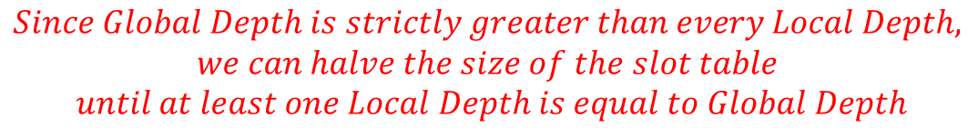

$Global Depth:$ 3
000
$Local Depth:$ 1
2
001
$Local Depth:$ 1
010
13
17
25
011
100
101
110
111
$$Since Global Depth is strictly greater than every Local Depth,$$
$$we can halve the size of the slot table$$
$$until at least one Local Depth is equal to Global Depth$$

Slide 20

$Global Depth:$ 1
000
$Local Depth:$ 1
2
001
$Local Depth:$ 1
13
17
25

Slide 21


$$Delete 2:$$
$Global Depth:$ 1
000
$Local Depth:$ 1
001
$Local Depth:$ 1
13
17
25
$$A merge is possible$$

Slide 22

$Global Depth:$ 1
$Local Depth:$ 1
13
17
25

Slide 23

$$Delete 17:$$
$Global Depth:$ 1
$Local Depth:$ 1
13
25
$$Question3\left(c\right)i:1$$
$$Question3\left(c\right)ii:1$$

