Slide 1
Consensus and leader election
Landon Cox
February 6, 2015

Slide 2
Two-phase commit
Two phases
Voting phase
Completion phase
During the voting phase
Special coordinator machine proposes value to rest of group
Other replicas tentatively apply update, reply “yes” to coordinator
During the completion phase
Coordinator tallies votes
Success (entire group votes “yes”): coordinator sends “commit” message
Failure (some “no” votes or no reply): coordinator sends “abort” message
On success, group member commits update, sends “ack” to coordinator
On failure, group member aborts update, sends “ack” to coordinator
Coordinator aborts/applies update when all “acks” have been received

Slide 3
Two-phase commit
Phase 1
Replica
Coordinator
Replica
Replica

Slide 4
Two-phase commit
Phase 1
Replica
Propose: X ← 1
Coordinator
Replica
Propose: X ← 1
Propose: X ← 1
Replica

Slide 5
Two-phase commit
Phase 1
Replica
X ← 1
Yes
Coordinator
Replica
Yes
X ← 1
Yes
Replica
X ← 1

Slide 6
Two-phase commit
Phase 2
Replica
X ← 1
Coordinator
Replica
3 Yes votes
X ← 1
Replica
X ← 1

Slide 7
Two-phase commit
Phase 2
Replica
X ← 1
Commit: X ← 1
Coordinator
Replica
Commit: X ← 1
X ← 1
Commit: X ← 1
Replica
X ← 1

Slide 8
Two-phase commit
Phase 2
Replica
X ← 1
Coordinator
Replica
X ← 1
Replica
X ← 1

Slide 9
Two-phase commit
Phase 2
Replica
X ← 1
ACK
Coordinator
Replica
ACK
X ← 1
ACK
Replica
X ← 1

Slide 10
Two-phase commit
Phase 1
What if fewer than 3 Yes votes?
Replicas will time out and assume update is aborted
Replica
X ← 1
No
Coordinator
Replica
2 Yes votes
Yes
X ← 1
Yes
Replica
X ← 1

Slide 11
Two-phase commit
Phase 1
What if fewer than 3 Yes votes?
Replicas do not commit
Replica
X ← 1
Abort: X ← 1
Coordinator
Replica
2 Yes votes
Abort: X ← 1
X ← 1
Abort: X ← 1
Replica
X ← 1

Slide 12
Two-phase commit
Phase 2
What if coord. fails after vote msgs, before decision msgs?
Replicas will time out and assume update is aborted
Replica
X ← 1
Coordinator
Replica
3 Yes votes
X ← 1
Replica
X ← 1

Slide 13
Two-phase commit
Phase 2
What if coord. fails after vote msgs, before decision msgs?
Replicas will time out and assume update is aborted
Replica
X ← 1
Coordinator
Replica
3 Yes votes
X ← 1
Replica
X ← 1

Slide 14
Two-phase commit
Phase 2
What if coord. fails after decision messages are sent?
Replicas commit update
Replica
X ← 1
Commit: X ← 1
Coordinator
Replica
Commit: X ← 1
X ← 1
Commit: X ← 1
Replica
X ← 1

Slide 15
Two-phase commit
Phase 2
What if coord. fails after decision messages are sent?
Replicas commit update
Replica
X ← 1
Coordinator
Replica
X ← 1
Replica
X ← 1

Slide 16
Two-phase commit
Phase 2
What if coord. fails while decision messages are sent?
If one replica receives a commit, all must commit
If replica time out, check with other members
If any member receives a commit, all commit
Replica
X ← 1
Commit: X ← 1
Coordinator
Replica
X ← 1
Replica
X ← 1

Slide 17
Two-phase commit
Phase 2
What if coord. fails while decision messages are sent?
If one replica receives a commit, all must commit
If replica times out, check with other members
Replica
X ← 1
Coordinator
Replica
X ← 1
Replica
X ← 1

Slide 18
Two-phase commit
Phase 2
What if coord. fails while decision messages are sent?
If one replica receives a commit, all must commit
If replica times out, check with other members
Replica
X ← 1
Coordinator
Replica
X ← 1
Replica
X ← 1

Slide 19
Two-phase commit
Phase 1 or 2
What if replica crashes during 2PC?
Coordinator removes it from the replica group
If replica recovers it can rejoin the group later
Replica
X ← 1
Coordinator
Replica
X ← 1
Replica
X ← 1

Slide 20
Two-phase commit
Phase 1 or 2
What if replica crashes during 2PC?
Coordinator removes it from the replica group
If replica recovers it can rejoin the group later
Replica
X ← 1
Coordinator
Replica
X ← 1
Replica
X ← 1

Slide 21
Two-phase commit
Phase 1 or 2
Can we write to the DB if replica crashes?
No, we won’t have enough “yes” votes
Replica
X ← 1
Coordinator
Replica
X ← 1
Replica
X ← 1

Slide 22
Two-phase commit
Phase 1 or 2
Can we write to the DB if replica crashes?
No, we won’t have enough “yes” votes
Replica
X ← 1
Coordinator
Replica
X ← 1
Replica
X ← 1

Slide 23
Two-phase commit
Besides the value of X, what else do nodes have to agree on?
The identity of the coordinator!
Replica
X ← 1
Coordinator
Replica
X ← 1
Replica
X ← 1

Slide 24
Two-phase commit
Besides the value of X, what else do nodes have to agree on?
The identity of the coordinator!
Replica
X ← 1
Coordinator
Replica
X ← 1
Replica
X ← 1

Slide 25
Two-phase commit
What happens if the coordinator fails?
Replicas have to agree on a new coordinator
A process called “leader election”
Replica
Coordinator ← C
Coordinator C
Replica
Coordinator ← C
Replica
Coordinator ← C

Slide 26
Two-phase commit
What happens if the coordinator fails?
Replicas have to agree on a new coordinator
A process called “leader election”
Replica
Coordinator ← C
Coordinator C
Replica
Coordinator ← C
Replica
Coordinator ← C

Slide 27
Two-phase commit
Can we use two-phase commit to agree on the coordinator?
Two-phase commit requires a coordinator
So to agree on one coordinator, need another coordinator, which requires agreement on yet another coordinator …
We have a serious boot-strapping problem
Replica
Coordinator ← C
Coordinator
C
Replica
Coordinator ← C
Replica
Coordinator ← C

Slide 28
Two-phase commit
Can we use two-phase commit to agree on the coordinator?
Two-phase commit requires a coordinator
So to agree on one coordinator, need another coordinator, which requires agreement on yet another coordinator …
We have a serious boot-strapping problem
Replica
Coordinator ← C
Coordinator
C
Replica
Coordinator ← C
Replica
Coordinator ← C

Slide 29
Two-phase commit
Besides the value of X, what else do nodes have to agree on?
The identity of the coordinator!
Replica
X ← 1
Coordinator
Replica
X ← 1
Replica
X ← 1

Slide 30
Two-phase commit
Besides the value of X, what else do nodes have to agree on?
The identity of the coordinator!
Replica
X ← 1
Coordinator
Replica
X ← 1
Replica
X ← 1

Slide 31
Two-phase commit
What happens if the coordinator fails?
Replicas have to agree on a new coordinator
A process called “leader election”
Replica
Coordinator ← C
Coordinator C
Replica
Coordinator ← C
Replica
Coordinator ← C

Slide 32
Two-phase commit
What happens if the coordinator fails?
Replicas have to agree on a new coordinator
A process called “leader election”
Replica
Coordinator ← C
Coordinator C
Replica
Coordinator ← C
Replica
Coordinator ← C

Slide 33
Two-phase commit
Can we use two-phase commit to agree on the coordinator?
Two-phase commit requires a coordinator
So to agree on one coordinator, need another coordinator, which requires agreement on yet another coordinator …
We have a serious boot-strapping problem
Replica
Coordinator ← C
Coordinator
C
Replica
Coordinator ← C
Replica
Coordinator ← C

Slide 34
Two-phase commit
Can we use two-phase commit to agree on the coordinator?
Two-phase commit requires a coordinator
So to agree on one coordinator, need another coordinator, which requires agreement on yet another coordinator …
We have a serious boot-strapping problem
Replica
Coordinator ← C
Coordinator
C
Replica
Coordinator ← C
Replica
Coordinator ← C

Slide 35
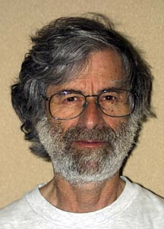

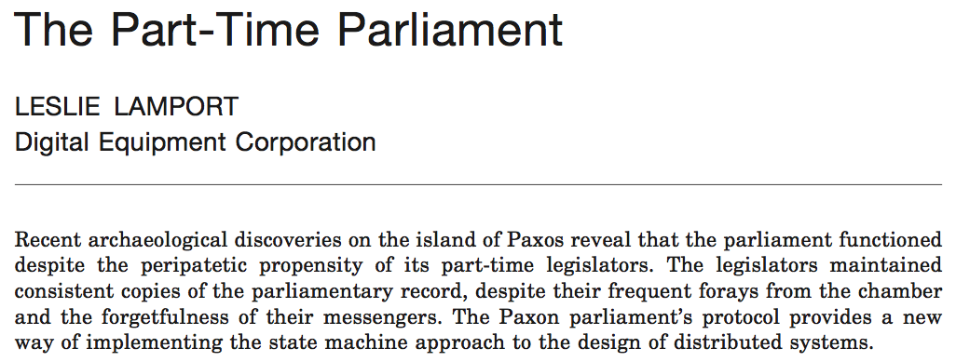
Paxos
ACM TOCS:
Transactions on Computer Systems
Submitted: 1990. Accepted: 1998
Introduced:

Slide 36
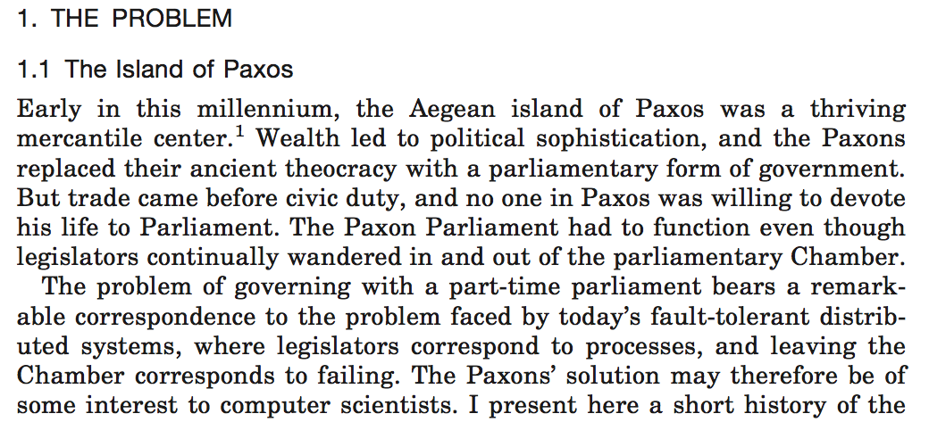

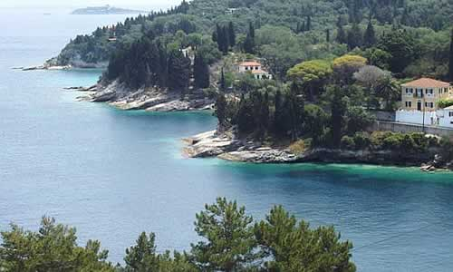

Slide 37
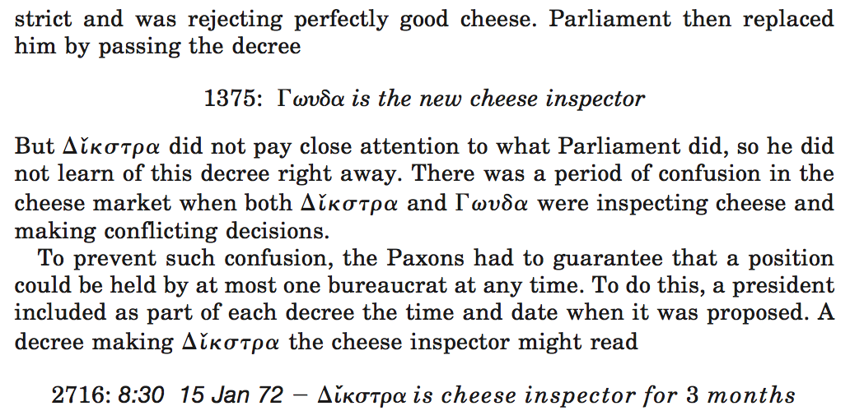
???

Slide 38
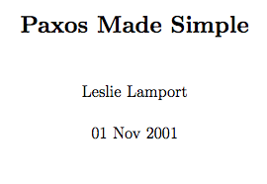
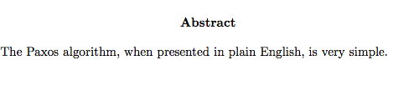
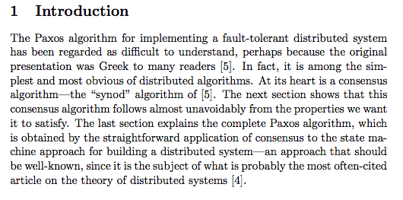
v2.0

Slide 39
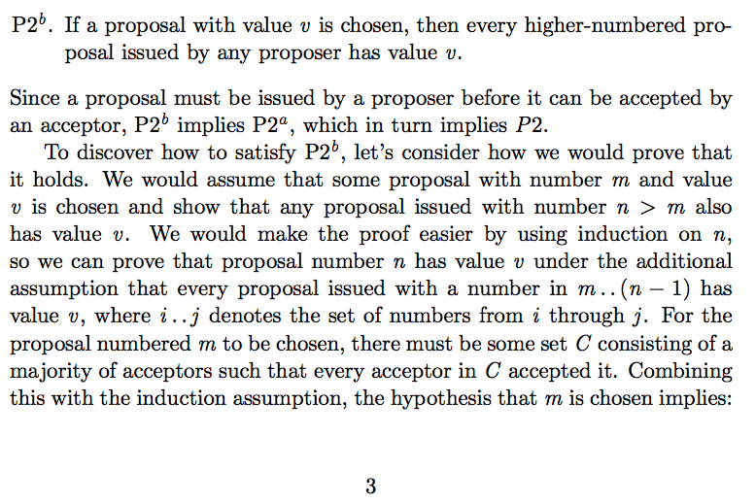
“Paxos Made Simple”

Slide 40
State machines
At any moment, machine exists in a “state”
What is a state?
Should think of as a set of named variables and their values

Slide 41
State machines
Clients can ask a machine about its current state.
What is your state?
1
2
Client
4
3
6
5
My state is “2”

Slide 42
State machines
“actions” change the machine’s state
What is an action?
Command that updates named variables’ values

Slide 43
State machines
“actions” change the machine’s state
Is an action’s effect deterministic?
For our purposes, yes. Given a state and an action,
we can determine next state w/ 100% certainty.

Slide 44
State machines
“actions” change the machine’s state
Is the effect of a sequence of actions deterministic?
Yes, given a state and a sequence of actions, can be 100% certain of end state

Slide 45
State machines
“actions” change the machine’s state
How to describe a set of actions (e.g., {a, b, c}) whose
effect is deterministic, regardless of how they’re ordered?
Those actions commute.

Slide 46
State machines
“actions” change the machine’s state
What determines whether actions commute?
Function of internal logic of machine;
we will assume that they do not.

Slide 47
Replicated state machines
Each state machine should compute same state, even if some fail.
Client
What is the state?
What is the state?
Client
What is the state?
Client

Slide 48
Replicated state machines
What has to be true of the actions that clients submit?
Applied in same order
Client
Apply action a.
Apply action c.
Client
Apply action b.
Client

Slide 49
State machines
How should a machine make sure it applies action in same order across reboots?
Store them in a log!
Action
Action
Action
…

Slide 50
Replicated state machines
Can reduce problem of consistent, replicated states to what?
Consistent, replicated logs.
…
…
…
…

Slide 51
Replicated state machines
How to make sure that logs are consistent?
Two-phase commit? …
…
…
…
…

Slide 52
Replicated state machines
Aren’t we back to where we started?
Yes, but now we can get to the heart of the matter
Apply action a.
…
…
Client
…
…

Slide 53
Replicated state machines
What is the heart of the matter?
Have to agree on the leader, outside of their logs.
Leader=L
Leader=L
Apply action a.
…
…
Client
Leader=L
Leader=L
…
…

Slide 54
Key elements of consensus
Leader election
Who is in charge?
Log replication
What are the actions and what is their order?
Safety
What is true for all states, in all executions?
e.g., either we haven’t agreed or we all agree on the same value

Slide 55
Key elements of consensus
Leader election
Who is in charge?
Log replication
What are the actions and what is their order?
Safety
What is true for all states, in all executions?
e.g., either we haven’t agreed or we all agree on the same value

Slide 56
Server states
Three states: leader, follower, candidate
C
F
L

Slide 57
Server state: follower
Passive state: respond to candidates and leaders
C
F
L

Slide 58
Server state: leader
Server handles all client requests
C
F
L
What should happen if a client sends a request to a follower?
Follower forwards request to leader.

Slide 59
Server state: candidate
An intermediate state, used during elections
C
F
L

Slide 60
Time divided into terms
Term 1
Term 2
T3
Term 4
Election
Normal operation
Election
Normal operation
Leader unknown
Leader known
What happened here?
Election failed

Slide 61
Terms as a logical clock
All servers maintain the current term
Terms increase monotonically
Maintained as a logical clock
Terms are exchanged whenever servers communicate
What if A’s term is bigger than B’s?
B updates its term to A’s
What if A’s term is bigger and B thinks of itself as the leader?
B reverts to a follower state
What if A’s term is bigger, and it receives a request from B?
A rejects B’s request
B must be up to date to issue requests

Slide 62

Server state: follower
S2
C
S1
F
L
C
Current term = 0
S3
F
L
C
Current term = 0
All servers start as followers.
All servers have local timers.
Note: no bootstrapping problem!
F
L
Current term = 0

Slide 63
Server state: follower
S2
C
S1
F
L
C
Current term = 0
S3
F
L
C
Current term = 0
F
L
Server remains follower as long as it receives periodic valid messages from a leader or candidate.
Called a “heartbeat” message.
Current term = 0

Slide 64
Server state: follower
S2
C
S1
F
L
C
Current term = 0
S3
F
L
C
Current term = 0
F
L
What should server assume if no heartbeat?
Assume no viable leader, start election.
Current term = 0

Slide 65
Server state: follower
S2
C
S1
F
L
C
Current term = 0
S3
F
L
C
Current term = 0
F
L
Who should the server nominate?
How about itself? At least it knows that it’s running.
Current term = 0

Slide 66
Server state: candidate
S2
C
S1
F
L
C
Current term = 0
S3
F
L
C
Current term = 1
F
L
To start an election:
Increment current term and set state to candidate
Current term = 0

Slide 67
Server state: candidate
S2
C
S1
F
L
C
Current term = 0
S3
F
L
C
Current term = 1
F
L
Need to collect votes. For whom should the server vote?
Itself, of course! Major qualification: It’s running.
Current term = 0

Slide 68
Server state: candidate
S2
C
S1
F
L
Vote in term 1
C
Current term = 0
Votes
S1=S1
S2=?
S3=?
S3
F
L
Vote in term 1
C
Current term = 1
F
L
How should S2, S3 respond to vote request?
Current term = 0

Slide 69
Server state: candidate
S2
C
S1
F
L
S1 in term 1
C
Current term = 1
Votes
S1=S1
S2=?
S3=?
S3
F
L
S1 in term 1
C
Current term = 1
F
L
How should S2, S3 respond to vote request?
Increment term, vote for S1 … why vote for S1?
Current term = 1
Our goal is consensus, and we know the collector
voted for itself.

Slide 70
Server state: candidate
S2
C
S1
F
L
C
Current term = 1
Votes
S1=S1
S2=S1
S3=S1
S3
F
L
C
Current term = 1
F
L
What should S1 do next?
Count votes (majority wins)
Make itself the leader, start sending heartbeats.
Current term = 1

Slide 71
Server state: candidate
S2
C
S1
F
L
Leader = S1
S1 is leader
C
Current term = 1
Leader = S1
S3
F
L
S1 is leader
C
Current term = 1
F
L
Leader = S1
Current term = 1

Slide 72
Server state: candidate
S2
C
S1
F
L
Leader = S1
C
Current term = 1
Leader = S1
S3
F
L
C
Current term = 1
F
L
Leader = S1
How many faults can we tolerate?
One. Need two/three to vote for same new leader
Current term = 1

Slide 73
Server state: candidate
S2
C
S1
F
L
Vote in term 1
C
Current term = 1
Votes
S1=S1
S2=?
S3=?
S3
F
L
Vote in term 1
C
C
Current term = 1
F
Votes
S1=?
S2=?
S3=S3
F
L
Who votes for whom if S1 and S3 both call elections?
Current term = 1

Slide 74
Server state: candidate
S2
C
S1
F
L
Vote in term 1
C
Current term = 1
Votes
S1=S1
S2=S3
S3=S3
S3
F
L
Vote in term 1
C
C
Current term = 1
F
Votes
S1=S1
S2=S3
S3=S3
F
L
Who votes for whom if S1 and S3 both call elections?
S2 votes for the server that asked first
Current term = 1

Slide 75
Server state: candidate
S2
C
S1
F
L
C
Current term = 1
Votes
S1=S1
S2=S3
S3=S3
S3
F
L
C
C
Current term = 1
F
Votes
S1=S1
S2=S3
S3=S3
F
L
What does S1 do if it loses the election?
Current term = 1

Slide 76
Server state: candidate
S2
C
S1
F
L
C
Current term = 1
Votes
S1=S1
S2=S3
S3=S3
S3
F
L
C
C
Current term = 1
F
Votes
S1=S1
S2=S3
S3=S3
F
L
What does S1 do if it loses the election?
Moves back to a follower state.
Current term = 1

Slide 77
Server state: candidate
S2
C
S1
F
L
Leader = S3
C
S3 is leader
Current term = 1
Leader = S3
S3
F
L
C
C
Current term = 1
S3 is leader
F
Leader = S3
F
L
Current term = 1

Slide 78
Server state: follower
S2
C
S1
F
L
C
Current term = 0
S3
F
L
C
Current term = 0
Can all three servers nominate themselves?
F
L
Current term = 0

Slide 79
Server state: candidate
S2
C
S1
Votes
S1=S1
S2=S2
S3=S3
F
L
C
Current term = 1
Votes
S1=S1
S2=S2
S3=S3
S3
F
L
C
Current term = 1
F
L
Votes
S1=S1
S2=S2
S3=S3
Can all three servers nominate themselves?
Sure!
Current term = 1

Slide 80
Server state: candidate
S2
C
S1
Votes
S1=S1
S2=S2
S3=S3
F
L
C
Current term = 1
Votes
S1=S1
S2=S2
S3=S3
S3
F
L
C
Current term = 1
F
L
Votes
S1=S1
S2=S2
S3=S3
Could this happen indefinitely?
Current term = 1

Slide 81
Server state: candidate
S2
C
S1
Votes
S1=S1
S2=S2
S3=S3
F
L
C
Current term = 1
Votes
S1=S1
S2=S2
S3=S3
S3
F
L
C
Current term = 1
F
L
Votes
S1=S1
S2=S2
S3=S3
Could this happen indefinitely?
Yes, there is not way to prevent this from happening.
The worst possible thing is always possible.
Current term = 1

Slide 82
Server state: candidate
S2
C
S1
Votes
S1=S1
S2=S2
S3=S3
F
L
C
Current term = 1
Votes
S1=S1
S2=S2
S3=S3
S3
F
L
C
Current term = 1
F
L
Votes
S1=S1
S2=S2
S3=S3
How do we make this less likely to occur?
Current term = 1

Slide 83
Server state: candidate
S2
C
S1
Votes
S1=S1
S2=S2
S3=S3
F
L
C
Current term = 1
Votes
S1=S1
S2=S2
S3=S3
S3
F
L
C
Current term = 1
F
L
Votes
S1=S1
S2=S2
S3=S3
How do we make this less likely to occur?
Randomize election timeouts
i.e., wait a random period before new election
Current term = 1

Slide 84
Server state: candidate
S2
C
S1
F
L
C
Current term = 1
S3
F
L
C
Current term = 1
Can we ever have two leaders?
F
L
Current term = 1

Slide 85
Server state: candidate
S2
C
S1
F
L
C
Current term = 1
S3
F
L
C
Current term = 1
Can we ever have two leaders?
No, votes either split or converge w/ three nodes.
F
L
Current term = 1

Slide 86
One lingering issue
Nodes still have to agree on cluster membership!
What if membership just grows monotonically?
Dead members can undermine availability
If enough dead members, may never achieve majority
We will return to this issue in a few lectures

Slide 87
Key elements of consensus
Leader election
Who is in charge?
Log replication
What are the actions and what is their order?
Safety
What is true for all states, in all executions?
e.g., either we haven’t agreed or we all agree on the same value

Slide 88
Leader=L
Each node maintains an action log.
Each entry contains an action and a term.
The term indicates when the leader received the action.
Leader=L
1
x ← 3
1
y ← 1
Leader=L
1
x ← 3
1
y ← 1
1
x ← 3
1
y ← 1

Slide 89
Leader=L
When a request comes in, leader appends action to its log.
Client
y ← 5
Leader=L
1
x ← 3
1
y ← 1
Leader=L
1
x ← 3
1
y ← 1
1
y ← 5
1
x ← 3
1
y ← 1

Slide 90
Leader=L
Next, the leader tells other servers to append action.
Client
y ← 5
Leader=L
1
y ← 5
1
x ← 3
1
y ← 1
Leader=L
1
y ← 5
1
x ← 3
1
y ← 1
1
y ← 5
1
x ← 3
1
y ← 1

Slide 91
Leader=L
The leader waits for confirmation that the entry was appended.
Client
y ← 5
Leader=L
ack
1
x ← 3
1
y ← 1
1
y ← 5
Leader=L
ack
1
x ← 3
1
y ← 1
1
y ← 5
1
x ← 3
1
y ← 1
1
y ← 5

Slide 92
As with leader election, majority rules.
Entry is committed once the leader that received it has replicated the entry on a majority of servers.
Leader=L
Client
y ← 5
Leader=L
3/3 … commit!
1
x ← 3
1
y ← 1
1
y ← 5
Leader=L
1
x ← 3
1
y ← 1
1
y ← 5
1
x ← 3
1
y ← 1
1
y ← 5

Slide 93
If action commits, leader updates state machine.
Leader=L
Client
y ← 5
Leader=L
1
x ← 3
1
y ← 1
1
y ← 5
Leader=L
1
x ← 3
1
y ← 1
1
y ← 5
1
x ← 3
1
y ← 1
1
y ← 5

Slide 94
Leader reports success to client and other servers if action commits
Leader=L
Client
y ← 5
C
Leader=L
C
1
x ← 3
1
y ← 1
1
y ← 5
C
Leader=L
1
x ← 3
1
y ← 1
1
y ← 5
1
x ← 3
1
y ← 1
1
y ← 5

Slide 95
What happens if one follower fails?
Action will still commit, since 2/3 are alive.
Leader=L
Leader=L
1
x ← 3
1
y ← 1
Leader=L
1
x ← 3
1
y ← 1
1
y ← 5
1
x ← 3
1
y ← 1
1
y ← 5

Slide 96
What happens if both followers fail: (1) after adding entry to logs, and (2) before acking?
Leader=L
The leader will keep trying to append. If one server comes back, the action will eventually commit.
Leader=L
1
x ← 3
1
y ← 1
1
y ← 5
Leader=L
1
x ← 3
1
y ← 1
1
y ← 5
1
x ← 3
1
y ← 1
1
y ← 5

Slide 97
How long might a client have to wait in this case?
A long time, i.e., until two machines append the action
Leader=L
Leader=L
1
x ← 3
1
y ← 1
1
y ← 5
Leader=L
1
x ← 3
1
y ← 1
1
y ← 5
1
x ← 3
1
y ← 1
1
y ← 5

Slide 98
What happens if leader fails: (1) after adding entry to log, and (2) before contacting followers?
Leader=L
Action will not commit. New entries will occur under next term.
Leader=L
1
x ← 3
1
y ← 1
Leader=L
1
x ← 3
1
y ← 1
1
y ← 5
1
x ← 3
1
y ← 1

Slide 99
As with leader election, majority rules (for now …).
Entry is committed once the leader that received it has replicated the entry on a majority of servers
Log index
1
2
3
4
5
6
7
8
1
x ← 3
1
y ← 1
1
y ← 9
2
x ← 2
3
x ← 0
3
y ← 7
3
x ← 5
3
x ← 4
Leader
1
x ← 3
1
y ← 1
1
y ← 9
2
x ← 2
3
x ← 0
1
x ← 3
1
y ← 1
1
y ← 9
2
x ← 2
3
x ← 0
3
y ← 7
3
x ← 5
3
x ← 4
Followers
1
x ← 3
1
y ← 1
1
x ← 3
1
y ← 1
1
y ← 9
2
x ← 2
3
x ← 0
3
y ← 7
3
x ← 5

Slide 100
In this example, which committed entry has the highest index?
Entry 7
Log index
1
2
3
4
5
6
7
8
1
x ← 3
1
y ← 1
1
y ← 9
2
x ← 2
3
x ← 0
3
y ← 7
3
x ← 5
3
x ← 4
Leader
1
x ← 3
1
y ← 1
1
y ← 9
2
x ← 2
3
x ← 0
1
x ← 3
1
y ← 1
1
y ← 9
2
x ← 2
3
x ← 0
3
y ← 7
3
x ← 5
3
x ← 4
Followers
1
x ← 3
1
y ← 1
1
x ← 3
1
y ← 1
1
y ← 9
2
x ← 2
3
x ← 0
3
y ← 7
3
x ← 5

Slide 101
Committing a log entry also commits all entries in leader’s log with lower index.
Note: the current leader’s index is the one that counts!
Log index
1
2
3
4
5
6
7
8
1
x ← 3
1
y ← 1
1
y ← 9
2
x ← 2
3
x ← 0
3
y ← 7
3
x ← 5
3
x ← 4
Leader
1
x ← 3
1
y ← 1
1
y ← 9
2
x ← 2
3
x ← 0
1
x ← 3
1
y ← 1
1
y ← 9
2
x ← 2
3
x ← 0
3
y ← 7
3
x ← 5
3
x ← 4
Followers
1
x ← 3
1
y ← 1
1
x ← 3
1
y ← 1
1
y ← 9
2
x ← 2
3
x ← 0
3
y ← 7
3
x ← 5
<sigh>This picture is far too orderly and easy to understand.
No guarantee the world will look like this.</sigh>

Slide 102
This can be the state of the logs when a leader comes to power.
Each server has assigned each entry (1) a term, and (2) an index.
Log index
1
2
3
4
5
6
7
8
9
10
11
12
1
1
1
4
4
5
5
6
6
6
Leader
(a)
1
1
1
4
4
5
5
6
6
(b)
1
1
1
4
(c)
1
1
1
4
4
5
5
6
6
6
6
Followers
(d)
1
1
1
4
4
5
5
6
6
6
7
7
(e)
1
1
1
4
4
4
4
(f)
1
1
1
2
2
2
3
3
3
3
3

Slide 103
What is the current term?
We are in term 8.
Log index
1
2
3
4
5
6
7
8
9
10
11
12
1
1
1
4
4
5
5
6
6
6
Leader
(a)
1
1
1
4
4
5
5
6
6
(b)
1
1
1
4
(c)
1
1
1
4
4
5
5
6
6
6
6
Followers
(d)
1
1
1
4
4
5
5
6
6
6
7
7
(e)
1
1
1
4
4
4
4
(f)
1
1
1
2
2
2
3
3
3
3
3

Slide 104
Why aren’t there any entries for term 8?
Because the leader hasn’t received any requests yet.
Log index
1
2
3
4
5
6
7
8
9
10
11
12
1
1
1
4
4
5
5
6
6
6
Leader
(a)
1
1
1
4
4
5
5
6
6
(b)
1
1
1
4
(c)
1
1
1
4
4
5
5
6
6
6
6
Followers
(d)
1
1
1
4
4
5
5
6
6
6
7
7
(e)
1
1
1
4
4
4
4
(f)
1
1
1
2
2
2
3
3
3
3
3

Slide 105
This can be the state of the logs when the leader comes to power.
Each server has assigned each entry (1) a term, and (2) an index.
Log index
1
2
3
4
5
6
7
8
9
10
11
12
1
1
1
4
4
5
5
6
6
6
Leader
(a)
1
1
1
4
4
5
5
6
6
(b)
1
1
1
4
What’s wrong with the logs of (a) and (b)?
They are missing log entries.

Slide 106
This can be the state of the logs when the leader comes to power.
Each server has assigned each entry (1) a term, and (2) an index.
Log index
1
2
3
4
5
6
7
8
9
10
11
12
1
1
1
4
4
5
5
6
6
6
Leader
(a)
1
1
1
4
4
5
5
6
6
(b)
1
1
1
4
How might this have happened?
They could have gone offline and come back; (a) during term 6, (b) during term 4

Slide 107
This can be the state of the logs when the leader comes to power.
Each server has assigned each entry (1) a term, and (2) an index.
Log index
1
2
3
4
5
6
7
8
9
10
11
12
1
1
1
4
4
5
5
6
6
6
Leader
What’s wrong with the logs of (c) and (d)?
They have extra log entries.
(c)
1
1
1
4
4
5
5
6
6
6
6
(d)
1
1
1
4
4
5
5
6
6
6
7
7

Slide 108
This can be the state of the logs when the leader comes to power.
Each server has assigned each entry (1) a term, and (2) an index.
Log index
1
2
3
4
5
6
7
8
9
10
11
12
1
1
1
4
4
5
5
6
6
6
Leader
How might this have happened?
(c) was leader for term 6, added entry and crashed; (d) was leader for 7, added entries and crashed
(c)
1
1
1
4
4
5
5
6
6
6
6
(d)
1
1
1
4
4
5
5
6
6
6
7
7

Slide 109
This can be the state of the logs when the leader comes to power.
Each server has assigned each entry (1) a term, and (2) an index.
Log index
1
2
3
4
5
6
7
8
9
10
11
12
1
1
1
4
4
5
5
6
6
6
Leader
What’s wrong with the logs of (e) and (f)?
They have extra log entries and missing log entries.
(e)
1
1
1
4
4
4
4
(f)
1
1
1
2
2
2
3
3
3
3
3

Slide 110
This can be the state of the logs when the leader comes to power.
Each server has assigned each entry (1) a term, and (2) an index.
Log index
1
2
3
4
5
6
7
8
9
10
11
12
1
1
1
4
4
5
5
6
6
6
Leader
(f) was leader for term 2, added several entries and crashed.
(f) quickly restarted and became leader for term 3, added more entries and crashed before any entries from terms 2 or 3 could commit
How could this have happened to (f)?
(e)
1
1
1
4
4
4
4
(f)
1
1
1
2
2
2
3
3
3
3
3

Slide 111
Servers have to keep track of committed log entry with highest index. What are those here?
Leader=L
2 for all three servers.
Client
y ← 5
Leader=L
1
x ← 3
1
y ← 1
1
2
Leader=L
1
x ← 3
1
y ← 1
1
y ← 5
1
2
3
1
x ← 3
1
y ← 1
1
2

Slide 112
Leader reports its highest index of committed action when forwarding request to followers.
This is how followers update their state machines.
Leader=L
Client
y ← 5
Leader=L
Term=1
y ← 5
High=2
1
x ← 3
1
y ← 1
1
2
Leader=L
Term=1
y ← 5
High=2
1
x ← 3
1
y ← 1
1
y ← 5
1
2
3
1
x ← 3
1
y ← 1
1
2

Slide 113
Leader also reports highest index immediately preceding current append request.
Leader=L
Client
y ← 5
Leader=L
Term=1
y ← 5
High=2
Pred=2
1
x ← 3
1
y ← 1
1
2
Leader=L
Term=1
y ← 5
High=2
Pred=2
1
x ← 3
1
y ← 1
1
y ← 5
1
2
3
1
x ← 3
1
y ← 1
1
2

Slide 114
Could this happen?
Yes, if follower failed before it received action with index 2 from term 1
Leader=L
Client
y ← 5
Leader=L
Term=1
y ← 5
High=2
Pred=2
1
x ← 3
1
Leader=L
Term=1
y ← 5
High=2
Pred=2
1
x ← 3
1
y ← 1
1
y ← 5
1
2
3
1
x ← 3
1
y ← 1
1
2

Slide 115
Should the recovered follower append the new action?
If it did, then it would have a different action in index 2 during term 1. Better to reject new action and append missing committed actions first.
Leader=L
Client
y ← 5
Leader=L
Term=1
y ← 5
High=2
Pred=2
1
x ← 3
1
Leader=L
Term=1
y ← 5
High=2
Pred=2
1
x ← 3
1
y ← 1
1
y ← 5
1
2
3
1
x ← 3
1
y ← 1
1
2

Slide 116
Can new action commit while recovered server receives committed actions it missed while down?
Leader=L
Yes, since can still achieve majority w/o it.
Client
y ← 5
Leader=L
Term=1
y ← 5
High=2
Pred=2
1
x ← 3
1
Leader=L
Term=1
y ← 5
High=2
Pred=2
1
x ← 3
1
y ← 1
1
y ← 5
1
2
3
1
x ← 3
1
y ← 1
1
2

Slide 117
This gives us a very important system property:
Two entries in different logs w/ same index and term always have the same action.
Leader=L
Client
y ← 5
Leader=L
Term=1
y ← 5
High=2
Pred=2
1
x ← 3
1
Leader=L
Term=1
y ← 5
High=2
Pred=2
1
x ← 3
1
y ← 1
1
y ← 5
1
2
3
1
x ← 3
1
y ← 1
1
2

Slide 118
Two entries in different logs w/ same index and term always have the same action. Why?
Leader=L
In a term leader creates at most one entry with a given index. Followers catch up first when behind.
Client
y ← 5
Leader=L
Term=1
y ← 5
High=2
Pred=2
1
x ← 3
1
Leader=L
Term=1
y ← 5
High=2
Pred=2
1
x ← 3
1
y ← 1
1
y ← 5
1
2
3
1
x ← 3
1
y ← 1
1
2

Slide 119
Next time: handling leader transitions.
Or how to (eventually) converge on a sane state from logs like this.
Log index
1
2
3
4
5
6
7
8
9
10
11
12
1
1
1
4
4
5
5
6
6
6
Leader
(a)
1
1
1
4
4
5
5
6
6
(b)
1
1
1
4
(c)
1
1
1
4
4
5
5
6
6
6
6
Followers
(d)
1
1
1
4
4
5
5
6
6
6
7
7
(e)
1
1
1
4
4
4
4
(f)
1
1
1
2
2
2
3
3
3
3
3

