Slide 1
mRMR特征选择
最大化特征与分类变量之间的相关性，而最小化特征与特征之间的相关性。这就是mRMR的核心思想。

Slide 2
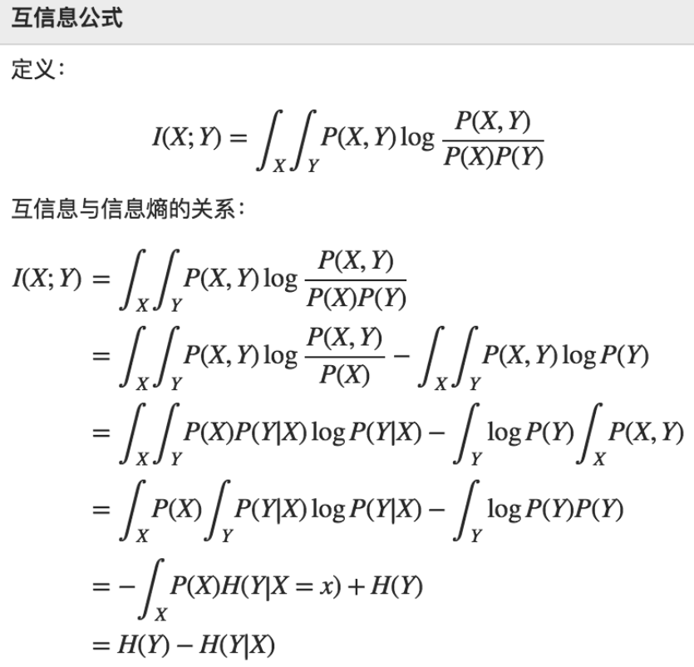
互信息

Slide 3
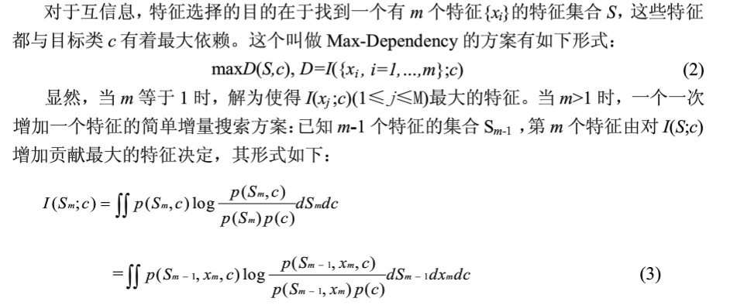

Slide 4
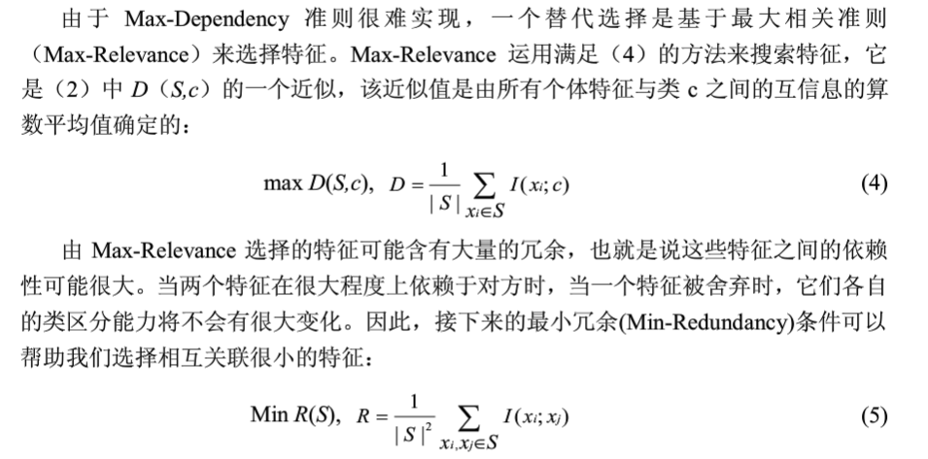

Slide 5
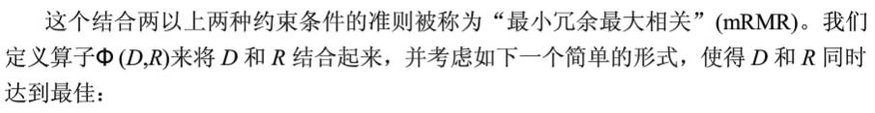
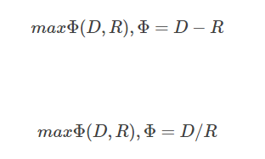
mRMR 可以通过max(V-W)或max(V/W)来统筹考虑相关性和冗余性，作为特征评价的标准。

Slide 6
pymrmr
First parameter is a pandas DataFrame.The rows of the dataset are the different samples. The first column is the classification (target) variable for each sample. The remaining columns are the different variables (features) which may be selected by the algorithm.
* Second parameter is a string which defines the internal Feature Selection method to use (defined in the original paper): possible values are "MIQ" or "MID";
* Third parameter is an integer which defines the number of features that should be selected by the algorithm.

Slide 7
import pandas as pd import pymrmr from sklearn import datasets df = pd.read_csv(r'C:/Users/zjc/Downloads/test_colon_s3.csv') # df = datasets.load_boston() pymrmr.mRMR(df, 'MIQ', 10)

Slide 8
*** MaxRel features *** Order Fea Name Score 1 765 v765 0.375 2 1423 v1423 0.337 3 513 v513 0.321 4 249 v249 0.309 5 267 v267 0.304 6 245 v245 0.304 7 1582 v1582 0.280 8 897 v897 0.269 9 1771 v1771 0.269 10 1772 v1772 0.269
*** mRMR features ***
Order Fea Name Score
1 765 v765 0.375
2 1123 v1123 24.913
3 1772 v1772 3.984
4 286 v286 2.280
5 467 v467 1.979
6 377 v377 1.768
7 513 v513 1.803
8 1325 v1325 1.634
9 1972 v1972 1.741
10 1412 v1412 1.689
Process finished with exit code 0

