Slide 1
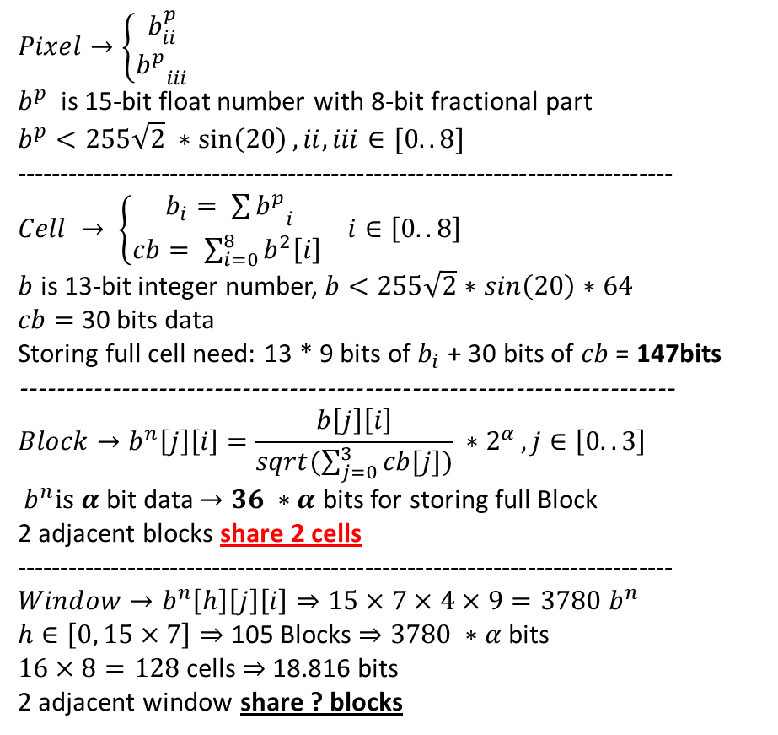
cell= 8x8 pixels
block = 2x2 cells
= center of b
window = 16x8 cells = mxn blocks
= z cell, , z = 1 => w = 15x7 b
 | 1 | 2 | 3 | 4 | 5 | 6 | 7 | 8
1 | cell
2
3
4
5
6
7
8
9
10
11
12
13
14
15
16
$$Pixel→\left\{\begin{aligned}b_{ii}^{p} \\ {b_{}^{p}}_{iii} \end{aligned}\right.$$
$b^{p}$ is 15-bit float number with 8-bit fractional part
$$b^{p}<255\sqrt{2} ∗\sin\left(20\right), ii, iii∈[0..8]$$
-----------------------------------------------------------------------------
$Cell → \left\{\begin{aligned}b_{i}= {\sum{b^{p}}}_{i} \\ cb= \sum_{i=0}^{8}{b^{2}\left[i\right] }\end{aligned}\right.$ $i∈\left[0..8\right]$
$b$ is 13-bit integer number,$b<255\sqrt{2}∗\sin\left(20\right)∗64$
$cb=$ 30 bits data
Storing full cell need: 13 * 9 bits of $b_{i}$ + 30 bits of $cb$ = 147bits
----------------------------------------------------------------------
$$Block→b^{n}\left[j\right]\left[i\right]=\frac{b\left[j\right]\left[i\right]}{sqrt(\sum_{j=0}^{3}{cb[j])}} ∗2^{α },j∈\left[0..3\right]$$
${ b}^{n}is α$bit data $→36 ∗α$ bits for storing full Block
2 adjacent blocks share 2 cells
-----------------------------------------------------------------------------
$$Window→b^{n}\left[h\right]\left[j\right]\left[i\right]⇒15×7×4×9=3780 b^{n}$$
$h∈\left[0, 15×7\right]⇒$ 105 Blocks $⇒3780 ∗α$ bits
$16×8=128$cells $⇒$18.816 bits
2 adjacent window share ? blocks
Cell and Block in a Window of HOG

Slide 2
 | 1 | 2 | 3 | 4 | 5 | 6 | 7 | 8 | 9 | 10
1 | cell
2
3
4
5
6
7
8
9
10
11
12
13
14
15
16
17
18
19
20
Center of window
2 adjacent windows share
15 * 8 or 16 * 7 cells
? blocks
Window movement in HOG

Slide 3
Same color means the same load(packet)
1 GRAY pixel
0 | 1 | 2 | 3 | 4 | 5 | 6 | 7 | 8 | 9
10 | 11 | 12 | 13 | 14 | 15 | 16 | 17 | 18 | 19
20 | 21 | 22 | 23 | 24 | 25 | 26 | 27 | 28 | 29
30 | 31 | 32 | 33 | 34 | 35 | 36 | 27 | 28 | 39
40 | 41 | 42 | 43 | 44 | 45 | 46 | 47 | 48 | 49
50 | 51 | 52 | 53 | 54 | 55 | 56 | 57 | 58 | 59
60 | 61 | 62 | 63 | 64 | 65 | 66 | 67 | 68 | 68
70 | 71 | 72 | 73 | 74 | 75 | 76 | 77 | 78 | 79
80 | 81 | 82 | 83 | 84 | 85 | 86 | 87 | 88 | 89
90 | 91 | 92 | 93 | 94 | 95 | 96 | 97 | 98 | 99
0/1 means don’t/do compute gradient of pixel
 | Type 0, 0000
 | Type 1, 0011
 | Type 2, 1111
 | Type 3, 1100
 | Type 4, 1111
 | Type 5, 1111
Example if 4 pixels/load for GRAY in CELL histogram generation

Slide 4
0/1 means don’t/do compute gradient of pixel
 | 0
R | R Type 1
G | G Type 1
B | B Type 1
1 Pixel: RGBA
Example if 1 PIXEL(RGBA) in CELL histogram generation
 | 0 |  |  |  | 1 |  |  |  | 2 |  |  |  | 3 |  |  |  | 4 |  |  |  | 5 |  |  |  | 6 |  |  |  | 7 |  |  |  | 8 |  |  |  | 9
0 | R | G | B | A | R | G | B | A | R | G | B | A | R | G | B | A | R | G | B | A | R | G | B | A | R | G | B | A | R | G | B | A | R | G | B | A | R | G | B | A
1 | R | G | B | A | R | G | B | A | R | G | B | A | R | G | B | A | R | G | B | A | R | G | B | A | R | G | B | A | R | G | B | A | R | G | B | A | R | G | B | A
2 | R | G | B | A | R | G | B | A | R | G | B | A | R | G | B | A | R | G | B | A | R | G | B | A | R | G | B | A | R | G | B | A | R | G | B | A | R | G | B | A
3 | R | G | B | A | R | G | B | A | R | G | B | A | R | G | B | A | R | G | B | A | R | G | B | A | R | G | B | A | R | G | B | A | R | G | B | A | R | G | B | A
4 | R | G | B | A | R | G | B | A | R | G | B | A | R | G | B | A | R | G | B | A | R | G | B | A | R | G | B | A | R | G | B | A | R | G | B | A | R | G | B | A
5 | R | G | B | A | R | G | B | A | R | G | B | A | R | G | B | A | R | G | B | A | R | G | B | A | R | G | B | A | R | G | B | A | R | G | B | A | R | G | B | A
6 | R | G | B | A | R | G | B | A | R | G | B | A | R | G | B | A | R | G | B | A | R | G | B | A | R | G | B | A | R | G | B | A | R | G | B | A | R | G | B | A
7 | R | G | B | A | R | G | B | A | R | G | B | A | R | G | B | A | R | G | B | A | R | G | B | A | R | G | B | A | R | G | B | A | R | G | B | A | R | G | B | A
9 | R | G | B | A | R | G | B | A | R | G | B | A | R | G | B | A | R | G | B | A | R | G | B | A | R | G | B | A | R | G | B | A | R | G | B | A | R | G | B | A
9 | R | G | B | A | R | G | B | A | R | G | B | A | R | G | B | A | R | G | B | A | R | G | B | A | R | G | B | A | R | G | B | A | R | G | B | A | R | G | B | A

Slide 5

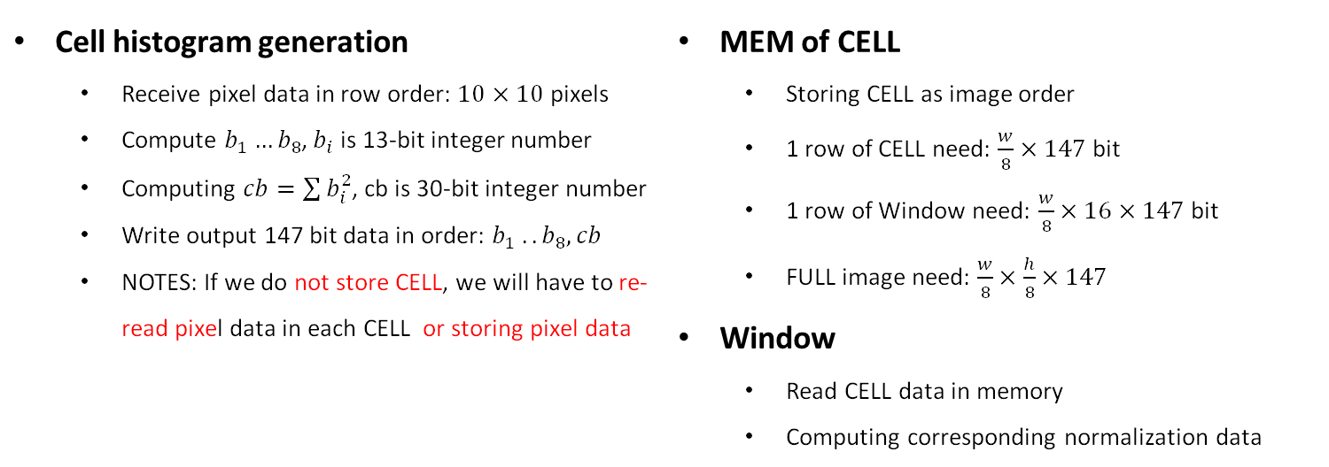

HOG MODULE
Control Center
N $×$cell histogram generation
Local MEM of CELL
M $×$Window
Mode
RGBA/RGB/Y..
Cell histogram generation
IMG
CELL
CELL
Window
Cell histogram generation Receive pixel data in row order: $10×10$ pixels Compute $b_{1}…b_{8}$, $b_{i}$ is 13-bit integer number Computing $cb=\sum{b_{i}^{2}}$, cb is 30-bit integer number Write output 147 bit data in order: $b_{1} .. b_{8}, cb$ NOTES: If we do not store CELL, we will have to re-read pixel data in each CELL or storing pixel data | MEM of CELL Storing CELL as image order 1 row of CELL need: $\frac{w}{8}×147$ bit 1 row of Window need: $\frac{w}{8}×16×147$ bit FULL image need: $\frac{w}{8}×\frac{h}{8}×147$ Window Read CELL data in memory Computing corresponding normalization data

