Slide 1
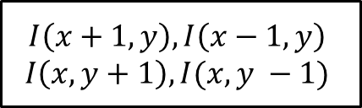
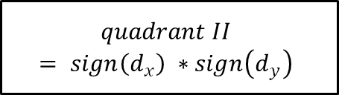
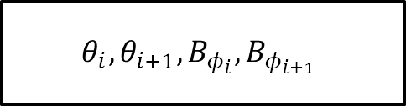

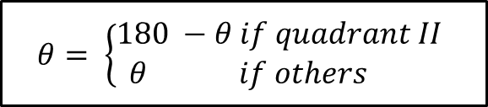
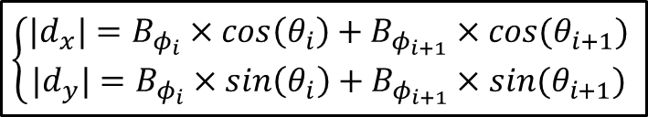
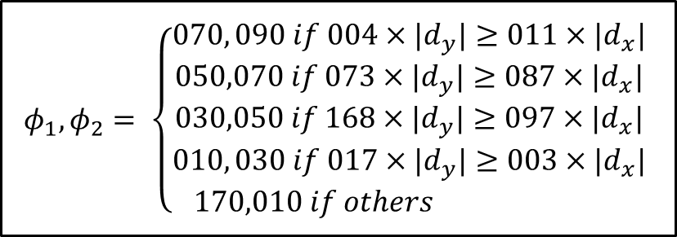

$$I\left(x+1,y\right), I\left(x−1,y\right)$$
$$I\left(x, y+1\right), I(x, y −1)$$
$d_{x}, d_{y}$
$$quadrant II$$
$$= sign\left(d_{x}\right) ∗sign\left(d_{y}\right)$$
$$|d_{x}|, {|d}_{y}|$$
$$φ_{1}, φ_{2}= \left\{\begin{aligned}070, 090 if 004×{|d}_{y}|≥011×{|d}_{x}| \\ 050,070 if 073×{|d}_{y}|≥087×{|d}_{x}| \\ 030,050 if 168×{|d}_{y}|≥097×{|d}_{x}| \\ 010, 030 if 017×{|d}_{y}|≥003×{|d}_{x}| \\ 170,010 if others \end{aligned}\right.$$
$$\left\{\begin{aligned}{|d}_{x}|=B_{φ_{i}}×\cos\left(θ_{i}\right)+B_{φ_{i+1}}×cos⁡(θ_{i+1}) \\ |d_{y}|=B_{φ_{i}}×\sin\left(θ_{i}\right)+B_{φ_{i+1}}×sin⁡(θ_{i+1})\end{aligned}\right.$$
$$θ= \left\{\begin{aligned}180 −θ if quadrant II \\ θ if others \end{aligned}\right.$$
$$θ_{i}, θ_{i+1}, B_{φ_{i}}, B_{φ_{i+1}}$$

