Slide 1


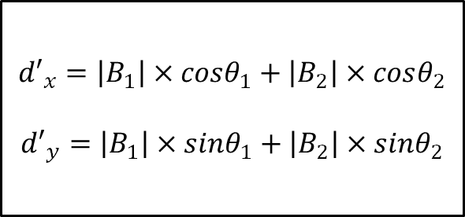

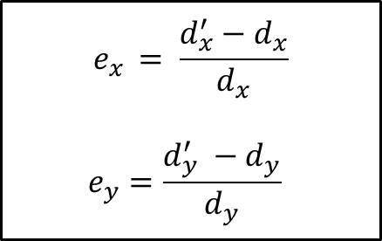

$$d_{x}^{}, d_{y}^{}$$
$${d′}_{x}=\left|B_{1}\right|×cosθ_{1}+\left|B_{2}\right|×cosθ_{2}$$
$${d′}_{y}=\left|B_{1}\right|×sinθ_{1}+\left|B_{2}\right|×sinθ_{2}$$
$$e_{x }= \frac{d_{x}^{′}−d_{x}}{d_{x}}$$
$$e_{y}=\frac{d_{y}^{′} −d_{y}}{d_{y}}$$
$$θ_{1}, B_{1}$$
$$d_{x}^{′}, d_{y}^{′}$$
$$θ_{2}, B_{2}$$

