Slide 1
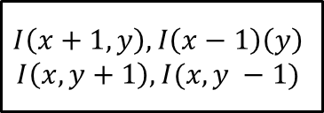
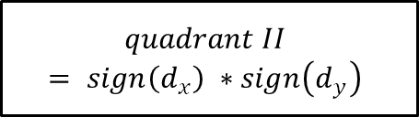
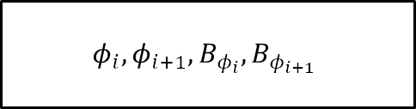

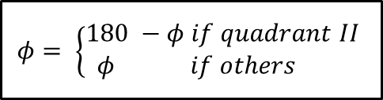
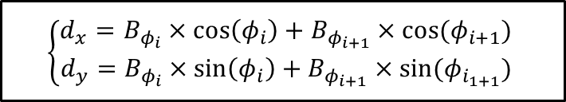


$$I\left(x+1,y\right), I\left(x−1\right)\left(y\right)$$
$$I\left(x, y+1\right), I(x, y −1)$$
$d_{x}, d_{y}$
$$quadrant II$$
$$= sign\left(d_{x}\right) ∗sign\left(d_{y}\right)$$
$$|d_{x}|, {|d}_{y}|$$
$$φ_{1}, φ_{2}= \left\{\begin{aligned}070, 090 if 004×d_{y}≥011×d_{x} \\ 050,070 if 073×d_{y}≥087×d_{x} \\ 030,050 if 168×d_{y}≥097×d_{x} \\ 010, 030 if 017×d_{y}≥003×d_{x} \\ 170,010 if others \end{aligned}\right.$$
$$\left\{\begin{aligned}d_{x}=B_{φ_{i}}×\cos\left(φ_{i}\right)+B_{φ_{i+1}}×cos⁡(φ_{i+1}) \\ d_{y}=B_{φ_{i}}×\sin\left(φ_{i}\right)+B_{φ_{i+1}}×sin⁡(φ_{i_{1+1}})\end{aligned}\right.$$
$$φ= \left\{\begin{aligned}180 −φ if quadrant II \\ φ if others \end{aligned}\right.$$
$$φ_{i}, φ_{i+1}, B_{φ_{i}}, B_{φ_{i+1}}$$

