Slide 1
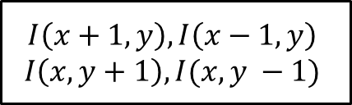
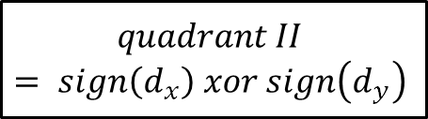
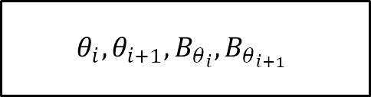
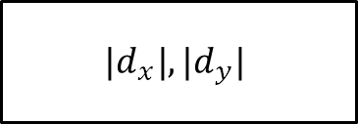
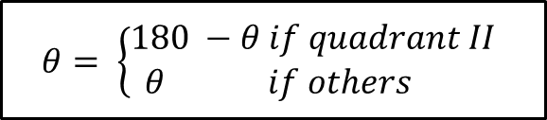
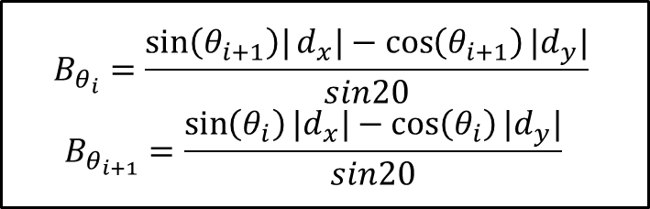
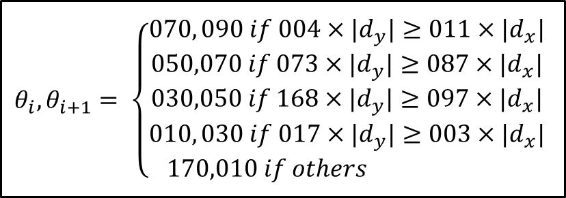

$$I\left(x+1,y\right), I\left(x−1,y\right)$$
$$I\left(x, y+1\right), I(x, y −1)$$
$d_{x}, d_{y}$
$$quadrant II$$
$$= sign\left(d_{x}\right) xor sign\left(d_{y}\right)$$
$$|d_{x}|, {|d}_{y}|$$
$$θ_{i}, θ_{i+1}= \left\{\begin{aligned}070, 090 if 004×{|d}_{y}|≥011×{|d}_{x}| \\ 050,070 if 073×{|d}_{y}|≥087×{|d}_{x}| \\ 030,050 if 168×{|d}_{y}|≥097×{|d}_{x}| \\ 010, 030 if 017×{|d}_{y}|≥003×{|d}_{x}| \\ 170,010 if others \end{aligned}\right.$$
$$B_{θ_{i}}=\frac{\sin\left(θ_{i+1}\right)|d_{x}|−cos\left(θ_{i+1}\right)|d_{y}|}{sin20}$$
$$B_{θ_{i+1}}=\frac{\sin\left(θ_{i}\right){|d}_{x}|−cos\left(θ_{i}\right){|d}_{y}|}{sin20}$$
$$θ= \left\{\begin{aligned}180 −θ if quadrant II \\ θ if others \end{aligned}\right.$$
$$θ_{i}, θ_{i+1}, B_{θ_{i}}, B_{θ_{i+1}}$$

