Slide 1










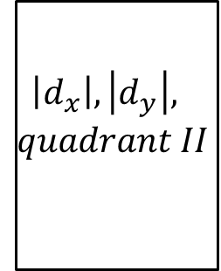

clk
4
/
$$θ_{1}$$
rst
$d_{x}, d_{y}$
$$\left|d_{x}\right|, \left|d_{y}\right|,$$
$$quadrant II$$
$$B×{|d}_{y}|$$
$$A×{|d}_{x}|$$
Angle and Magnitude Calculation
$$4$$
/
$$θ_{2}$$
$$I(x+1,y)$$
$$I(x−1,y)$$
17
/
$$B_{1}$$
$$I(x,y+1)$$
17
/
$$B_{2}$$
$$I(x,y−1)$$
Step 1
Step 2
Step 3
Step 4

