Slide 1
React Native глазами
iOS-разработчика
Ришат Шамсутдинов, iOS developer @ frumatic

Slide 2
JavaScriptCore

Slide 3
Native Code
Native Modules
Touch Events
View Hierarchy
Animations

Slide 4
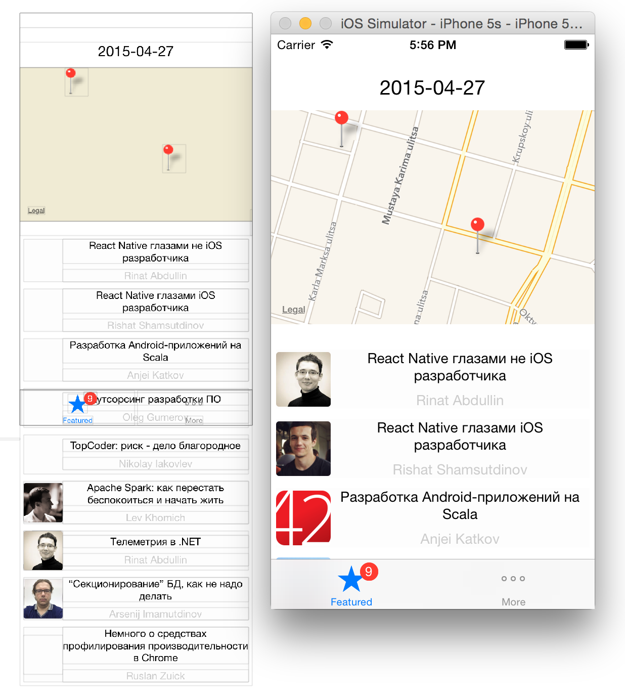

Slide 5


Slide 6

@Red_ReeS

