Slide 1


David Mareček, Rudolf Rosa
marecek@ufal.mff.cuni.cz, rosa@ufal.mff.cuni.cz
From Balustrades to Pierre Vinken:
Looking for Syntax
in Transformer Self-Attentions
Charles University, Prague
Faculty of Mathematics and Physics
Institute of Formal and Applied Linguistics
BlackboxNLP Workshop, Firenze, 1 August 2019

Slide 2
From balustrades to Pierre Vinken
fotka balustrády na schodišti
fotka Pierra Vinkena

Slide 3
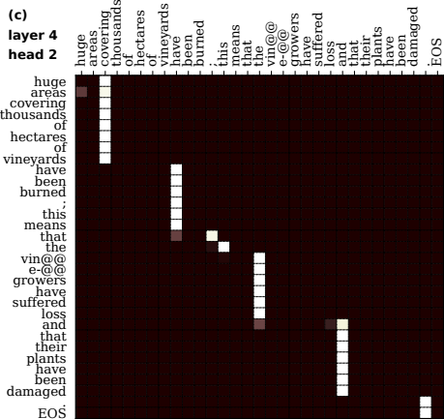
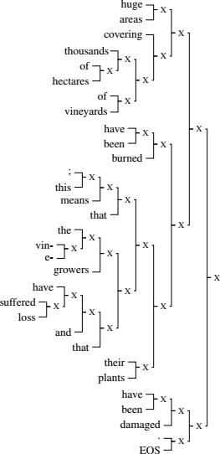
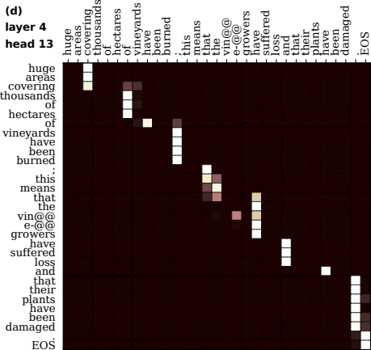
Transformer self-att. → syntax
náhled hnusný, PDF export dobrý!!!

Slide 4
Overview
Experiment setup
Inspection of self-attention heads
Extracting and scoring phrase candidates
Linguistically uninformed CKY parsing
Results
Summary

Slide 5
Experiment setup
transformer neural machine translation encoder
  6 layers x 16 heads, 100k shared BPEs…
6 language pairs: fr ↔ en, de ↔ en, fr ↔ de
  Europarl training data
analyze encoder self-attention matrices
extract constituency syntax trees
compare against Stanford parser syntax trees
  trained on linguistically annotated treebanks:
  Penn Treebank, Negra Corpus, French Treebank

Slide 6
Transformer NMT
tady asi srtukturu tranformera trochu
ať je jasný odkuď tahám ty self attention matrices
positions ~ input words (actually subwords)
each head attends to some words…
one example sentence throughout all slides
  Huge areas covering thousands of hectares of vineyards have been burned; this means that the vine-growers have suffered loss and that their plants have been damaged.

Slide 7
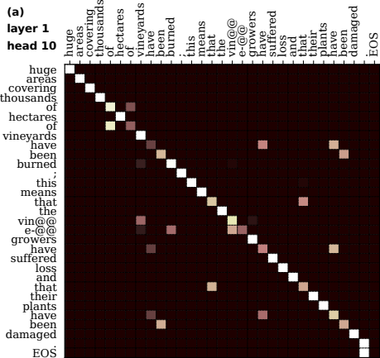
Diagonal (current word)
náhled hnusný, PDF export dobrý!!!

Slide 8
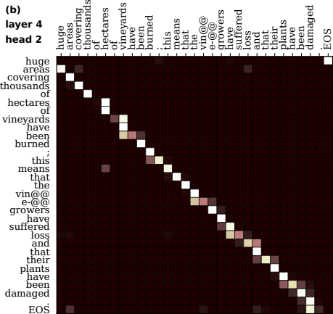
Shifted diagonal (previous word)

Slide 9
Short balusters (“phrases”)

Slide 10
Long balusters (“phrases”)

Slide 11
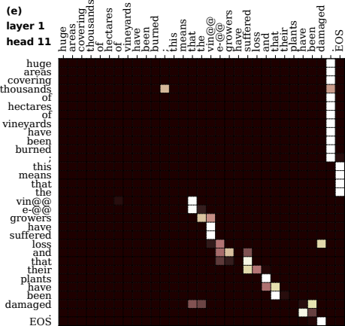
Partial balustrades + attend to end

Slide 12
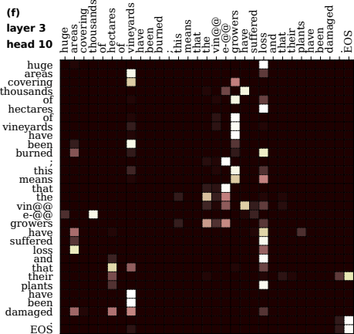
Scattered attention (uninterpreted)

Slide 13
Phrase candidates & scoring
keep only max on each line
phrase candidate
  each contiguous baluster
  sequence of words attending to the same position
phrase score
  average attention weight
  sum over all layers and heads
  short phrases more common
  → equalization
linguistically uninformed!

Slide 14
Binary constituency CKY parsing
standard recursive algorithm
constructs a binary constituency tree which maximizes the sum of scores of phrases in the tree
split each phrase into a pair of subphrases
so as to maximize the sum of phrase scores
linguistically uninformed!
náhled hnusný, PDF export dobrý!!!

Slide 15
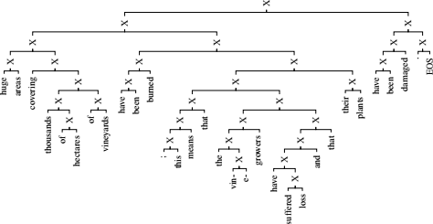
Results
Huge areas covering thousands of hectares of vineyards have been burned; this means that the vine-growers have suffered loss and that their plants have been damaged.
náhled hnusný, PDF export dobrý!!!

Slide 16
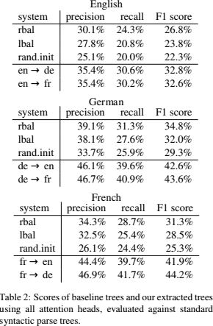
Results

Slide 17
Summary
Transformer NMT encoder self-attentions
  diagonals, shifted diagonals, scattered attention…
  balustrades: can be interpreted as phrases
Linguistically uninformed syntax extraction
  baluster → phrase, attention weight → phrase score
  binary constituency parsing using CKY
  no training, no hyperparameters, using all heads
    see the paper for subselecting only some heads
Resulting structures are quite syntactically sane
  F1 score 6 – 13 points above baseline (30% → 40%)

Slide 18
Thank you for your attention
David Mareček, Rudolf Rosa
marecek@ufal.mff.cuni.cz, rosa@ufal.mff.cuni.cz
From Balustrades to Pierre Vinken:
Looking for Syntax in Transformer Self-Attentions
Charles University, Prague
Faculty of Mathematics and Physics
Institute of Formal and Applied Linguistics
ufal.cz/grants/lsd

