Slide 1
Welcome and Introduction
Would you like to conduct this activity in English or Spanish?
Bienvenida e Introducción
¿Prefiere realizar ésta actividad en Inglés o en Español?

Slide 2
Welcome
Welcome to this educational program about colorectal cancer and screening.
You will be learning about this type of cancer and how to detect it early
We will ask you a series of questions to learn a little more about you
Then you will complete the education and decide what to do next.
Bienvenidos a este programa educativo acerca del cáncer de colon y recto y su detección .
Usted va a aprender sobre éste tipo de cáncer y como detectarlo de manera temprana.
Vamos a hacerle algunas preguntas para conocer un poco más sobre usted .
Después usted completará la educación y decidirá que hacer a continuación.

Slide 3
Eligibility Screening History
The following set of questions will help us to see if you need to get tested for colorectal cancer
Las siguientes preguntas nos ayudarán a determinar si usted necesita hacerse la prueba para el cáncer de colon y recto.

Slide 4
Baseline Survey
In the following sections you will complete a survey that will help us to learn more about you and where you are in your decision making about colorectal cancer.
En la siguiente sección usted completará una encuesta que nos ayudará a conocer más acerca de usted y lo que Ud. piensa sobre el cáncer de colon y recto.

Slide 5
Baseline Survey (Continued)
(Add a series of pages showing the 89 English Language questions on “2e. Baseline Survey ENG 10.14.14.docx”. Cut the survey into pages as shown in https://www.dropbox.com/home/NCI%20-%20R21/screenshots/EN/BaseLineSurvey As shown in the following slides)
(Add a series of pages showing the 89 Spanish language questions on “2s. Baseline Survey Span 10.14.14.docx” Cut the survey into pages as shown in https://www.dropbox.com/home/NCI%20-%20R21/screenshots/ES/BaseLineSurvey As shown in the following slides)

Slide 6
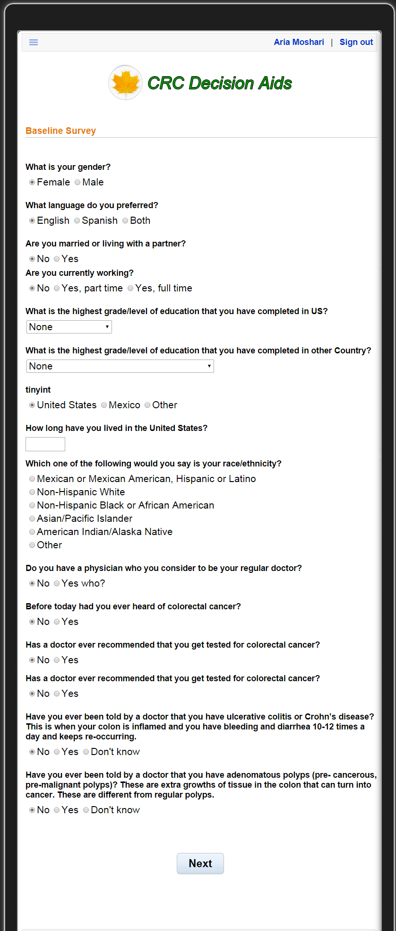
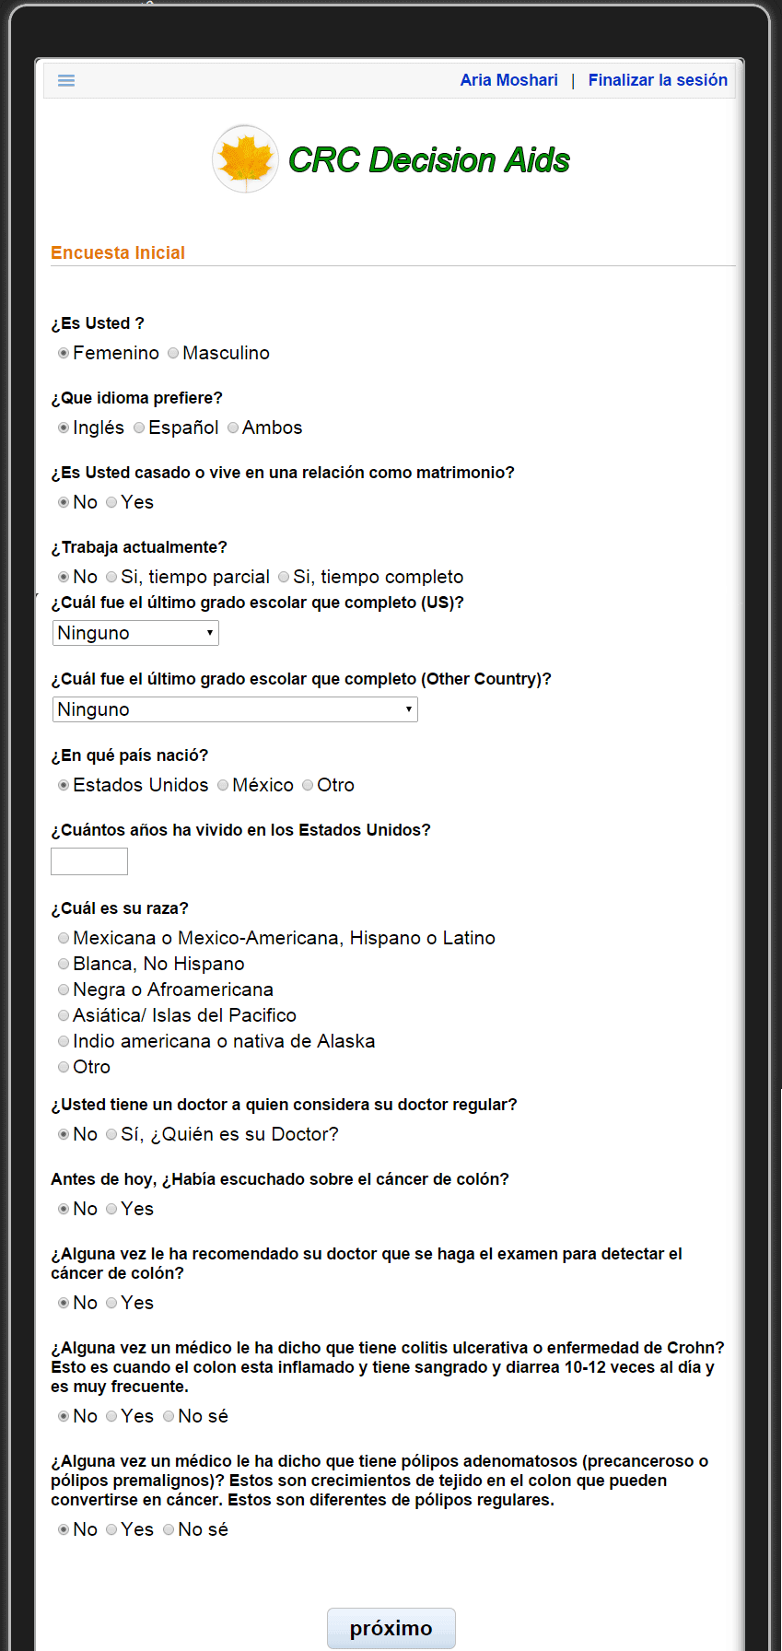

Slide 7
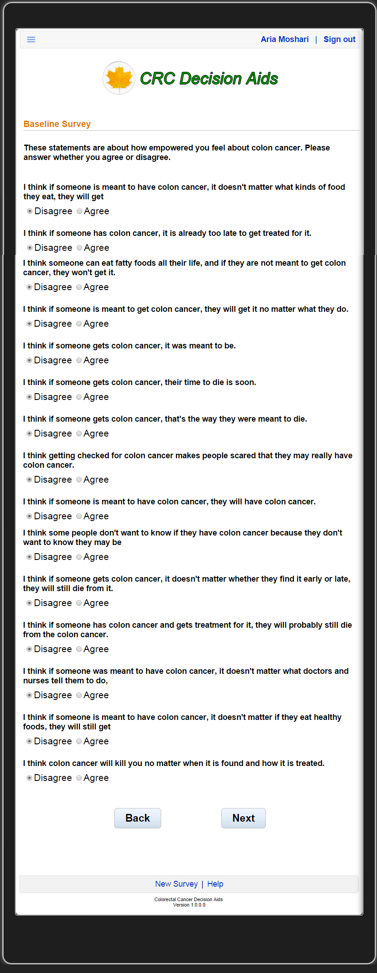
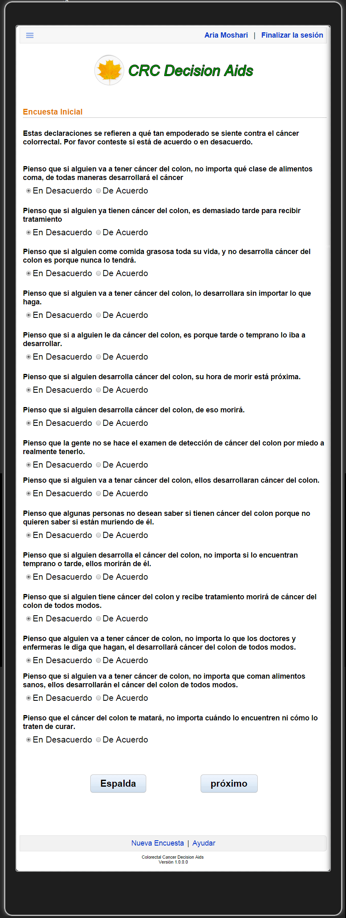

Slide 8
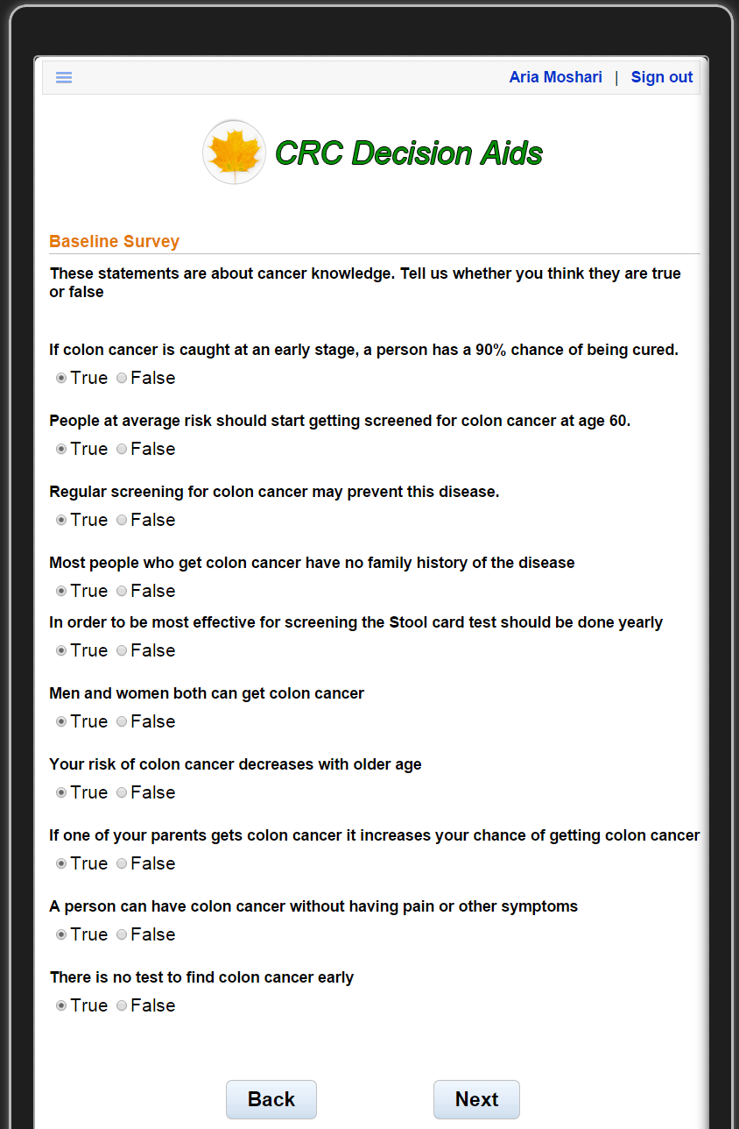
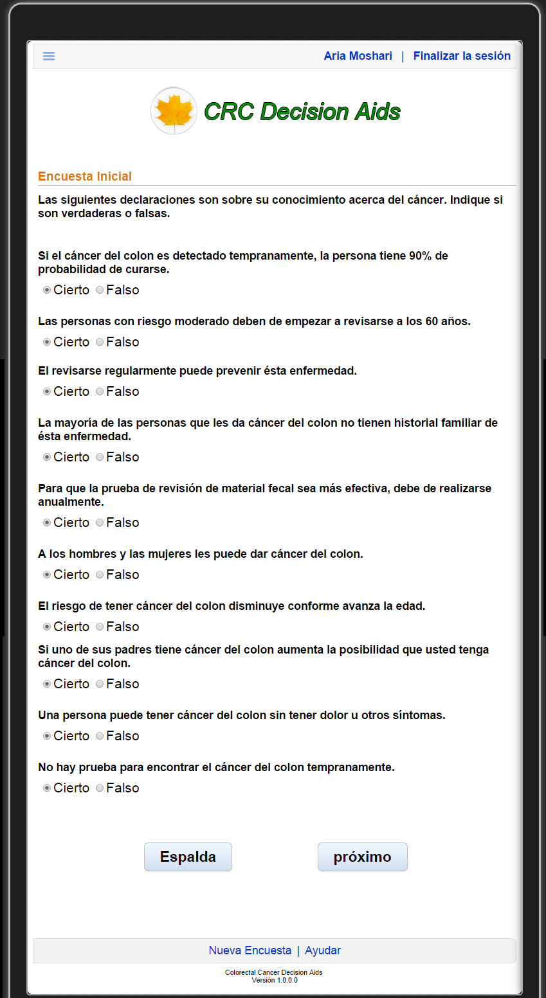

Slide 9
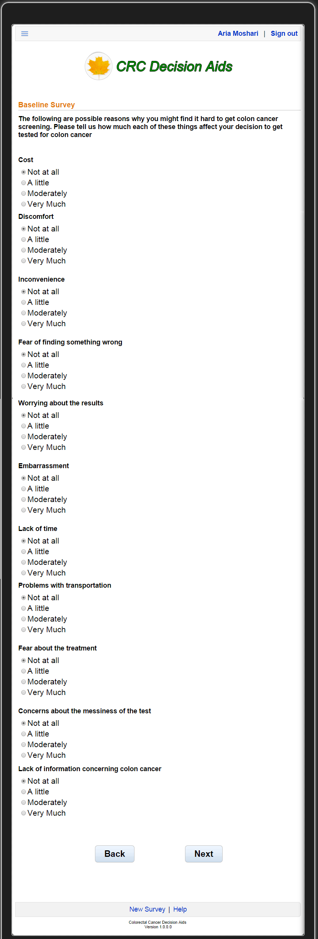
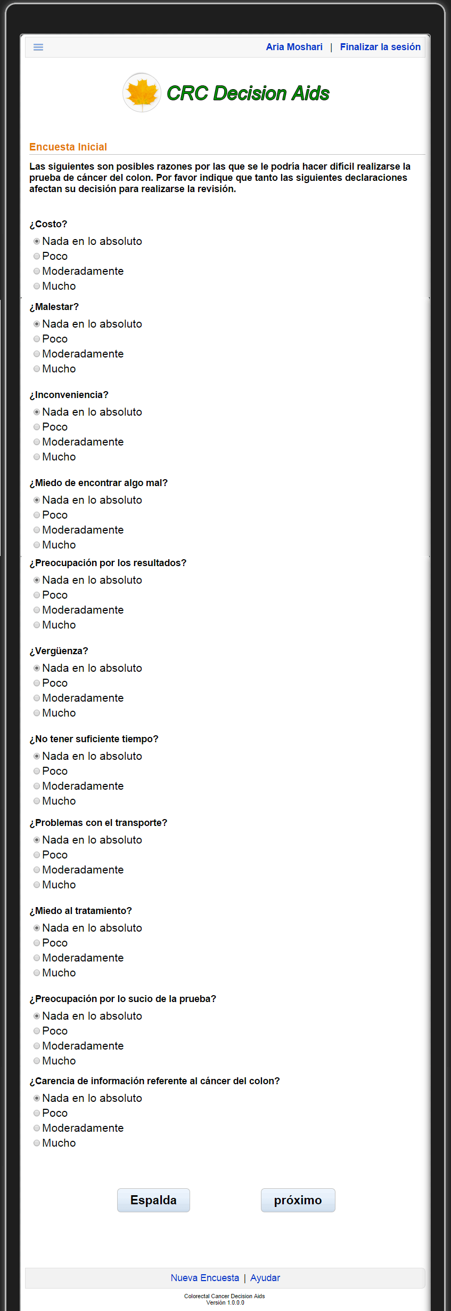

Slide 10
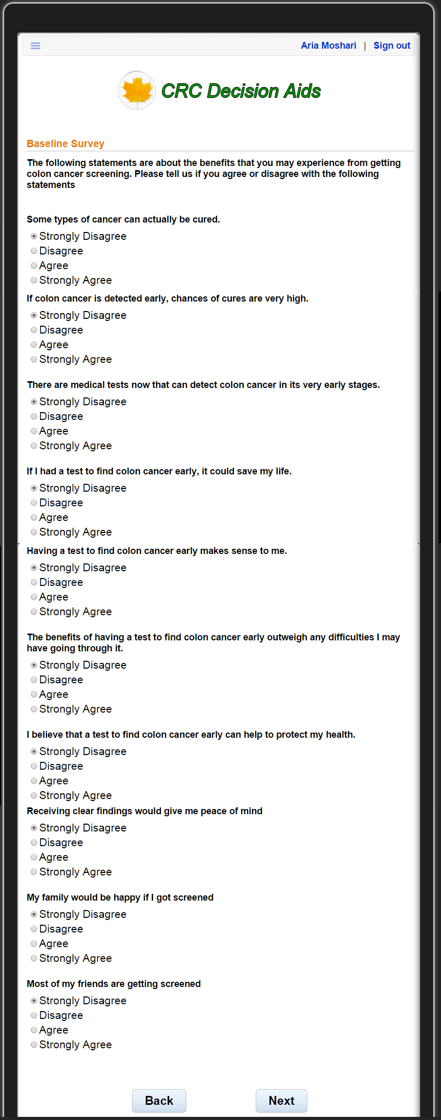
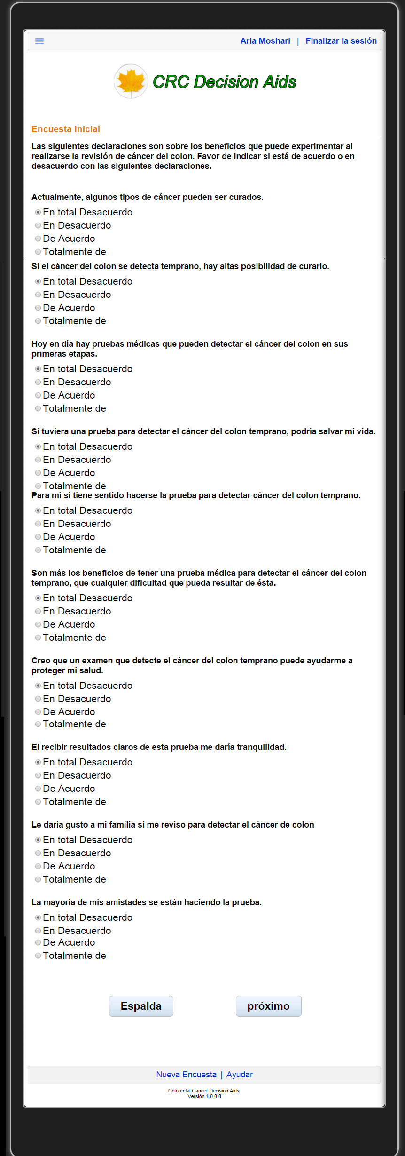

Slide 11
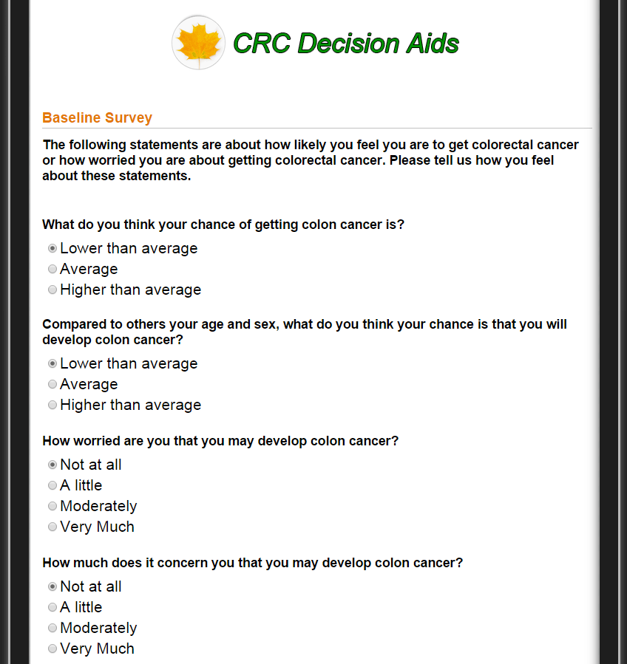
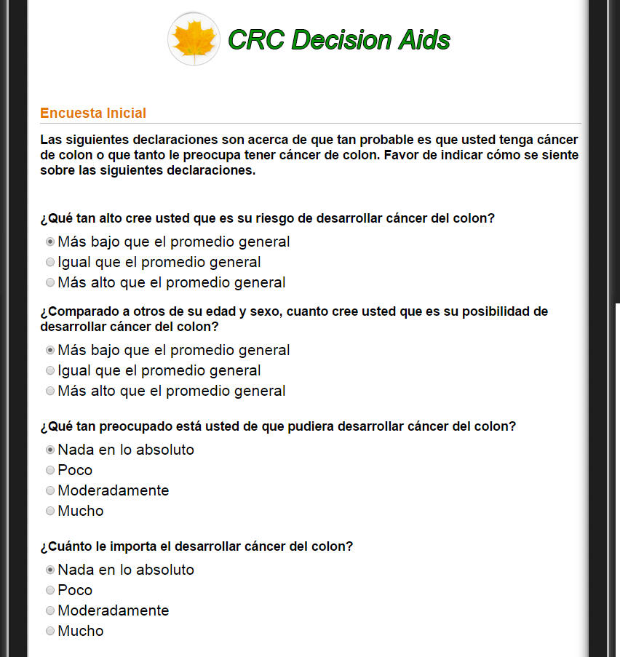

Slide 12
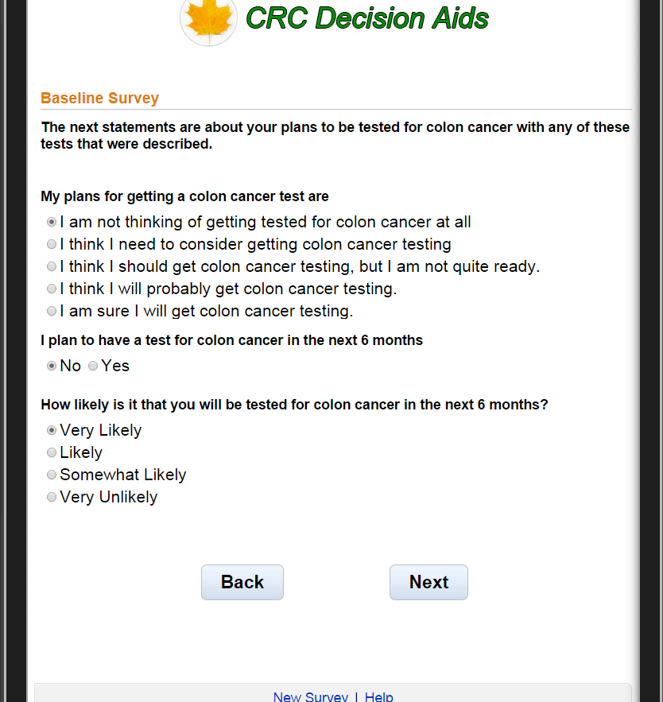
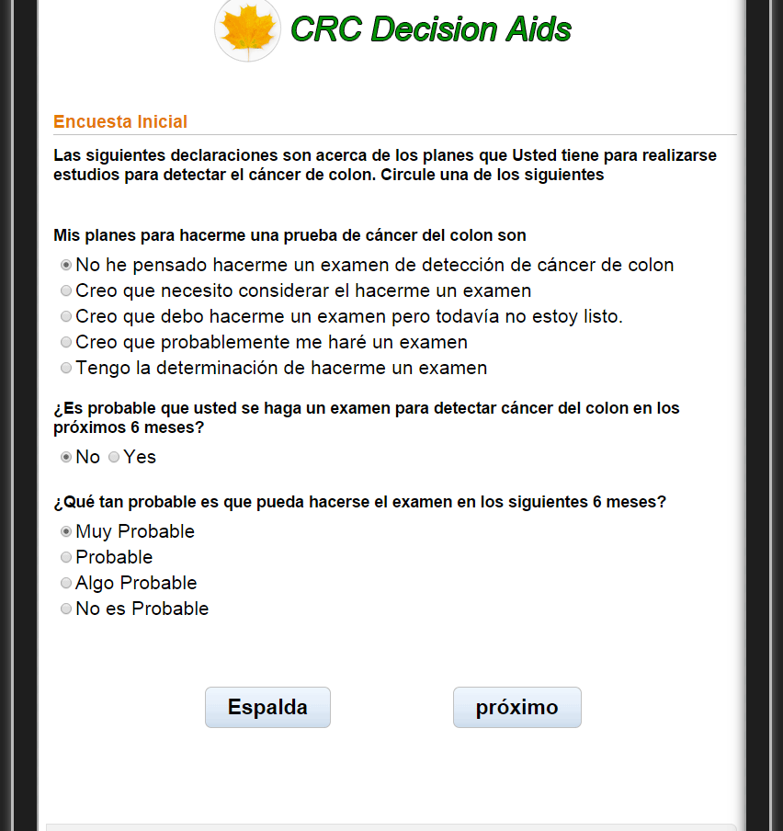

Slide 13
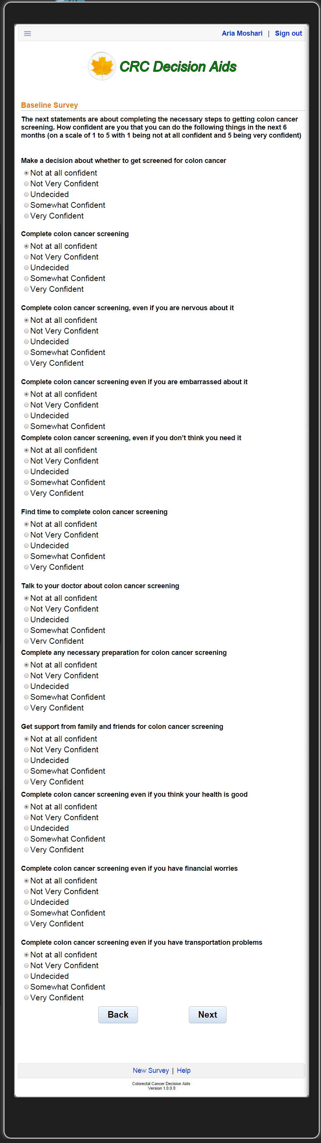
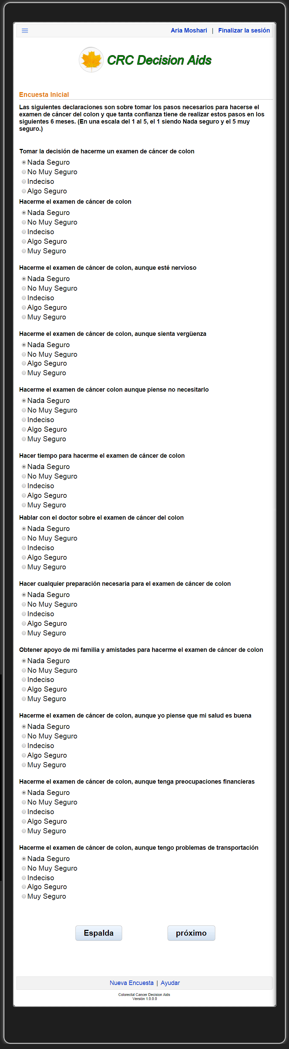

Slide 14
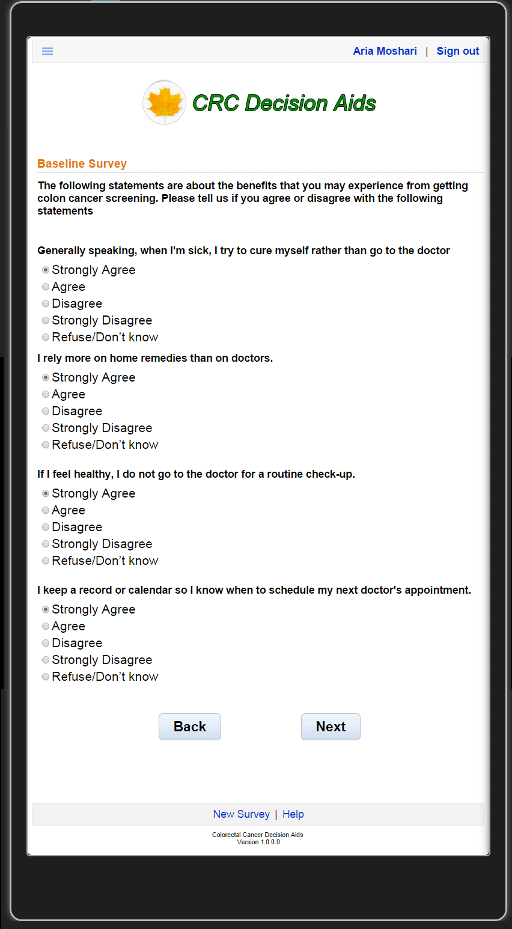
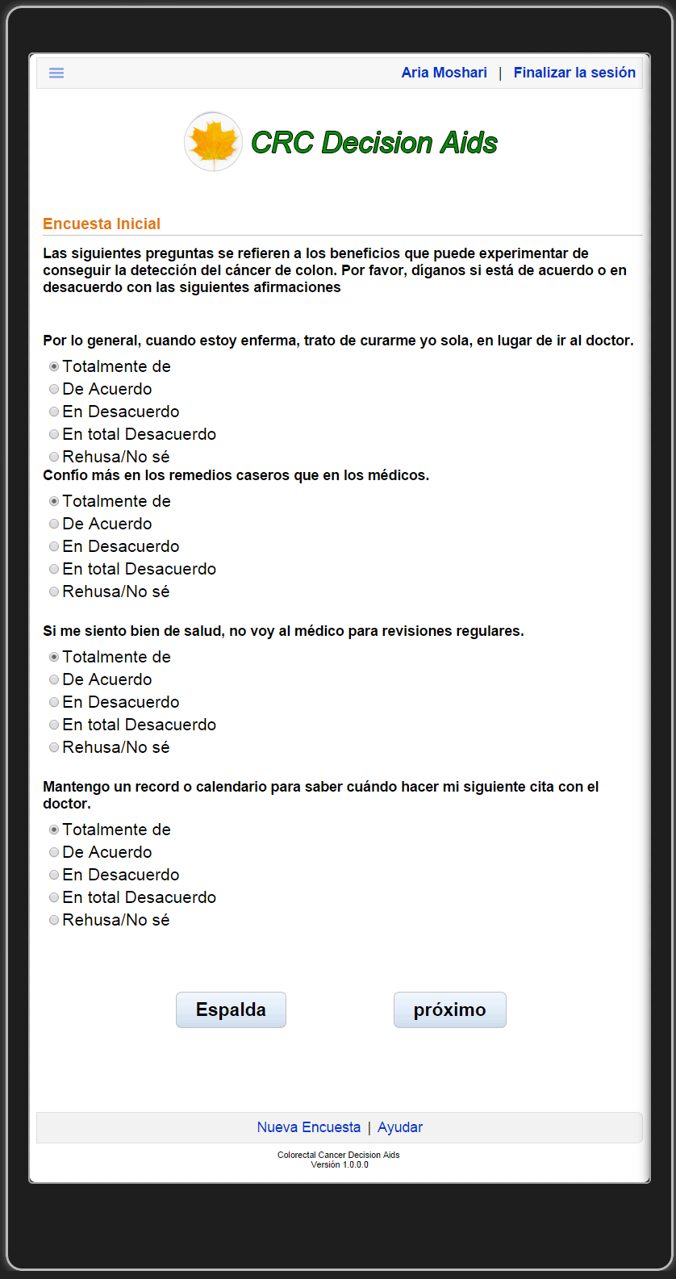

Slide 15
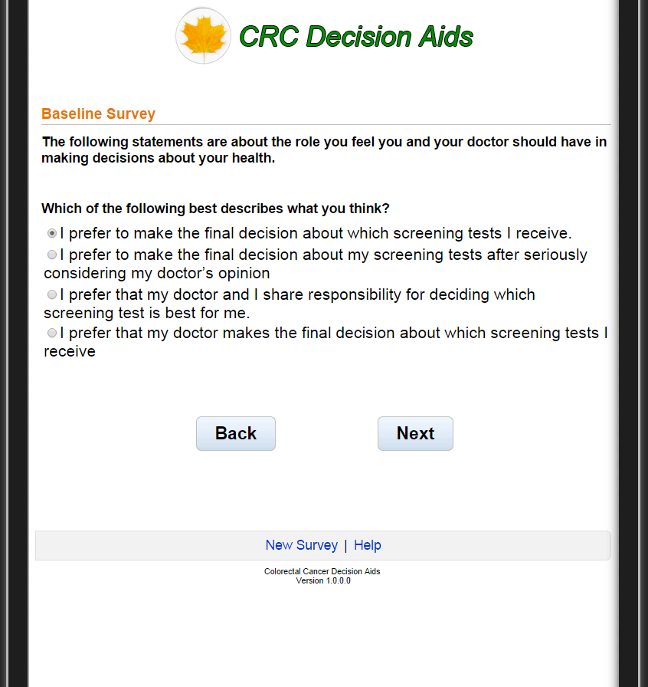
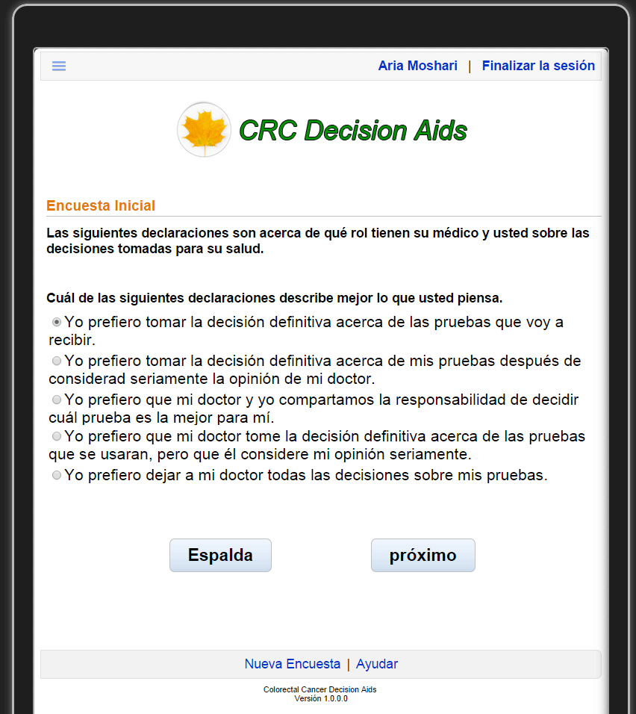

Slide 16
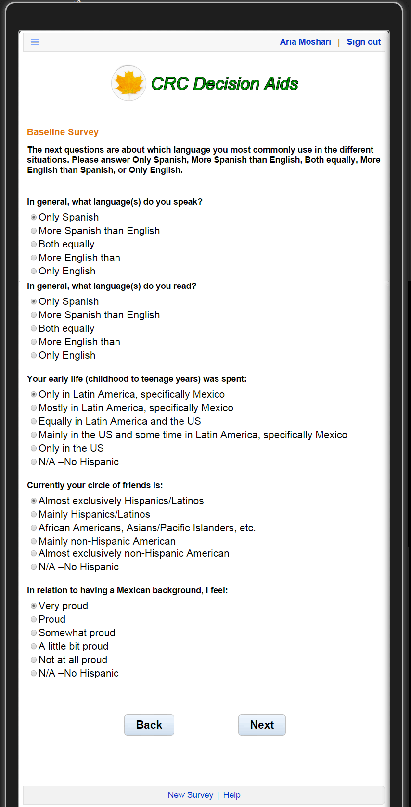
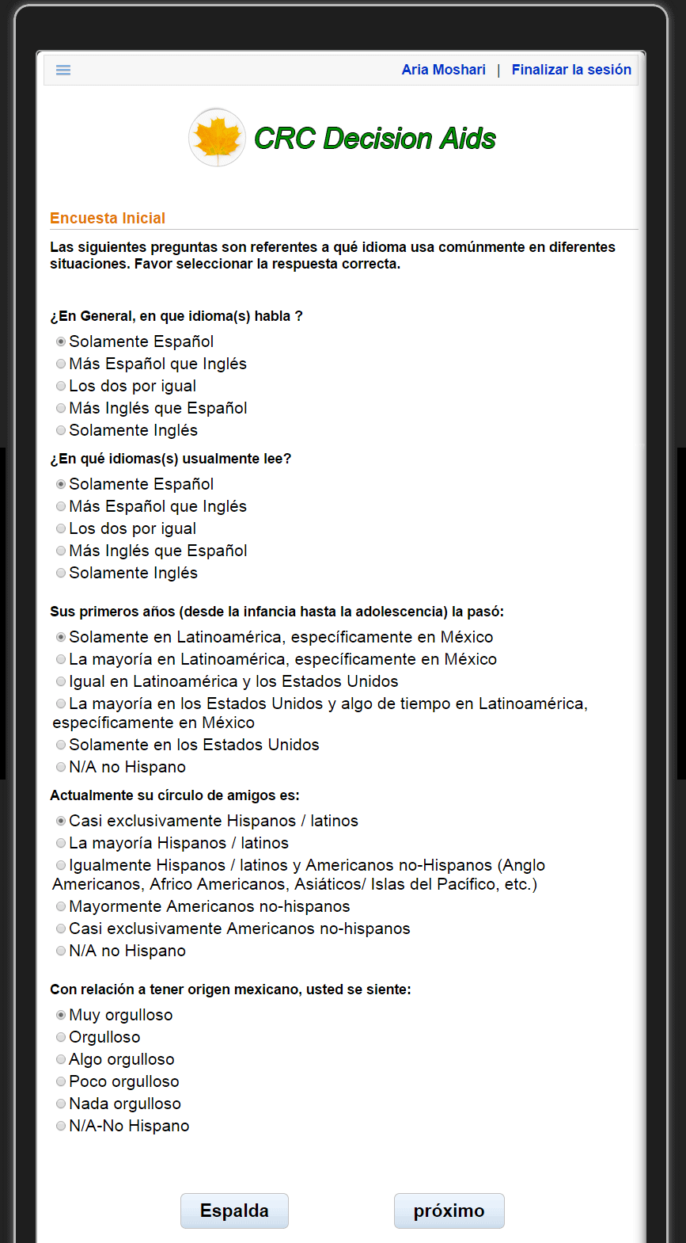

Slide 17
Video Segment 1-3: What is colorectal cancer and why is it important to get tested?
Now you are going to learn more about colorectal cancer and polyps and why it is important to get tested even if you do not have any symptoms.
Ahora usted va a aprender más sobre el cáncer de colon y recto, los pólipos y por qué es importante hacerse la prueba, incluso si usted no tiene ningún síntoma.

Slide 18
(Show video segments 3:02 – 3:58, 6:42 – 7:17, and 14:19 – 14:53 from the file “ACCION Longform ENG (HD).mp4”. Splice these segments together with a 1 second fade in, 1-second fade transitions between each and a 1 second fade out at the end. )
(Show video segments 3:02 – 3:58, 6:42 – 7:17, and 14:19 – 14:53 from the file “ACCION Longform SPN (HD).mp4”. Splice these segments together with a 1 second fade in, 1-second fade transitions between each and a 1 second fade out at the end. )
(Kiran are the time indicies the same for the Spanish and English videos? I recall seeing two different lists of indicies, but cannot locate the source.)

Slide 19
How should I decide which test to have?
The following is a list of factors that people say can help them to choose which test to have.
La siguiente es una lista de factores que la gente ha dicho les puede ayudar a elegir qué prueba realizarse.

Slide 20
Video Segment 4: help describe a FIT
In the following video you will learn more about the fecal immunochemical test, also known as the FIT test
En el siguiente video usted aprenderá mas sobre la prueba de sangre oculta en las heces fecales o prueba inmunoquímica fecal (FIT por sus siglas en inglés)

Slide 21
(Show video segment 9:46 - 11:39 from the file “ACCION Longform ENG (HD).mp4”. Use a 1 second fade in at the beginning and a 1 second fade out at the end. )
(Show video segment 9:46 - 11:39 from the file “ACCION Longform SPN (HD).mp4”. Use a 1 second fade in at the beginning and a 1 second fade out at the end. )

Slide 22
Describe Fecal Immunochemical Test
“This section provides more detailed information about the Fecal Immunochemical test. You can put your mouse over each area to get more information.”
"En esta sección se ofrece información más detallada acerca de la prueba inmunoquímica fecal. Usted puede poner el ratón de la computadora sobre cada zona para obtener más información. "

Slide 23
Video Segment 5: help describe a COloNOSCOPY
In the following video you will learn more about colonoscopy.
En el siguiente video usted aprenderá más sobre …

Slide 24
Show the video Alex saved at https://ctsit-forge.ctsi.ufl.edu/projects/ccda-colorectal-cancer-decision-aids/repository/ccdaa_media/revisions/master/raw/english/ccdaa_english_5.mov
Show the Video Alex saved at https://ctsit-forge.ctsi.ufl.edu/projects/ccda-colorectal-cancer-decision-aids/repository/ccdaa_media/revisions/master/raw/spanish/ccdaa_spanish_5.mov

Slide 25
Describe Colonoscopy
“In this section you can get more detailed information about the colonoscopy click on the mouse to get more information about the test.”
"En esta sección se ofrece información más detallada acerca de la prueba de colonoscopía. Usted puede poner el ratón de la computadora sobre cada zona para obtener más información. "

Slide 26
Video Segment 6: help describe Flexible Sigmoidoscopy
“In the following video you will learn more about the flexible sigmoidoscopy”
“En el siguiente video usted aprenderá más sobre la prueba de sigmoidoscopía flexible”

Slide 27
(Show video segment 13:41 - 14:19 from the file “ACCION Longform ENG (HD).mp4”. Use a 1 second fade in at the beginning and a 1 second fade out at the end. )
(Show video segment 13:41 - 14:19 from the file “ACCION Longform SPN (HD).mp4”. Use a 1 second fade in at the beginning and a 1 second fade out at the end. )

Slide 28
Describe Flexible Sigmoidoscopy
“In this section you can get more information about the flexible sigmoidoscopy. Click on the mouse to get more information about the test”
"En esta sección se ofrece información más detallada acerca de la prueba de sigmoidoscopía flexible. Seleccione con el ratón de su computadora para obtener más información sobre esta prueba.”

Slide 29
Elicit Patient's Preferences on Attributes
“In this section you are going to consider a series of options that will help you decide which test is right for you for colorectal cancer screening”
Please look at the table and score each attribute of each screening test between 1 and 10, 1 being least preferable and 10 being most preferable.
“En esta sección usted considerará una serie de opciones que le ayudarán a decidir que prueba es más adecuada para usted para la detección del cáncer de colon y recto "
Por favor revise la tabla y califique cada atributo de cada prueba de detección entre 1 y 10, siendo 1 el peor o menos preferible y 10 el mejor o más preferible.

Slide 30
(The following slides are based on the document “Decision Aid Test Characterisitcs [English] 5.18.15.docx” which can be found in Drop Box)
(Spanish slides are not included at this time, but if they were, the would be based on the document “Decision Aid Test Characterisitcs [Spanish] 5.18.15.docx” which can be found in Drop Box. )

Slide 31
FIT Test Characteristics
Test Description: This test checks if your bowel movement contains blood. It is done at home using a test kit with 3 cards. You smear a sample of your bowel movement onto a card. This is done for 3 different bowel movements. The three cards are then returned to the lab.
Accuracy: if there were 10 cancers, this test could find 8 of them; if there were 10 large polyps, this test could find 2 of them. | 1 2 3 4 5 6 7 8 9 10
Amount of colon examined: The colon is not examined directly | 1 2 3 4 5 6 7 8 9 10

Slide 32
FIT Test Characteristics
Complications: There are no complications with this test | 1 2 3 4 5 6 7 8 9 10
Cost: The average cost before insurance is about $25. Health plans usually cover the cost of the test. | 1 2 3 4 5 6 7 8 9 10

Slide 33
FIT Test Characteristics
Discomfort: There is no discomfort with this test. | 1 2 3 4 5 6 7 8 9 10
Frequency: It is recommended that you have this test done every year | 1 2 3 4 5 6 7 8 9 10

Slide 34
FIT Test Characteristics
Location: The test is done by you at home and a lab technician checks the cards | 1 2 3 4 5 6 7 8 9 10
Further testing: If the test is abnormal, you would need to have a colonoscopy to find out what is wrong . | 1 2 3 4 5 6 7 8 9 10

Slide 35
FIT Test Characteristics
Sedation: None | 1 2 3 4 5 6 7 8 9 10
Test Preparation: There is no preparation for the test. | 1 2 3 4 5 6 7 8 9 10

Slide 36
FIT Test Characteristics
Scientific evidence: High quality evidence suggests that this test could prevent 2 out of every 10 new cancers; and high quality evidence also suggests that this test could prevent 1.5 to 3.3 out of 10 colorectal cancer deaths with regular testing after age 50. | 1 2 3 4 5 6 7 8 9 10
Time: Time required for the test is a few minutes on three separate occasions. You won’t miss time off from your regular activities. | 1 2 3 4 5 6 7 8 9 10

Slide 37
FIT Test Characteristics
Responsibilities: When you decide to have this test, you will have to pick up the test kit, put a sample of your bowel movement on the cards and mail it or bring it to the lab | 1 2 3 4 5 6 7 8 9 10

Slide 38
Colonoscopy Test Characteristics
Test Description: A doctor checks for growths or cancer in your whole colon using a flexible long narrow, lighted tube with a camera on the end. It is inserted into your bottom and then passed into your whole colon, which can be seen on a TV screen. You are given medicine through a needle in your arm to make you sleepy during the test.
Accuracy: If there were 10 cancers, this test could find 9.5 of them; if there were 10 large polyps, this test could find 9.5 of them | 1 2 3 4 5 6 7 8 9 10
Amount of colon examined: The. entire colon is examined with this test | 1 2 3 4 5 6 7 8 9 10

Slide 39
Colonoscopy Test Characteristics
Complications: 2 to 3 out of every 1,000 tests may result in a serious complication. 1 in every 20,000 tests may lead to a complication resulting in death | 1 2 3 4 5 6 7 8 9 10
Cost: The average cost before insurance is $800 - $16002 Under the Patient Prevention and Affordable Care Act, all health plans are required to cover preventive screening tests, like colonoscopies. However, you may still owe a copay or deductible. | 1 2 3 4 5 6 7 8 9 10

Slide 40
Colonoscopy Test Characteristics
Discomfort: If you have this test, you may experience cramping abdominal pain, diarrhea and gas before and after the test but not during the test. | 1 2 3 4 5 6 7 8 9 10
Frequency: It is recommended that you have this test once every 10 years | 1 2 3 4 5 6 7 8 9 10

Slide 41
Colonoscopy Test Characteristics
Location: The test is done in the hospital or outpatient endoscopy center by a physician specialist. | 1 2 3 4 5 6 7 8 9 10
Further testing: There is no need for further tests to find out what is wrong. | 1 2 3 4 5 6 7 8 9 10

Slide 42
Colonoscopy Test Characteristics
Sedation: A shot is given to make you sleepy. | 1 2 3 4 5 6 7 8 9 10
Test Preparation: To get ready to have this test, you will have to do the following things The day before the test, you can only have a clear liquid diet. The night before this test and between 5 and 6 on the morning of the test, you drink a gallon of solution, drinking a glass every 10 to 15 minutes. This causes diarrhea, which empties your colon. On the day of the test, you cannot eat breakfast but can take your medications. | 1 2 3 4 5 6 7 8 9 10

Slide 43
Colonoscopy Test Characteristics
Scientific evidence: Fair quality evidence suggests that this test could prevent 4.7 to 7.5 out of every 10 new cancers; and fair quality evidence also suggests that this test could prevent 5.7 to 7.4 out of 10 colorectal cancer deaths with regular testing after age 50. | 1 2 3 4 5 6 7 8 9 10
Time: It takes 45 minutes to have this test but you will need a whole day off from your regular activities. | 1 2 3 4 5 6 7 8 9 10

Slide 44
Colonoscopy Test Characteristics
Responsibilities: When you decide to have this test, you will have to alter your diet, make an appointment, buy the solution and take the solution at home according to the instructions. You need to bring a responsible adult who can drive you home. | 1 2 3 4 5 6 7 8 9 10

Slide 45
Flexible Sigmoidoscopy Test Characteristics
Test Description: A doctor checks for growths or cancer in the lower third of your colon using a short flexible narrow, lighted tube with a camera on the end. It is inserted into your bottom and then passed only into your lower colon, which can be seen on a TV screen. You are awake during the test.
Accuracy: If there were 10 cancers in the lower colon, this test could find 9.5 of them | 1 2 3 4 5 6 7 8 9 10
Amount of colon examined: The lower third of the colon is examined with this test | 1 2 3 4 5 6 7 8 9 10

Slide 46
Flexible Sigmoidoscopy Test Characteristics
Complications: For every 20,000 tests, 1 may result in a serious complication. | 1 2 3 4 5 6 7 8 9 10
Cost: The average cost before insurance is : $500 - $7502 Under the Patient Prevention and Affordable Care Act, all health plans are required to cover preventive screening tests, like flexible sigmoidoscopy. However, you may still owe a copay or deductible. | 1 2 3 4 5 6 7 8 9 10

Slide 47
Flexible Sigmoidoscopy Test Characteristics
Discomfort: If you have this test, you may experience cramping abdominal pain, diarrhea and gas before, during and after the test. | 1 2 3 4 5 6 7 8 9 10
Frequency: It is recommended that you have this test once every 10 years | 1 2 3 4 5 6 7 8 9 10

Slide 48
Flexible Sigmoidoscopy Test Characteristics
Location: This test can be done by a primary care doctor or a physician specialist in a doctor’s office or in a hospital. | 1 2 3 4 5 6 7 8 9 10
Further testing: If the test is abnormal, you would need to have a colonoscopy to find out what is wrong. | 1 2 3 4 5 6 7 8 9 10

Slide 49
Flexible Sigmoidoscopy Test Characteristics
Sedation: None | 1 2 3 4 5 6 7 8 9 10
Test Preparation: To get ready for this test, you will need to do the following things: After midnight on the night before the test, you cannot eat or drink anything. One hour before the test, you need to give yourself 2 enemas which cause diarrhea and empty your colon. An enema is when you place liquid medicine into your bottom. On the day of the test, you cannot eat breakfast but can take your medications. | 1 2 3 4 5 6 7 8 9 10

Slide 50
Flexible Sigmoidoscopy Test Characteristics
Scientific evidence: High quality evidence suggests that this test could prevent 1.6 to 3.8 out of every 10 new cancers; and high quality evidence also suggests that this test could prevent 3.1 to 5.4 out of 10 colorectal cancer deaths with regular testing after age 50. | 1 2 3 4 5 6 7 8 9 10
Time: It takes about 30 minutes to have this test. You will need half a day off from your regular activities. | 1 2 3 4 5 6 7 8 9 10

Slide 51
Flexible Sigmoidoscopy Test Characteristics
Responsibilities: When you decide to have this test, you will have to alter your diet, make an appointment, buy the enema solution and give yourself the enemas at home according to the instructions. | 1 2 3 4 5 6 7 8 9 10

Slide 52
Present CRC Screening choice to patient
“According to the selections you made in the previous screen, looks like the following test best meets your preference;”
“De acuerdo a la calificación que usted realizó en la pantalla anterior , parece ser que la siguiente prueba es la que usted prefiere:”

Slide 53
Final Questions
“In this section you will be asked to complete some of the same questions as earlier in order for us to understand if this program helped you in making a decision about colorectal cancer screening”
"En esta sección, se le pedirá completar algunas de las mismas preguntas que respondió al principio con el fin de que nosotros evaluemos si este programa le ayudó a tomar una decisión sobre la detección del cáncer de colon y recto "

Slide 54
Usability Evaluation
In this last section you will be asked about this software and how easy it was to use
En esta última sección se le preguntará acerca de éste software o programa de computadora y que tan fácil fue utilizarlo.

Slide 55
Thank you for your time. We hope you found this useful.
Gracias por su tiempo. Esperamos que le haya parecido útil.

