Slide 1
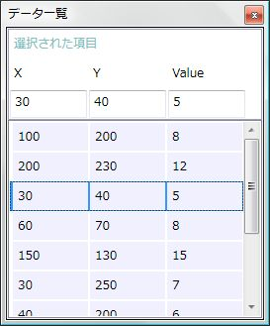
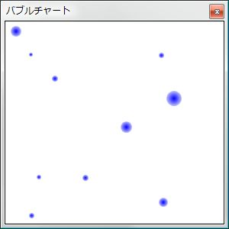
class Item{
double X {get; set;}
double Y {get; set;}
double Value {get; set;}
}
ObservableCollection<Item> Data;

