Slide 1
與HOST及MFCC 介接

Slide 2
介接方式
Remote Object
  Set , Query
  (部份輸出設備必須透過 HC 控管)
Notify Event
  Report,Event

Slide 3
使用Remote Object
加入RemoteInterface.dll reference
建立 remote object
操作remote object

Slide 4
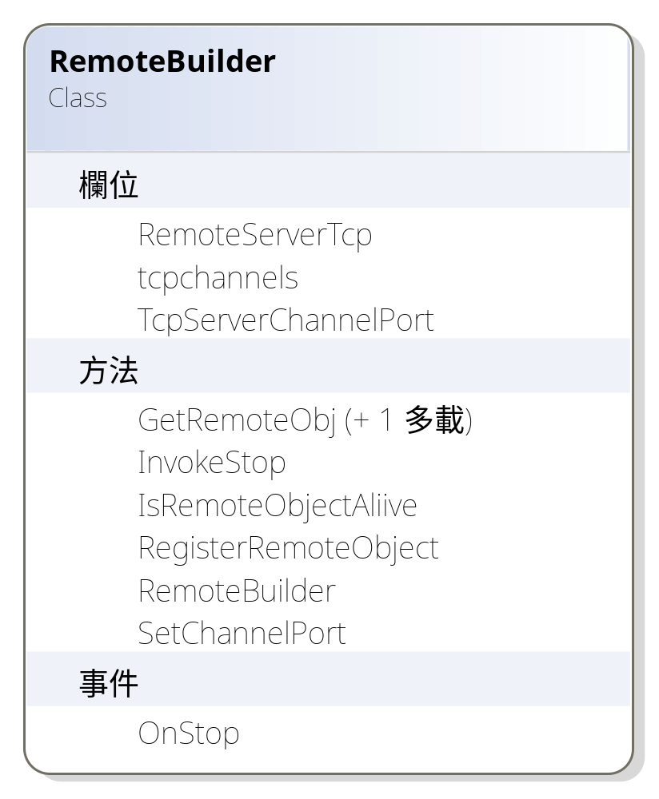
GetRemoteObject

Slide 5
語法
RemoteInterface.RemoteObjectType robj=
( RemoteInterface.RemoteObjectType )RemoteInterface.RemoteBuilder.GetRemoteObj(typeof(RemoteInterface. RemoteObjectType ), RemomeUri);
robj.method();
robj.property=…;
說明:
RemoteUri=“tcp://ip:port/RemoteObjectName”

Slide 6
端午節任務example
public static RemoteInterface.IQYCommands robj =
(RemoteInterface.IQYCommands)RemoteInterface.RemoteBuilder.GetRemoteObj(typeof(RemoteInterface.IQYCommands), “tcp://192.168.22.89:9090/IQYCommands”);

Slide 7
端午節任務 IQYCommands
public interface IQYCommands
{
DataSet get_current_5min_all_section_data();
// DataSet get_rgs_display_status();
DataSet get_rgs_conf_table();
DataSet get_current_travel_time();
DataSet get_travel_sections_detail_data(string ip, byte display_part);
DateTime get_current_travel_data_time_stamp();
DataSet get_tblIcons();
DataSet get_RGS_all_tables();
DataSet get_all_rgs_display_status();
void setFreeInputModeAndMessage(string ip, byte display_part,byte iconid, string finput1, string finputcolor1, string finput2, string finputcolor2);
void setTravelMode(string ip, byte display_part);
DataSet get_rms_config();
void set_rms_mode_planno(string ip,byte mode, byte planno);
bool IsRGSConnected(string ip);
//bool IsRGSConnected(string ip);
//bool IsRMSConnected(string ip);
}

Slide 8
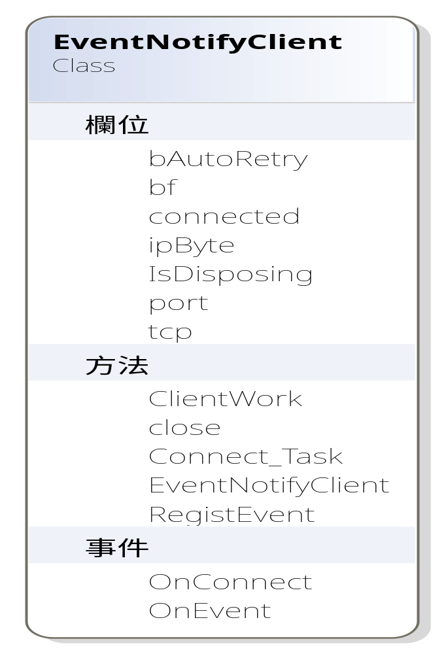
NotifyEvent

Slide 9
NofifyClient
加入RemoteInterface.dll reference
New EventNotifyClient
  New EventNotifyClient(string strIP,int port,bool bAutoRetry)
Binding OnConnect Event
  nclient.OnConnect += new RemoteInterface.OnConnectEventHandler(nclient_OnConnect);
於 OnConnect 事件中撰寫欲註冊的的遠端事件(OnEvent)
  public void RegistEvent(NotifyEventObject eventObj)
於 OnEvent 事件中處理遠端傳來之事件
當畫面關閉時必須記得 close NotifyClient 以關閉遠端連線
  Nclient.close();

Slide 10
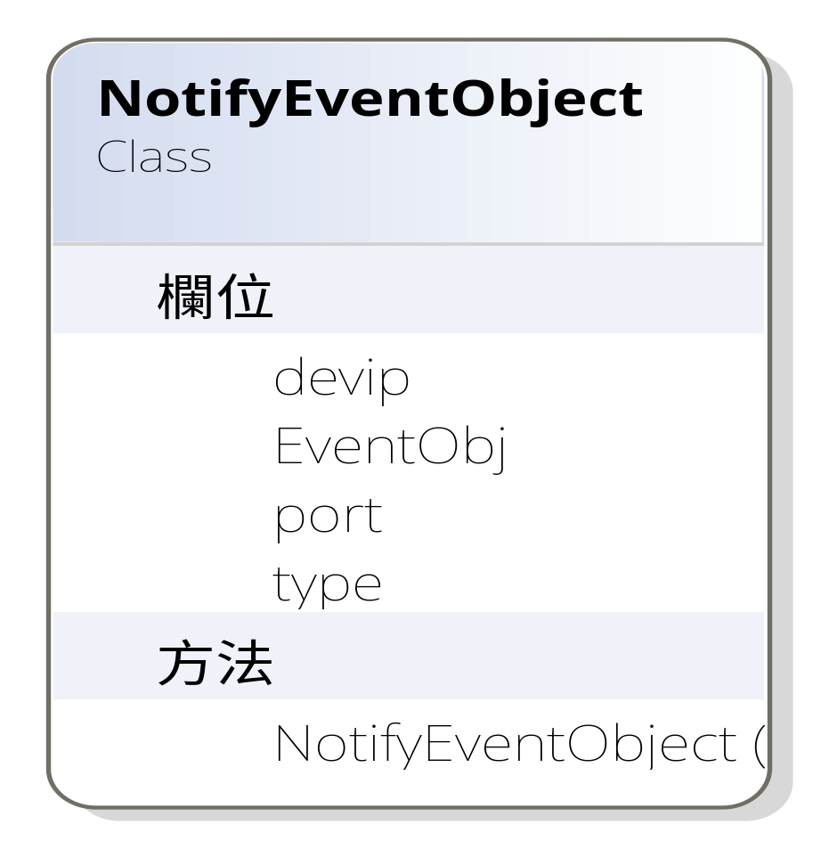
NotifyEventObject

Slide 11
NotifyEventObject Constructor
public NotifyEventObject(EventEnumType type, string device_ip, object objEvent)
public NotifyEventObject(EventEnumType type, string device_ip,int port, object objEvent)
說明
device_ip 為設備之IP位置 ，若 ‘*’ 代表所有的設備

Slide 12
端午節任務範例 RGS 狀態
nclient = new RemoteInterface.EventNotifyClient(“192.168.22.89”,
3000, true);
nclient.OnConnect += new RemoteInterface.OnConnectEventHandler(nclient_OnConnect);
void nclient_OnConnect()
{
nclient.RegistEvent(new RemoteInterface.NotifyEventObject(RemoteInterface.EventEnumType.RGS_Connection_Event, "*", null));
nclient.RegistEvent(new RemoteInterface.NotifyEventObject(RemoteInterface.EventEnumType.RGS_HW_Status_Event, "*", null));
nclient.OnEvent += new RemoteInterface.NotifyEventHandler(nclient_OnEvent);
//throw new Exception("The method or operation is not implemented.");
}

Slide 13
OnEvent 事件處理範例
void nclient_OnEvent(RemoteInterface.NotifyEventObject objEvent)
{
try
{
if (objEvent.type == RemoteInterface.EventEnumType.RGS_Connection_Event)
{
QYTask.Ds.tblRGSMainRow r = ds.tblRGSMain.FindByip(objEvent.devip);
r.connected = (bool)objEvent.EventObj;
r.EndEdit();
r.AcceptChanges();
}
else if (objEvent.type == RemoteInterface.EventEnumType.RGS_HW_Status_Event)
{
Comm.I_HW_Status_Desc hw_desc = (Comm.I_HW_Status_Desc)objEvent.EventObj;
QYTask.Ds.tblRGSMainRow r = ds.tblRGSMain.FindByip(objEvent.devip);
System.Collections.IEnumerator ie = hw_desc.getEnum().GetEnumerator();
while (ie.MoveNext())
{
if ((int)ie.Current == 1 || (int)ie.Current == 0 || (int)ie.Current == 8 || (int)ie.Current == 9 || (int)ie.Current == 10 || (int)ie.Current == 11)
r[hw_desc.getDesc((int)ie.Current)] = hw_desc.getStatus((int)ie.Current);
r.EndEdit();
r.AcceptChanges();
}
}

