Slide 1
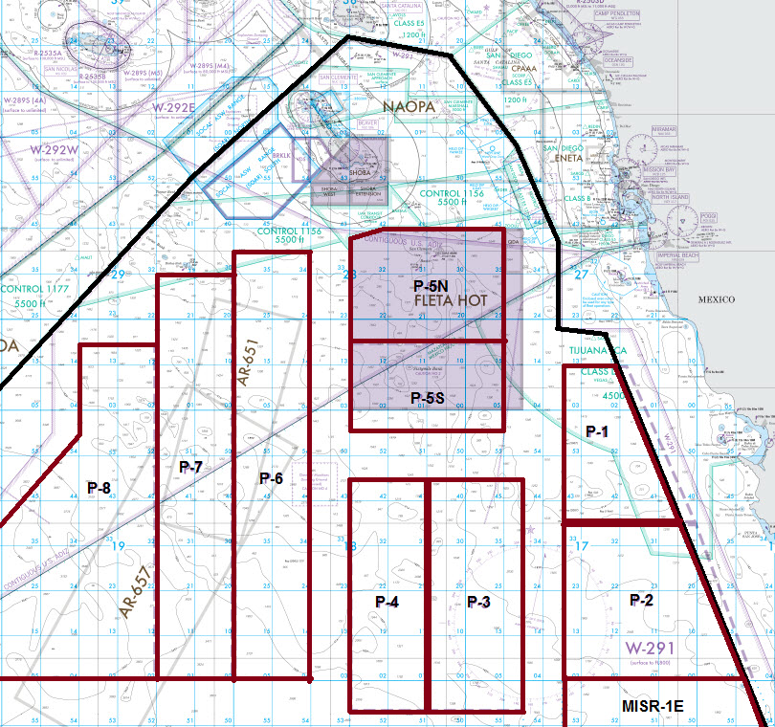
UAS OPAREAS
Puma are normally flown by
NSW surface to 1.5K.
Outlaws are targets for GUNEX
Or TRACKEX during fleet training.
Fire Scouts are Helo type(UAS) aircraft
That operate SFC-10K off of an
LCS.
Scan Eagles are in support of the
COAST Guard and operate SFC-3K
Off Cutters.
Quadcopters operate SFC to 500ft
In support of counter UAS training
Conducted by 3rd Fleet.
Puma
UAS’s not listed
MQ-4 - operate above 45K in all of 291.
MQ-9 – operate 20K-30K
Over the areas listed Fire Scout, Outlaw and Puma.
Small experimental UAS aircraft at VC-3 or NOTS pier located on San Clemente.
Outlaw
Puma
Counter UAS quadcopter
Fire Scout/Scan Eagle
Counter UAS quadcopter
Fire Scout

