Slide 1
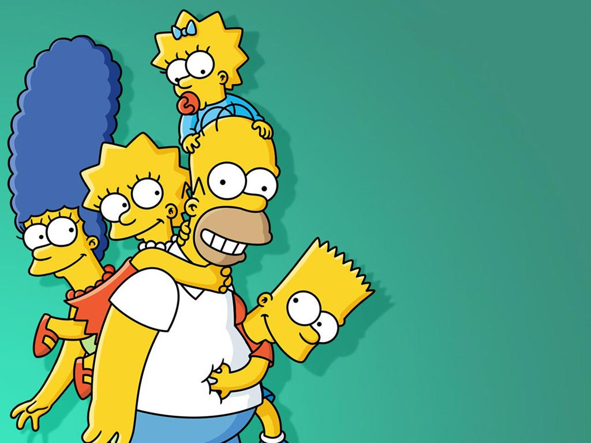


by HERBER

Slide 2

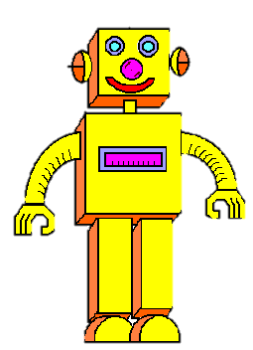
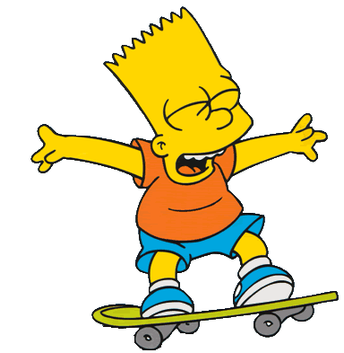

Slide 3
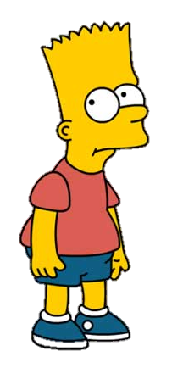
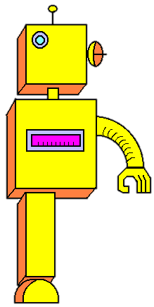






My robot is broken.
Can you help me, please?

Slide 4
Where’s its NECK?
GOOOOOOD!

Slide 5
Where’s its HEAD?
GOOOOOOD!

Slide 6
Where’s its LEG?
GOOOOOOD!
CLICK ON THE BODY PARTS

Slide 7
Where’s its FOOT?
GOOOOOOD!
CLICK ON THE BODY PARTS

Slide 8
Where’s its ARM?
GOOOOOOD!
CLICK ON THE BODY PARTS

Slide 9
Where’s its EYE?
GOOOOOOD!
CLICK ON THE BODY PARTS

Slide 10
Where’s its HAND?
GOOOOOOD!
CLICK ON THE BODY PARTS

Slide 11
Where’s its NOSE?
GOOOOOOD!
CLICK ON THE BODY PARTS

Slide 12
Where’s its EAR?
GOOOOOOD!
CLICK ON THE BODY PARTS

Slide 13
Where’s its MOUTH?
GOOOOOOD!
CLICK ON THE BODY PARTS

Slide 14

Thank you!
Bye!
See you!

Slide 15


