Slide 1

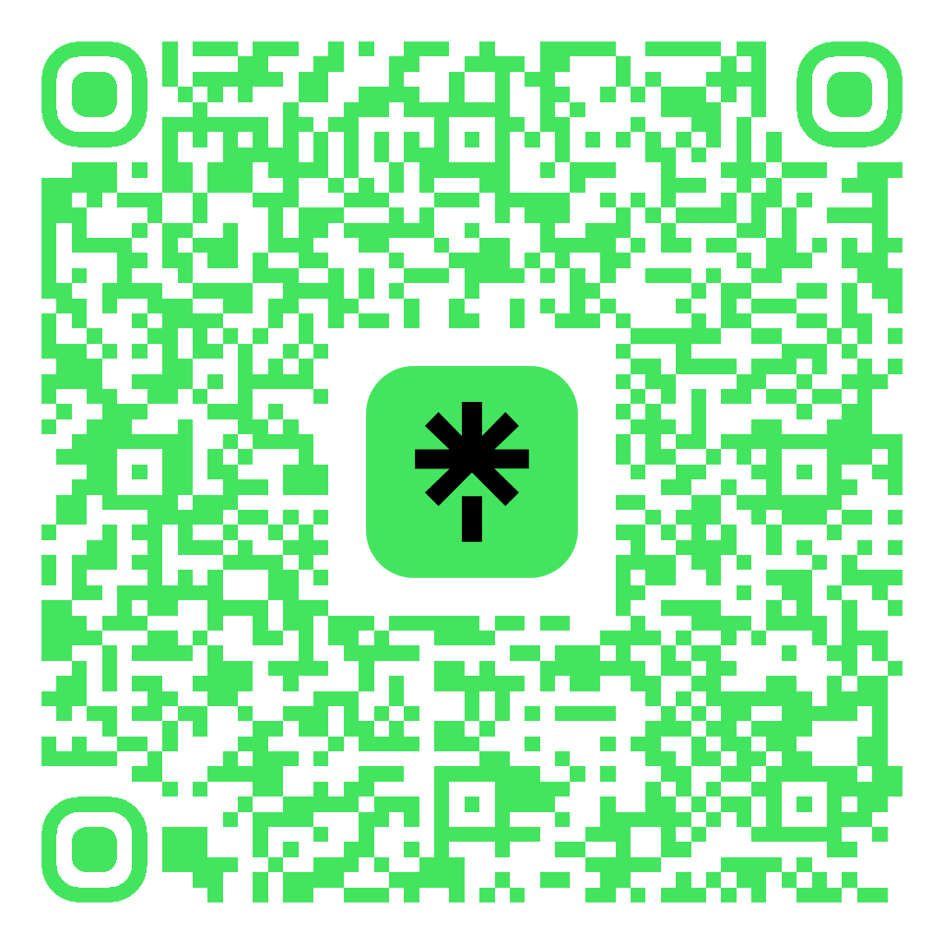
Casual Coding
Come to the front and talk to an officer to get started!

