Slide 1



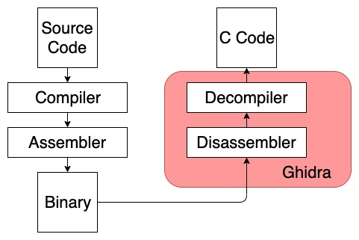
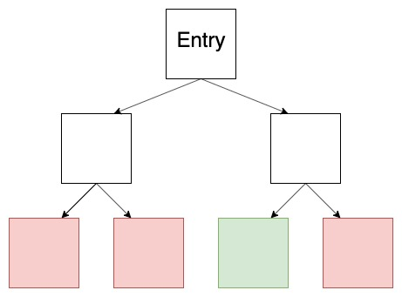
Kernel Sanders
Grant Hernandez, Hunter Searle, Owen Flannagan, Claire Seiler, Kevin R.B. Butler
Computer & Information Science & Engineering, University of Florida
grant.hernandez@ufl.edu, huntersearle@ufl.edu, owenflannagan@ufl.edu, cseiler@ufl.edu, butler@ufl.edu
Reverse Engineering
Symbolic Execution
Blah blah blah
Execution begins at the entry point. At each branch or memory access, execution splits into different paths, tracking the constraints of each path. When execution reaches an undesired state (red), that path is killed. When execution reaches the desired state (green) the constraints are passed to a solver that calculates the required input to arrive at that state.
Specific Challenge
Talk about a specific challenge here

