Slide 1
Graph Coloring Problem
CS301 Project Presentation
Group 187
İbrahim Mahir Akbaş 29492
Ufuk Ulaş Tokat 28914

Slide 2
Contents
1. Problem Description 2
1.1 Overview 2
1.2 Decision Problem 2
1.3 Optimization Problem 3
1.4 Example Illustration 3
1.5 Real World Applications 4
1.6 Hardness of the Problem 6
2. Algorithm Description 7
2.1 Brute Force Algorithm 7
2.2 Heuristic Algorithm 9
3. Algorithm Analysis 12
3.1 Brute Force Algorithm 12
3.1.1 Correctness Analysis 12
3.1.2 Time Complexity 13
3.1.3 Space Complexity 14
3.2 Heuristic Algorithm 15
3.2.1 Correctness Analysis 15
3.2.2 Time Complexity 17
3.2.3 Space Complexity 17
4. Sample Generation (Random Instance Generator) 18
5. Algorithm Implementation 19
5.1 Brute Force Algorithm 19
5.1.1 Initial Testing of the Algorithm 21
5.2 Heuristic Algorithm 22
6. Experimental Analysis of the Performance (Performance Testing) 26
7. Experimental Analysis of the Quality 28
8. Experimental Analysis of the Correctness (Functional Testing) 32
9. Discussion 39
References

Slide 3
Problem Description
Graph Coloring: Assign colors to each vertex of an undirected graph such that no two adjacent vertices share the same color.
Input: Undirected graph G(V,E) and a positive integer k.
Question: Can G be colored with k colors?

Slide 4
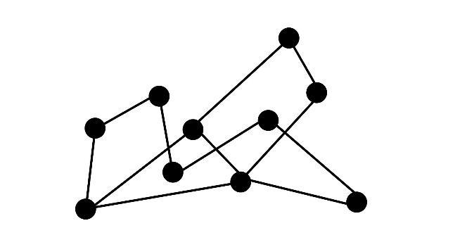
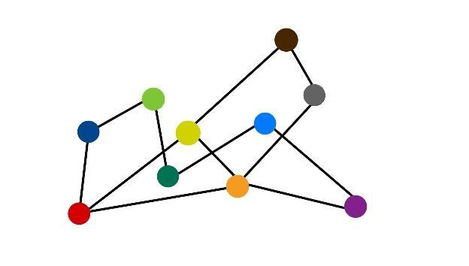
1.1 Example Illustration
Figure 1: Illustration of an undirected graph
Figure 2: Trivial approach for graph coloring

Slide 5
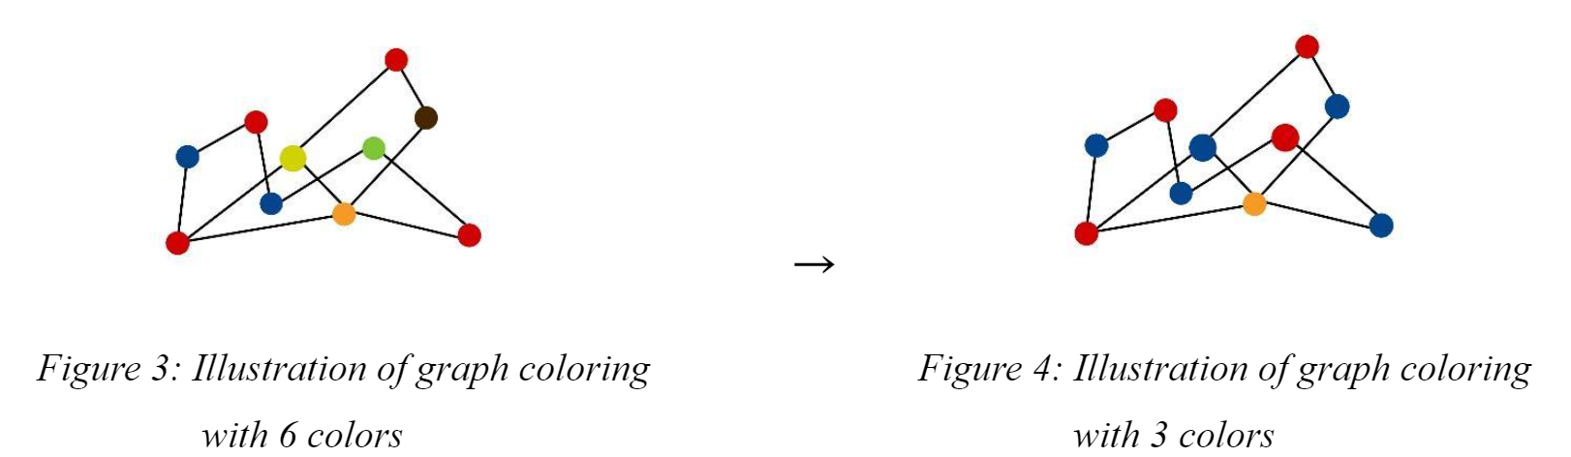
1.1 Example Illustration

Slide 6
1.2 Real World Applications
Event Scheduling
Nodes can be designed to show events and an edge can show conflict between events
Team Building
express people as nodes and edges as friendships
Wireless Communication
Devices that will communicate are the vertices and interference with each other are edges

Slide 7
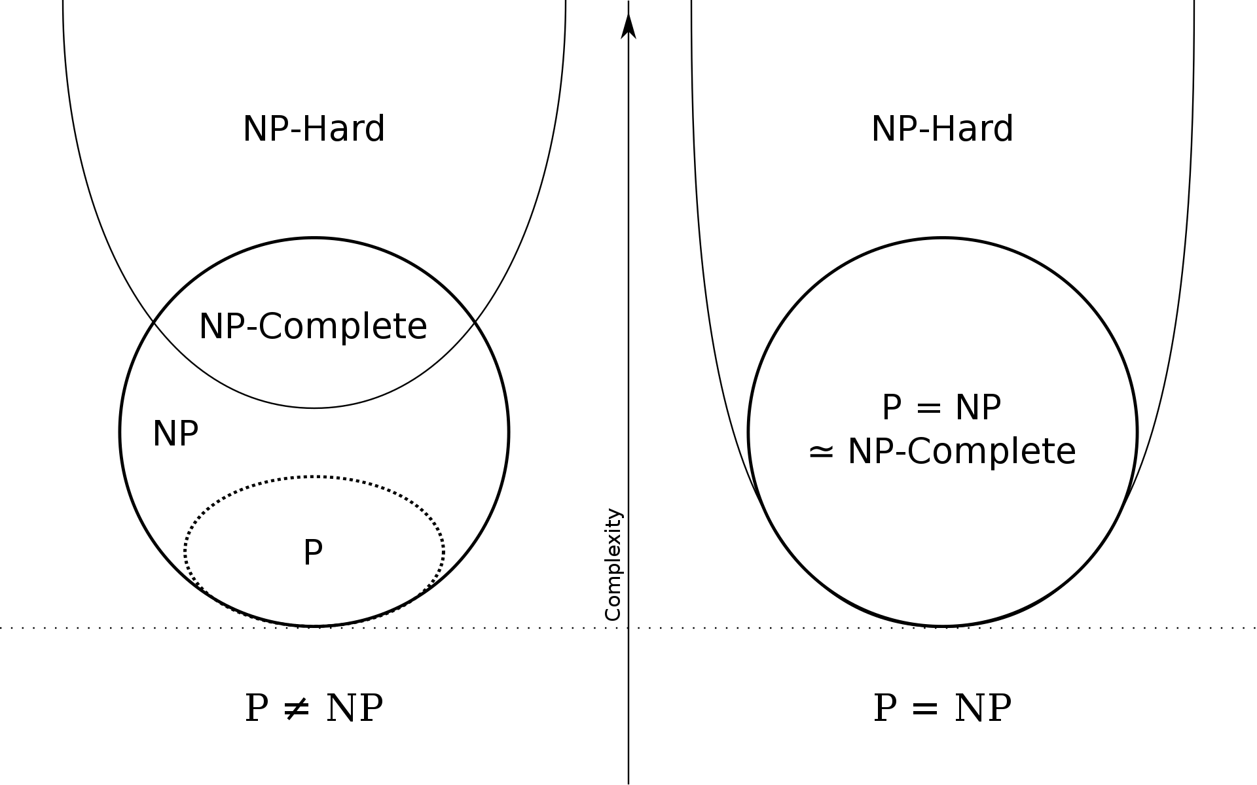
1.3 Hardness of Problem
NP - complete to decide
Karp, 1972
Finding minimum NP-hard

Slide 8

2. Algorithm Description

Slide 9

2.1 Brute-Force Algorithm
Greedy approach
Exponential complexity
Direct approach that gives the solution

Slide 10
2.1.1 Pseudocode
Step 1: Initialize the vertices.
Step 2: For current_coloring in all_collorings
Step 2.1: Assume current_combination is valid coloring
Step 2.2: Initialize is_valid to True.
Step 2.3: For current_edge(u,v) in all_edges
Step 2.3.1: If color u equal to color v
Step 2.3.2: Set is_valid to false.
Step 2.4: If is_colloring is True and number of colors is smaller than k
Step 2.5: Return current_colloring
Step 3: Return None

Slide 11
2.2 Heuristic Algorithm
Welsh Powell: Heuristic approach to find a coloring with optimal number of colors.
Inputs: The algorithm takes an undirected graph G = (V, E) as input, where V is the set of vertices and E is the set of edges.
Outputs: Dictionary objects as following
{1: 0, 2: 0, 3: 1, 4: 0, 5:1}

Slide 12
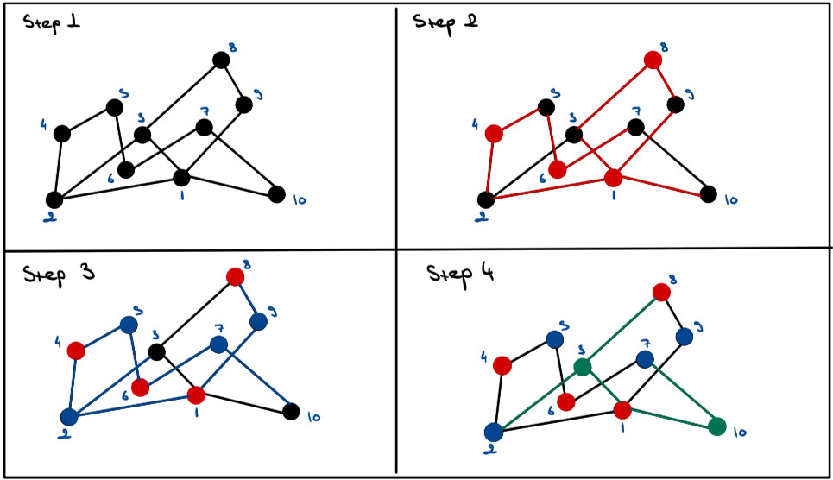
2.2.1 Overview
Sorting vertices
Start with coloring highest degree
Color the vertex not connected to it and have highest degree with same color
Continue with same process until all vertices that can have that color are colored
Continue with remaining vertices with another color

Slide 13
2.2.2 Pseudocode
***********************************************************************
Step 1: Sort vertices by degree in descending order
Step 2: Initialize colors and assign the first vertex color 1
Step 3: For each vertex in the sorted list starting from the second vertex:
Step 3.1: Get the colors of neighboring vertices of the current vertex
Step 3.2: Determine available colors by subtracting neighboring colors from all possible colors
Step 3.3: If available colors exist:
Step 3.1.1: Assign the minimum available color to the current vertex
Step 3.4: If no available colors exist:
Step 3.4.1: Assign a new color to the current vertex, one greater than the maximum color used so far.
Step 4: Return the dictionary containing proper coloring
***********************************************************************

Slide 14
3. Algorithm Analysis

Slide 15
3.1 Brute Force Algorithm
Correctness Analysis
Time Complexity
Space Complexity

Slide 16
3.1.1 Correctness Analysis
The algorithm always finds a proper coloring:
The algorithm will try a coloring at each iteration.
If it is a proper, stop.
Even if none of the iterations does satisfy the conditions of proper coloring there will be one case where k = n (n is the number of nodes).
The algorithm finds the coloring with the minimum number of colors.

Slide 17
3.1.1 Correctness Analysis
2. The algorithm finds the coloring with the minimum number of colors.
Assumption: Algorithm uses K colors, K>K′
Contradiction:
Algorithm explores colorings in order
Stops at K′ if K′ is minimum
Can't use K if K>K′
Conclusion: Algorithm always finds minimum colors

Slide 18
3.1.2 Time & Space Complexity
Time Complexity
Undirected graph G(V, E): n nodes, m edges, k colors
Worst case: Every node has different color
k^n possible ways to assign colors
To check if coloring is valid, inspect all m edges
Worst case time complexity: O((k^n)xm)
Space Complexity
It must show colors of each node for all cases
Therefore O(n) in the worst and best cases

Slide 19
3.2.1 Correctness of Heuristic Algorithm
Theorem: The Welsh-Powell algorithm correctly constructs a colored graph where each node and their neighbors have different colors for an undirected graph G.
Proof: To prove the correctness of the algorithm, we need to show two properties:
Property 1: The resulting set C is a colored graph as explained above.
Property 2: The algorithm terminates and colors all vertices in the graph.

Slide 20
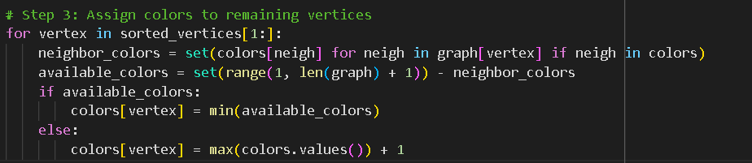
Property 1
By using for loops(iteration) assigning colors based on vertex ordering and checking neighboring colors, the algorithm guarantees that no adjacent vertices in the resulting graph C share the same color.

Slide 21
Property 2
At the end of the algorithm's execution, every vertex in G will have a color assigned to it. The reason behind it is that the algorithm iterates all the vertices and colors all of them. Also, since the number of vertices is finite algorithm will terminate eventually.

Slide 22
3.2.2 Time & Space Complexity
Time Complexity:
Sorting takes O(Vlg(V))
Goes over all of the vertices in the graph
For all vertices it looks at their neighbors
In the worst case a vertex will have V-1 vertices
So it is O(V^2).
Space Complexity:
O(V + E) space to store graph information
No extra space for sorting
O(V) space for the colors array

Slide 23
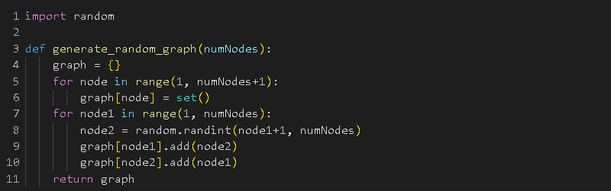
4. Random Sample Generator
create an empty instance of a graph
add vertices that don’t have any neighbors to the graph
go through all nodes and randomly decide whether to add an edge or not
if the algorithm decides to add an edge it will add node u to connection list of v and v to connection list u

Slide 24

5. Algorithm Implementation

Slide 25
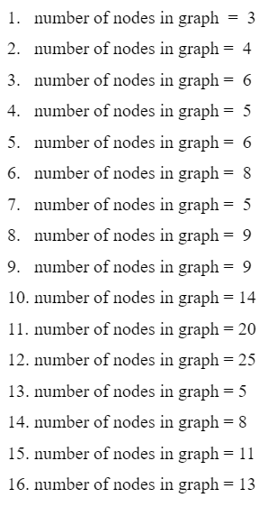
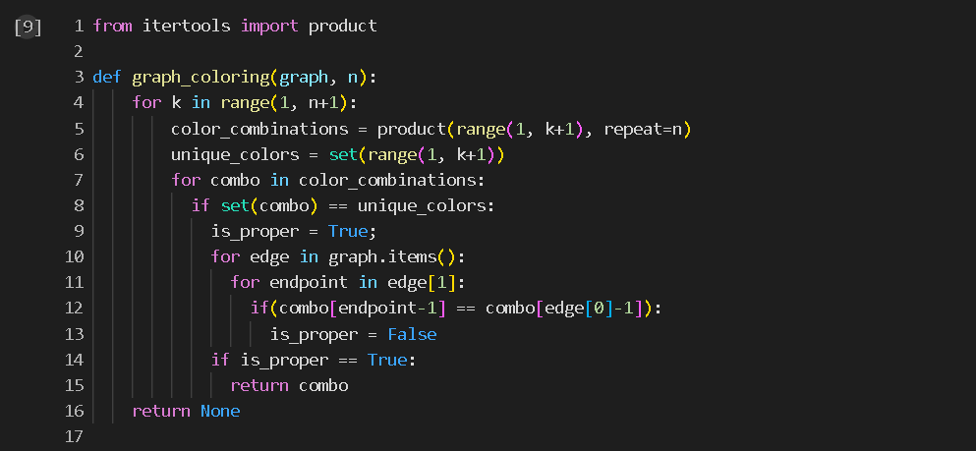
5.1 Brute Force Algorithm
Implementation

Slide 26
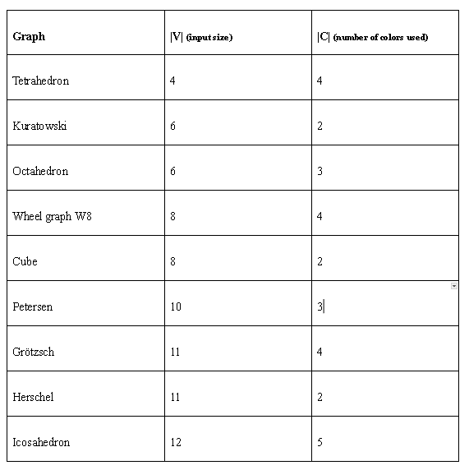
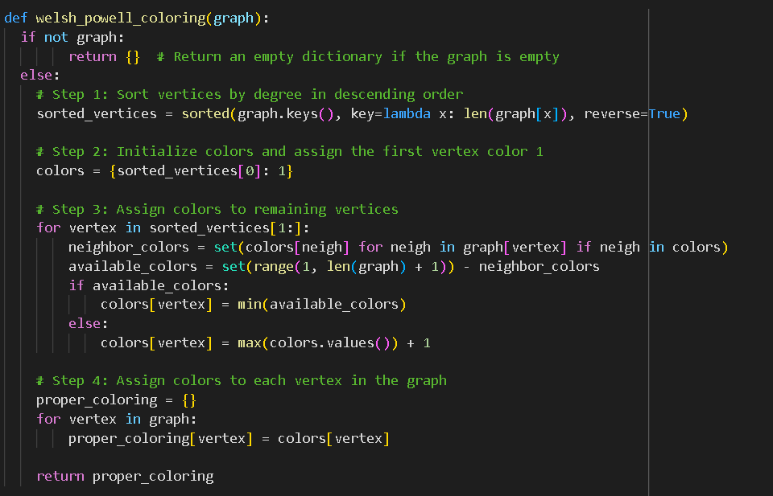
5.2 Heuristic Algorithm Implementation

Slide 27
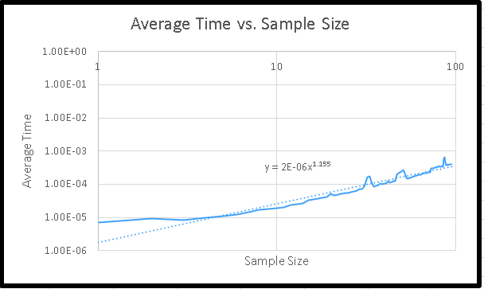
6. Experimental Analyses of The Performance
1000 random instances for each size.
Sizes between 5 and 100.
Confidence level of 0.95.
Standard deviation * t will be less than 0.1
So our results are confident enough to talk about performance.
Real life time complexity: O(n^1.155)

Slide 28
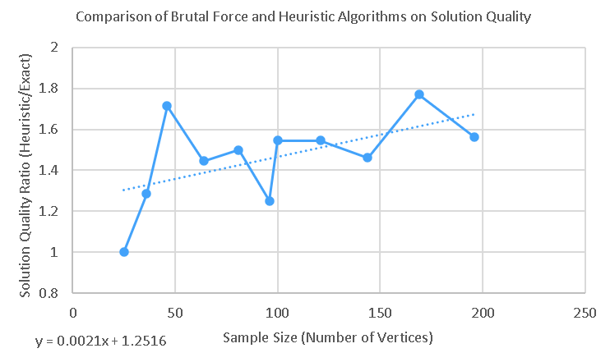
7. Experimental Analyses of Quality
Working fine in:
CAR Graphs
Register Allocation Graphs
Working badly in:
Queen graphs
Equation for error with respect to sample size:
y = 0.0021x + 1,12516.

Slide 29

8. Experimental Analyses of the Correctness

Slide 30
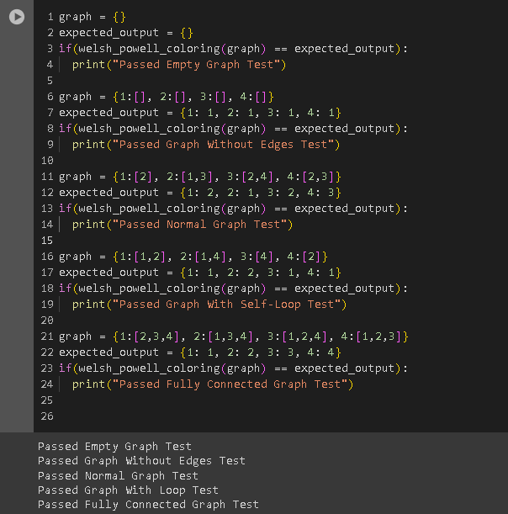
Black Box Testing
Empty Graph
Graph With No Edges
Normal Graph
Graph With Self-Loop
Graph With Fully Connected Components

Slide 31
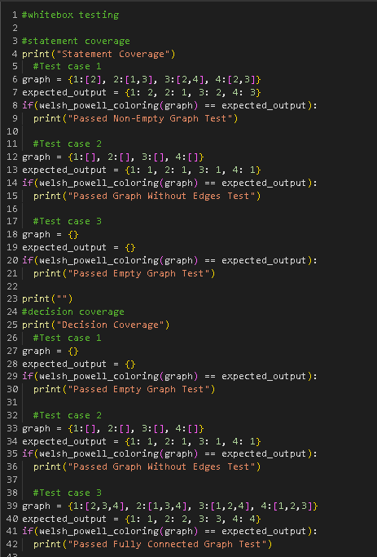
White Box Testing
Statement Coverage:
Non-Empty Graph
Graph Without Edges
Empty Graph
Decision Coverage:
Empty Graph
Graph Without Edges
Fully Connected Graph

Slide 32
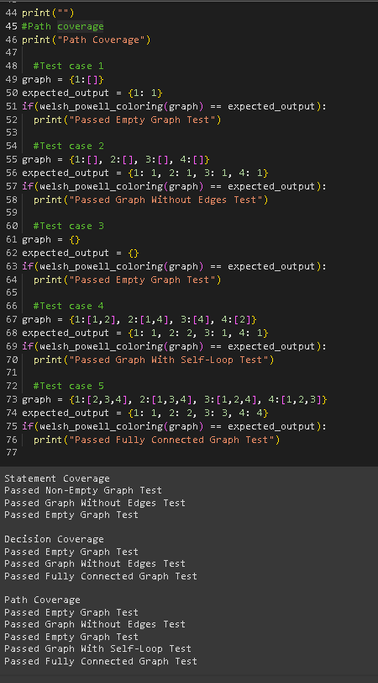
Path Coverage:
Graph With One Vertices
Empty Graph
Graph Without Edges
Graph With Self-Loop
Connected Graph

Slide 33
9. Discussion
Brute Force:
Exponential Time
Real Optimal
Not Feasible With Size > 20
Heuristic:
Quadratic Time
Not Optimal
Can Work With Realy Big Sizes

Slide 34
References
Dailey, D. P. (1980), "Uniqueness of colorability and colorability of planar 4-regular graphs are NP-complete", Discrete Mathematics, 30 (3): 289–293, doi:10.1016/0012-365X(80)90236-8
Garey, M. R.; Johnson, D. S.; Stockmeyer, L. (1974), "Some simplified NP-complete problems", Proceedings of the Sixth Annual ACM Symposium on Theory of Computing, pp. 47–63, doi:10.1145/800119.803884
Garey, M. R.; Johnson, D. S. (1979), Computers and Intractability: A Guide to the Theory of NP-Completeness, W.H. Freeman, ISBN 0-7167-1045-5
Karp, R. M. (1972). Reducibility among combinatorial problems. In R. E. Miller & J. W. Thatcher (Eds.), Complexity of Computer Computations (pp. 85-103). Plenum Press.
Kettani, O., Ramdani, F., & Tadili, B. (2013). A Heuristic Approach for the Vertex Cover Problem. International Journal of Computer Applications, 82(4), 9.
M. Rajagaspar & S. Senthil (2022), “Applications of Graph Coloring Using Vertex Coloring”, Journal of Algebraic Statics, 13 (2): 3447-3454
T. Satish, B. Seema, S. Anand (2022), “Applications of graph coloring in various fields”, Materials Today: Proceedings, 66 (8): 3498-3501, https://doi.org/10.1016/j.matpr.2022.06.392.
Rhyd Lewis (2016) Graph Colouring: An Ancient Problem with Modern Applications, Impact, 2:1, 47-50, DOI: 10.1080/2058802X.2016.11963998
A., Murat (2016), “A Performance Comparison of Graph Coloring Algorithms”, International Journal of Intelligent Systems and Applications in Engineering, 2147-67992, https://dergipark.org.tr/en/download/article-file/254140

