Slide 1
Examining Instagram Usage Patterns: A Comparative Analysis of Finals vs. Non-Finals Weeks
Ufuk Güvenç
31191

Slide 2
Table of Contents
-Motivation
-Aims of the Project
-Null Hypothesis
-Dataset
-Findings
-Conclusion
-Further Improvements

Slide 3
Motivation
Why did I choose this project?
-I chose this project to understand how my Instagram activity correlates with academic stress, particularly during final exam periods, and to identify patterns that can help improve my productivity and time management.

Slide 4
Aims of the Project
What are the main questions I am trying to answer in this project?
-Does my Instagram activity significantly change during final exam weeks compared to non-final periods?
-What patterns or behaviors emerge in my social media usage during high-stress academic times?
What is the importance of my findings?
-The findings provide valuable insights into my social media habits, showing how they align with academic milestones.

Slide 5
Null Hypothesis
There is no significant difference in Instagram activity (messages, stories, saved posts, and likes) during final exam weeks compared to non-final weeks.

Slide 6
Dataset
Why this dataset ? (stories, likes, saved posts and messages)
-They represent key user interactions with the platform

Slide 7
Findings
Findings will be inspected for all four datasets (stories, likes, saved posts and messages).
Since the data i directly obtained from Instagram was well structured, clean and consistent, i didn’t reorganize the data, instead i navigate the path to the data and extracted timestamps from it without cleaning or doing any operations on data.

Slide 8
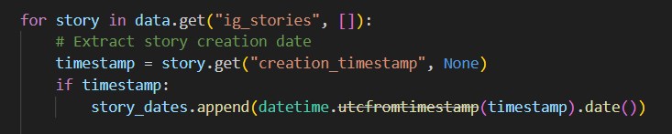
Findings, Stories
-I parse and clean the data
source by transforming
time-stamps into dates.
-Afterwards I proceeded to visualize
data by creating chart of my yearly story posting activity.

Slide 9
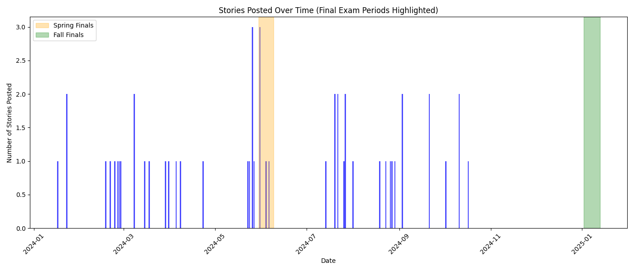
-First finding of my project showed that during exam periods I tend to be less active in terms of sharing stories.

Slide 10
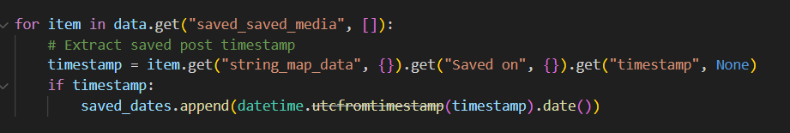
Findings, Saved Posts
-Saved posts are
basically referring
to videos or
photos that i saved. These “posts” can be a variety of media such as memes, car videos, dog videos etc. (Esentially what interests me) This way i can watch/see them later.
-I transformed time-stamps into dates.
-Then I plotted two graphs. First graph shows the yearly saved posts while second graph shows the weekly average of finals weeks vs. non-finals weeks.

Slide 11
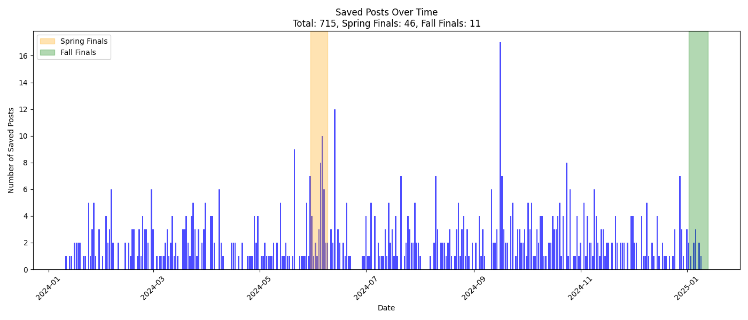

Slide 12
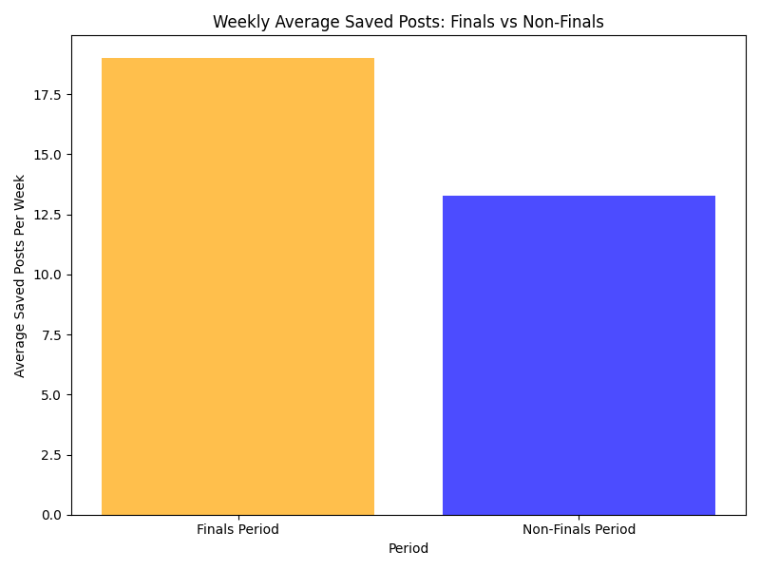
-Second finding shows that, by observing these two graphs provided, i tend to save more posts while it’s Finals weeks.

Slide 13
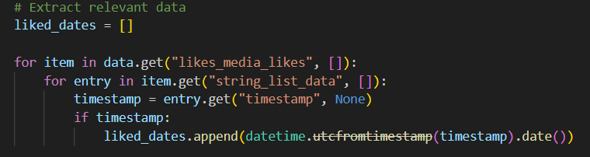
Findings, Likes
-Likes refers to the
posts I liked (in
homepage and fyp)
-Timestamps are
again transformed into dates.
-Then two graphs are plotted. First graph shows the yearly liked posts while the second showcases the weekly average inside/outside of finals weeks.

Slide 14
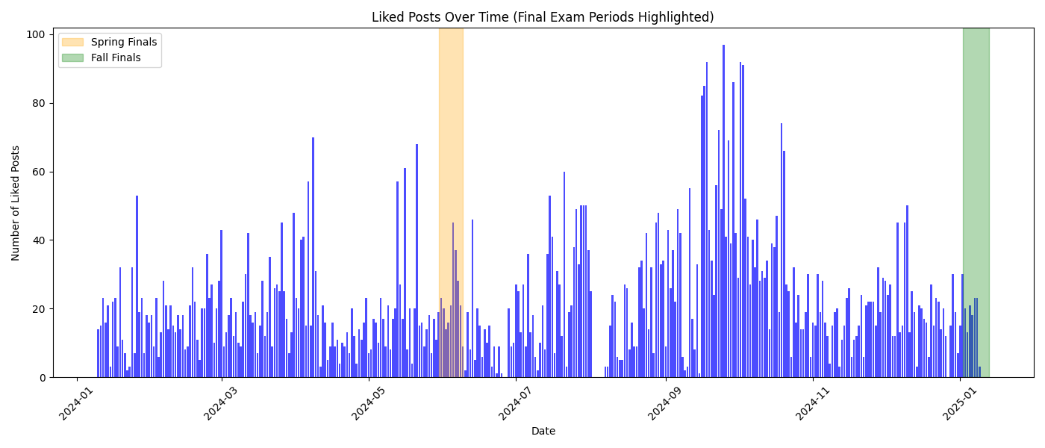

Slide 15
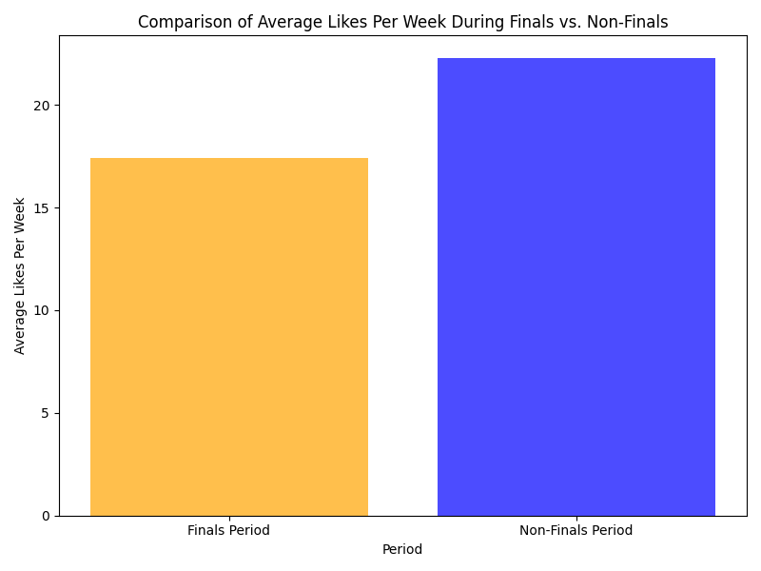
-These two graphs are my third finding. By looking at them we can cleary see that during finals weeks the number of posts I liked is less than when it’s not finals weeks.

Slide 16
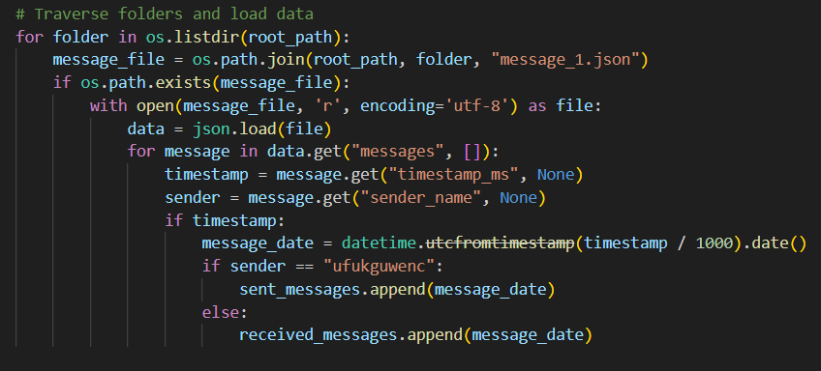
Findings, Messages
-Fourth finding consists
all the messages i
sent/receive. The data’s
timestamp is
transformed into date,
and findings are grouped
by whether i (ufukguwenc)
sent them or received them from someone else.

Slide 17
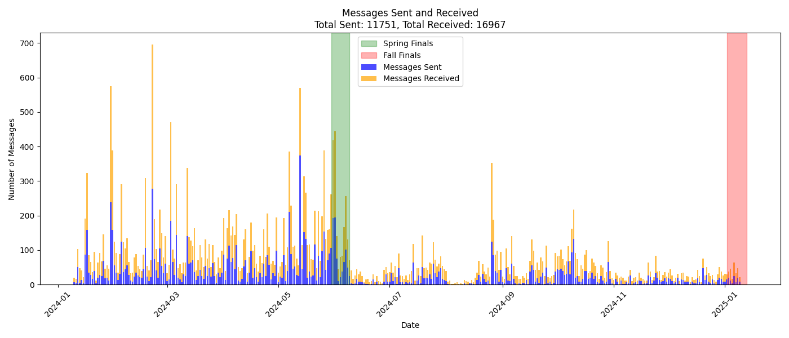

Slide 18
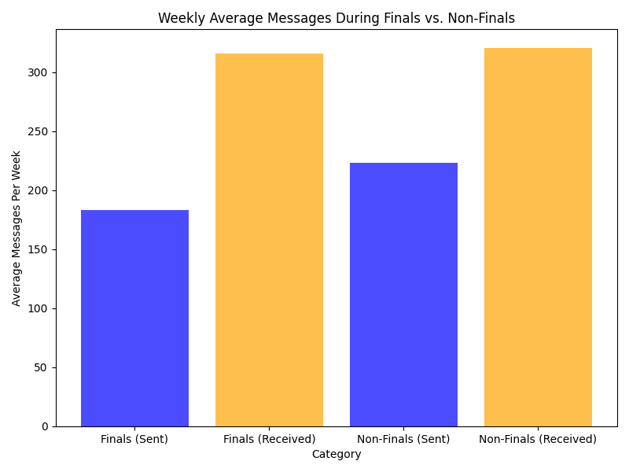
-Examining two graphs, it clearly indicates that my interaction with Instagram (messagewise) decreases over finals weeks.

Slide 19
Conclusion
-Our findings contradict the null hypothesis, which stated: "There is no significant difference in Instagram activity (messages, stories, saved posts, and likes) during final exam weeks compared to non-final weeks."
-The analysis clearly shows significant differences in Instagram usage patterns during finals weeks.

Slide 20
Conclusion
-Story Posting: Decreases, suggesting reduced active engagement and sharing.
-Saved Posts: Increase significantly, reflecting a tendency to consume and bookmark content, possibly as a coping mechanism for stress.
-Likes: Decline, indicating less passive browsing of content during high-stress periods.
-Messages: Decrease, showing reduced social interaction during finals weeks.
-These findings demonstrate that Instagram activity varies by type during finals, rejecting the null hypothesis and confirming that academic stress influences social media behavior in complex ways.

Slide 21
Further Improvements
-Using unsupervised machine learning algorithms, Instagram activities can be grouped into distinct patterns. This way, we can further understand users’ engagement patterns with the app.
–Using supervised machine learning algorithms, we can predict how Instagram usage changes based on academic stressors or any other external factors. This way we can Help users anticipate their own social media behavior and make adjustments, such as planning study schedules around high-distraction periods

