Slide 1

EA 2010
Assignment
Davide Cucci & Antonis Thomas

Slide 2

“Jajuk is software that organizes and plays music. It is a full-featured application geared towards advanced users with large or scattered music collections. Using multiple perspectives, the software is designed to be intuitive and provide different ways to perform the same task.”
http://jajuk.info
Jajuk Advanced Jukebox
Antonis Thomas & Stavros Lopatatzidis

Slide 3
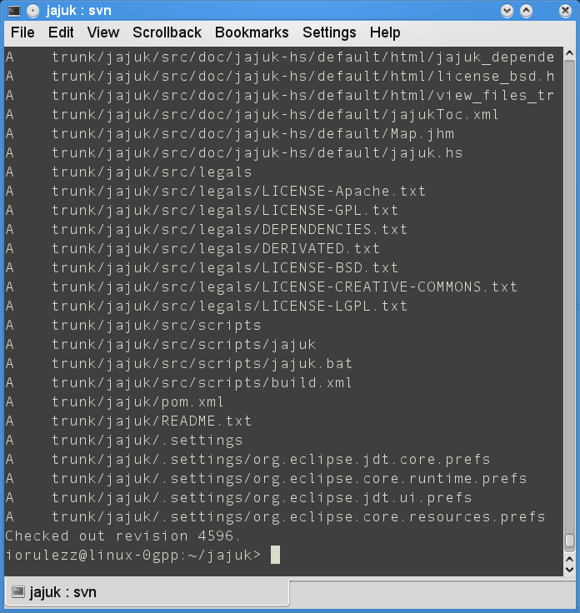
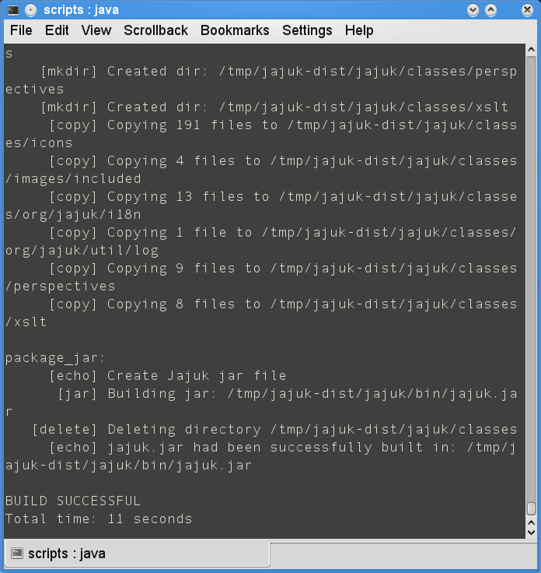

svn co https://jajuk.svn.sourceforge.net
/svnroot/jajuk/trunk/
Compiled using the ant tool
http://ant.apache.org
SVN Checkout and Compilation
Antonis Thomas & Stavros Lopatatzidis

Slide 4
Our Contribution
* Lyrics: Ability to edit lyrics and save them in a Txt file or in the Tag of the music file according to the file format. Also loading lyrics from Txt or Tag
* Digital DJ: New dj manager choosing tracks based on track properties (Artist, Year, ...)
Full list of features: http://jajuk.info/index.php/Features
Antonis Thomas & Stavros Lopatatzidis

Slide 5
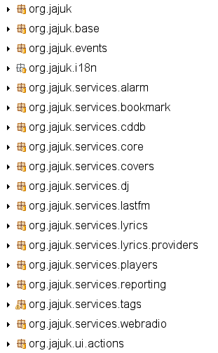
Jajuk Packages
* Jajuk is completely
Package Oriented
* 6 basic packages in the package Jajuk (base, events, i18n, services, ui and util)
* our work was focused on services and ui packages
Antonis Thomas & Stavros Lopatatzidis

Slide 6
Project Code
/**
* An Album *
* <p>
* Logical item
*/
public class Album extends LogicalItem implements Comparable<Album> {
/**
* For perfs, we cache the associated tracks. This cache is filled by the
* TrackManager using the getTracksCache() method
*/
private List<Track> cache = new ArrayList<Track>(15);
/**
* Album constructor
*
* @param id
* @param sName
*/
public Album(String sId, String sName) {
super(sId, sName);
}
Sample from Album Class (Album.java)
High Quality Code
* 56000 lines pure code
* Full of comments
* Nice variables and methods naming
* Code easily modified
Antonis Thomas & Stavros Lopatatzidis

Slide 7
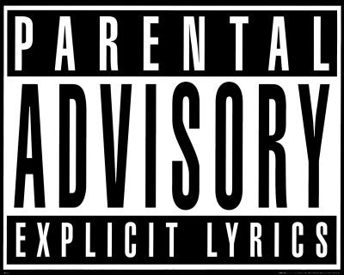
Contribution
Lyrics
* In display mode the lyrics of a track can be shown
* Edit Lyrics or Cancel
* If edit is selected save function is enabled
* Lyrics area becomes editable
Antonis Thomas & Stavros Lopatatzidis

Slide 8
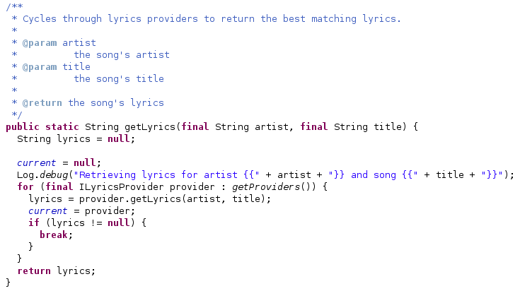
getLyrics method
in LyricsService
LyricsService loads the providers and get
lyrics with method getLyrics(artist,title)
Providers have actually 2 methods :
getLyrics(artist,title) and
getWebURL(artist,title)
Past Lyrics Code
Antonis Thomas & Stavros Lopatatzidis

Slide 9
Lyrics Implemented Code
* Lyric Persisters commit lyrics with method commitLyrics(lyrics,File)
* LyricsService must have also commit method
* The TxtProvider and TagProvider have higher priority than the past ones in the array Providers
Antonis Thomas & Stavros Lopatatzidis

Slide 10
Lyrics Implemented Code
* Many GUI components are declared
* LyricsView has new method editLyrics
* On the press of Edit button the lyrics are become editable
* Save button is enabled
* It's up to your choice!!!
Antonis Thomas & Stavros Lopatatzidis

Slide 11

Contribution
Digital DJ
* One new dj manager based on track properties
* Same style as the other dj managers
* Choosing MetaDataInformation, comparator and value
* Playlist appropriate to the options is generated
Antonis Thomas & Stavros Lopatatzidis

Slide 12
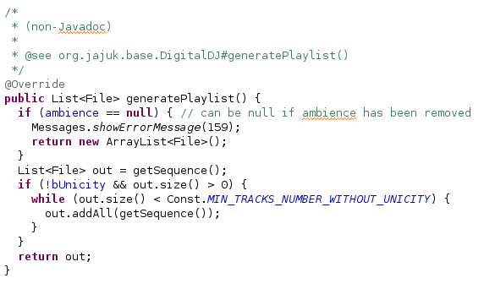
The generatePlaylist method in the AmbienceDigitalDj
Each type of Dj has 2 classes for
example Ambience, AmbienceDigitalDj
First Class – object & information
Second Class – generating playlist
DigitalDj could be an Ambience, Transition
or Proportion one.
Past Digital Dj Code
Antonis Thomas & Stavros Lopatatzidis

Slide 13
DigitalDj Implemented Code
* Property as an object consists of MetaDataInfo, Comparator and Value
* PropertyDigitalDj with methods like generatePlaylist,
accept(Track,Property)
and toXML()
* DigitalDjFactory
FactoryImpl extends
DigitalDjManager
* Saved Djs are loaded from an XML file
Antonis Thomas & Stavros Lopatatzidis

Slide 14
DigitalDj Implemented Code
* WizardDigitalDj has two more classes
* PropertiesPanel organises all the MetaDataInformation
* PropertiesSelectionDialog
extends JajukJDialog creates window for editing properties
Antonis Thomas & Stavros Lopatatzidis

Slide 15
Collaboration
* Constant Discussion with Jajuk Team and especially project leader Bertrand Florat via Jajuk developer mailing list and ticket system
On 07/02/2009 11:30 PM, Bertrand Florat wrote:
> ?? I don't see why you refer to persistence here. We are in a provider,
> not a persister. This method should be in TxtPersister instead IMO. The
> LyricsView will use one or more providers and one or more persisters but
> providers and persisters shouldn't have any reference between them
> (separation of concerns)
>
>
I can see what you mean. I thought over that and observed that
the JajukProvider does not have any reason to implement
ILyricsProvider. So I was thinking of seperating JajukProvider
and to not implement the interface. This way there will be
no interference between providers and persisters.
Antonis Thomas & Stavros Lopatatzidis

Slide 16
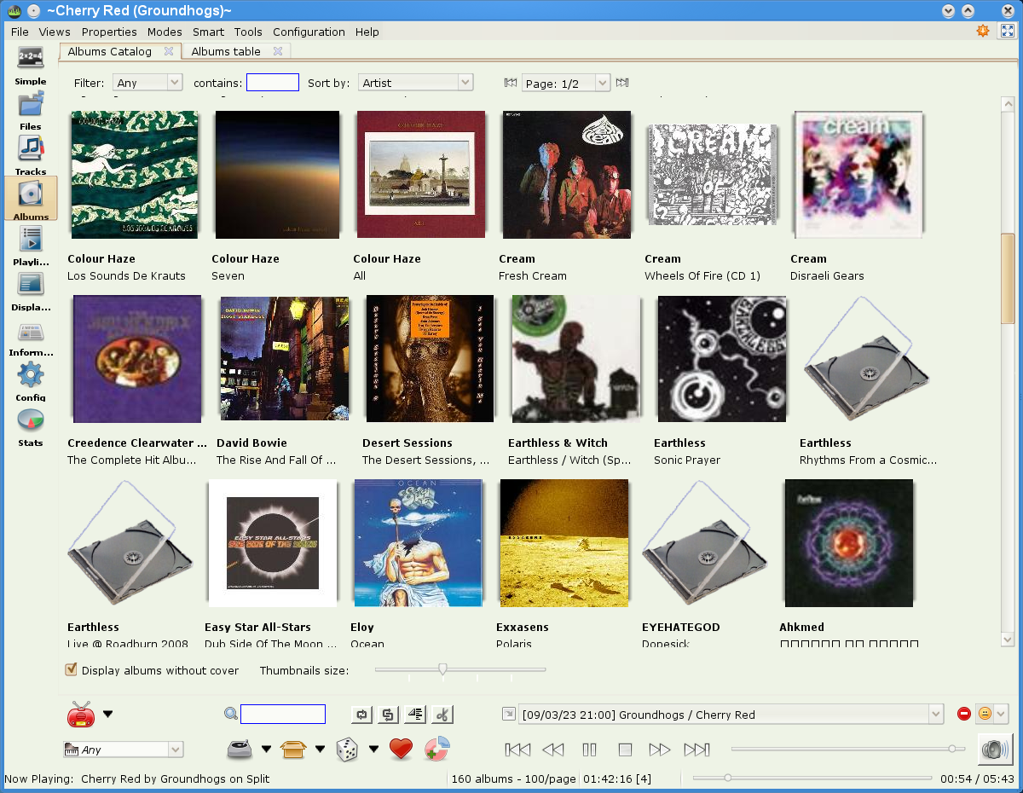
Album View
shows all the albums and the user can choose the one he wants to listen by double clicking it
Album View
Jajuk User Interface
Antonis Thomas & Stavros Lopatatzidis

Slide 17
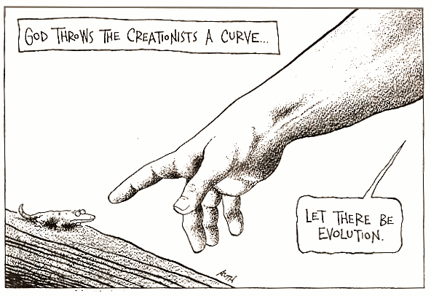
Questions ???
Thank You
Davide Cucci & Antonis Thomas

