Slide 1

A Modern Library Management System: Design, Implementation, and Analytics
Adil Arslan Itvfu-21 (20213280)

Slide 2
Introduction: The Need for Modern Library Management
Traditional library management can be inefficient, lacking integration and data insights.
This project addresses the need for a modern, web-based Library Management System (LMS) supporting multiple schools.

Slide 3
Project Objectives and Key Features
Implement core library functions: Book Cataloging (Manual/ISBN), User Management (Roles: Student, Librarian, Admin), School Management.
Develop a robust circulation system: Loans, Reservations, and an automated Waitlist-to-Reservation flow.
Integrate an Analytics Dashboard providing insights into book popularity, demand, genre performance, and user activity.
Utilize a modern tech stack (Vue.js, Node.js, tRPC, PostgreSQL, TypeORM) for type-safety and developer experience.

Slide 4
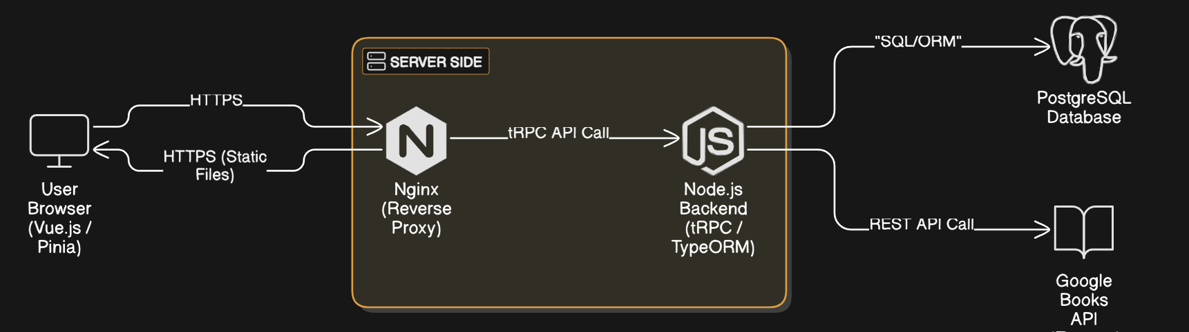
Architecture and Technology Stack
Frontend: Vue.js 3 (Composition API) with Pinia for state management, Flowbite-Vue for UI components. Provides the user interface for students, librarians, and admins.
Backend: Node.js with TypeScript, using tRPC for type-safe API communication with the frontend. Handles business logic and database interactions.
Database: PostgreSQL relational database.
ORM: TypeORM for object-relational mapping between TypeScript code and the database.
API Integration: Calls Google Books API for ISBN-based book data enrichment.
Proxy: Nginx configured as a reverse proxy, serving the Vue frontend build and forwarding API requests (/v1/trpc) to the Node.js backend.

Slide 5
Book Cataloging and User Roles
Book Management:
Librarians can add books via ISBN (fetches data from Google Books API) or manually enter all details.
Ability to edit existing book information, including stock levels and genres.
Genre management includes associating existing genres or creating new ones on-the-fly during book entry/edit.
User Management:
Distinct roles (Student, Librarian, Admin) with different permissions enforced via tRPC middleware.
Secure password hashing using bcrypt.

Slide 6
Loan, Reservation, and Waitlist System
Reservations: Users can reserve available books (availableQuantity > 0). Backend checks prevent users from reserving books they already have on loan or reserved. Reservations expire after a set period (e.g., 7 days).
Loans: Librarians can convert active reservations into loans (marking the reservation 'Completed' and creating a Loan record). Loan returns increment availableQuantity.
Automated Waitlist:
If a book has availableQuantity = 0, users can join a waitlist (FIFO based on createdAt).
Backend checks prevent joining if user already has the book loaned, reserved, or is already on the waitlist.
Key Feature: When a loan is returned or a reservation is cancelled/expires, backend logic automatically checks the waitlist for that book. If users are waiting, the first user is removed from the waitlist and automatically granted an active reservation.

Slide 7
Analytics Dashboard Overview
Key Metrics Displayed:
Top Books: Lists of most loaned, reserved, and viewed books within selected timeframes.
Activity Trends: Charts showing daily/weekly/monthly counts of loans, reservations, and views over time.
Demand Analysis: Highlights books with active waitlists and flags books potentially needing more copies based on availability, waitlist/reservation pressure, and recent view activity ("High Demand Indicators").
Genre Performance: Shows book counts per genre and top genres by circulation activity.
User Activity: Displays the count of recently active users vs. total users.

Slide 8
Conclusion
Summary: Successfully developed a functional multi-school LMS with core circulation features and a valuable analytics module. The system utilizes a modern, type-safe stack.
Key Achievements: Implemented automated waitlist processing, provided data-driven insights through analytics, demonstrated effective use of tRPC and TypeORM.

Slide 9
Future Directions
Refine stock recommendation algorithm with more data/machine learning.
01
Implement user notifications (e.g., when a waitlisted book becomes reserved).
02
Add more granular analytics (e.g., user-specific reading history).
03
Enhance security (MFA, more robust authorization).
04
Develop advanced reporting features.
05
Improve UI/UX based on user feedback.
06

Slide 10

Thank you
Any Questions?

