Slide 1

A Web-based System for Efficient Healthcare Navigation
By Ufuk Saylan

Slide 2
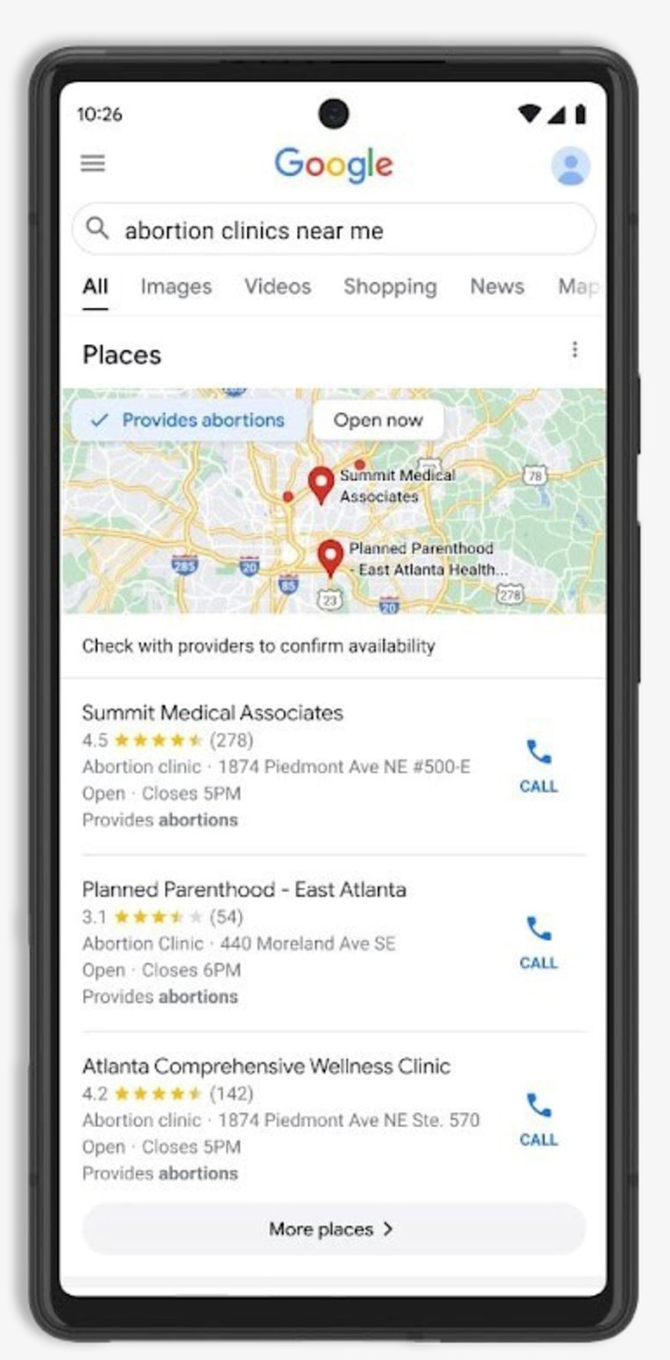

Finding the Right Medical Care (Relevance & Problem)
Problem: Information is scattered across different sources.
Gap: General mapping apps (like Google Maps) lack crucial medical-specific filters (e.g., Is this clinic equipped for trauma? Does it have cardiology?).
Consequence: Difficulty, confusion, and potential delays when quick access to the appropriate facility is needed. Existing directories focus on doctors, not facilities/navigation.
Notes:
Anyone needing medical help in Vilnius faces a challenge: information is fragmented, and relying on general tools can be problematic. While we use map apps daily, they often lack the specific filters crucial for healthcare – like finding a cardiologist or verifying if a clinic truly offers emergency services. Worse still, as my research review found, these general platforms can sometimes be actively misleading. For instance, documented cases show searches for sensitive services like abortion clinics directing users to non-medical 'crisis pregnancy centers' with entirely different aims. This isn't just inconvenient; it can lead to confusion, costly delays, and people being guided inappropriately precisely when clear, accurate directions to the right care are most needed. Existing doctor directories or hospital websites don't solve this integration problem either My analysis looked closely at the tools already available in Vilnius. General mapping platforms like Google Maps are great for basic navigation but lack essential medical details and, as we saw, can even be misleading sometimes. Then there are local healthcare directories, like manodaktaras.lt, which are good for finding specific doctors or booking appointments, but they aren't really designed for finding the most appropriate facility based on its services or for integrated routing. Official hospital websites offer detailed info, but you need to know which specific institution to check, which isn't helpful for discovery. Even the newer national platforms like the E-Health app, while useful for booking, don't necessarily solve the problem of identifying the most suitable facility based on complex needs or providing easy navigation.

Slide 3
Creating a Dedicated Solution (Object & Tasks of the Thesis)
Object: Design, implementation, and analysis of a dedicated full-stack web application system for this purpose (including backend, frontend, API, database, and routing integration).
Analyze requirements/existing solutions.
Select technologies.
Design system architecture.
Implement full-stack application.
Test components.
Notes:
The object of this thesis was therefore to design, implement, and analyze a dedicated full-stack web application system – encompassing the backend, frontend, database, and routing elements. The core tasks were to analyze needs, select the appropriate technologies, design the architecture, implement the application, and test it thoroughly

Slide 4
System Requirements - Scope & Key Functionalities
Emergency Search
Detailed Facility Search & Filtering (type, specialty, emergency)
Info Display
Interactive Mapping
Routing
User Feedback
Admin Interface
Limited to Vilnius
Notes:
The application scope focused on a web app for Vilnius, enabling users to find and get directions to medical facilities. Core functionalities include emergency search, detailed filtered search (by type, specialty, accessibility), mapping, routing, user feedback, and an admin interface. Things like appointment booking were kept out of scope

Slide 5
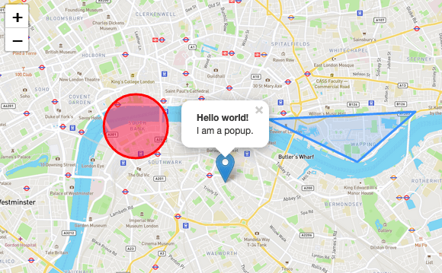

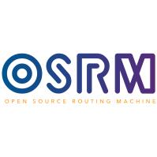

Technology Selection Rationale
Backend: Ruby on Rails (developer productivity, gems).
Database: PostgreSQL + PostGIS (powerful geospatial features, good Rails integration).
Frontend: Vue.js (clear docs, component-based, good for SPA).
Routing: OSRM (high performance, self-hosted, open-source).
Mapping Library: Leaflet (lightweight, simple, good performance).
Notes:
The technologies were chosen carefully: Ruby on Rails for backend productivity, PostgreSQL with PostGIS for its powerful geospatial capabilities, Vue.js for a modern interactive frontend, the OSRM engine for high-performance open-source routing without external API costs, and Leaflet for efficient map display

Slide 6
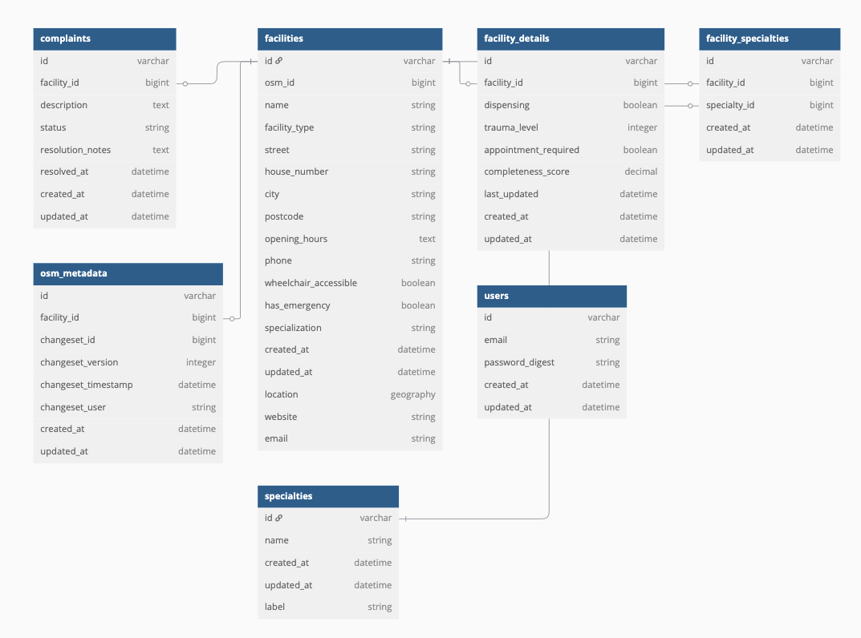
System Development - Data Model
Notes:
The data model uses PostgreSQL with PostGIS, centered around the facilities table which stores geographic location. It manages data for 380 facilities across 91 specialties, linking them via join tables. The ER Diagram [See Fig \ref{fig:er_diagram}] shows the structure

Slide 7
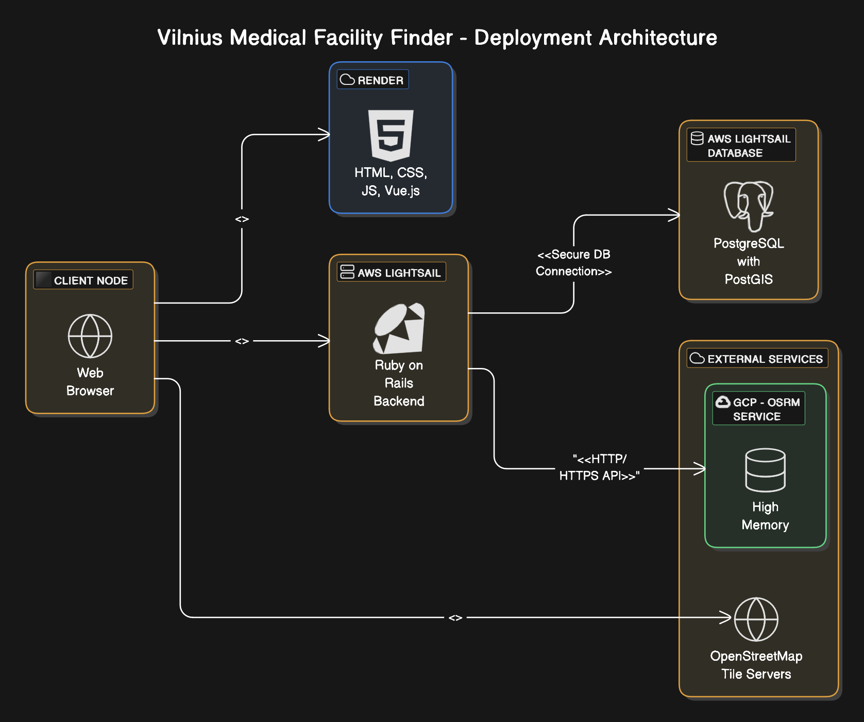
Deployment Architecture
Notes:
Architecturally, the system follows a logical layered approach – Presentation, Application, Data, Integration – promoting modularity [See Fig \ref{fig:logical_architecture}]. Physically, it's deployed across platforms best suited for each component: Render for the frontend, AWS for the backend and database, and Google Cloud Platform for the memory-intensive OSRM routing engine [See Fig \ref{fig:deployment_diagram

Slide 8
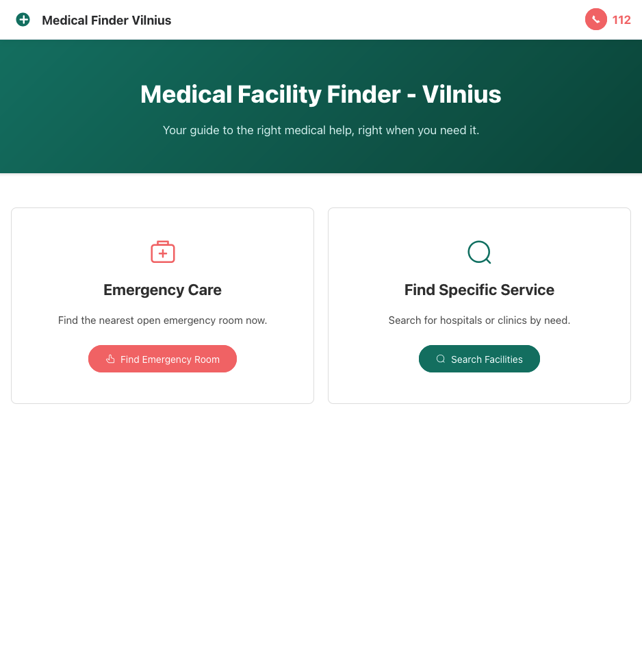
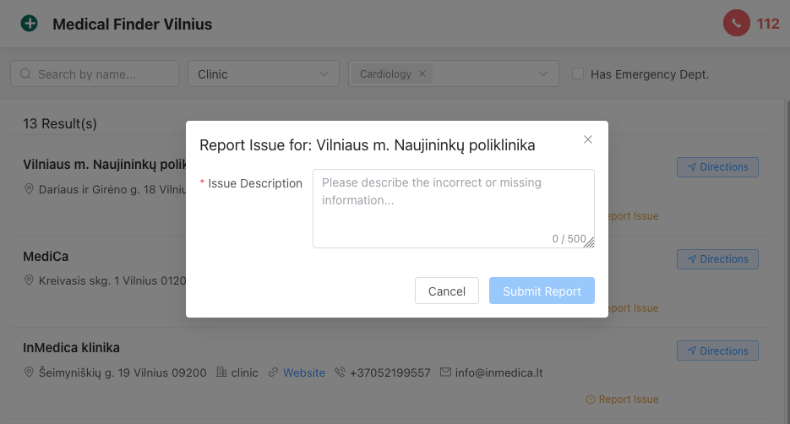
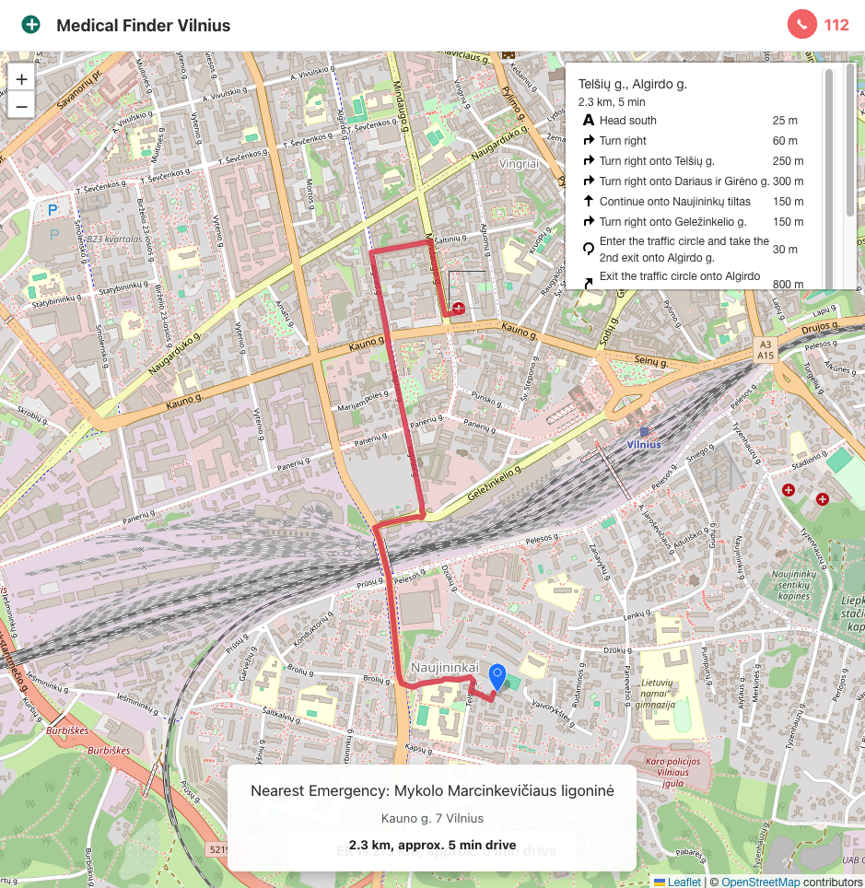
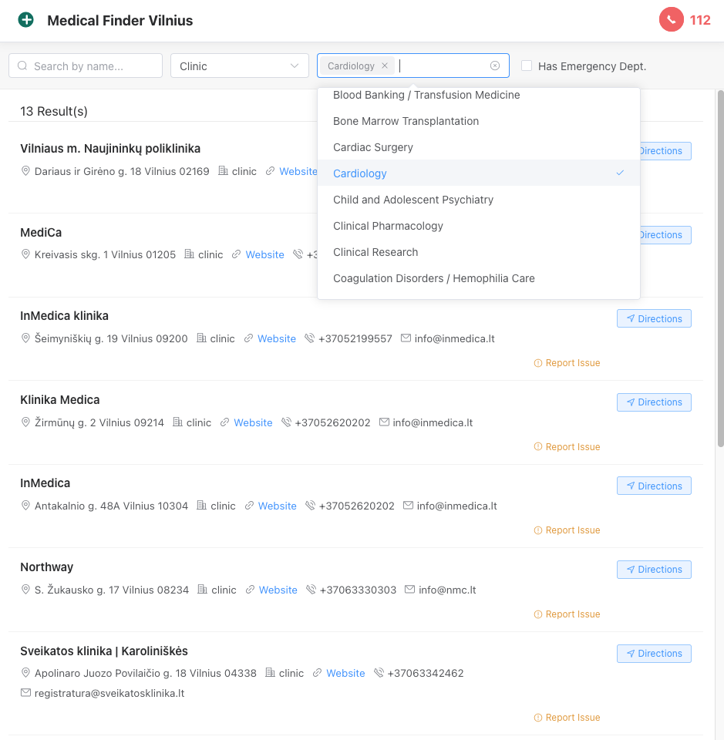
System Development - Frontend User Interaction
https://emergency-facility-finder-ui.onrender.com

Slide 9
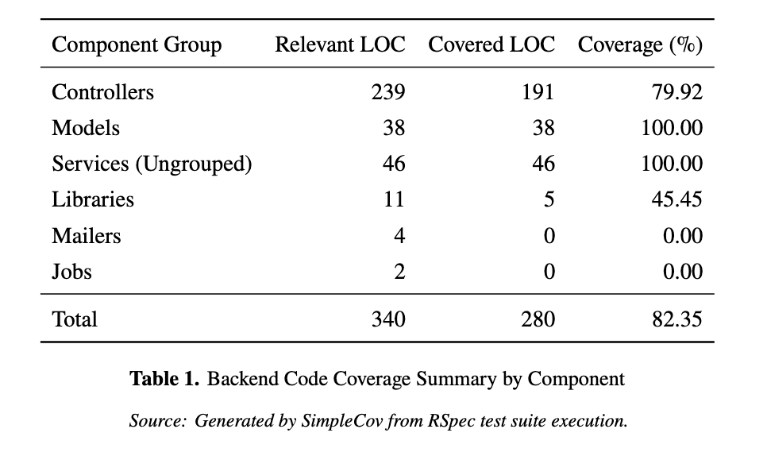
System Testing & Evaluation
Backend Testing: RSpec, 82.35% coverage User Feedback (Informal): Positive reception, intuitive. Rehab anecdote.
Proposed Formal Usability Testing
Notes:
For testing, the backend has 58 automated RSpec tests achieving over 82% code coverage [See Table \ref{tab:coverage_summary}], ensuring core logic reliability. Informal user feedback during demos was positive, highlighting the intuitive interface and the practical value of features like specialty filtering – confirmed by a user's real-life anecdote. Furthermore, a detailed task-based usability test plan was outlined in the thesis [See Section \ref{sec:task_test_outline}] to provide a clear path for more formal user validation in the future."

Slide 10
Conclusions
Goal Met: Addressed specific healthcare navigation challenges in Vilnius.
Tasks Achieved: Systematically completed all project phases (Analysis -> Tech Selection -> Design -> Implementation -> Testing).
Limitations: Data accuracy maintenance is crucial
Value Proposition: Delivered a functional and demonstrably useful tool for Vilnius healthcare navigation.
Notes:
In conclusion, this thesis set out to address the healthcare navigation challenges in Vilnius, and it successfully delivered a functional web application. Its contribution and novelty lie in the targeted integration of technology to solve that specific local gap – providing a unified interface with granular medical filters and integrated routing focused on Vilnius. The project systematically achieved its objectives, completing the main tasks defined at the outset: from analyzing requirements and existing systems, selecting appropriate technologies, and designing the architecture, through to implementing the full-stack application and testing its core components. While acknowledging limitations, especially the crucial ongoing challenge of data accuracy, the result is a demonstrably useful tool providing value for residents and visitors in Vilnius.

