Slide 1
WikiBook
UFUK BARIŞ TUNCA B1705.09002

Slide 2
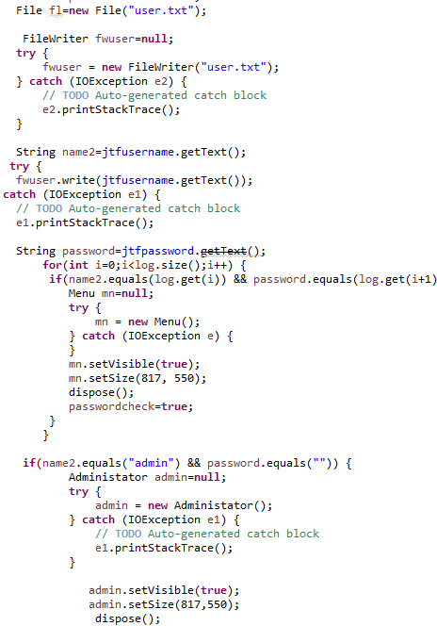
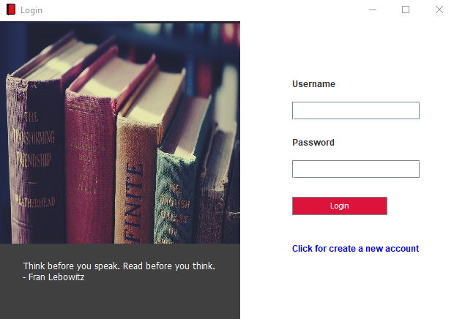
Login
-File
-Operations

Slide 3
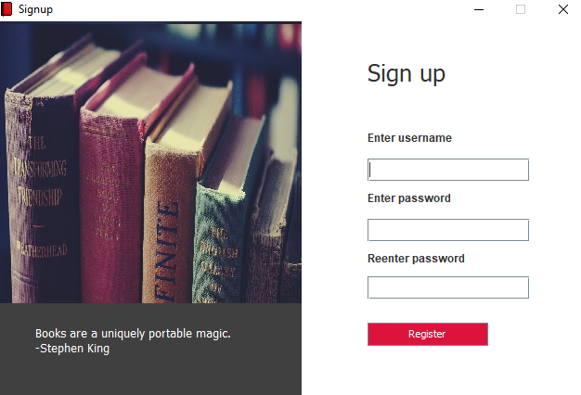
Register
-Register
-Operations

Slide 4
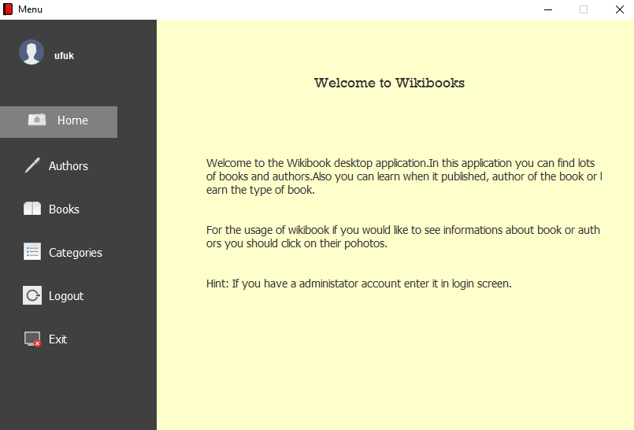
Home
-İnformation
-Hint
-Username

Slide 5
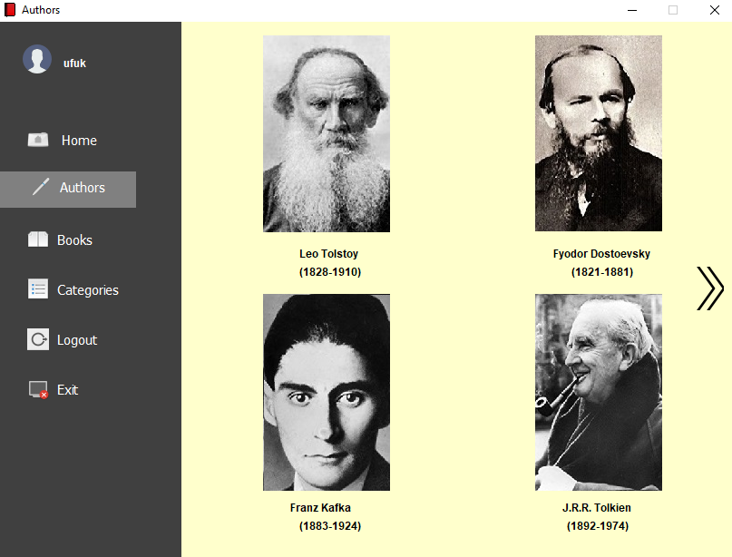
Authors
-10 Author
-Authors information

Slide 6
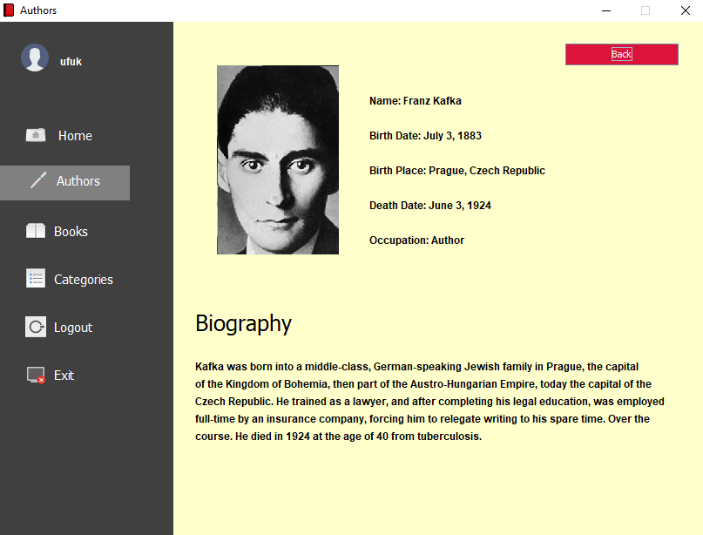
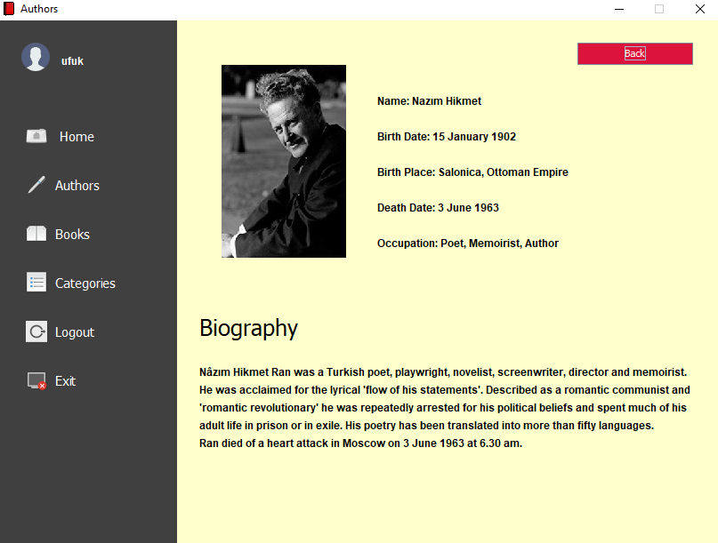

Slide 7
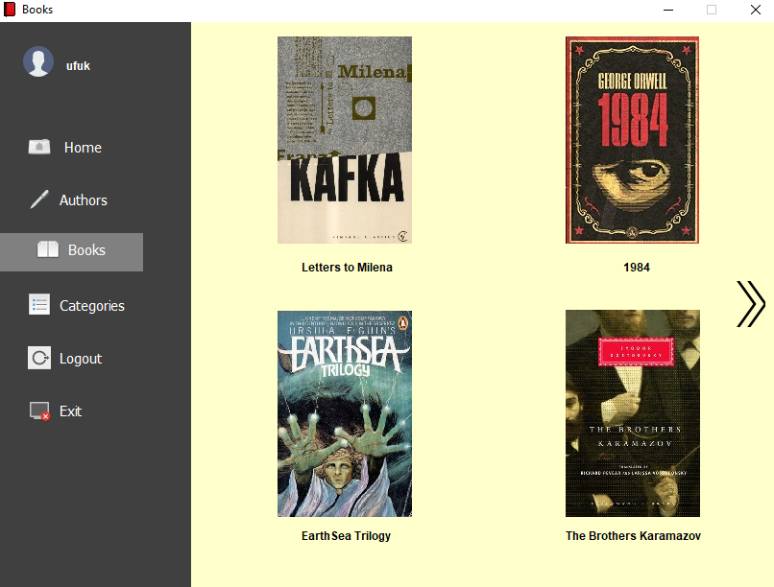
Books
-17 Books
-Book information

Slide 8

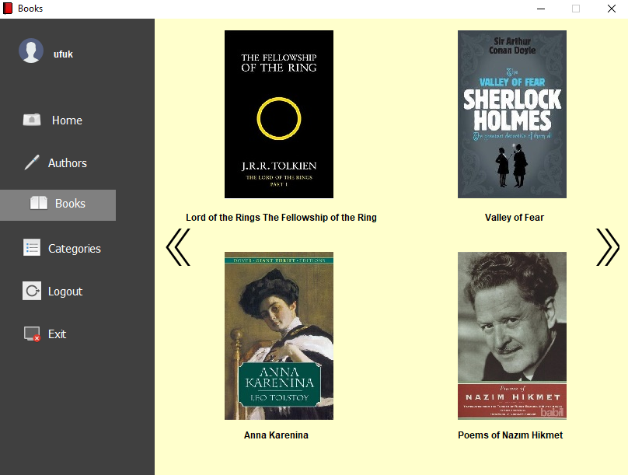

Slide 9
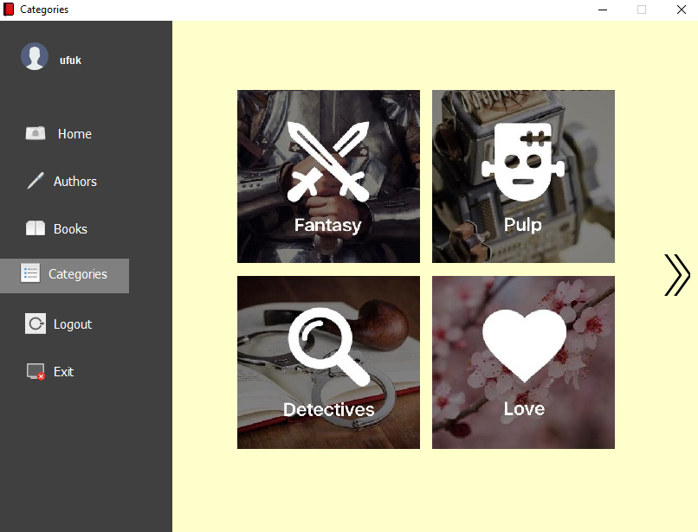
Categories
-Categories
-7 categories

Slide 10
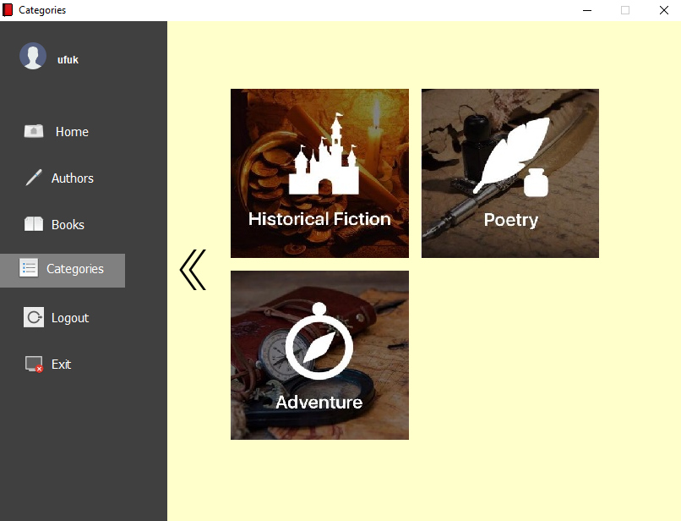

Slide 11
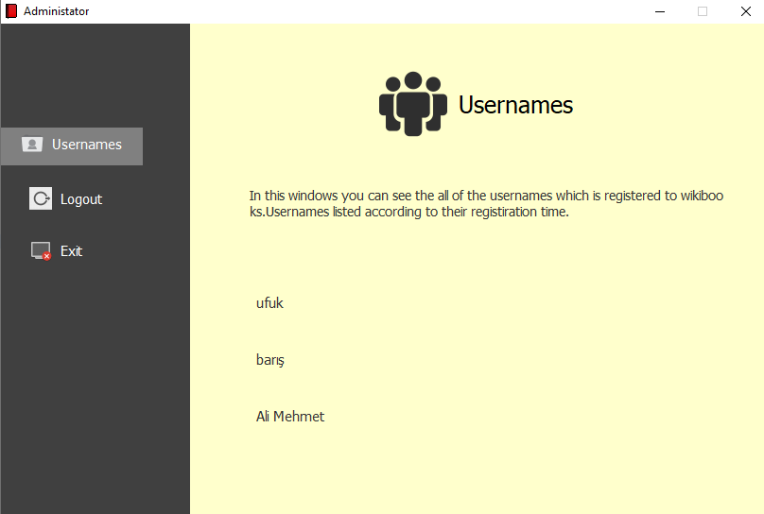
Administator
-Usernames
-Register

