Slide 1


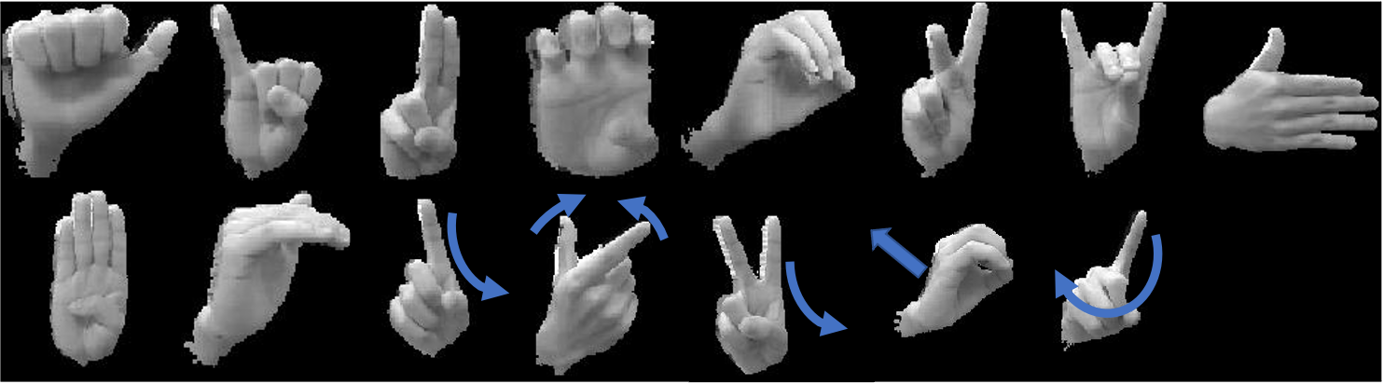
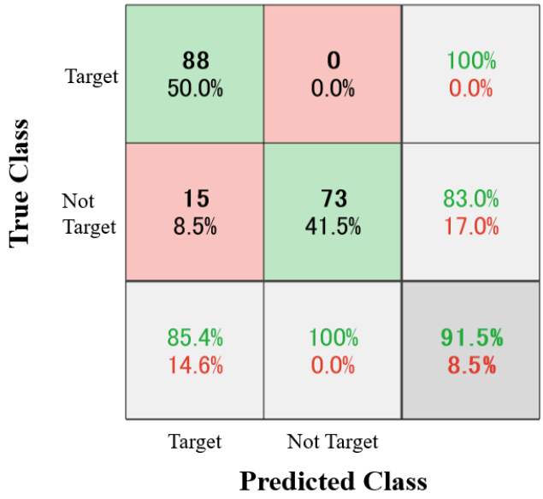
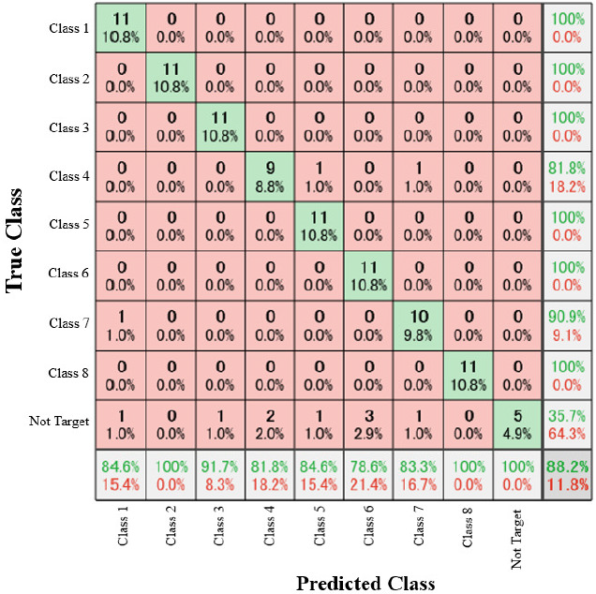
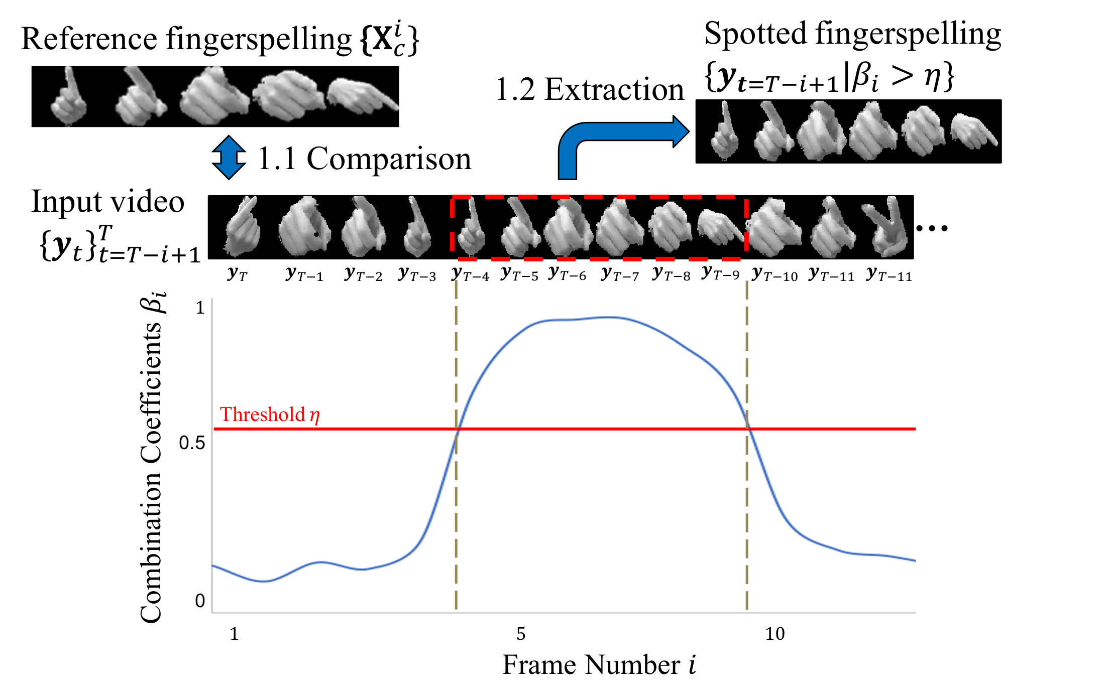
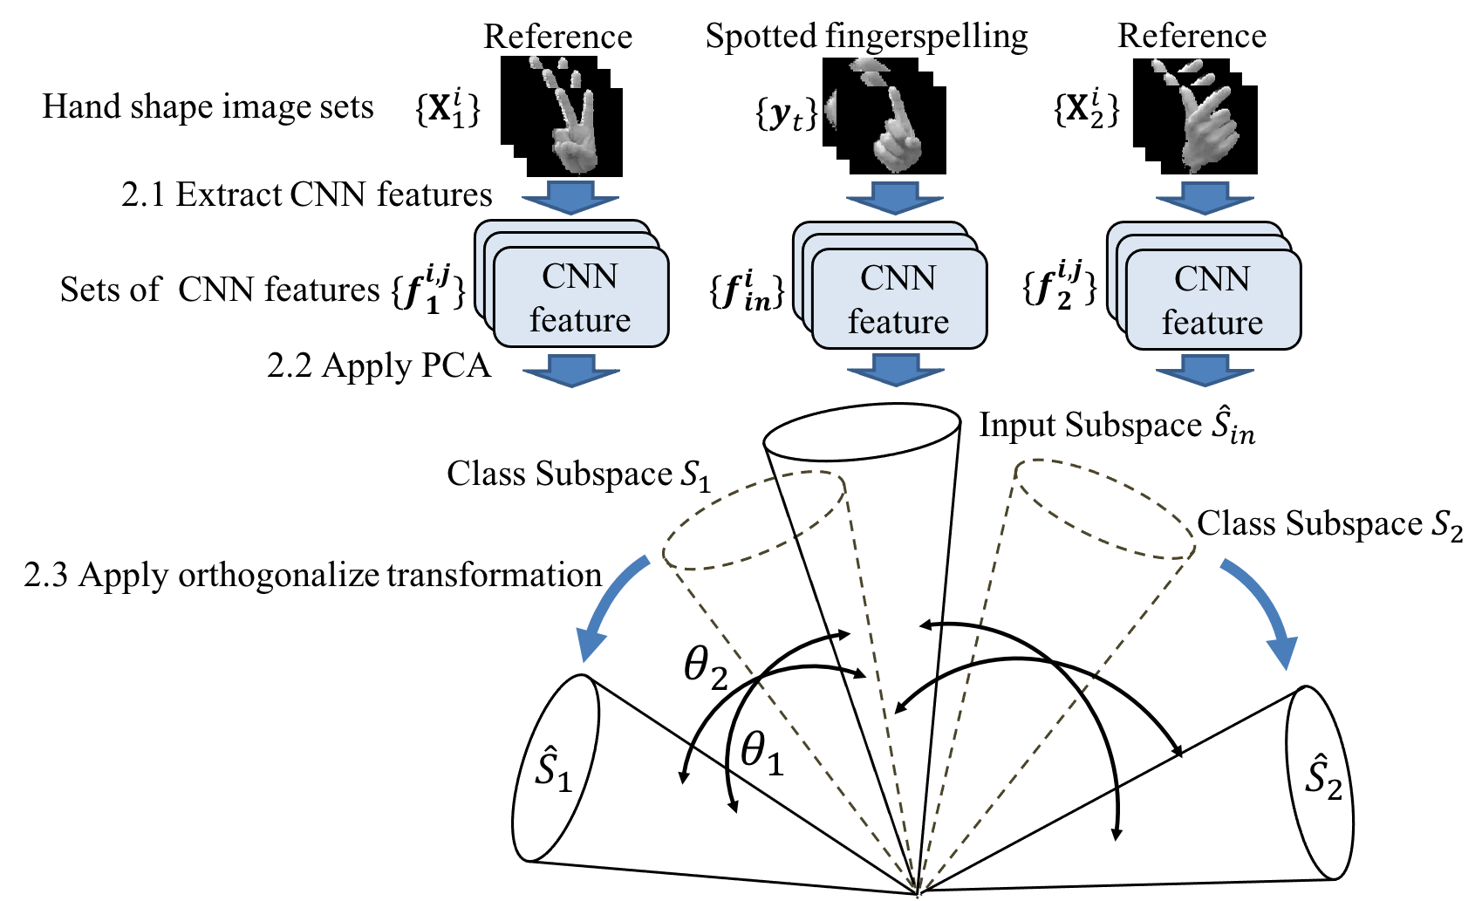


Fingerspelling Recognition with Two-Steps Cascade Process of
Spotting and Classification
Masanori Muroi¹, Naoya Sogi¹, Nobuko Kato², Kazuhiro Fukui¹
¹ Graduate School of Systems and Information Engineering, University of Tsukuba, Japan
² Faculty of Industrial Technology, Tsukuba University of Technology, Japan
(1) Introduction
(3) Experiments
Fingerspelling is a tool to express proper nouns and new technical terms that have not been yet defined in sign languages.
Main goal : Detect and recognize fingerspellings in an input video which is composed of fingerspellings and not fingerspelling signs.
Basic idea : Divide a whole process into two-steps cascade process:
Spotting : Extract a fingerspelling sequence in an input video by utilizing temporal dynamic information.
Classification : Classify the spotted sequence by utilizing 3D hand shape information.
To efficiently incorporate two different information, we propose a fingerspelling classification framework
based on three methods: 1) temporal regularized CCA (TRCCA)[1] for spotting, 2) orthogonal mutual subspace method (OMSM)[2] and 3) CNN features[3] for classification.
Dataset:
We recorded 15 fingerspelling classes by a depth camera.
We synthesized an input video, which continuously inputs fingerspelling and not fingerspelling sequences alternately.
Evaluation index:
Spotting performance, Classification accuracy, Recognition time.
Static
Dynamic
“a”
“mo”
Sample images of our fingerspelling dataset.
Japanese fingerspelling examples
(2) Proposed framework
Step1: Spotting process
Step2: Classification process
Confusion Matrix: Results of the spotting process.
Accuracies and recognition times of different methods.
Framework | Accuracy | Recognition Time
TRCCA[1] | 64.1% | 39.7 ms
CNN feat - OMSM | 68.9% | 52.7 ms
KOTRCCA[1] | 79.0% | 169.0 ms
TRCCA - CNN(softmax) | 80.7% | 56.9 ms
TRCCA - KOMSM | 86.9% | 187.3 ms
TRCCA - CNN feat - OMSM(Proposed) | 88.2% | 91.2 ms
Confusion Matrix:
Results of the classification process
Fingerspelling images in an input video are detected by considering the temporal information using TRCCA.
TRCCA: Calculate similarity between two sequences
considering temporal information.
The detailed procedure
1.1 The input image sequence $\{{y_{t}\}}_{t=T−i+1}^{T}$is compared with
the reference fingerspelling $\left\{{\text{X}}_{c}^{i}\right\}$ by TRCCA.
If the input sequence has high similarity with the reference
fingerspelling, the input sequence is classified as a fingerspelling.
1.2 Fingerspelling images $\left\{y_{t=T−i+1} | β_{i}>η\right\}$ are extracted
from the input sequence.
Spotted fingerspelling is classified by OMSM with CNN features using hand shape image sets.
OMSM: Represent 3D shape of a hand by subspace,
then classify it by subspace similarity.
The detailed procedure
2.1 CNN features $\left\{f_{in}^{i}\right\}$ and $\left\{f_{c}^{i,j}\right\}$ are extracted from $\left\{y_{t=T−i+1} | β_{i}>η\right\}$ and $\left\{{\text{X}}_{c}^{i}\right\}$.
2.2 Each class subspace $\{S_{c}\}$ and an input subspace $S_{in}$ are generated by applying PCA
to the sets of CNN features.
2.3 Orthogonal subspaces {${\hat{S}}_{c}\}$ and ${\hat{S}}_{in}$ are generated by applying orthogonalize
transformation to $\{S_{c}\}$ $and S_{in}$.
2.4 The spotted fingerspelling is classified based on similarities between the input subspace $S_{in}$
and reference subspaces {${\hat{S}}_{c}\}$.
(4) Conclusion
We proposed fingerspelling recognition framework based on a complementary combination of TRCCA and OMSM with CNN features.
We confirmed that our two-steps process significantly outperforms conventional one-step methods in terms of classification accuracy and recognition time.
(5) References
[1]S. Tanaka, A. Okazaki, N. Kato, H. Hino and K. Fukui, Spotting fingerspelled words from sign language video by temporally regularized canonical component analysis, 2016 IEEE International Conference on Identity, Security and Behavior Analysis, 2016, pp. 1-7.
[2]K. Fukui and O. Yamaguchi, The kernel orthogonal mutual Subspace method and its application to 3D object recognition, in Asian Conference on Computer Vision, 2007, pp. 467-476.
[3] N. Sogi, T. Nakayama, and K. Fukui, A method based on convex cone model for image-set classification with cnn features, in 2018 International Joint Conference on Neural Networks, 2018, pp. 1-8.

