Slide 1
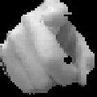
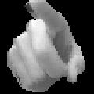
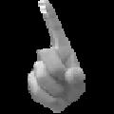


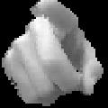






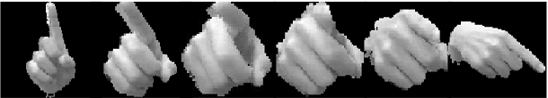
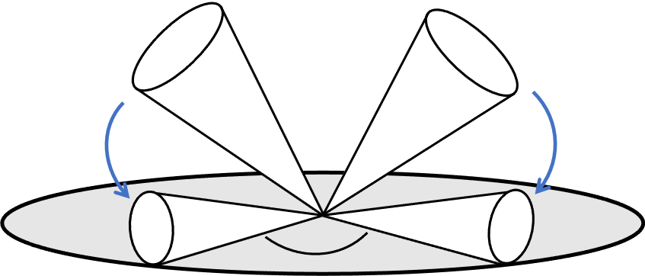

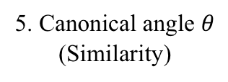
Fingerspelling Recognition with Two-Steps Cascade Process of
Spotting and Classification
Masanori Muroi, Naoya Sogi, Nobuko Kato, Kazuhiro Fukui
We propose a framework for fingerspelling recognition, based on the combination of TRCCA and OMSM with CNN features.
Step1: Spotting a target fingerspelling
Input
Video
…
1. Extract a target fingerspelling
Apply TRCCA
Step2: Classifying the spotted fingerspelling
2. Extract CNN features
Set of CNN features
Reference subspace
Input subspace
3. PCA
OMSM is performed on
CNN features
4. Orthogonalization
5. Canonical angle $θ$
(Similarity)
Notes:
Hello everyone. My name is Masanori Muroi from university of Tsukuba.
Today, I will talk about fingerspelling recognition with two-steps cascade process of spotting and classification.
Spotting is to extract a target fingerspelling from an input video
and classification is to categorize the extracted fingerspelling.
The key idea of our framework is to introduce different types of methods to each process,
because the temporal dynamics and hand shape information are essential for the spotting and classification, respectively.
To incorporate the different information, we constructed the framework based on the combination of TRCCA for spotting and OMSM with CNN features for classification.
We demonstrate the effectiveness of our framework compared to conventional methods on a private Japanese fingerspelling dataset.
If you are interested in our research, please come to our presentation booth. Thank you.

