Slide 1
Delhi Metro Data Analysis Project
Data Cleaning & Visualization | Python | Pandas | Matplotlib | Seaborn

Slide 2
Project Overview
• Analyze Delhi Metro trip dataset
• Understand ridership, fares, stations and profit patterns
• Perform data cleaning for missing values
• Visualize key trends using Matplotlib & Seaborn

Slide 3
Dataset Overview
• Columns: From_Station, To_Station, Fare, Distance_km, Passengers, Ticket_Type, Remarks, Date, Profit
• Used df.head(), df.info(), df.shape() for basic inspection
• Converted 'Date' column to datetime format

Slide 4
Missing Values & Cleaning Steps
• Checked missing values using df.isnull().sum()
• Filled Ticket_Type with MODE
• Filled Passengers with MEDIAN
• Filled Remarks with MODE
• Trimmed spaces in station names

Slide 5
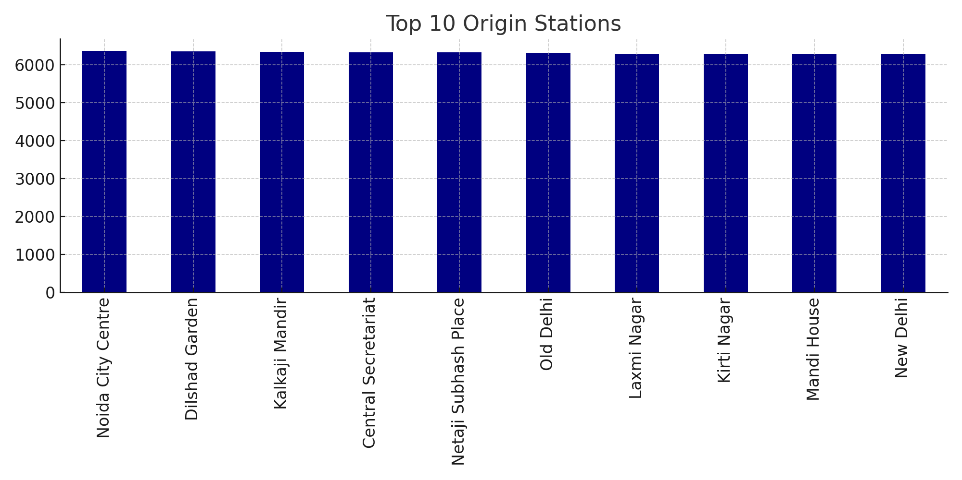
Top 10 Origin Stations — Insight:
Shows highest-traffic origin stations.

Slide 6
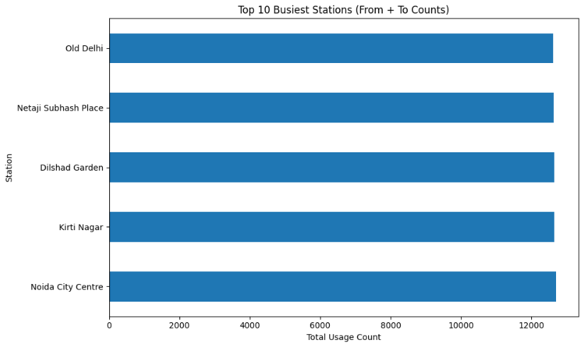
Most Busiest Stations

Slide 7
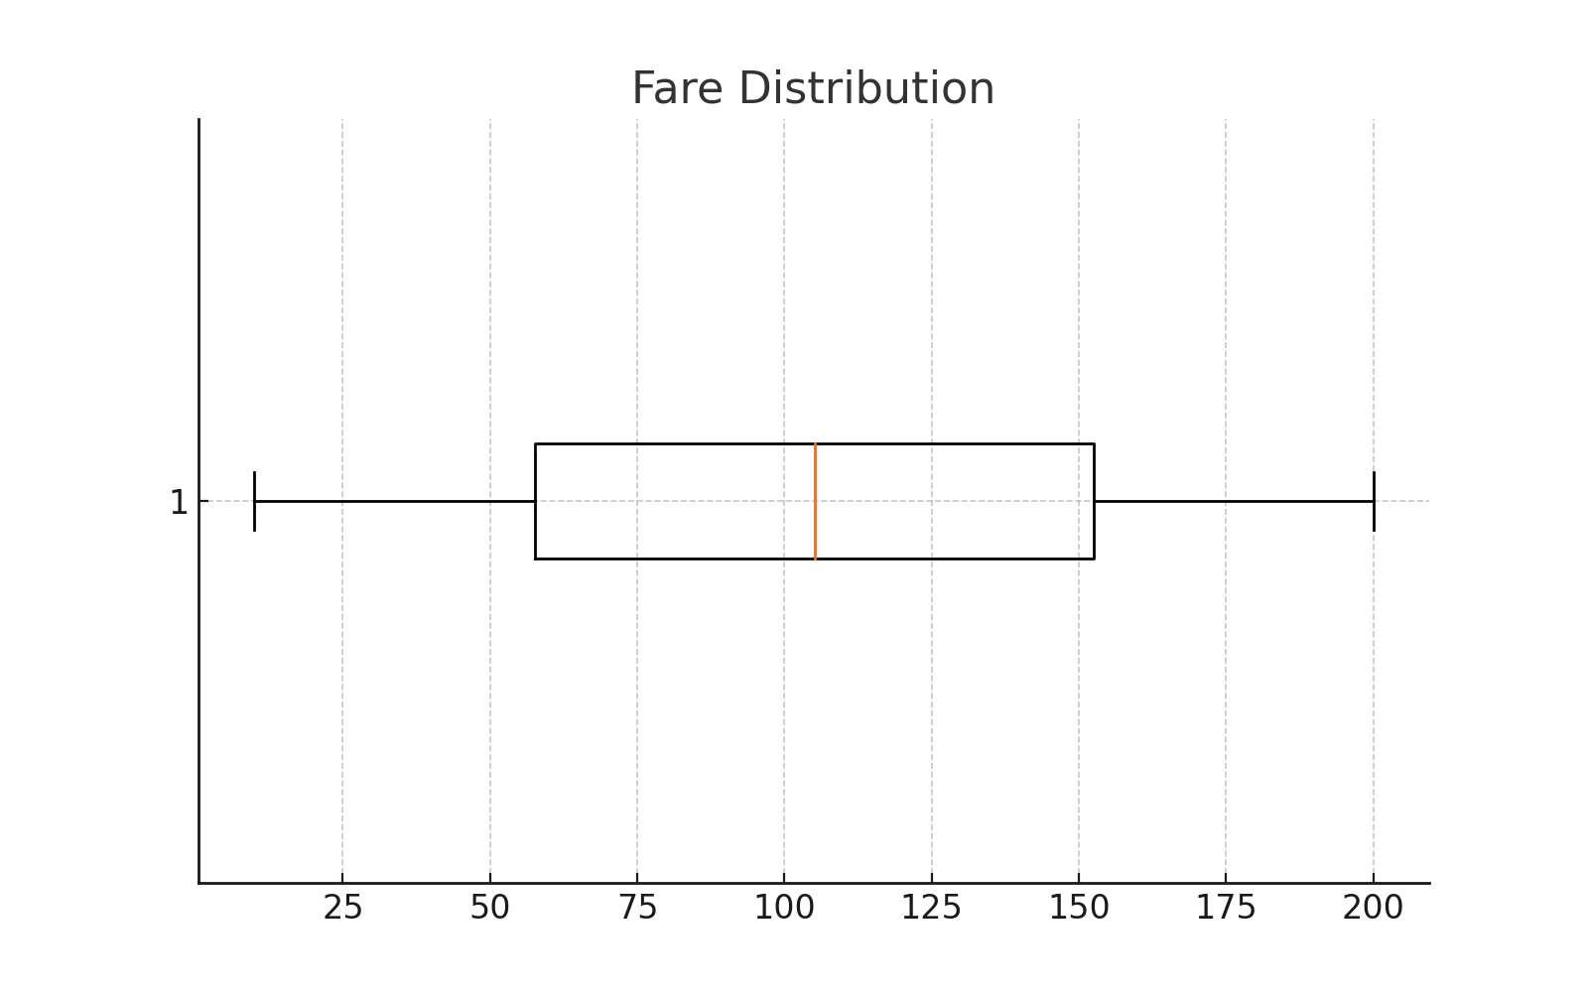
Fare Distribution — Insight:
Shows fare range and outliers.

Slide 8
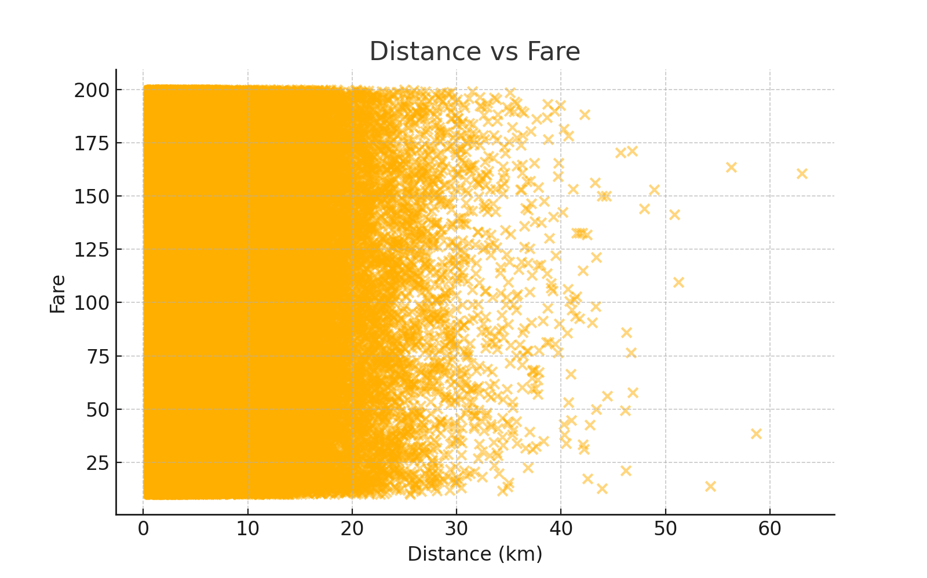
Distance vs Fare — Insight:
Fare increases with distance.

Slide 9
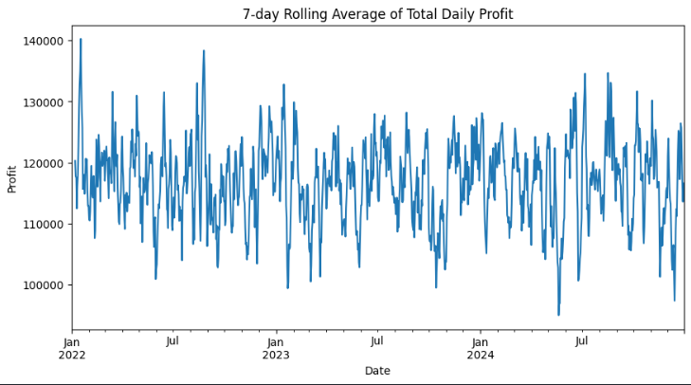
7-day Rolling Average of Total Daily Profit

Slide 10
Conclusion
• Data successfully cleaned using MODE & MEDIAN
• Identified busiest stations and high-demand areas
• Observed clear relation between distance and fare
• Profit trends remain stable with periodic fluctuations
• Visual analysis helps understand commuter behavior and revenue patterns

