Slide 1
BOMMAI
THE TOY CHAT BOT

Slide 2
TEAM NAME: BOMMAI
OUR AIM: To develop the toy chat bot which helps children to learn and play.
Toy chat bot makes good interaction with children while playing and teaching.
It plays the role of teacher and friend.

Slide 3
Algorithm and working
CHILDREN’S QUERY
IBM WATSON
(BOT)
BOT’S RESPONSE

Slide 4
LANGUAGES / SOFTWARE USED
JSON
IBM CLOUD SERVICES
NODE RED SERVICE

Slide 5
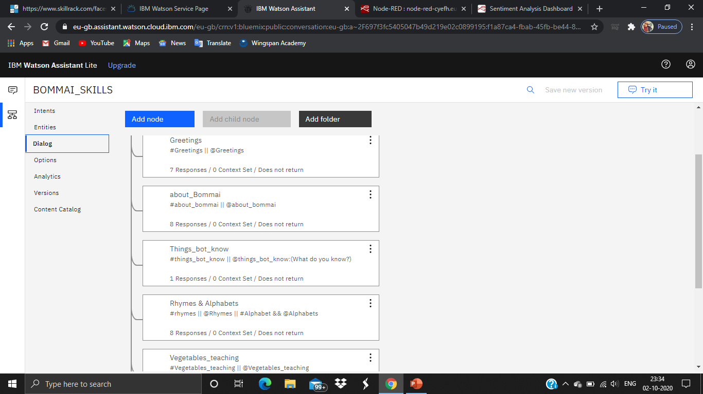
Skills given to bot

Slide 6
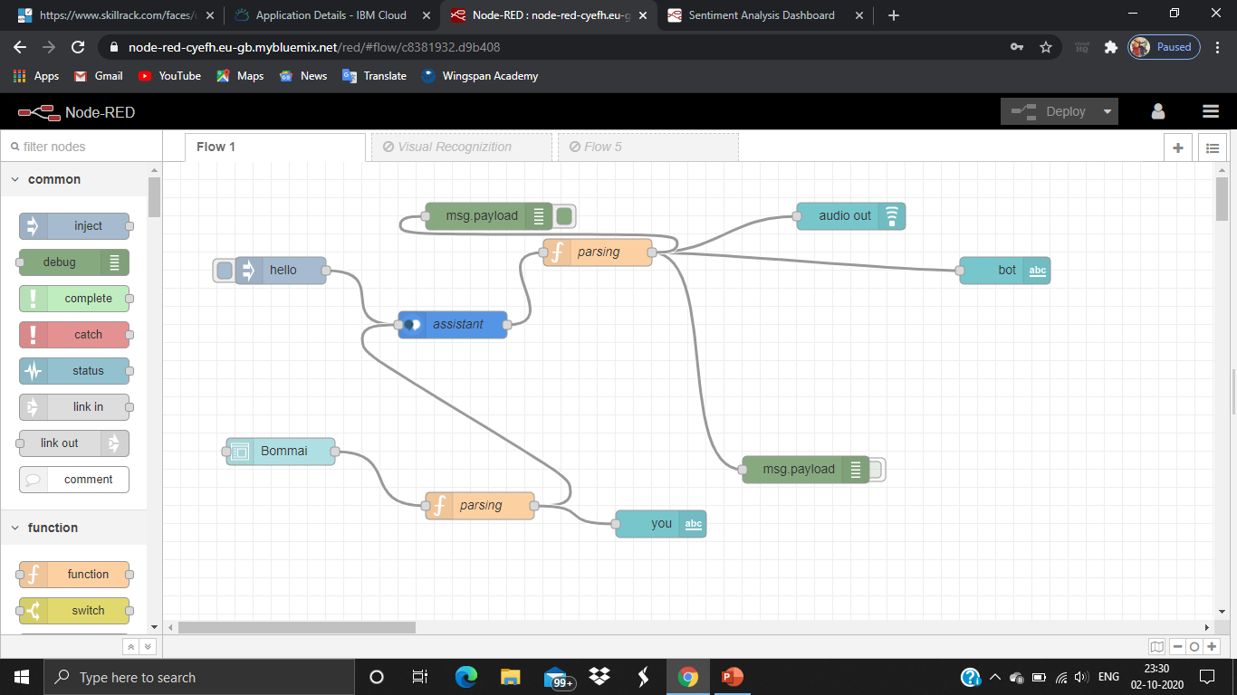
Nodes used in Node red

Slide 7
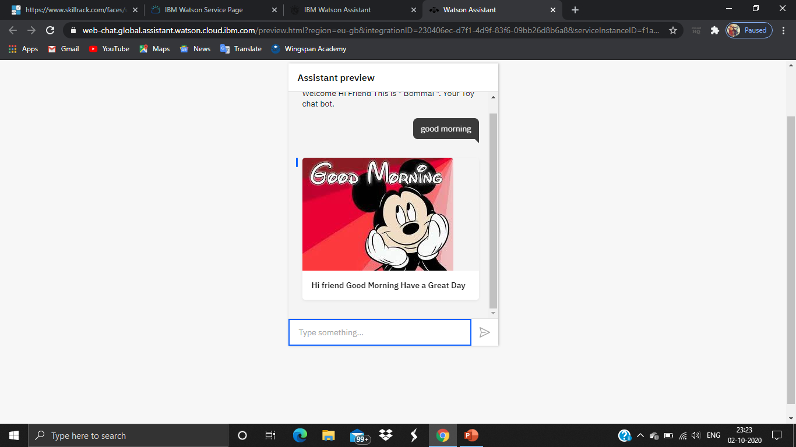
Output
Link:

Slide 8
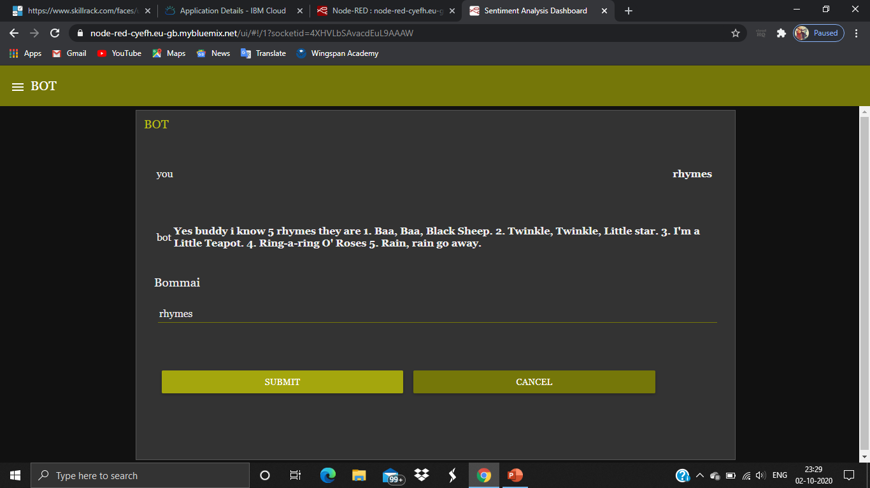
Upgrading Bot Output

