Slide 1
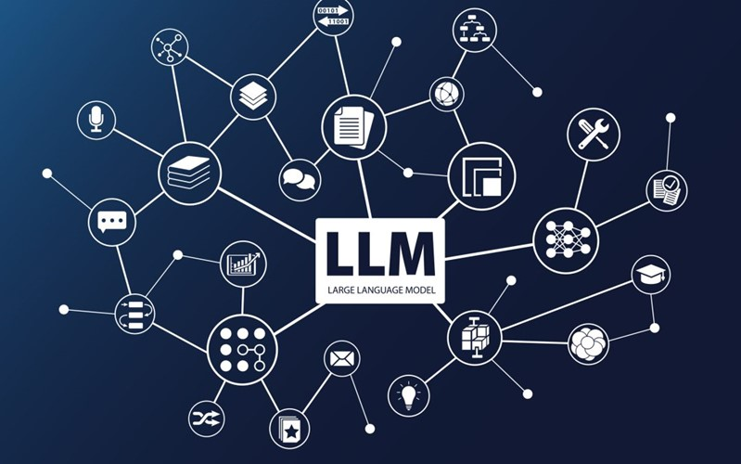

Comparing LLM’s for Indic Language Tasks

Slide 2
Contents
Steps to use Open source LLMs
Datasets
Tokenization
Model XGen-7B
GPU requirements for Pre-Training
Further steps

Slide 3
Steps to use Open source LLMs
Chose the pretrained model from open source library. e.g , Hugging face
Chose the datasets
Tokenize the datasets
Pretraining task: Pretrain the LLM using Tokanized dataset so that the model learns semantics of the language/datastes
Fine tuning the LLM: depending upon the down stream tasks fine tune the model using labeled datasets
E.g., Masked language modeling [LLM]
causal language modeling [CLM]

Slide 4
Datasets
Dataset | Size | Dataset | Size
Ks.txt | 694 KB | Ur.txt | 5.59GB
dg.txt | 1.42MB | Pa.txt | 9.48GB
Mni.txt | 9.32MB | Mr.txt | 14.6GB
Bd.txt | 45.1MB | Or.txt | 2.18GB
Sat.txt | 58.6MB | Ne.txt | 14GB
Sd.txt | 112MB | Gu.txt | 7.06GB
Kha.txt | 131MB | Ta.txt | 11GB
Sa.txt | 131MB | ml.txt | 25GB
Mai.txt | 192MB | Kn.txt | 643MB
Te.txt | 378MB | En.txt | 39.7GB
Gom.txt | 533MB | Hi.txt | 80GB
Total Size =
c AI4Bharath

Slide 5
Tokenization
Dataset : kn.tx size : 643 MB
Tokenization with padding and truncation : 85GB (without preprocessing)
Tokenization w/o padding and truncation: 6.5 GB
Example sentence: ಸ್ವ ಉಪಕರಣ ಮೂಲಕ -
No of words : 4
No of Tokens : 40
no of words 91
no of tokens 2392

Slide 6
Model XGen-7B
Why X-Gen ?
Trained on multiple languages and available in hugging face
7 billion parameters model.
One of the key differentiators of XGen-7B is the 8K context window. A larger context window translates to a large prompt and the output generated by the model.

Slide 7
GPU requirements for Pre-Training
For a 7B parameter model .
Model size = 7B x 4Bytes = 28GB.
Total size required for updating parameters = 3 * Model Size ( Depends on the optimizer) = 3 * 28 GB
= 84 GB

Slide 8
Further steps
Finish up the Pre –Training task and save the model
Fine tune the pre-trained model using task specific dataset
Evaluate the model performance on those datasets

