Slide 1


AI for Energy:
Data-efficient and explainable algorithms to exploit energy flexibility
Chris Develder, et al.
AI4E Team, IDLab, Ghent University – imec

Slide 2
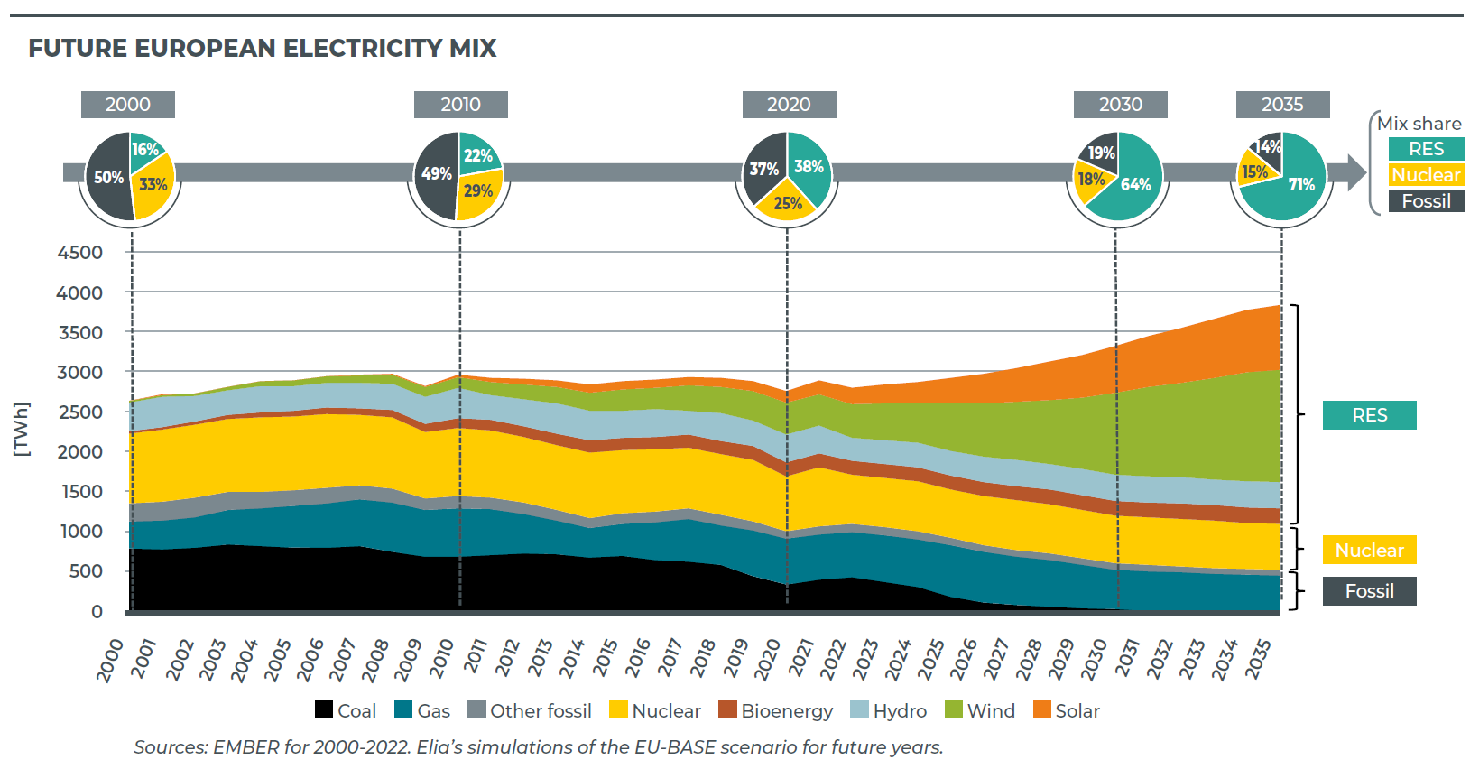

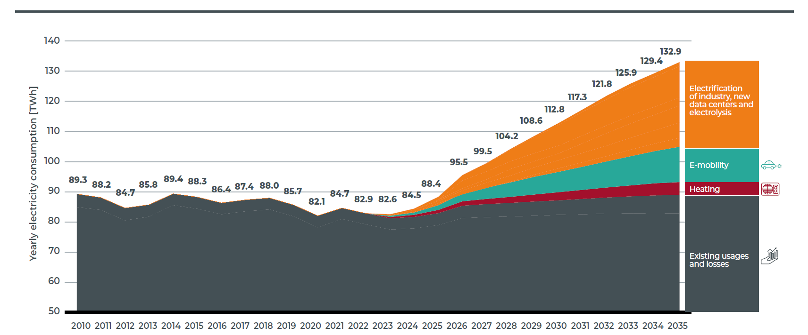


Energy Transition
Source: Adequacy & flexibility study for Belgium (2024-2034), ELIA
RES share in EU electricity supply: ~45% by 2035
e-Mobility + Heat pumps
in BE electricity demand: ~25% by 2035
Source: Adequacy & flexibility study for Belgium (2024-2034), ELIA

Slide 3


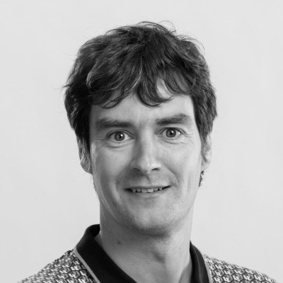







AI4E: VISION
Research, develop and incubate data-driven (decision making) technology supporting decarbonization of our society through co-creation with industry & research partners

Slide 4





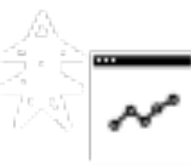
AI4E: FIT-FOR-PURPOSE & HOLISTIC SOLUTIONS
Neural
Networks
Reinforcement Learning
Graph Neural Networks
. . .
Data-efficient
Control
Scalable
Flexibility Exploitation
Predictive
Support Tools

Slide 5


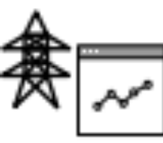
AI4E Research Tracks
Data-driven decision making for . . .
Home Energy Management (HEM)
  Value stacking (capacity tariff / dynamic pricing / . . .)
  Heterogeneous households (Heat pump / EV / Home battery / Thermal Storage)
Real/short-time (24h down to 1s) flexibility optimization
  Multi-market day-ahead and real-time trading in energy and flexibility markets (EU/UK)
  Multi-asset flexibility coordination, focusing on residential flexibility
Support tools for power system operators
  Decision support for consumer-centric market vision
  (Imbalance forecasting; RTP price calculations; digital twins . . .)
  State estimation and forecasting (DSO/TSO)

Slide 6

Data-efficient learning to control:
Physics-informed RL for residential heat pumps
Home Energy
Management
G. Gokhale, B. Claessens, and C. Develder, ”Physics-informed neural networks for control-oriented thermal modeling of buildings”, Appl. Energy, Vol. 314, 15 May 2022, pp. 1-10. doi:10.1016/j.apenergy.2022.118852
G. Gokhale, B. Claessens, and C. Develder, ”PhysQ: A physics-informed reinforcement learning framework for building controls”, Arxiv preprint, 21 Nov. 2022, arXiv:2211.11830v1
Thanks
Gargya!

Slide 7


Reinforcement Learning: Heat pump control
Challenge: Learn good policy
from little data!
state
- outdoor T
- indoor T
- price
- time
action
HEM
controller
heat pump power

Slide 8


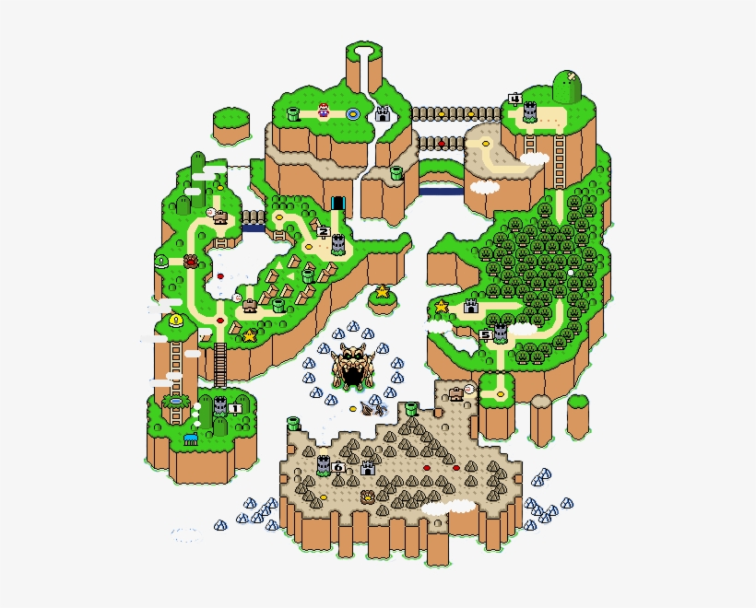
Reinforcement Learning: Agent acts in an environment
Action
At each timestep t the agent
  Gets state observation s_{t}
  Gets scalar reward r_{t} (depending on current state and thus previous action(s))
  Decides to take action a_{t}
The environment
  Receives action a_{t}
  Emits state s_{t +1} (which will depend on action)
  Emits scalar reward r_{t + 1}
RL idea: learn a policy that maps state s_{t} to action a_{t} ,
such that long-term reward ∑r_{t} is maximized
s_{t}
r_{t}
a_{t}
State
Reward

Slide 9
Reinforcement Learning: Agent acts in an environment
Action
HEM
controller
At each timestep t the agent
  Gets state observation s_{t}
  Gets scalar reward r_{t} (depending on current state and thus previous action(s))
  Decides to take action a_{t}
The environment
  Receives action a_{t}
  Emits state s_{t +1} (which will depend on action)
  Emits scalar reward r_{t + 1}
RL idea: learn a policy that maps state s_{t} to action a_{t} ,
such that long-term reward ∑r_{t} is maximized
s_{t}
r_{t}
€
a_{t}
State
Cost

Slide 10
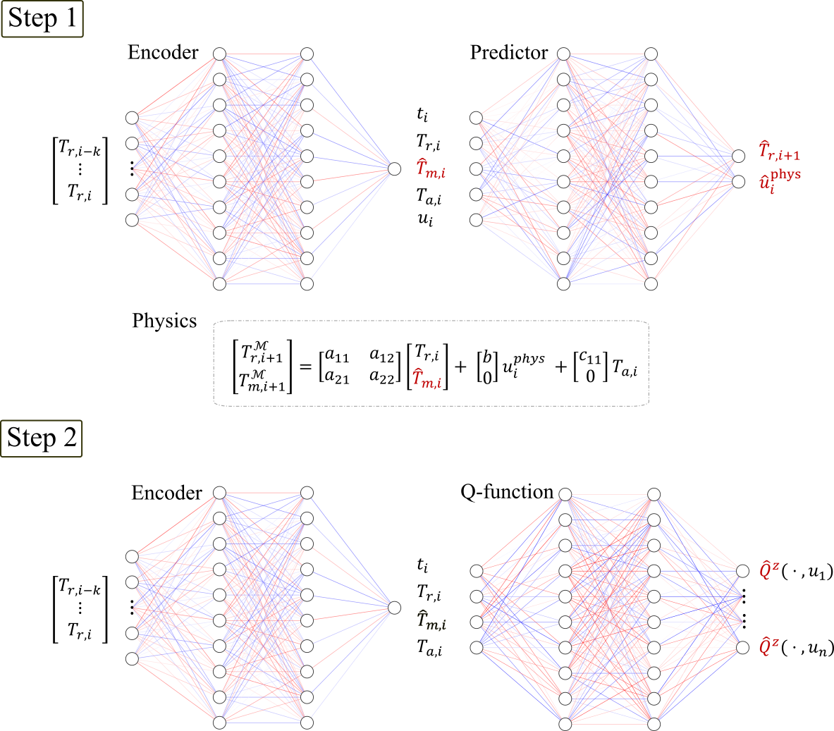
PhysQ: A physics-informed reinforcement learning framework
PhysQ:
  Physics informed RL framework
  Leverages prior physics to learn physically relevant latent representations
  Learns a control policy using this latent representation
Two-step Algorithm:
  Step 1: Learn physically relevant representation (bulk temperature T_{m}), from predicting state transitions
  Step 2: Learn a low-dimensional Q-function based on this representation, to perform the actual control
state
Idea:
Add physical quantity (following laws of physics) to representation
Here: building mass temperature; learn it from indoor temp. prediction

Slide 11
PhysQ: A physics-informed reinforcement learning framework
PhysQ:
  Physics informed RL framework
  Leverages prior physics to learn physically relevant latent representations
  Learns a control policy using this latent representation
Two-step Algorithm:
  Step 1: Learn physically relevant representation (bulk temperature T_{m}), from predicting state transitions
  Step 2: Learn a low-dimensional Q-function based on this representation, to perform the actual control
Idea:
Use that representation (incl. physics) to learn control actions
state

Slide 12
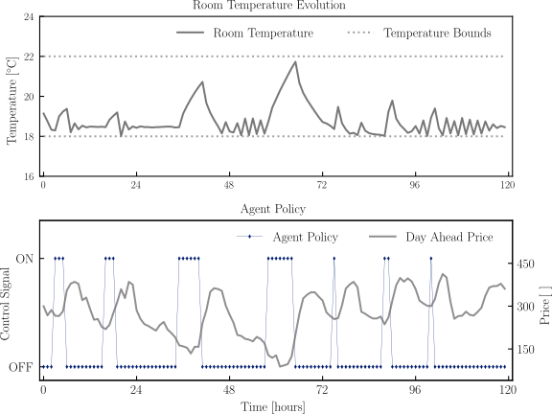
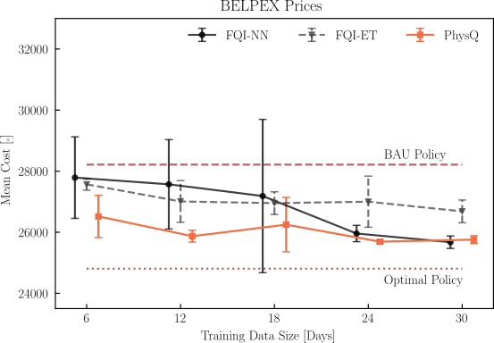
Simulation results
Results for BELPEX prices using a building simulator
Comparison over different training data sizes and agent types
Black box models
Heating at (relatively) low price points
On
Lower overall cost,
especially for low volumes of training data
Off

Slide 13
Simulation results
Results for BELPEX prices using a building simulator
Comparison over different training data sizes and agent types
Lower overall cost, especially
for low training data volume
Black box models
Heating at (relatively) low price points
On
Off

Slide 14
Interpretable decision trees distilled from black-box RL policies
Home Energy
Management
G. Gokhale, S.S. Karimi Madahi, B. Claessens and C. Develder, "Distill2Explain: Differentiable decision trees for explainable reinforcement learning in energy application controllers", in Proc. 15th ACM Int. Conf. Future Energy Sys. (e-Energy 2024), Singapore, 4-7 Jun. 2024, pp. 1-8. doi:10.1145/3632775.3661937
T. Van Puyvelde, M. Zareh and C. Develder, "Interpretable reinforcement learning for heat pump control through asymmetric differentiable decision trees", in Proc. AI-Driven Energy Effic. Dyn. Syst. (AI-DEEDS 2025) at ACM e-Energy 2025, Rotterdam, The Netherlands, 17 Jun. 2025, pp. 968-972. doi:10.1145/3679240.3734671
Thanks
Gargya &
Toon!

Slide 15

Black-box Reinforcement Learning
Challenge: Find a good policy that is explainable
state
action
- outdoor T
- indoor T
- time
- load
- PV power
- . . .
- heat pump power
- battery power
- . . .
HEM
controller

Slide 16
Black-box Reinforcement Learning
Challenge: Find a good policy that is explainable
state
action
- outdoor T
- indoor T
- time
- load
- PV power
- . . .
- heat pump power
- battery power
- . . .
HEM
controller
Idea: replace neural networks by decision trees derived from it!

Slide 17
Enhancing explainability: Differentiable Decision Trees
“If it is sunny and household load is low, then charge battery”
PV power > 0.47
PV power > 0.47
yes
no
Load > 0.68
Load > 0.68
PV power > 0.41
yes
no
yes
no
[0.385, 0.413, 0.076, 0.069, 0.057]
[0.060, 0.082, 0.304, 0.344, 0.210]
[0.060, 0.082, 0.304, 0.344, 0.210]
[0.077, 0.081, 0.418, 0.071, 0.353]
[0.378, 0.384, 0.087, 0.097, 0.053]
Discharge at 50% power
Charge at 50% power
Remain idle
Discharge at 50% power
[
,
,
,
,
]
Action probabilities:
discharge
at 100% power
discharge
at 50% power
idle
charge
at 50% power
charge
at 100% power

Slide 18
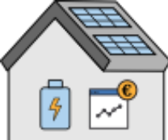
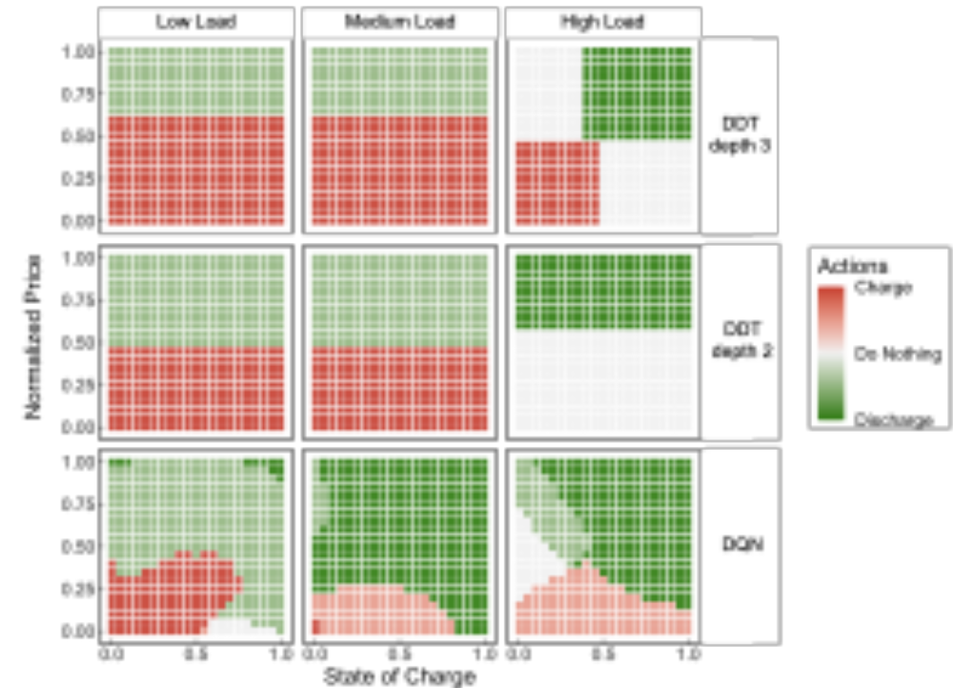
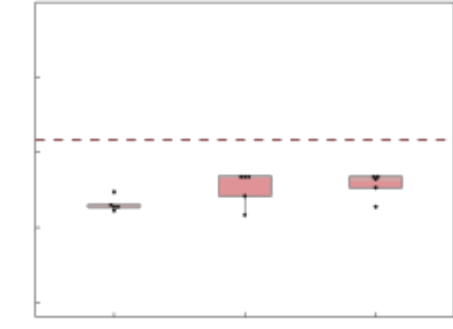
Sample result: Home battery control under time-varying pricing
Household with rooftop PV and battery
Day-ahead pricing (qh based) and capacity tariff (= based on max. peak load)
Low Load
Med. Load
High Load
Comparable cost . . .
DDT
depth 3
20
Baseline RBC
with simpler policies
15
Cost (€)
DDT
depth 2
10
Normalized Cost
5
DQN
DDT
depth 2
DDT
depth 3
DQN
DQN
DDT
depth 2
DDT
depth 3
Battery state-of-charge

Slide 19
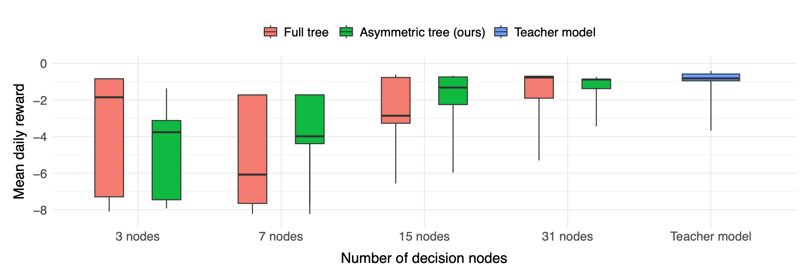
Sample result: Heat-pump control
Same idea applied to space heating with a heat pump (= minimization of cost while maintaining comfort)
Extended methodology to allow asymmetric trees (= branches can have different depths)
Assymmetric trees =
Better performance for same size!
Performance approaches teacher model (DQN) for larger decision trees

Slide 20

Scalable Attention-based
RL for Multi-asset Control
Flexibiity
Optimization
S.S. Karimi Madahi, G. Gabriele, B. Claessens and C. Develder, "Scalable attention-based reinforcement learning method for multi-asset control", in Proc. Workshop Comput. Optim. Buildings (CO-BUILD) at ICML 2025, Vancouver, Canada, 18 Jul. 2025, pp. 1-8.. https://openreview.net/attachment?id=3h0v1Ht73L&name=pdf
G. Gabriele, F. Pavirani, S.S.K. Madahi, and C. Develder, "Forecasting what matters: Decision‑focused RL for controlled EV charging with unknown departure times", in Proc. 17th ACM Int. Conf. Future Energy Sys. (e-Energy 2026), Banff, Canada, 23-25 Jun. 2026, pp. 235-239. doi:10.1145/3744255.3811736
Thanks
Soroush &
Giuseppe!

Slide 21
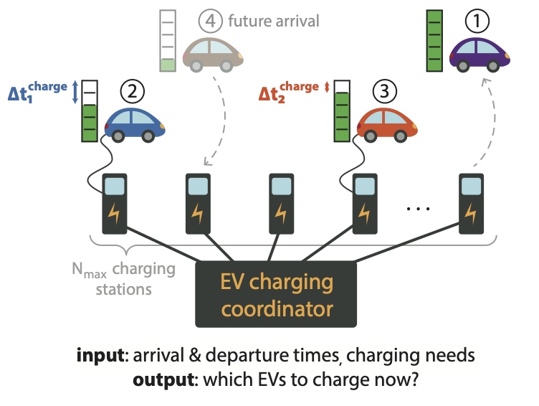
Controlling EV charging
Why?
  Limit peak load
  Limit charging costs
  Balancing
  . . .
How?
  Identify EV requirements (timing + energy)
  Automatic control algorithm
t₂
t₃
AI for EV charging =
(1) KNOWING and (2) CONTROLLING EV sessions

Slide 22


Step 1: Charging session characterization
M. Lahariya, D.F. Benoit and C. Develder, “Synthetic data generator for electric vehicle charging sessions: Modeling and evaluation using real-world data", Energies, Vol. 13, Issue 16, Paper no. 4211, 2020.
N. Sadeghianpourhamami, N. Refa, M. Strobbe and C. Develder, “Quantitative analysis of electric vehicle flexibility: A data-driven approach”, Int. J. Electr. Power Energy Syst., Vol. 95, Feb. 2018, pp. 451-462.
Anytime charging,
short sojourn (61.5%)
C. Develder, N. Sadeghianpourhamami, M. Strobbe and N. Refa, "Quantifying flexibility in EV charging as DR potential: Analysis of two real-world data sets", in Proc. 7th IEEE Int. Conf. Smart Grid Communications (SmartGridComm 2016), Sydney, Australia, 6-9 Nov. 2016, pp. 600-605.
Daytime charging
(9.4%)
Nighttime charging (29.1%)
Thanks
Nasrin
& Manu!

Slide 23

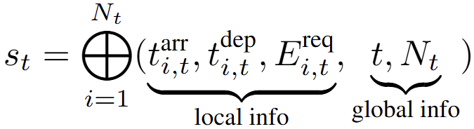
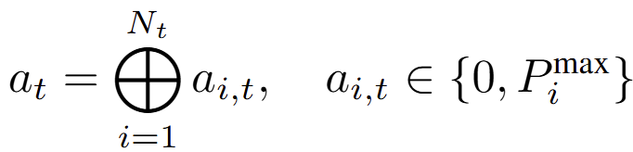

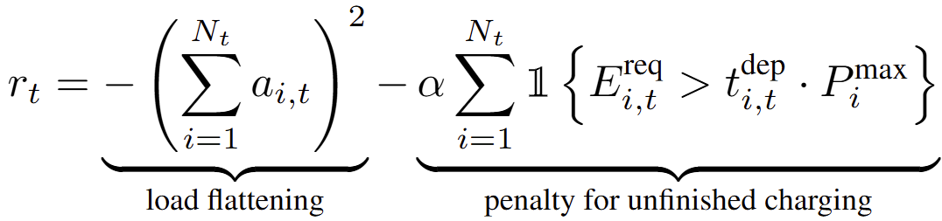
Step 2: Scalable RL controller
At each timestep t the agent
  Gets state observation
  Decides to take action
DistSAC
s_{t}
r_{t}
a_{t}
Goal: Minimize peak load
+ Charge EVs on time
The environment
  Receives action a_{t}
  Transitions to state s_{t +1}
  Returns scalar reward
State
Reward
Action

Slide 24


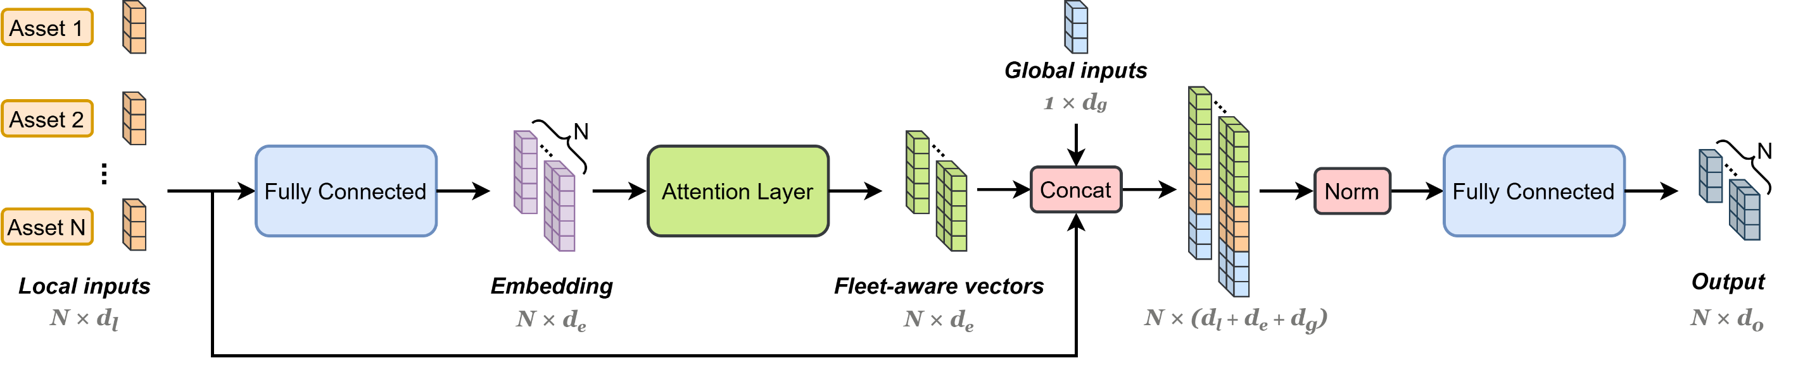
Step 2: Attention-based state representations for scalable RL
Idea:
Construct state representation combining own asset + relative to other assets + global state
Use state representation as input representation in conventional RL (e.g., to map to Q-value, action, …)
N

Slide 25
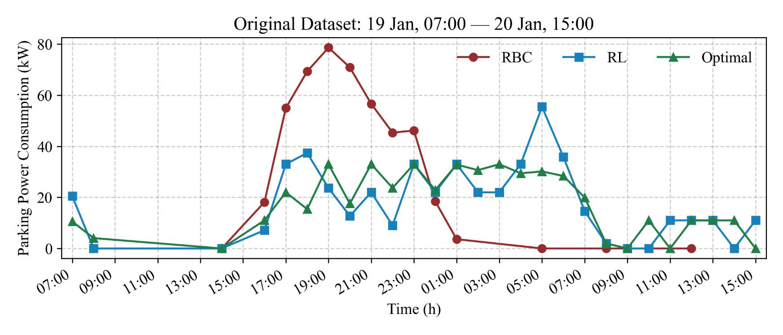
Simulation Results
Significant peak reduction compared to uncontrolled charging
BAU
Attention-based RL
Flattens load (peak reduced by 27%)*
Performs close to optimization based on perfect foresight
*: 27% is the average over full test set
Notes:
Ne

Slide 26
Simulation Results
Peak reduction of our RL solution is very
close to optimal control (w/ perfect foresight)
BAU
Attention-based RL
Flattens load (peak reduced by 27%)*
Performs close to optimization based on perfect foresight
*: 27% is the average over full test set
Notes:
Ne

Slide 27


Imbalance price prediction with Monte Carlo Tree Search (MCTS)
Support Tools
for DSO & TSO
F. Pavirani, J. Van Gompel, S.S. Karimi Madahi, B. Claessens and C. Develder, "Predicting and publishing accurate imbalance prices using Monte Carlo Tree Search", Appl. Energy, Vol. 392, No. 125944, 15 Aug. 2025. doi:10.1016/j.apenergy.2025.125944
J. Van Gompel, B. Claessens and C. Develder, "Probabilistic forecasting of power system imbalance using neural network-based ensembles", Appl. Energy, Vol. 401, Part B, No. 126714, Dec. 2025. doi:10.1016/j.apenergy.22025.126714
Thanks
Fabio &
Jonas!

Slide 28


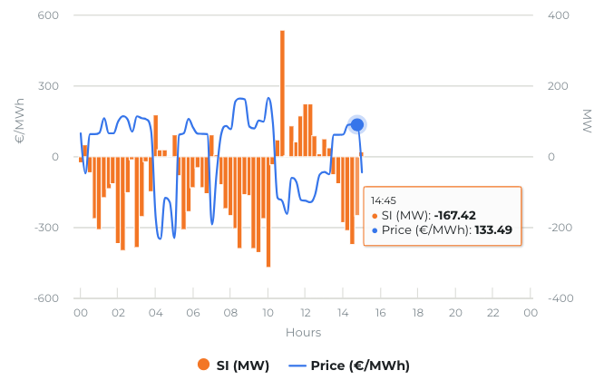
Maintaining System Balance
Generation: Renewable sources Load: Increased electrification
Mismatch needs to be solved
  Compensation from aFRR, mFRR
  Reaction of BRPs themselves
  . . . where imbalance prices for BRP depend on SI
But … price predictions are published within the quarter!
-> influences behavior of BRPs!
Source: https://www.elia.be/en/grid-data/balancing/imbalance-prices-15-min (Fri, April 2024, 15:00)

Slide 29
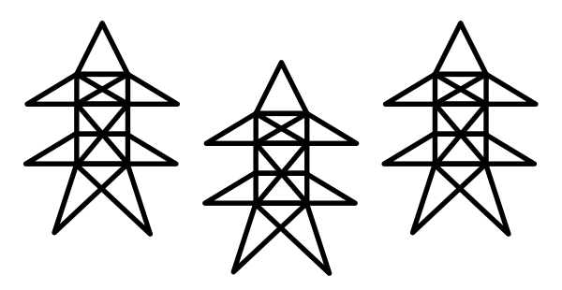
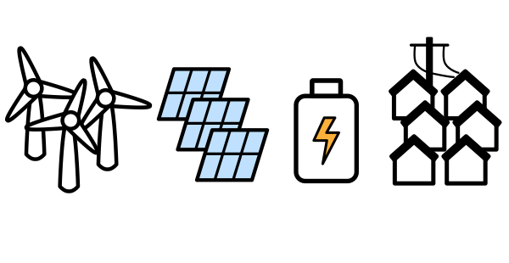
Imbalance Price Publication
Grid
Measured system imbalance (15’)
BRPs react to published prices
TSO
BRPs
Publish imbalance price forecast (1’)
But … price predictions are published within the quarter!
-> influences behavior of BRPs!

Slide 30
MCTS Based Imbalance Price Forecasting
System state
Net Reserve
Volume (NRV)
Forecaster
BRP
Response
Model
MCTS = Monte Carlo Tree Search
Roll out possible scenarios, based on system model
Learn to decide best “action”
timesteps
Price prediction
J. Van Gompel, B. Claessens and C. Develder, "Probabilistic forecasting of power system imbalance using neural network-based ensembles", Appl. Energy, Vol. 401, Part B, No. 126714, Dec. 2025. doi:10.1016/j.apenergy.2025.126714
S.S. Karimi Madahi, B. Claessens and C. Develder, "Distributional reinforcement learning-based energy arbitrage strategies in imbalance settlement mechanism", J. Energy Storage, Vol. 104, Part A, Dec. 2024, pp. 114377. doi:10.1016/j.est.2024.114377
Notes:
System imbalance = - NRV + BRP response
Battery capacity for BRP: small (60MW, 150MWh) – medium (125MW, 310MWh) – large (250MW, 620MWh)
NRV prediction: w/o inputs correlated to BRP response; i.e., only
Time features,
SI and NRV history,
Net cross-border nominations,
PV and Wind generation forecasts, and
Load forecasts.

Slide 31
Results: Price prediction within the quarter
Error approaches zero towards end of quarter
Lower prediction error &
lower uncertainty on estimates!
Caveat: sample results for perfect NRV and BRP response models
!
Notes:
Baseline = Elia’s current price formula
Battery capacity for BRP:
small (60MW, 150MWh)
medium (125MW, 310MWh) ← this figure!
large (250MW, 620MWh)

Slide 32
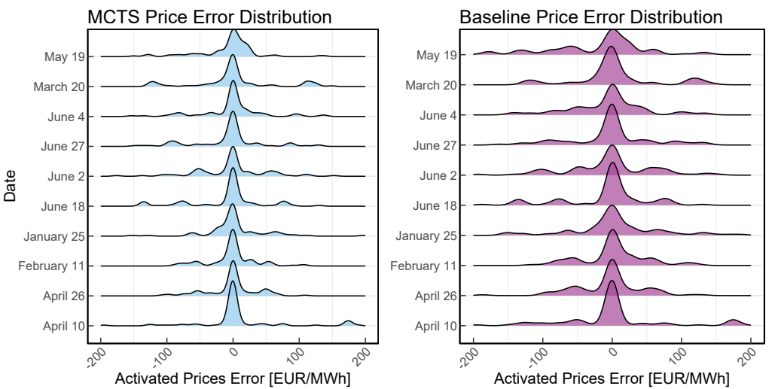
Results: Overall error distributions
Distributions of errors are more narrowly centered around zero!
Notes:
Battery capacity for BRP:
small (60MW, 150MWh)
medium (125MW, 310MWh)
large (250MW, 620MWh)

Slide 33
A real-world testbed environment:
HomeLabGym
Home Energy
Management
T. Van Puyvelde, M.-S. Verwee, G. Gokhale, M. Zareh Eshdoust and C. Develder, "HomeLabGym: A real-world testbed for home energy management systems", in Proc. 15th ACM Int. Conf. Future Energy Sys. (e-Energy 2024), Singapore, 4-7 Jun. 2024, pp. 1-2. doi:10.1145/3632775.3661974
Thanks
Toon!

Slide 34
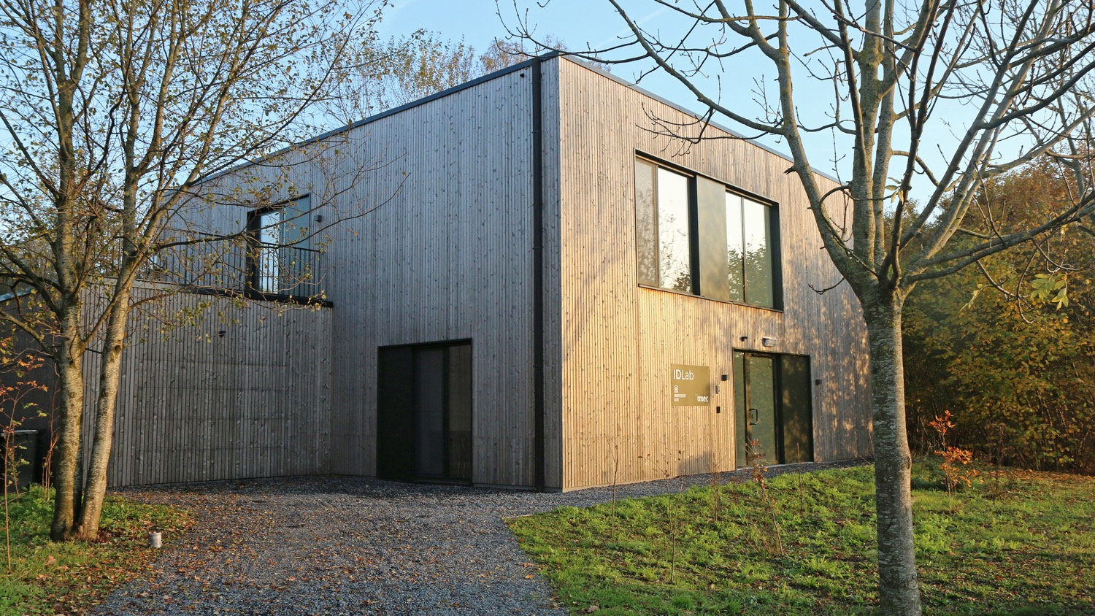




HomeLab
Research infrastructure to validate and optimize IoT & AI innovations in real environment
>300 sensors (temperature, energy, light, occupancy, …)
HVAC, ESS, PV
Controllable blinds and windows
. . .
Notes:
HomeLab is an initiative of imec and Ghent University. It is both a home and a lab as it is a two-story house in which people can live temporarily to test and co-create IoT prototypes or products. With technical corridors in every room and an open home automation system, it offers tremendous flexibility to develop and install early prototypes of smart products and test their interoperability with other systems.
It focuses on testing and co-developing smart home innovations in a variety of application domains – from home automation and (health)care to entertainment, energy and security. It aims at serving the needs of SMEs as well as large businesses, researchers, non-profit organizations, etc.
It is located on the Technology Campus Ghent in Belgium
www.imec-int.com/homelab

Slide 35
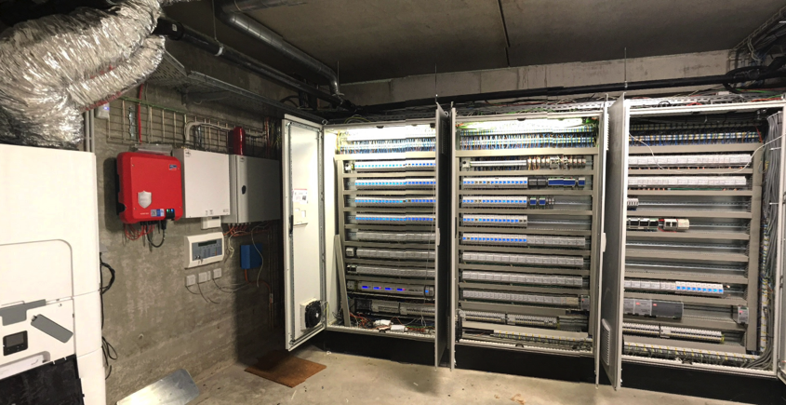
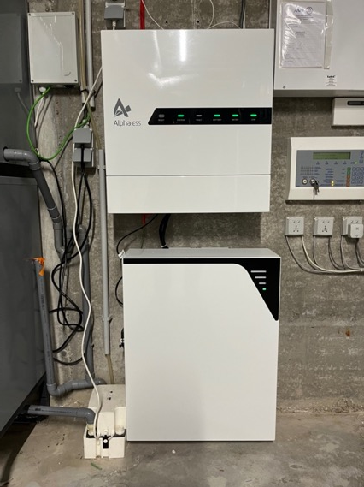
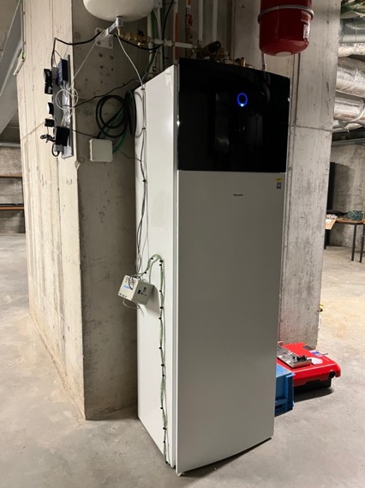

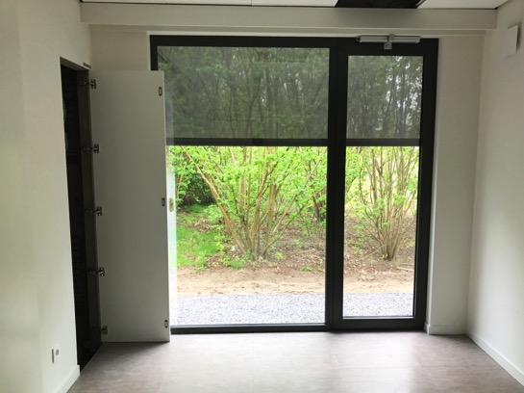
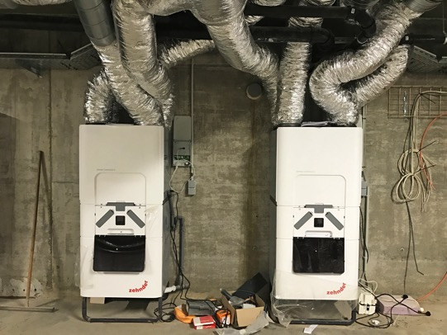
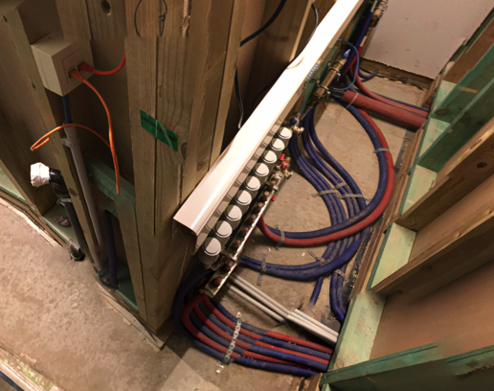
Home battery
Energy consumption monitoring per wall socket and building system
(> 150 measurement points)
Collab w/
PhD funded by
5kWp solar panels
Controllable heat pump + low temperature radiators + controllable valves
2 ventilation systems with controllable valves to living room and meeting rooms
Controllable blinds & windows
Energy infrastructure
Notes:
The cellar holds the HVAC (heating, ventilation, and air conditioning) equipment (2 ventilation systems with top cooling + heat pump), and the extended electrical cabinets . On the roof 5kWp solar panels are installed
HomeLab features an open home automation system (Velbus) able to control and monitor all functional elements (screens, switches, doors, windows, etc.) in the house.
Multiple vendor systems can be installed simultaneously in order to validate or benchmark building automation components or services.

Slide 36
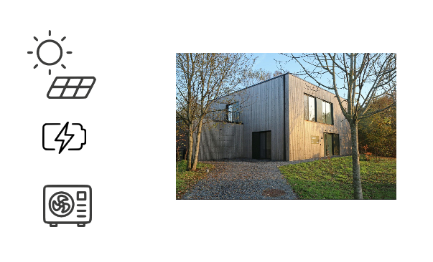
HomeLabGym
?
action
Controller
next state,
reward
Focus of our research: controllers, based on reinforcement learning, to exploit energy flexibility

Slide 37
HomeLabGym
Wishlist:
Standardized approach
Plug-and-play
Extensible solution
Broad range of
communication protocols
. . .
action
Controller
next state,
reward

Slide 38


HomeLabGym
PV
action
Modbus, API, TCP/IP
Docker,
Grafana
Controller
HomeLabGym
Battery
Heat Pump
next state,
reward
. . .
Standardized interface, used for many RL benchmarks (cf. OpenAI gym environments)

Slide 39
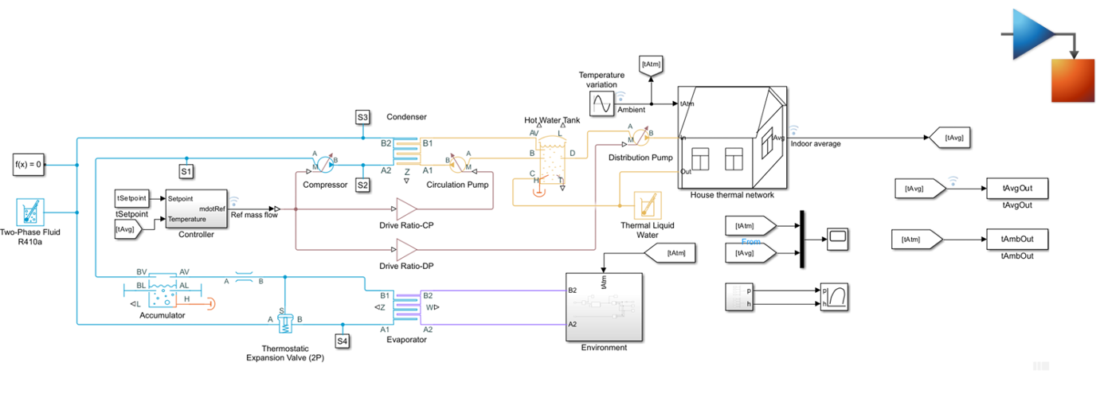
HomeLabGym
PV
Modbus, API, TCP/IP
Docker,
Grafana
HomeLabGym
Battery
Heat Pump
action
Controller
. . .
next state,
reward
HomeSimGym
(Matlab engine)

Slide 40
HomeLabGym
PV
Modbus, API, TCP/IP
Docker,
Grafana
HomeLabGym
Battery
Heat Pump
action
Controller
. . .
next state,
reward
HomeSimGym
(Matlab engine)

Slide 41
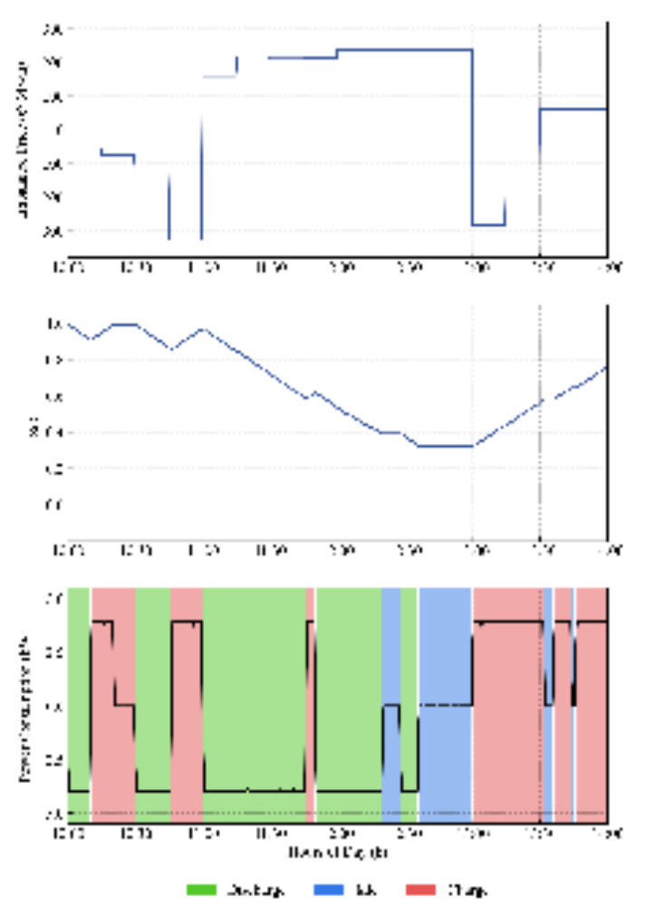

Example use case for HomeLabGym:
Validation of RL for energy arbitrage
S.S. Karimi Madahi, G. Gokhale, M.-S. Verwee, B. Claessens and C. Develder, "Control policy correction framework for reinforcement learning-based energy arbitrage strategies", in Proc. 15th ACM Int. Conf. Future Energy Sys. (e-Energy 2024), Singapore, 4-7 Jun. 2024, pp. 1-9.. doi:10.1145/3632775.3661948
Case study:
  Home battery
  Time-varying prices (qh-based)
  Distributional DQN strategy accounting
Validation of simulation
  Real-world battery
  Using HomeLabGym
Results
  Latency in communication (up to ~10s)
  Battery efficiency affected by temperature
  Effect on daily revenue: real profit €5.6 vs. simulated €6
Thanks
Soroush!

Slide 42




Thank you!
Any questions?
It’s not easy
being green …
chris.develder@ugent.be
http://users.ugent.be/~cdvelder
https://ugentai4e.github.io

Slide 43
The AI4E team at IDLab, Ghent University – imec
https://ugentai4e.github.io/

Slide 44
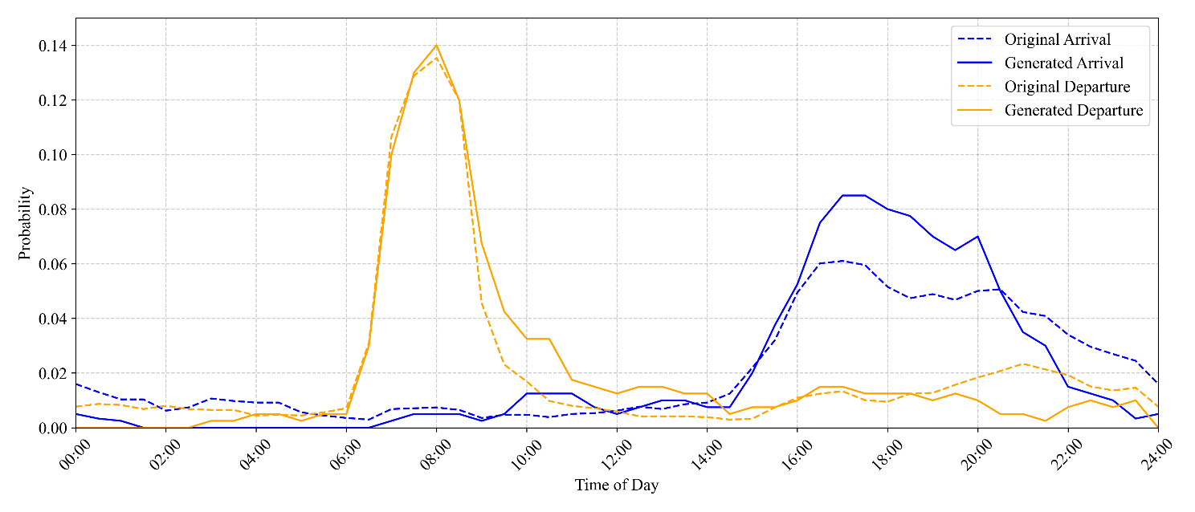
Simulation Setup
Datasets
Historical real-world dataset of 20 EVs
  Belgian residential charging sessions
  Data split: 40d train / 5d eval / 5d test
Scaled dataset of 100 EVs
  Fit Gaussian mixture model on historical dataset
  Data split: 30d train / 7d eval / 7d test
Benchmark controllers
Business-as-usual (BAU): Start charging upon arrival
Optimal: MPC optimization with perfect foresight over full day
Departures
Arrivals
Notes:
Ne

Slide 45
MCTS based imbalance price forecasting
Ensemble
Neural Network
Forecaster
Training
Data
Training
Data
Cluster of
RL Controller
Agents

