Slide 1

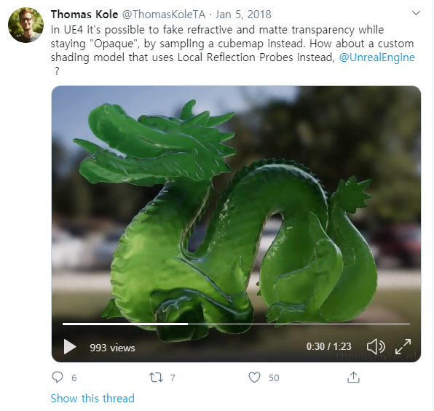
Fake Glass
Opaque Transparent
Blend Mode : Opaque
Thomas Kole’s sites
https://twitter.com/thomaskoleta/status/949035297089695744
https://www.youtube.com/watch?v=hVFPU5eEmGA
https://thomaskole.nl/2018/01/20/opaque-transparency/

Slide 2
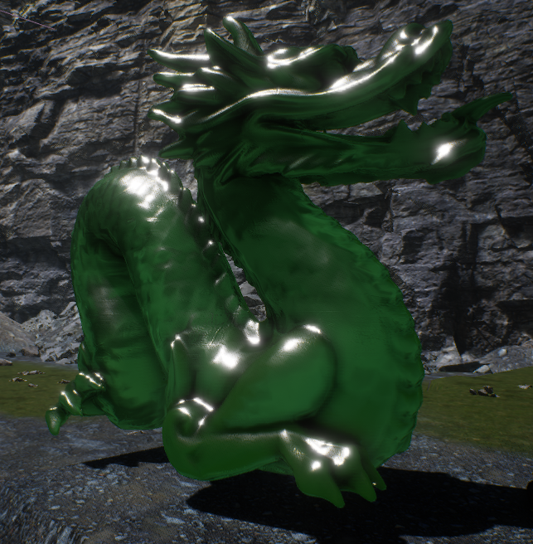
Fake Glass

Slide 3
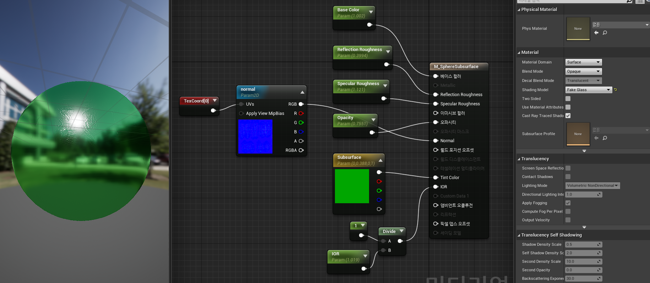
Fake Glass - Material

