Slide 1
PhysX migration
(2.8.1 -> 3.3.4)

Slide 2


2.8.1
3.3.4

Slide 3
API Interface : Actors – Dynamic
2.8.1
3.3.4
NxActorDesc actorDesc;
NxBodyDesc bodyDesc;
NxBoxShapeDesc boxDesc;
boxDesc.dimensions = NxVec3(1.5f, 1.5f, 1.5f);
actorDesc.shapes.pushBack(&boxDesc);
actorDesc.density = 1.0f;
actorDesc.body = &bodyDesc;
actorDesc.globalPose.t = NxVec3(3.0f, 0.0f, 0.0f);
NxActor *pActor = gScene->createActor(actorDesc);
PxRigidDynamic* dynamic =
PxCreateDynamic(sdk, trans, geom, *material, 1.0f);
PxRigidDynamic* dynamic =
sdk>createRigidDynamic(trans);
PxShape* box = sdk.createShape(geom, material, true);
dynamic->attachShape(box);
PxRigidBodyExt::updateMassAndInertia();
shape->release();
dynamic->setAngularDamping(0.5f);
dynamic->setLinearVelocity(velocity);
gScene->addActor(*dynamic);
Description
Actor
Actor
Description

Slide 4
API Interface : Actors – Static
2.8.1
3.3.4
NxActorDesc actorDesc;
NxBodyDesc bodyDesc;
NxBoxShapeDesc boxDesc;
boxDesc.dimensions = NxVec3(1.5f, 1.5f, 1.5f);
actorDesc.shapes.pushBack(&boxDesc);
actorDesc.density = 1.0f;
actorDesc.body = NULL;
actorDesc.globalPose.t = NxVec3(3.0f, 0.0f, 0.0f);
NxActor *pActor = gScene->createActor(actorDesc);
PxRigidStatic* static =
PxCreateStatic(sdk, trans, geom, *material, 1.0f);
PxRigidStatic* static =
sdk>createRigidStatic(trans);
PxShape* box = sdk.createShape(geom, material, true);
dynamic->attachShape(box);
shape->release();
gScene->addActor(*static);

Slide 5
API Interface : Actors – Kinematic
2.8.1
3.3.4
NxActorDesc actorDesc;
NxBodyDesc bodyDesc;
bodyDesc.flags |= NX_BF_KINEMATIC;
NxCapsuleShapeDesc capsuleDesc;
capsuleDesc.radius = 1.0f;
capsuleDesc.height = 1.5f;
actorDesc.shapes.pushBack(&capsuleDesc);
actorDesc.density = 1.0f;
actorDesc.body = &bodyDesc;
actorDesc.globalPose.t = NxVec3(0.0f, 2.0f, 0.0f);
NxActor *pActor = gScene->createActor(actorDesc);
PxRigidDynamic* kinematic =
PxCreateKinematic(sdk, trans, geom, *material, 1.0f);
PxRigidDynamic* kinematic = sdk>createRigidDynamic(trans);
Kinematic->setRigidBodyFlag(PxRigidBodyFlag::eKINEMATIC, true)
PxShape* sphere = sdk.createShape(geom, material, true);
kinematic->attachShape(sphere);
shape->release();
gScene->addActor(*dynamic);
Dynamic
Flag

Slide 6
API Interface : Shapes - 생성
2.8.1
3.3.4
NxActorDesc actorDesc;
NxBodyDesc bodyDesc;
NxBoxShapeDesc boxDesc;
boxDesc.dimensions = NxVec3(1.5f, 1.5f, 1.5f);
actorDesc.shapes.pushBack(&boxDesc);
actorDesc.density = 1.0f;
actorDesc.body = NULL;
actorDesc.globalPose.t = NxVec3(3.0f, 0.0f, 0.0f);
NxActor *pActor = gScene->createActor(actorDesc);
PxRigidStatic* actor = sdk>createRigidStatic(trans);
PxShape* box =
sdk.createShape(PxBoxGeometry(1.0,1.0,1.0), material, true); // true : 공유
actor->attachShape(box);
box->release();
actor->createShape(PxBoxGeometry(1.0, 1.0, 1.0), material);
gScene->addActor(*actor);

Slide 7
API Interface : Shapes – 공유 셰이프
2.8.1
3.3.4
PxShape* box =
sdk.createShape(PxBoxGeometry(), material, true); // 공유
box->setLocalPose(pose); // assert
box->setFlag(PxShapeFlag::eSIMULATION_SHAPE, true); // assert
box->setFlag(PxShapeFlag::eSCENE_QUERY_SHAPE, true); // assert
actor1->attachShape(*box); // ok
actor2->attachShape(*box); // ok
PxShape* sphere =
sdk.createShape(PxShpereGeometry(), material, false); // 비공유
sphere->setLocalPose(pose); // ok
box->setFlag(PxShapeFlag::eSIMULATION_SHAPE, true); // ok
box->setFlag(PxShapeFlag::eSCENE_QUERY_SHAPE, true); // ok
actor1->attachShape(*sphere); // ok
actor2->attachShape(*sphere); // error
메모리 절감 효과

Slide 8
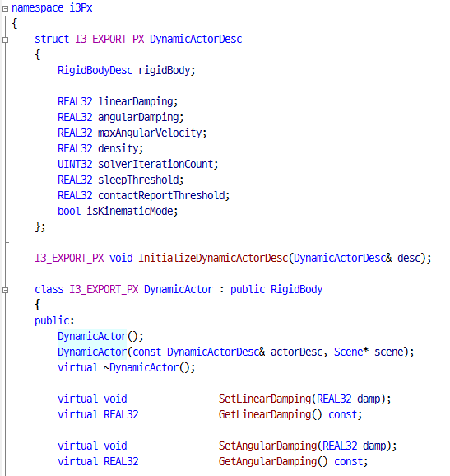
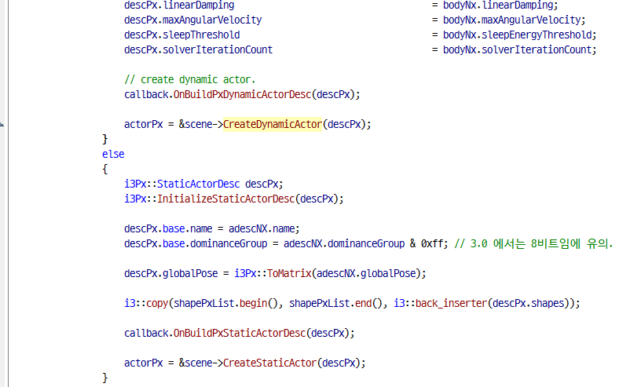
API Interface : i3Px – Actor/Shape
2.8.1 + 3.3.4 => i3Px

Slide 9
API Interface : Collision
2.8.1
3.3.4
void SetActorCollisionGroup(NxActor *actor, NxCollisionGroup group)
{
NxU32 nbShapes = actor->getNbShapes();
NxShape*const* shapes = actor->getShapes();
while (nbShapes--)
{
shapes[nbShapes]->setGroup(group);
}
}
SetActorCollisionGroup(box1, 1);
SetActorCollisionGroup(capsule1, 2);
SetActorCollisionGroup(sphere1, 2);
gScene->setGroupCollisionFlag(1, 2, true);
gScene->setGroupCollisionFlag(2, 3, true);
gScene->setGroupCollisionFlag(1, 3, false);
PxShape* box =
sdk.createShape(PxBoxGeometry(1.0,1.0,1.0), material, true);
box->setSimulationFilterData ... ?????
box->setQueryFilterData ... ?????

Slide 10
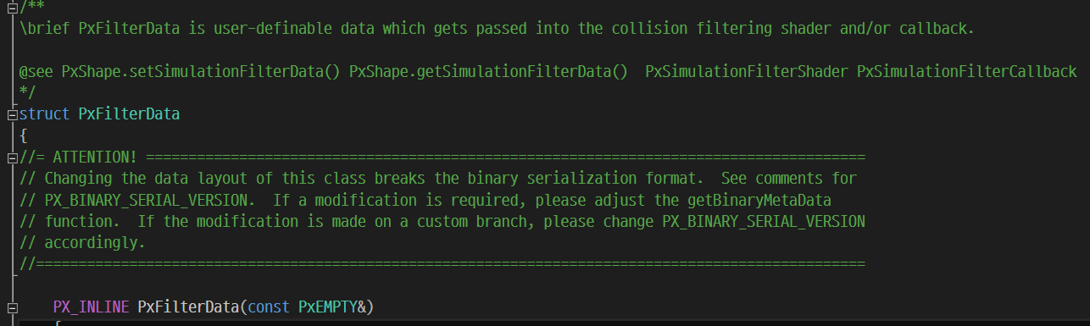
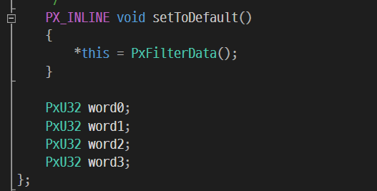
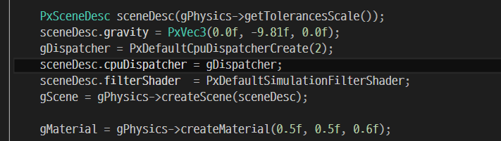
API Interface : Collision
3.3.4 – PxFilterData ?

Slide 11
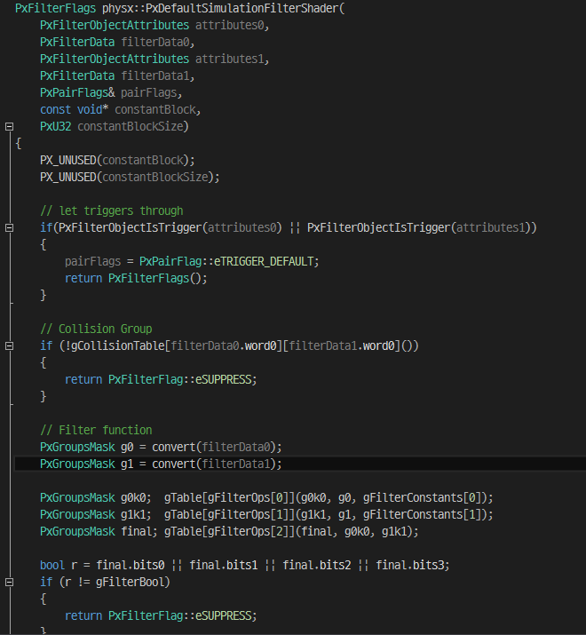
API Interface : Collision
3.3.4 – PxFilterData ?
Group : PxFilterData.word0
Filtering : PxFilterData.word2, word3
기대했던 기존 PB 컬리전 실행이 안됨

Slide 12
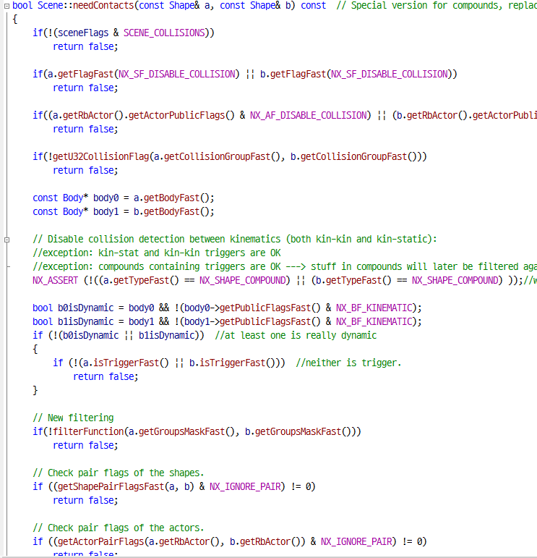
API Interface : Collision
3.3.4 – PxDefaultSimulationFilterShader
2.8.1 – Filtering.cpp
?
기대했던 기존 PB 컬리전 실행이 안됨

Slide 13
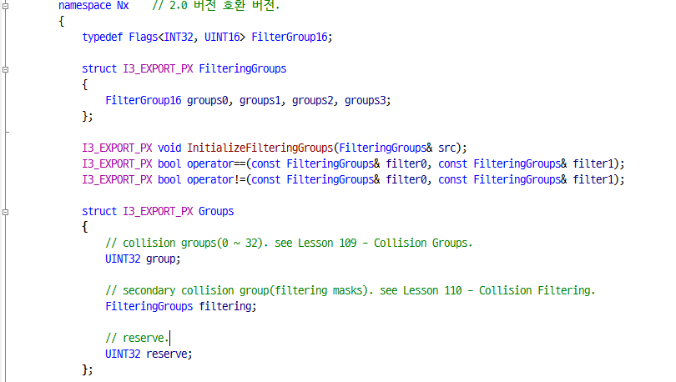
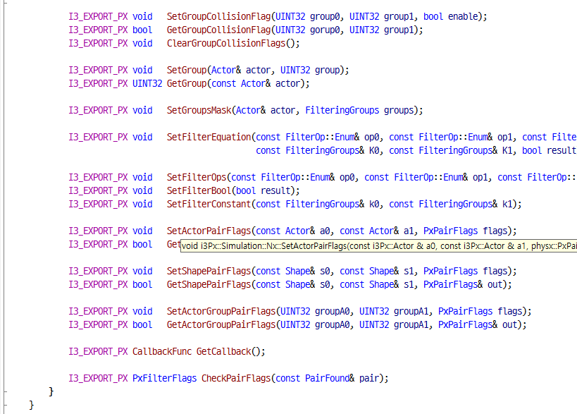
API Interface : Collision
i3Px Wrapping – 2.8.1 Interface 호환

Slide 14
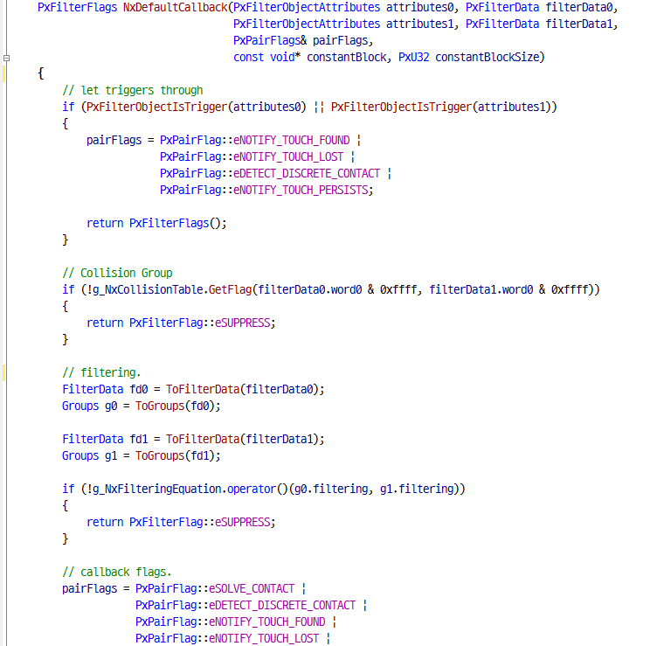
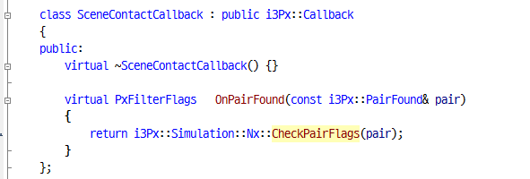
API Interface : Collision
i3Px Wrapping – 2.8.1 Interface 호환

Slide 15
Data Converting
Map TriangleMesh
Load(2.8.1)
map resource
Game
PhysX 2.8.1 mesh data
Convert(3.3.4)

