Slide 1
DevOps community
Build you own CI
October 2018 – Cyril Marin & René Ribaud

Slide 2

Goal of the session
Build a simple Continuous Integration for a “hello world project”.
  Capitalize on our Docker knowledge, tools will be installed using Docker images
  Infrastructure used:
    Project code will be hosted on Github
    1 x VM will host CI tools
    1 x VM will be used to deploy the project.
Notes:
- Various tech

Slide 3





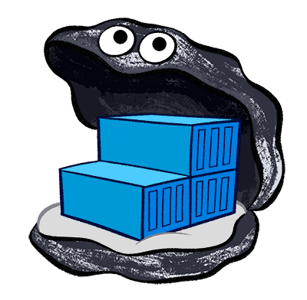
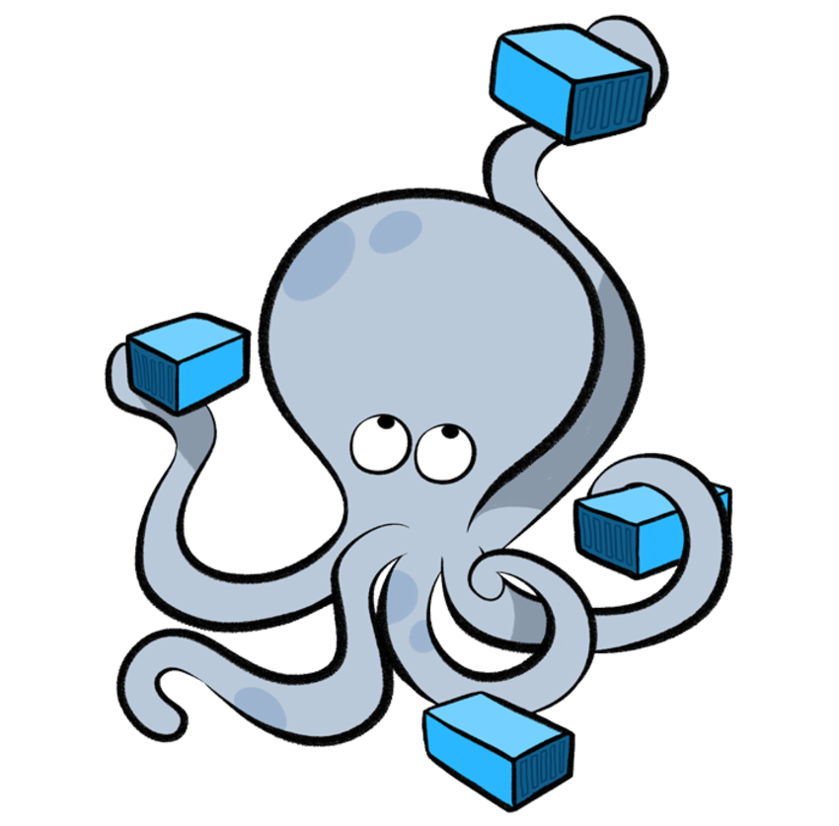
CI/CD Pipeline
0
1
Trigger
Webhook
2
Trigger the CI via a webhook coming from GitHub
  Each time a PR is open
  Each time a merge is done on master or develop
Run project Junit and Jacoco
  Junit will run unit tests
  Jacoco wil analyze lines run be the tests and provide the coverage.
Run Sonarqube to analyze code quality
Package the project and send the produced images to Docker registry
Trigger deployment on our node using Docker compose
3
4
Notes:
- Various tech

Slide 4
Deploy 2 x VM
Use the portal at registry.uggla.fr to create 2 Vms
  Use docker 18.04 images
In the next part of the document we will refer to the VM as
  vmci → VM that will contains tools, warning this VM should be created with 4GB of memory.
  vmdev → VM that will be used to deploy the project
Notes:
- Various tech

Slide 5

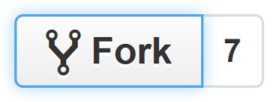

THE project !
Simple HelloWorld project
URL : https://github.com/uggla/HelloWorld
Fork the project using Github button
To create your own project
Clone your own project on the vmdev
  git clone <your project url)
Build and run the fantastic project using maven docker image
(note maven images contains openjdk)
  docker run --rm -it -v /tmp/.m2:/root/.m2 -v $(pwd):/usr/src/myproject -w /usr/src/myproject maven:3-jdk-8-slim mvn package
  docker run --rm -it -v /tmp/.m2:/root/.m2 -v $(pwd):/usr/src/myproject -w /usr/src/myproject maven:3-jdk-8-slim java -jar HelloWorld-0.1.0.jar
Notes:
- Various tech

Slide 6
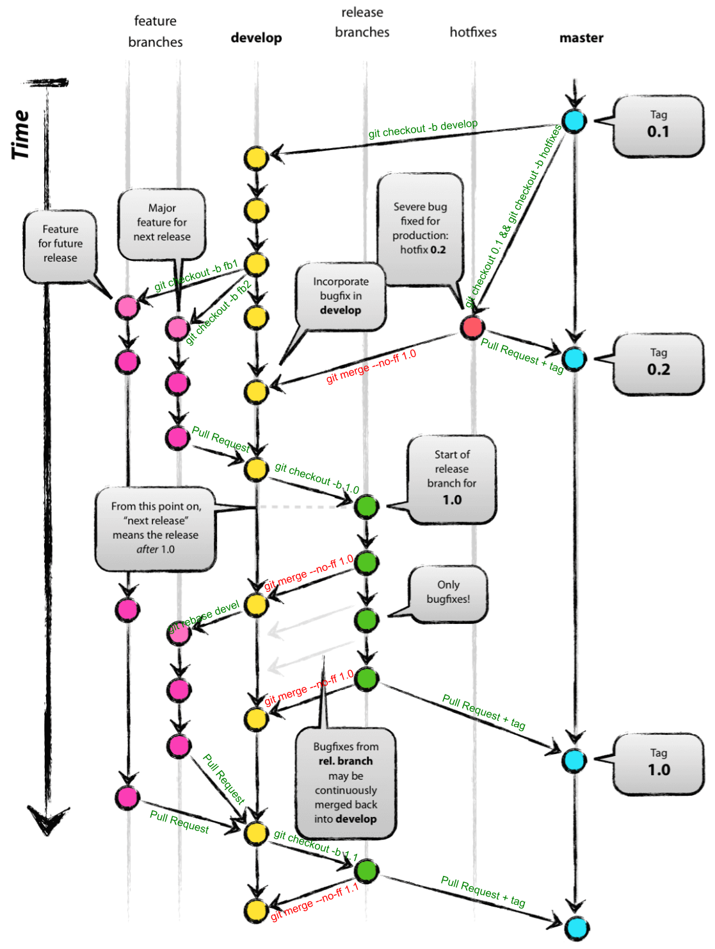
Git branching model
This project will be managed using Git branching model, explaining this model in depth is not part of this session.
  Create the required develop branch
    git checkout -b develop
Notes:
- Various tech

Slide 7
Install the tools
Install Jenkins
Install Sonar
To do it:
  Go into project ci directory
  Run run.sh
    Create appropriate user for Jenkins
    Set correct permission on the Docker socket
    Install registry certificate from registry.uggla.fr
Notes:
- Various tech

Slide 8
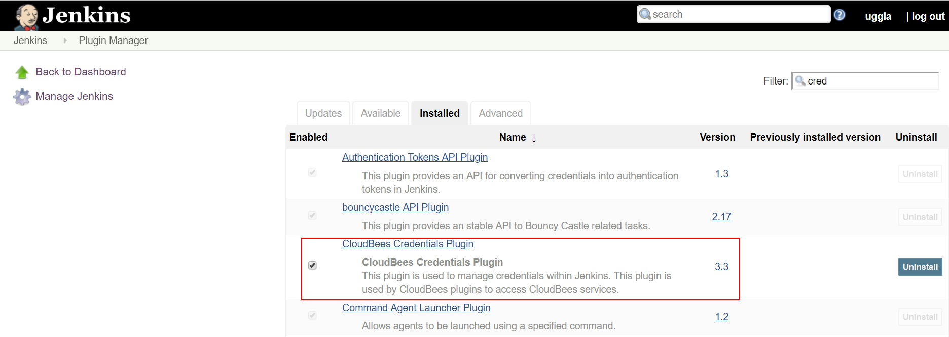
Configuration Jenkins #1
Go to http://<vmci ip>:8080
Go ahead with the setup by installing recommended plugins
Create an admin user, please set a strong password as the vm is exposed to the internet
Install Cloubees credentials plugins + blue oceancd
Notes:
- Various tech

Slide 9
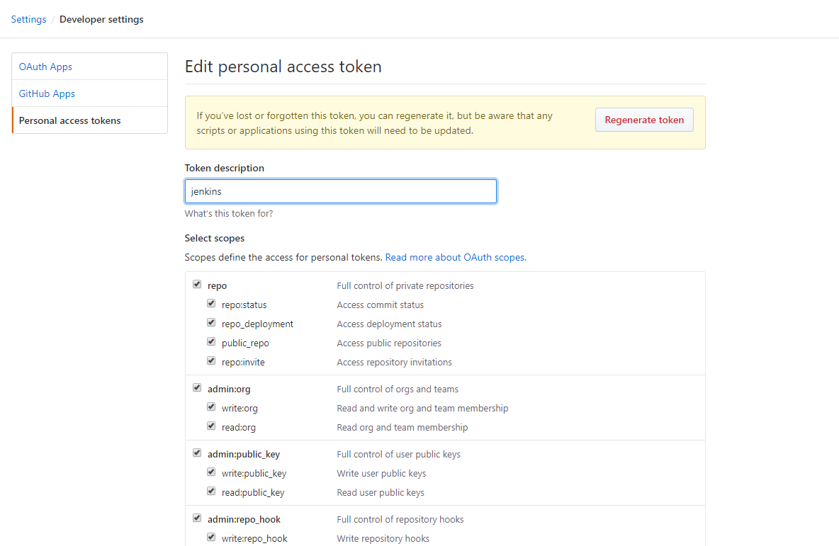
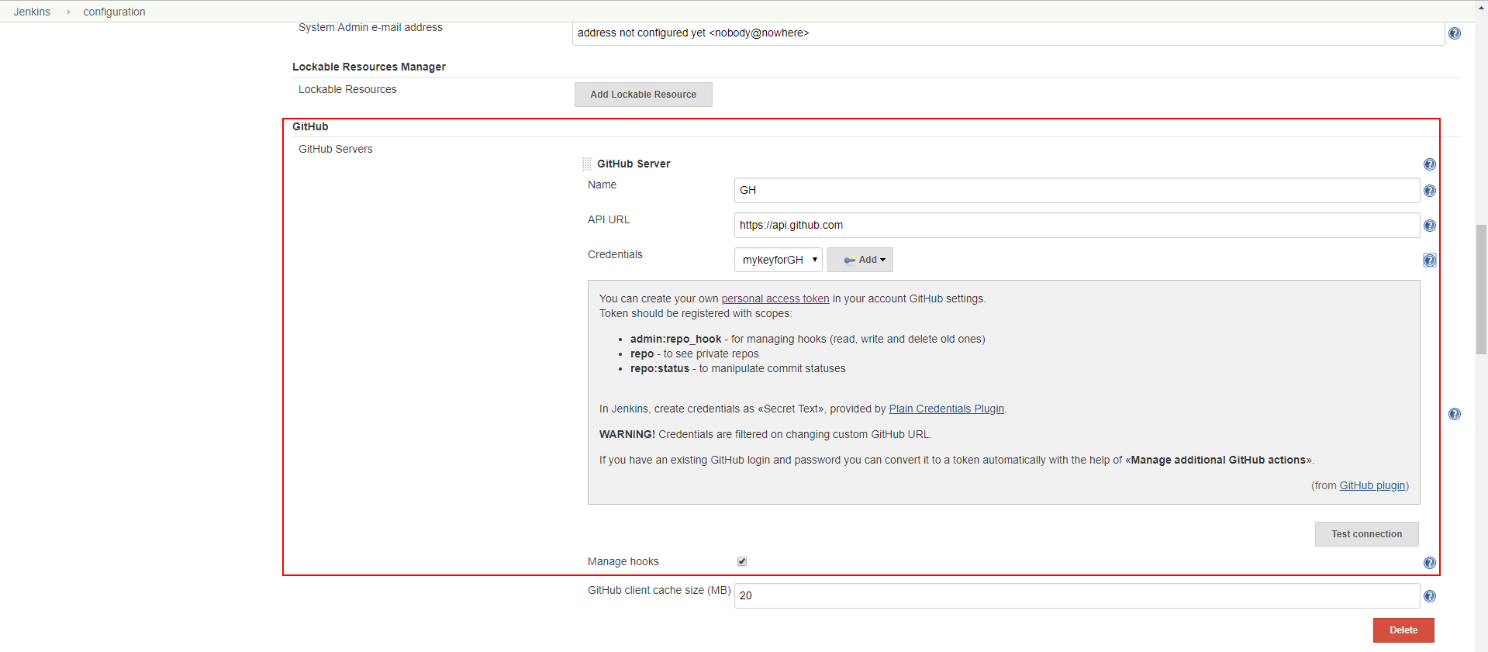
Configuration Jenkins #2
Configure the trigger
  Create a personal access token to your Github account
  Configure a Github server within Jenkins
Notes:
- Various tech

Slide 10
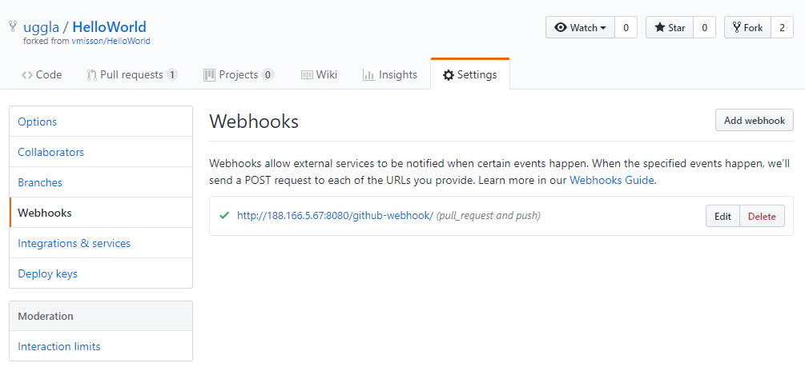
Configuration Jenkins #3
Configure the trigger
  Check the Github repository webhook configuration
  Click the edit button in order to have details and checks
Notes:
- Various tech

Slide 11
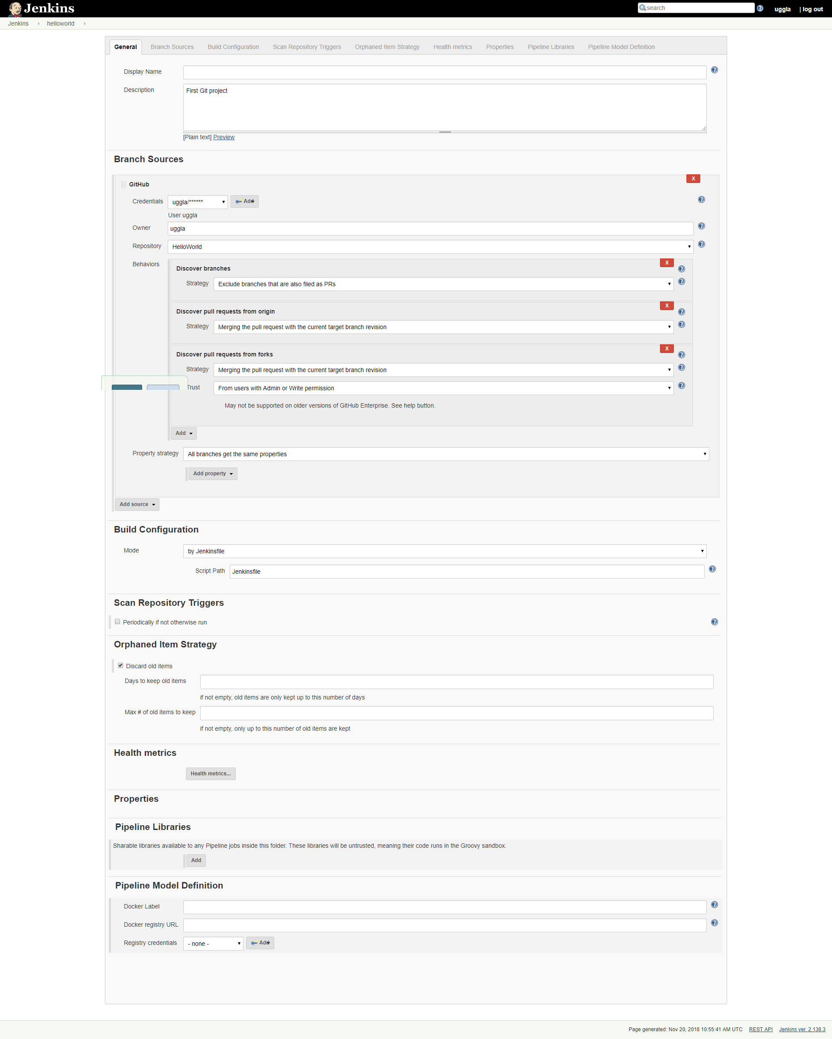
Configuration Jenkins #4
Create a multibranch pipeline
  Set the correct Github credentials
  Set the correct repository
  Set options as default settings
Notes:
- Various tech

Slide 12
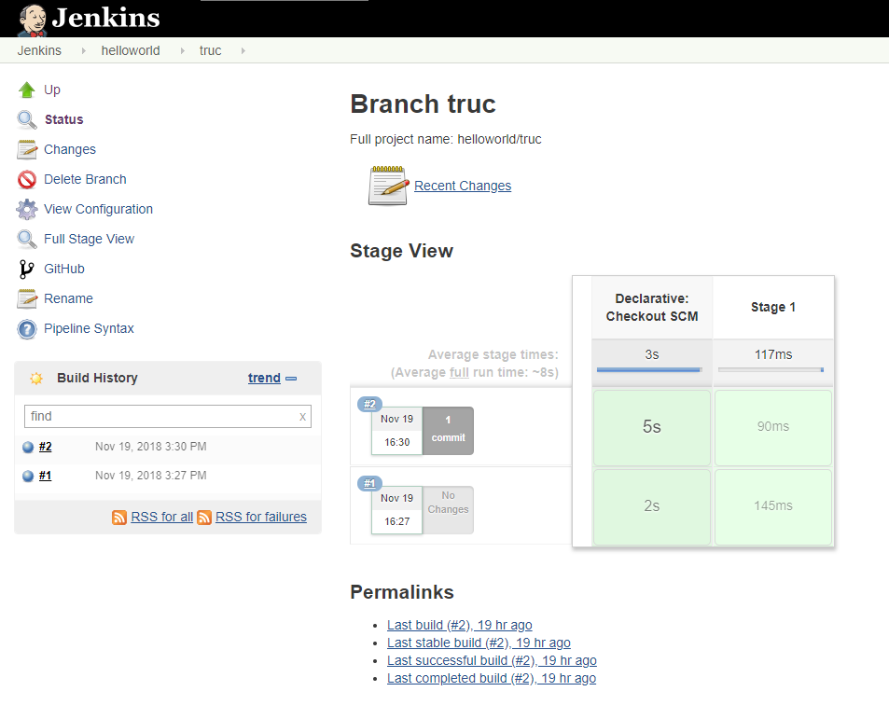
Define the pipeline #1
Check CI
  Create a small Jenkinsfile at the root of the project
  Commit and push the file
  A job should be successfully run and logs must contain the echos from Jenkinsfile
  If it works, create a new branch and an associated PR.
pipeline {
agent any
stages {
stage('Stage 1') {
steps {
echo 'Hello world!'
echo 'Coucou !'
echo 'Welcome !'
}
}
}
}
Notes:
- Various tech

Slide 13
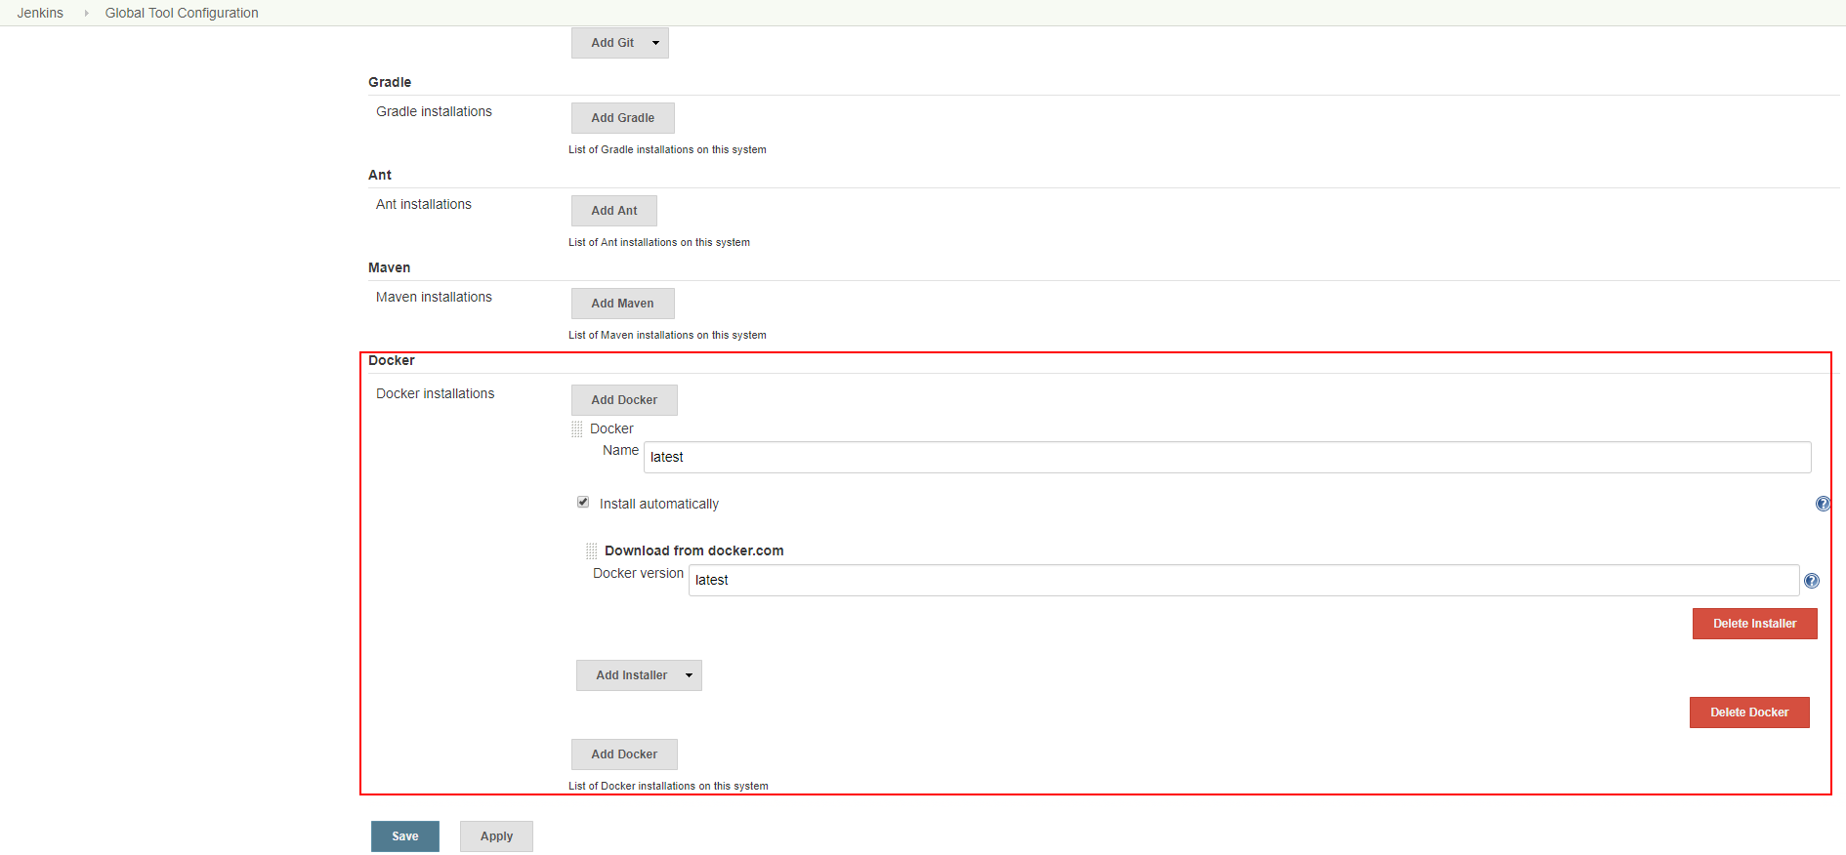
Define the pipeline #2
Build the project
  Add Docker to the list of tools
  Update Jenkinsfile to build the project using maven Docker container
  Doc : https://jenkins.io/doc/book/pipeline/docker/
pipeline {
agent any
stages {
stage('Build') {
steps {
echo 'Hello world!'
echo 'Coucou !'
echo 'Welcome !'
script {
docker.withTool('latest') {
docker.image('maven:3-jdk-8-slim').inside("-v $WORKSPACE:/usr/src/myproject:rw -v $HOME/.m2:/root/.m2:rw -w /usr/src/myproject") { c ->
sh "mvn clean package"
}
}
}
}
}
}
}
Notes:
- Various tech

Slide 14
Add Sonar quality check #1
Configure sonar
  Connect to sonar http://<vmci ip>:9000
  Login with admin:admin and set a token for your project (keep the token somewhere it will be used later)
  Set a strong password as the vm is internet facing
  Install sonarqube scanner for Jenkins plugin
Notes:
- Various tech

Slide 15
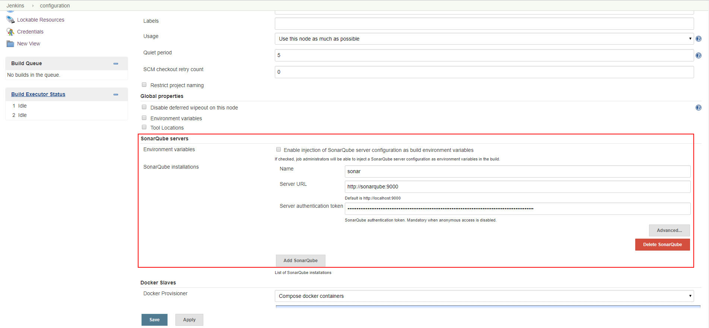
Add Sonar quality check #2
Configure sonar
  Configure the plugin
Notes:
- Various tech

Slide 16
Add Sonar quality check #3
Configure sonar
  Update pipeline allowing sonar analysis
pipeline {
agent any
stages {
stage('Build') {
steps {
echo 'Hello world!'
echo 'Coucou !'
echo 'Welcome !'
script {
docker.withTool('latest') {
docker.image('maven:3-jdk-8-slim').inside("-v $WORKSPACE:/usr/src/myproject:rw -v $HOME/.m2:/root/.m2:rw -w /usr/src/myproject") { c ->
sh "mvn clean package"
}
}
}
}
}
stage('Quality check') {
steps {
script {
docker.withTool('latest') {
docker.image('maven:3-jdk-8-slim').inside("--network ci_cinet -v $WORKSPACE:/usr/src/myproject:rw -v $HOME/.m2:/root/.m2:rw -w /usr/src/myproject") { c ->
withSonarQubeEnv('sonar') {
sh 'mvn sonar:sonar'
}
}
}
}
}
}
}
}
Notes:
- Various tech

Slide 17
Package the application #1
Add a stage to package the application
  Update pipeline allowing packaging
def IMAGENAME='named-your-image'
pipeline {
agent any
stages {
stage('Build') {
steps {
echo 'Hello world!'
echo 'Coucou !'
echo 'Welcome !'
script {
docker.withTool('latest') {
docker.image('maven:3-jdk-8-slim').inside("-v $WORKSPACE:/usr/src/myproject:rw -v $HOME/.m2:/root/.m2:rw -w /usr/src/myproject") { c ->
sh "mvn clean package"
}
}
}
}
}
stage('Quality check') {
steps {
script {
docker.withTool('latest') {
docker.image('maven:3-jdk-8-slim').inside("--network ci_cinet -v $WORKSPACE:/usr/src/myproject:rw -v $HOME/.m2:/root/.m2:rw -w /usr/src/myproject") { c ->
withSonarQubeEnv('sonar') {
sh 'mvn sonar:sonar'
}
}
}
}
}
}
stage('Package app') {
steps {
script {
docker.withTool('latest') {
docker.withRegistry('https://registry.uggla.fr/') {
def myImg = docker.build("${IMAGENAME}:${env.BUILD_ID}")
myImg.push()
}
}
}
}
}
}
}
Notes:
- Various tech

Slide 18
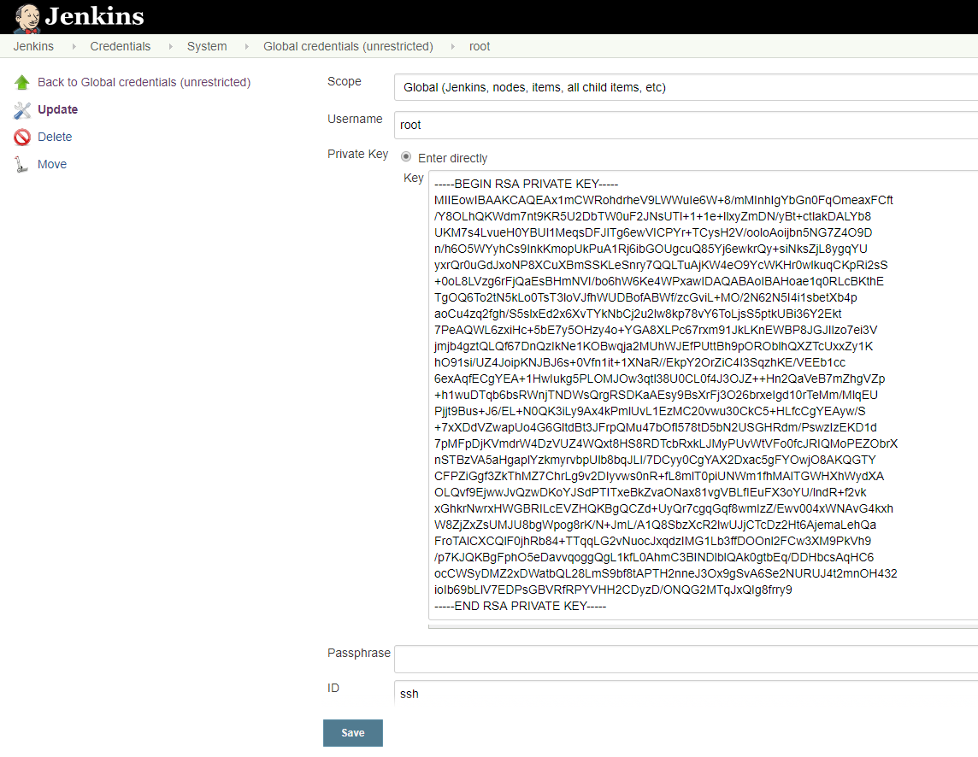
Deploy the application #1
REGISTRY_FQDN=registry.uggla.fr
# Get certificate from registry
curl -L http://${REGISTRY_FQDN}:81/ca.crt > /usr/local/share/ca-certificates/ca-registry.crt
update-ca-certificates
systemctl restart docker.service
Deploy and run the application
  Add the Docker registry certificate to vmdev
  Create a ssh root keys
  Load private keys to into Jenkins credentials
Notes:
- Various tech

Slide 19
Deploy the application #2
Deploy and run the application
  Add Jenkins ssh pipeline steps plugin
  Update Jenkinsfile to add deployment
def IMAGENAME='named-your-image'
def VMDEV='188.166.48.108'
pipeline {
agent any
...
stage('Deploy app') {
steps {
script {
withCredentials([sshUserPrivateKey(
credentialsId:'ssh',
keyFileVariable:'pkey',
PassphraseVariable:'',
usernameVariable:'user')]){
sh "ssh -i ${pkey} -o StrictHostKeyChecking=no root@${VMDEV} docker run -i registry.uggla.fr/${IMAGENAME}:${env.BUILD_ID}"
}
}
}
}
}
}
Notes:
- Various tech

